Slide 1
HAMIL-Al-QURAN
GROUP MEMBERS:
MAHEEN ARSHAD MALIK
MARIA RAFIQUE
MAHA AMJAD

Slide 2
Purpose
Help people Memorize the Quran
To be implemented in schools where hifz classes are held.
Home based learning for eager students

Slide 3
Vision
A healthy environment in Quran teaching and learning by changing the way things work in class room (madrassa’s) and bringing the classroom up to date with technology. We will improve the techniques through which Quranic knowledge is imparted which will be helpful for coming generations. By taking advantage of emerging technologies the Madrassa system can be revised.

Slide 4
Objectives
Aid teachers in guiding students in memorizing the Quran.
Help students struggling in memorizing of Quran.
Enhance reading experience with pauses and proper recitations recorded by various renowned reciters. It’ll aid Home based learning.
Motivate students through progress indicators which encourage students to keep going; through encouraging badges, medals and vocals.

Slide 5
Requirements
Functional Requirements:
To detect mistakes in the recitation of user.
Generate a report which shows the total no of mistakes in the given passage.
Underline the text in which the reciter made a mistake
Non-Functional Requirements:
User can click on the text to hear the correct recitation.
Display the translation of verses being recited.
To achieve 99% accuracy of detecting the mistakes.
To make the application work offline.

Slide 6
Process Model
Incremental iterative process model

Slide 7
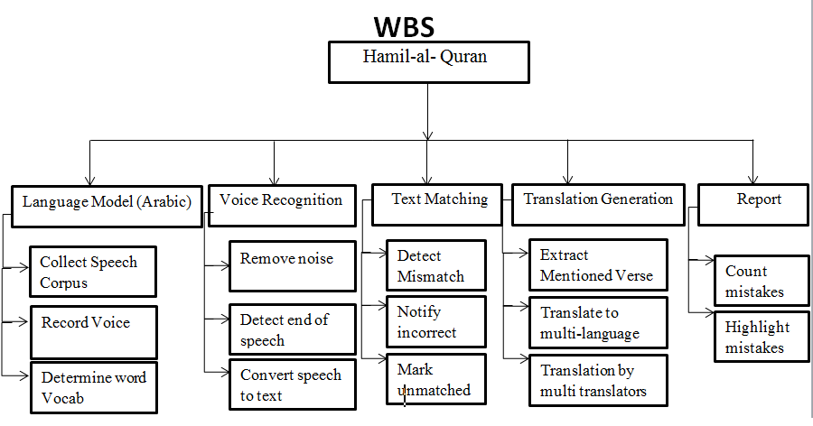
Work Breakdown Structure

Slide 8
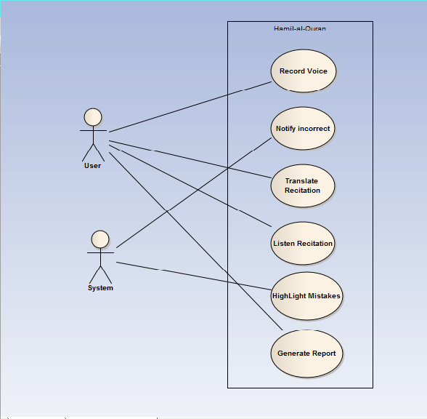
Use Case Diagram

Slide 9
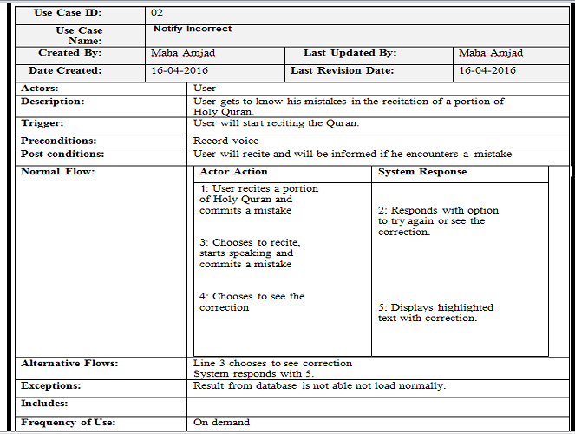
Sample Use Case

Slide 10
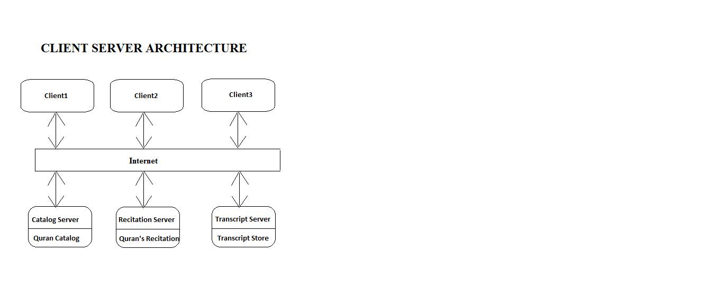
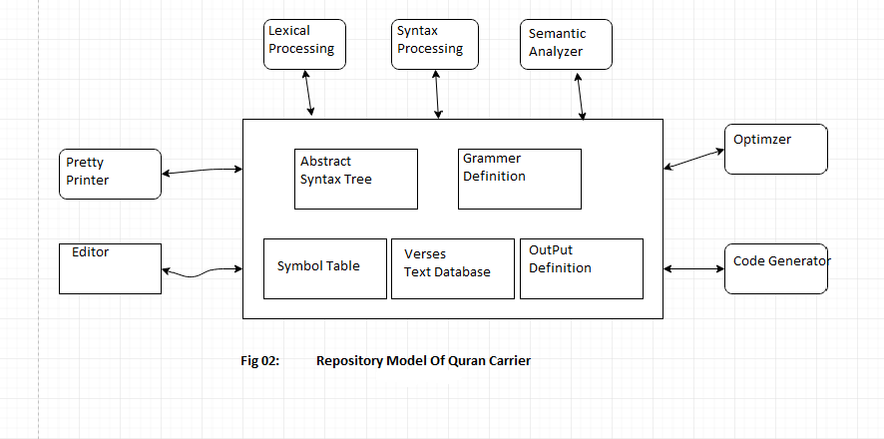
Architecture

Slide 11
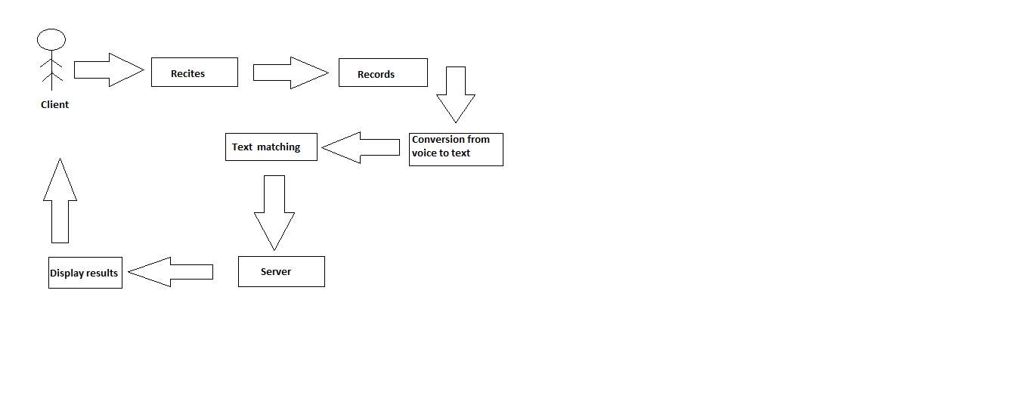
Product Perspective
Block Diagram for understanding the product Perspective

Slide 12
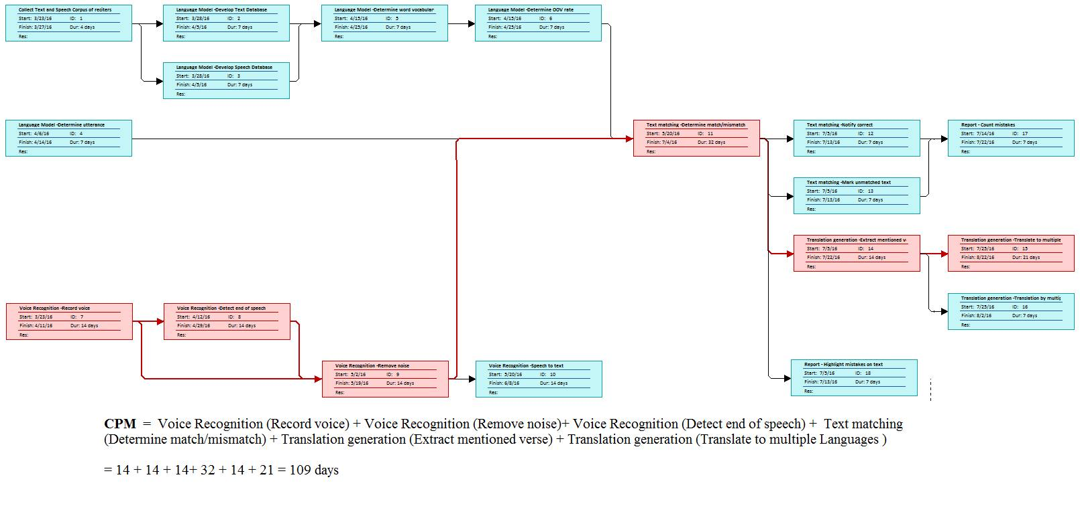
Network Diagram CPM

Slide 13
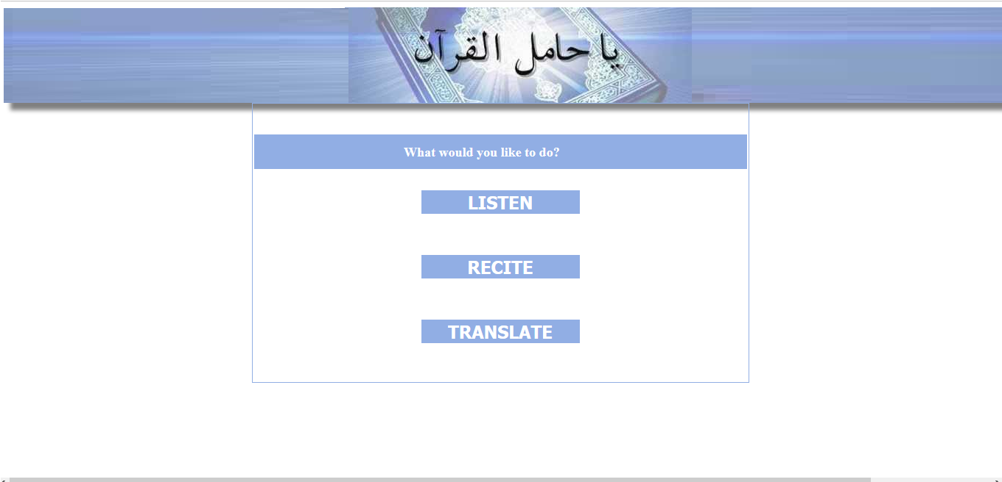
Project GUI’s

Slide 14
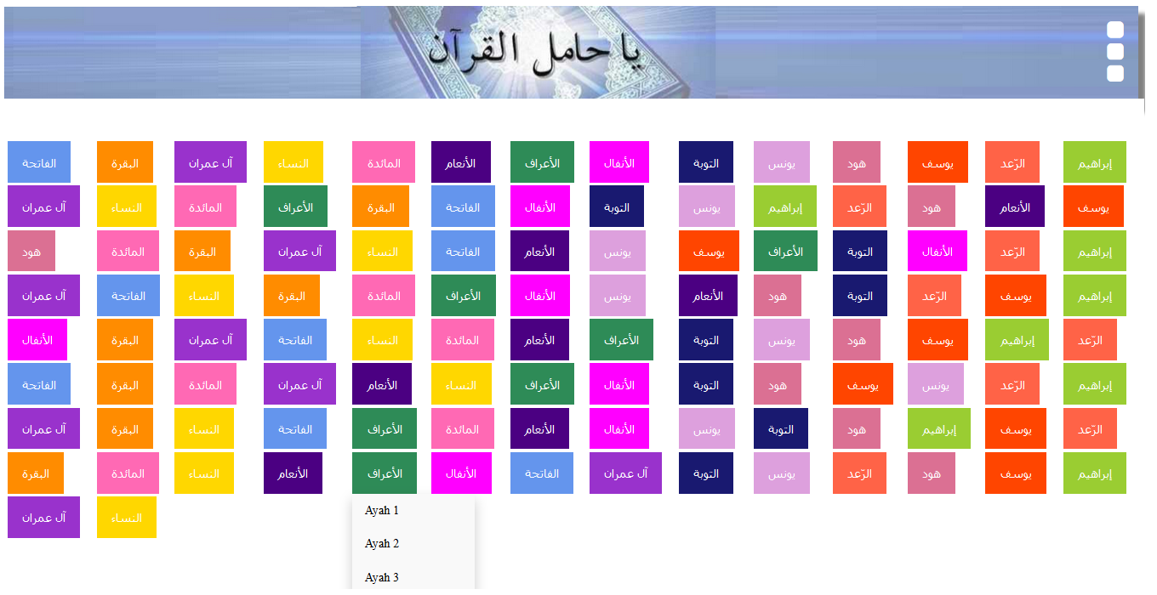
Project GUI’s

Slide 15
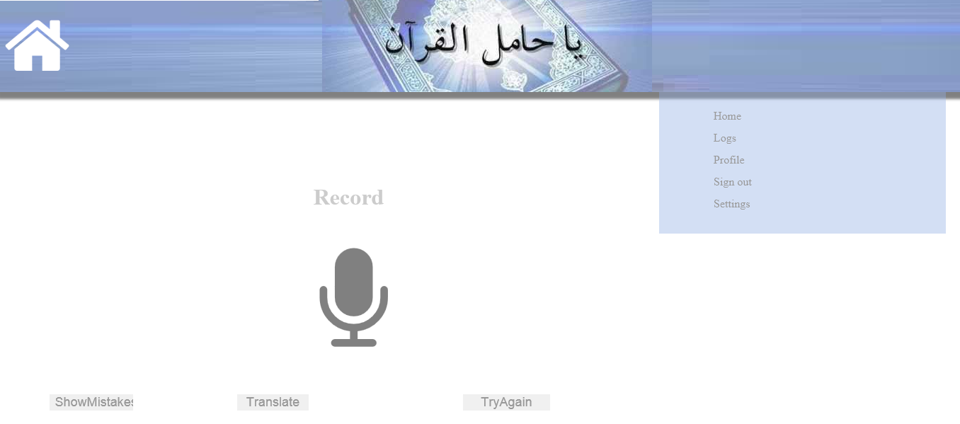
Project GUI’s

Slide 16
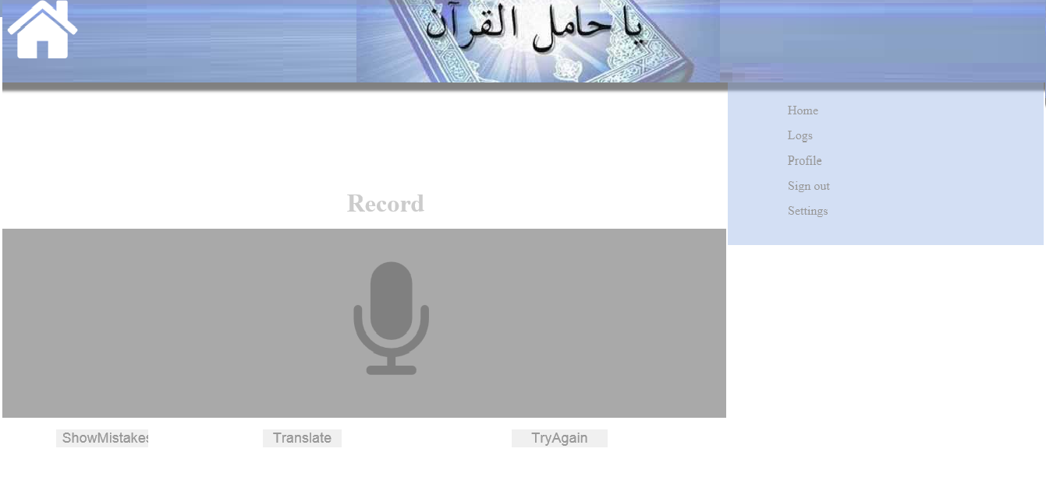
Project GUI’s

Slide 17
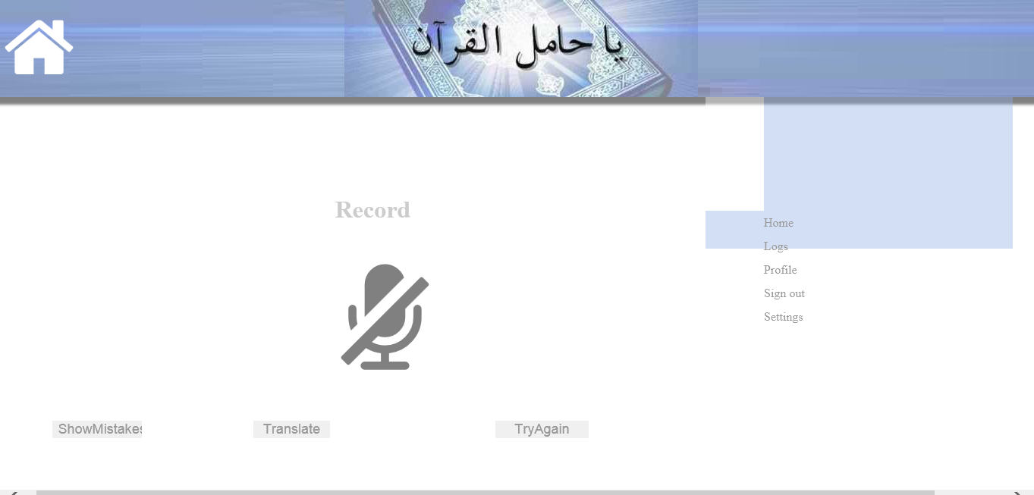
Project GUI’s

Slide 18
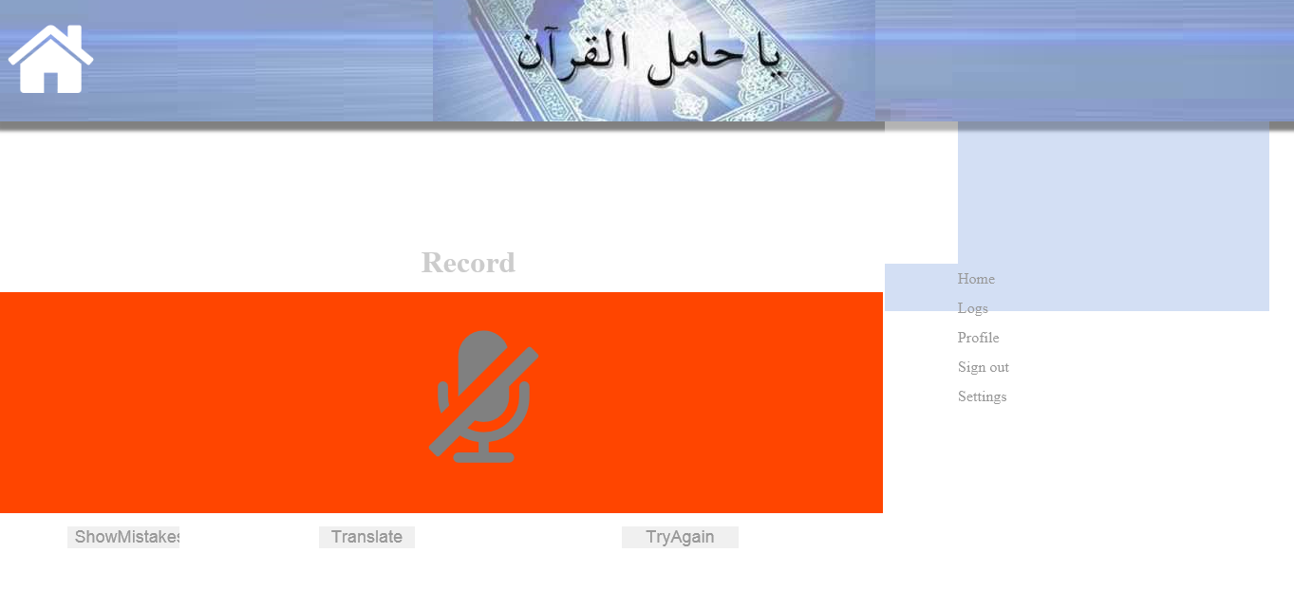
Project GUI’s

Slide 19
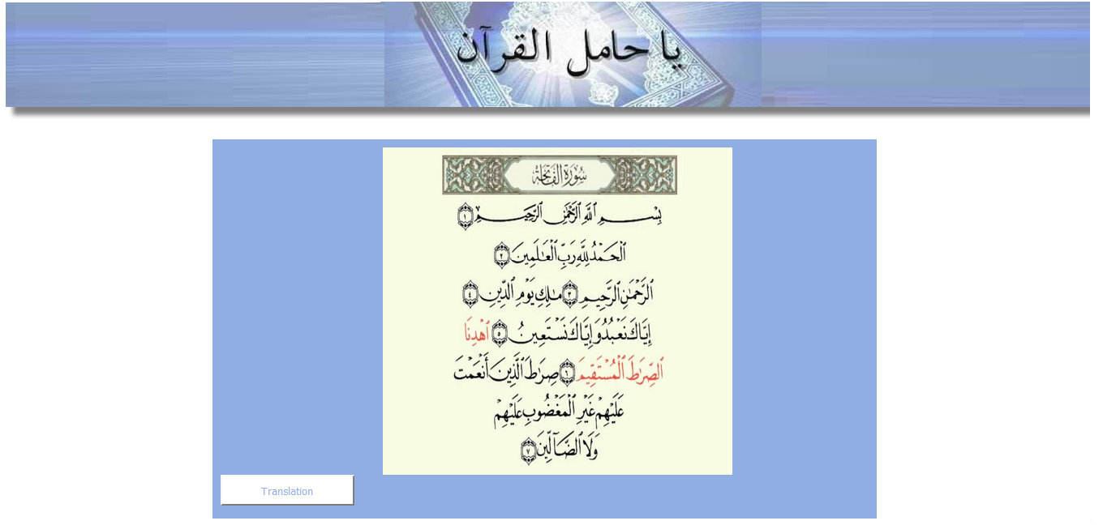
Project GUI’s

Slide 20
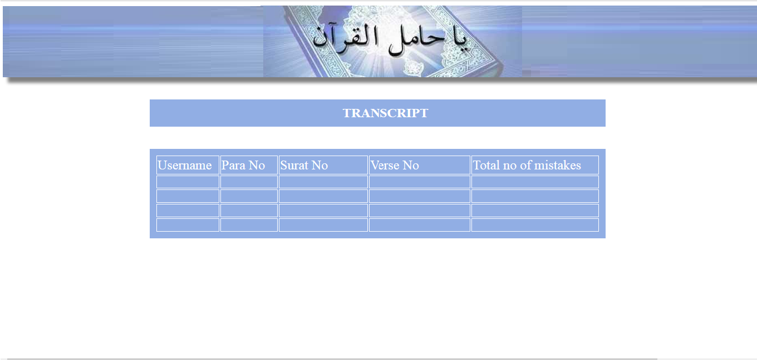
Project GUI’s

Slide 21
Conclusion
This project is scalable and has a large target market.
The report has analyzed the requirements and summarized the required functionality.

