Slide 1
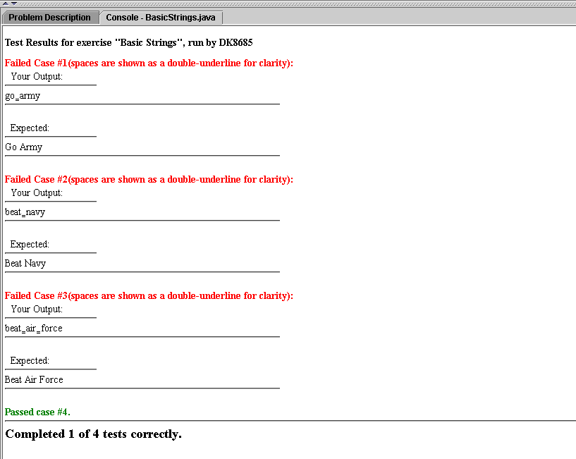
An introductory message about the test case you failed. May include information on the purpose of the test case.
This is what your program produced. The double underline is included to show where you used spaces.
This is what your program should have displayed. Note the difference in capitalization.
When your solution is correct for a test case, this is all you will see.

Slide 2
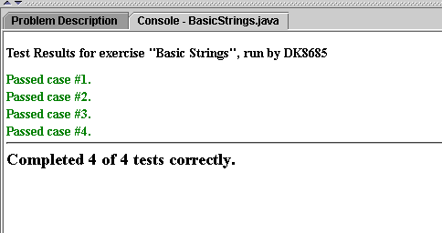
Tests passed, so no details given.

