Slide 1
AI+ Solution Match Pitch
選題一: 碩網資訊--虛擬小店員最懂您，茫茫電商大街中找到您的命中商品
選題二: 全球華人(1111人力銀行)—資安 - 假徵才真盜取履歷偵測
組員：王選仲、蔡明憲

Slide 2
選題一: 碩網資訊--虛擬小店員最懂您，茫茫電商大街中找到您的命中商品
Recommendation System
Main Concern
Solution
Efficiency
Collaborative Filtering
Accuracy
Content-based
Deep Learning

Slide 3
LSTM(RNN or CNN) + DNN
選題一: 碩網資訊--虛擬小店員最懂您，茫茫電商大街中找到您的命中商品
user_info_nlp
embedding_lookup
LSTM
(RNN or CNN)
concat
prod_info_nlp
embedding_lookup
LSTM
(RNN or CNN)
DNN
user_info_cat
onehot
output
prod_info_cat
onehot
prod_info_num
prod_info_num

Slide 4
LSTM(RNN or CNN) + DNN
選題一: 碩網資訊--虛擬小店員最懂您，茫茫電商大街中找到您的命中商品
user_info_nlp
embedding_lookup
LSTM
(RNN or CNN)
concat
prod_info_nlp
embedding_lookup
LSTM
(RNN or CNN)
DNN
user_info_cat
onehot
output
prod_info_cat
onehot
prod_info_num
prod_info_num
Collaborative Filtering Factor

Slide 5
LSTM(RNN or CNN) + DNN
選題一: 碩網資訊--虛擬小店員最懂您，茫茫電商大街中找到您的命中商品
user_info_nlp
embedding_lookup
LSTM
(RNN or CNN)
concat
prod_info_nlp
embedding_lookup
LSTM
(RNN or CNN)
DNN
user_info_cat
onehot
output
prod_info_cat
onehot
prod_info_num
prod_info_num
Collaborative Filtering Factor

Slide 6
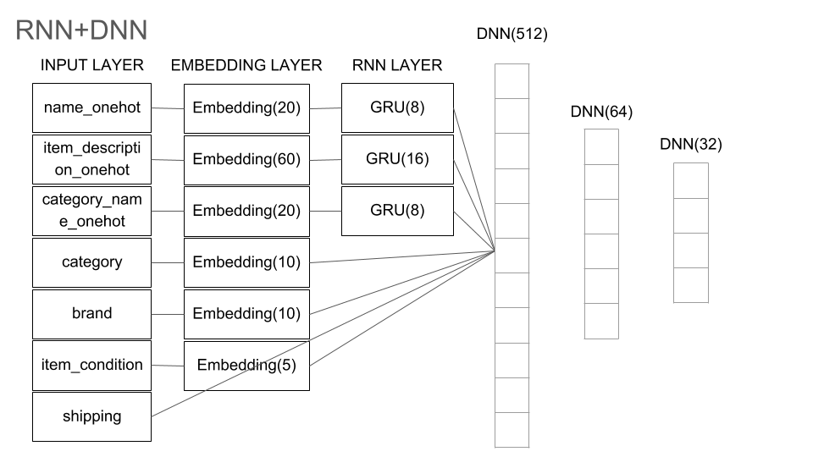
選題一: 碩網資訊--虛擬小店員最懂您，茫茫電商大街中找到您的命中商品
Project Experience
Kaggle - Mercari Price Suggestion Challenge
http://140.119.164.203/106_dm_team01/

Slide 7
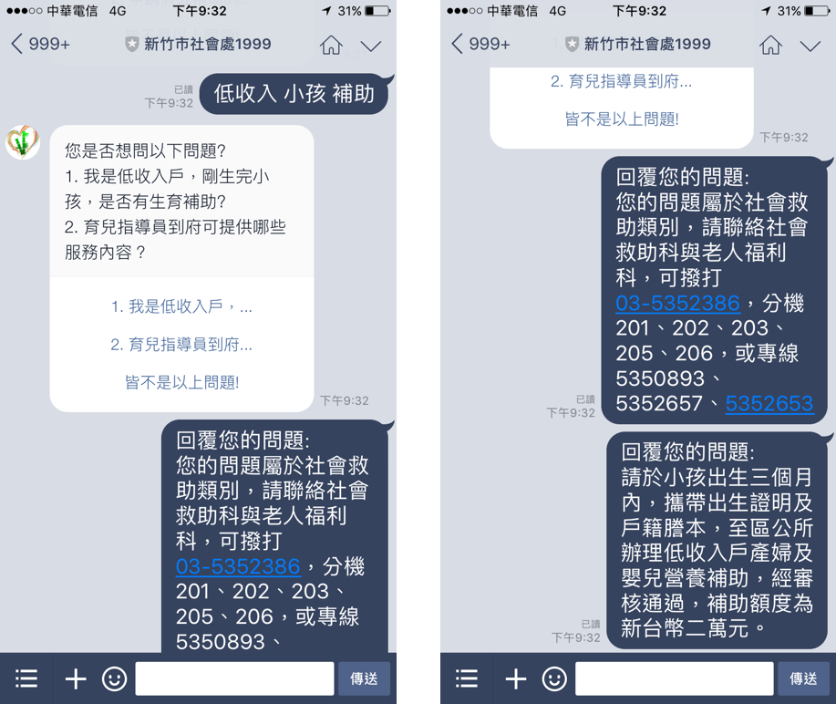
選題一: 碩網資訊--虛擬小店員最懂您，茫茫電商大街中找到您的命中商品
Project Experience
Chatbot Recommendation System
https://github.com/GoatWang/HsinchuHackthon_QA1999_ClassifierTraining

Slide 8
全球華人(1111人力銀行)—資安 - 假徵才真盜取履歷偵測
Classification System
Word Match
TFIDF
BM25
Edit Distance
Laplace
Stop Words
Deep Learning

Slide 9
LSTM(RNN or CNN) + DNN
選題一: 碩網資訊--虛擬小店員最懂您，茫茫電商大街中找到您的命中商品
concat
profile_nlp
embedding_lookup
LSTM
(RNN or CNN)
DNN
profile_cat
onehot
output
profile_num
Feature Engineering

Slide 10
LSTM(RNN or CNN) + DNN
選題一: 碩網資訊--虛擬小店員最懂您，茫茫電商大街中找到您的命中商品
concat
profile_nlp
embedding_lookup
LSTM
(RNN or CNN)
DNN
profile_cat
onehot
output
profile_num
Feature Engineering

Slide 11
LSTM(RNN or CNN) + DNN
選題一: 碩網資訊--虛擬小店員最懂您，茫茫電商大街中找到您的命中商品
concat
profile_nlp
embedding_lookup
LSTM
(RNN or CNN)
DNN
profile_cat
onehot
output
profile_num
Feature Engineering

Slide 12
全球華人(1111人力銀行)—資安 - 假徵才真盜取履歷偵測
Project Experience
Kaggle – Quara Question Pair
Train_Word_Match
Train_Word_Match_OnlyStops
Tfidf_Train_Word_Match
The Same
Laplace
XGBoost
Not The Same
BM25
Word mover's distance(Word2Vec)
Edit Distance
http://140.119.164.203/106_dm_team01/

Slide 13
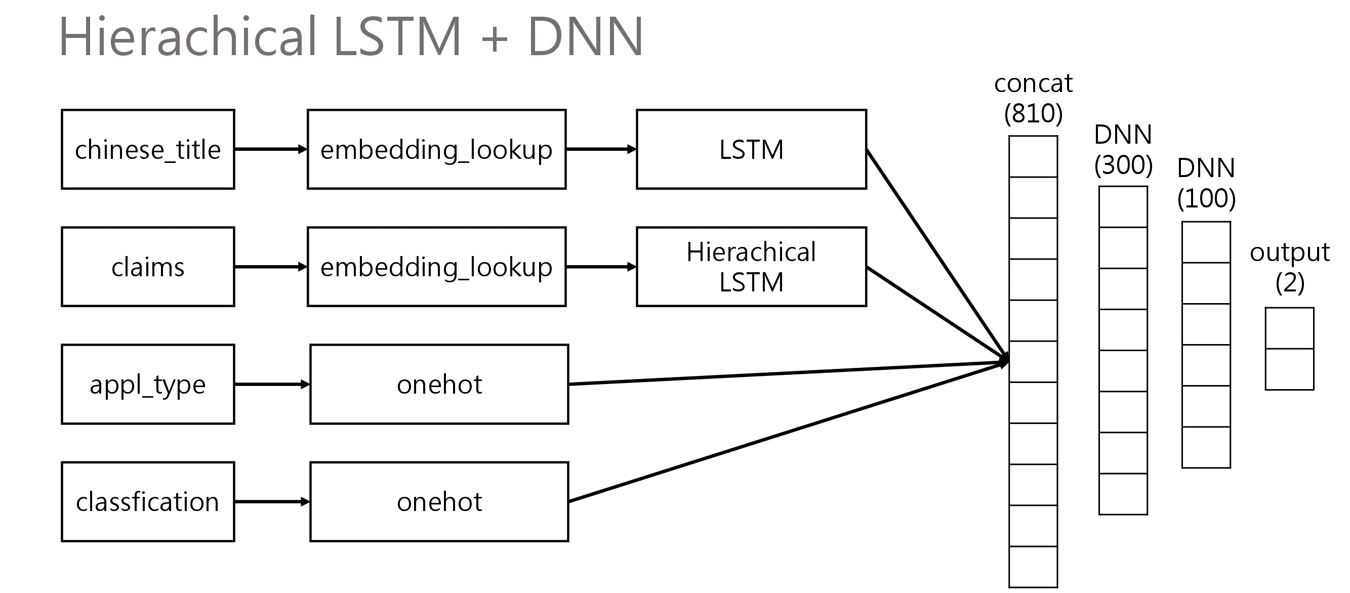
全球華人(1111人力銀行)—資安 - 假徵才真盜取履歷偵測
Project Experience
2018 資料創新應用競賽 – Patent Evaluator

Slide 14
Hierachical LSTM + DNN
concat
(810)
chinese_title
embedding_lookup
LSTM
DNN
(300)
DNN
(100)
claims
embedding_lookup
Hierachical
LSTM
output
(2)
appl_type
onehot
classfication
onehot

Slide 15
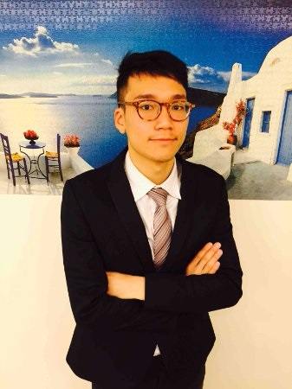
Finding Jobs…
王選仲 GoatWang
成就
2017 iThome競賽文章獲 三萬人次觀看
2017 新竹開放資料黑客松 第二名
2016 CASA大數據行銷爭霸戰 銀質獎
語言
雅思6.5 (聽:6.5, 說:6, 讀:6, 寫:7)
聯絡
E-mail: jeremy4555@yahoo.com.tw
電話: 0921687452

