Slide 1
Machion Learning 02 PreProcessing
姓名 王選仲
興創知能 AI工程師
2020.05.02
jeremy4555@yahoo.com.tw
https://www.linkedin.com/in/hsuanchungwang/

Slide 2
Target of PreProcessing
Convert data to be understood by the model
Help model Learn Efficiently

Slide 3
Table of Content
DataFrame Inspection
Missing Data
Outlier
Inconsistent Data e.g. Negative Age
Categorical Data e.g. Natural Language Data
Normalization
Feature Generation
Notes:
議題:
請問取log與normalize有什麼差別?

Slide 4
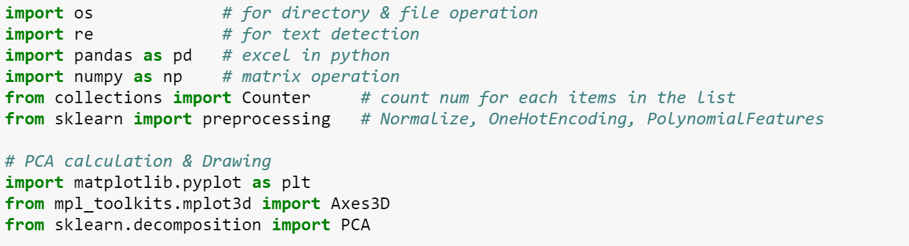
Package Used

Slide 5
Table of Content
DataFrame Inspection
Missing Data
Outlier
Inconsistent Data e.g. Negative Age
Categorical Data e.g. Natural Language Data
Normalization
Feature Generation
Notes:
議題:
請問取log與normalize有什麼差別?

Slide 6
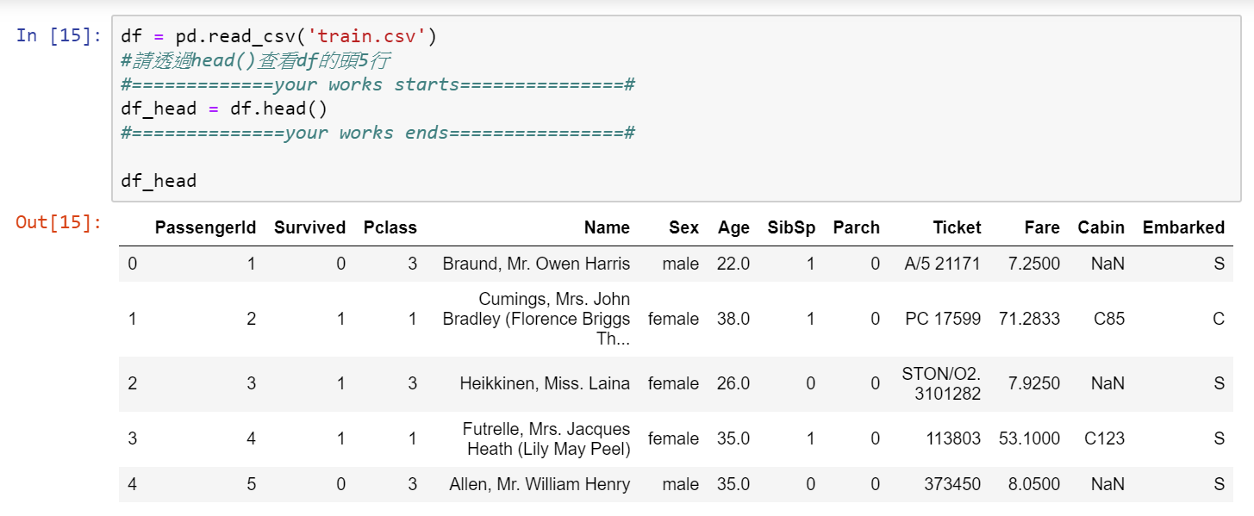
DataFrame Inspection
head

Slide 7
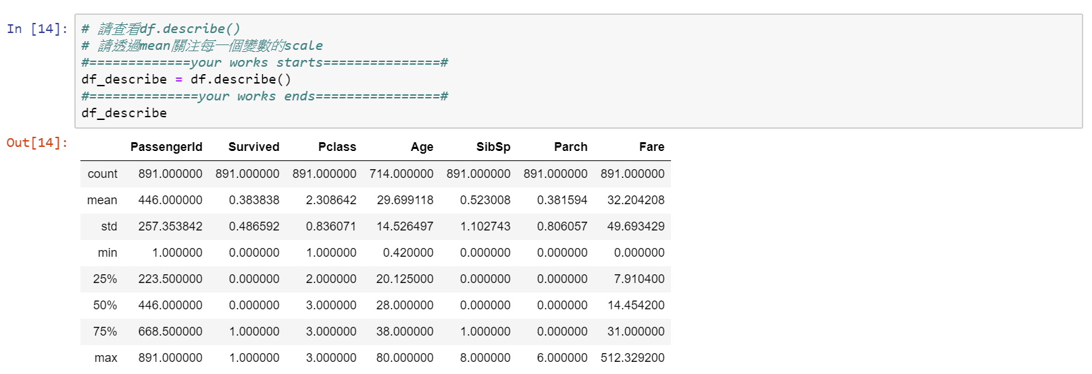
DataFrame Inspection
Statistics

Slide 8
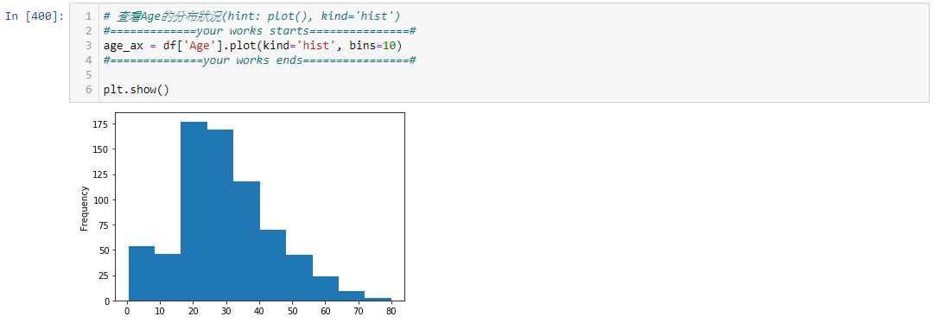
DataFrame Inspection

Slide 9
Table of Content
DataFrame Inspection
Missing Data
Outlier
Inconsistent Data e.g. Negative Age
Categorical Data e.g. Natural Language Data
Normalization
Feature Generation
Notes:
議題:
請問取log與normalize有什麼差別?

Slide 10
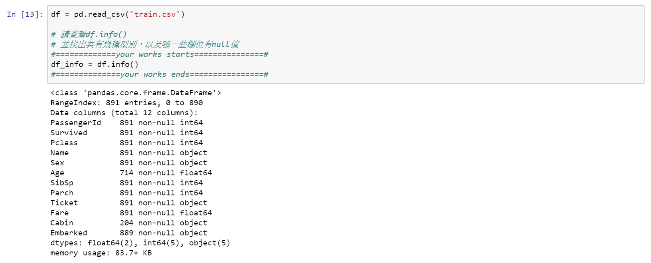
Missing Data
Detection

Slide 11
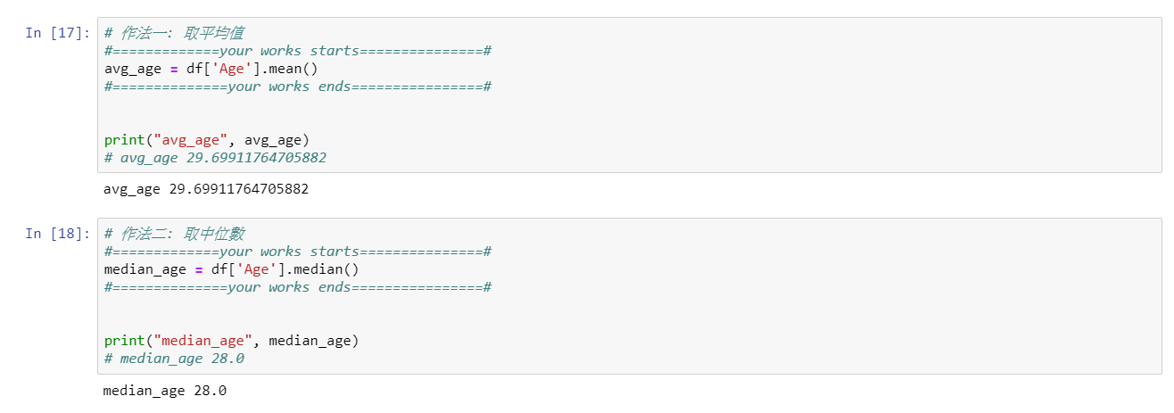
Missing Data
Filling
Mean
Median

Slide 12
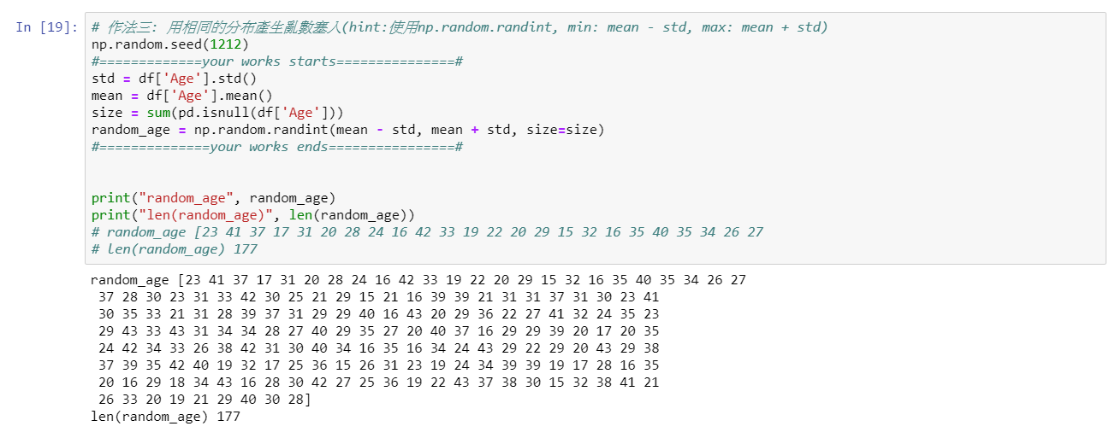
Missing Data
Filling
Random number between mean ± std

Slide 13
Table of Content
DataFrame Inspection
Missing Data
Outlier
Inconsistent Data e.g. Negative Age
Categorical Data e.g. Natural Language Data
Normalization
Feature Generation
Notes:
議題:
請問取log與normalize有什麼差別?

Slide 14
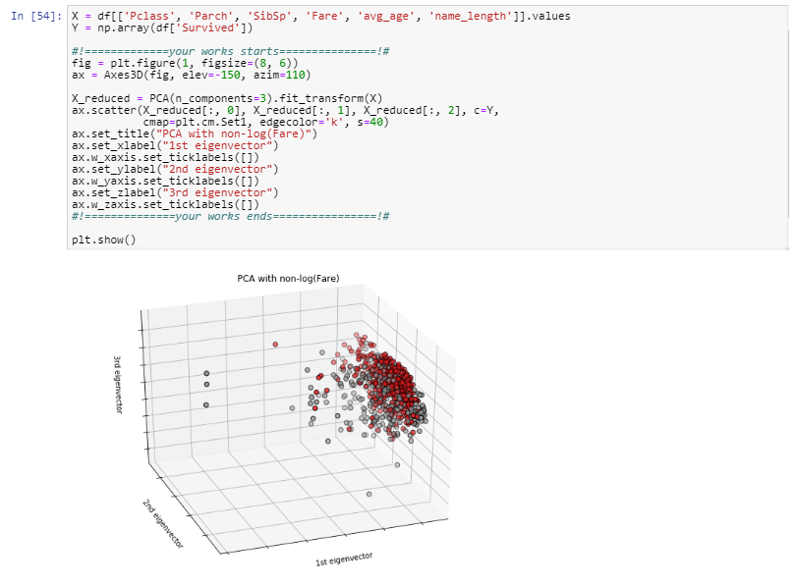
Outlier
Detection

Slide 15
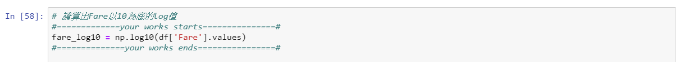
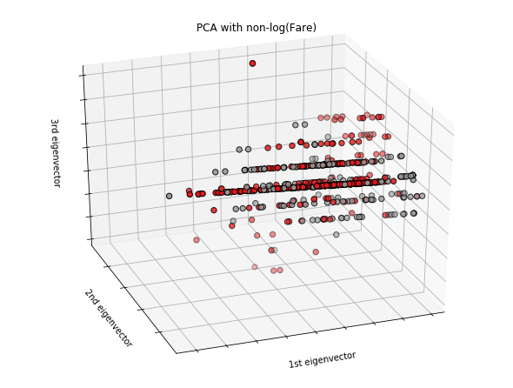
Outlier
Processing: log

Slide 16
Table of Content
DataFrame Inspection
Missing Data
Outlier
Inconsistent Data e.g. Negative Age
Categorical Data e.g. Natural Language Data
Normalization
Feature Generation
Notes:
議題:
請問取log與normalize有什麼差別?

Slide 17
Inconsistent Data
Detection: Domain Knowledge
Processing: Domain Knowledge

Slide 18
Table of Content
DataFrame Inspection
Missing Data
Outlier
Inconsistent Data e.g. Negative Age
Categorical Data e.g. Natural Language Data
Normalization
Feature Generation
Notes:
議題:
請問取log與normalize有什麼差別?

Slide 19
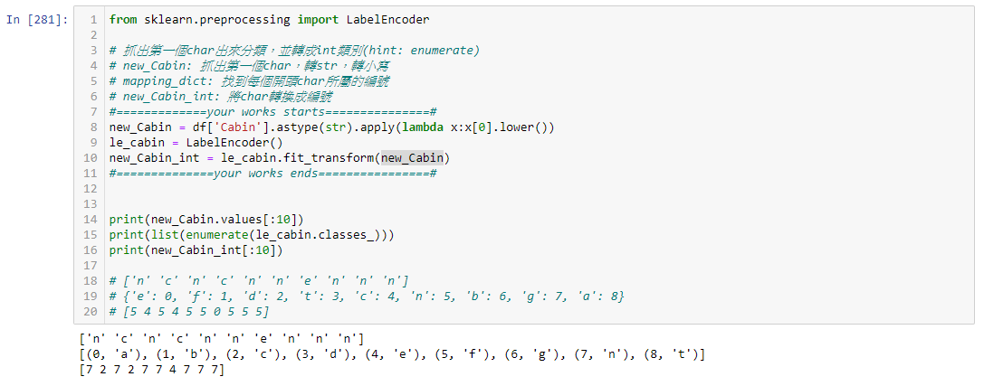
Categorical Data
Label Encoding

Slide 20
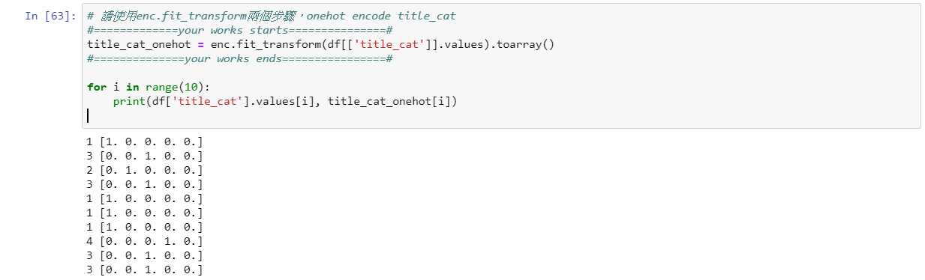
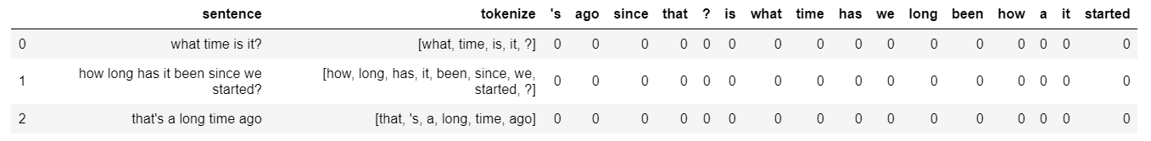
Categorical Data
OneHot Encoding
NLP Example

Slide 21
Table of Content
DataFrame Inspection
Missing Data
Outlier
Inconsistent Data e.g. Negative Age
Categorical Data e.g. Natural Language Data
Normalization
Feature Generation
Notes:
議題:
請問取log與normalize有什麼差別?

Slide 22
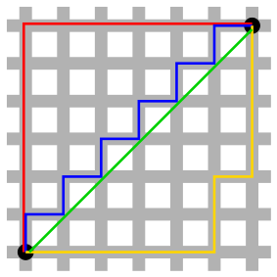
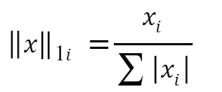
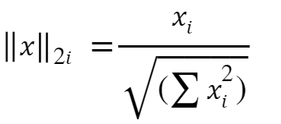
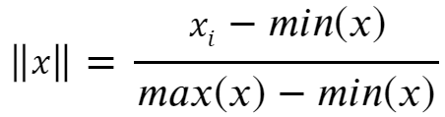
Normalization
L1 Norm
L2 Norm
Norm to 0 ~ 1

Slide 23
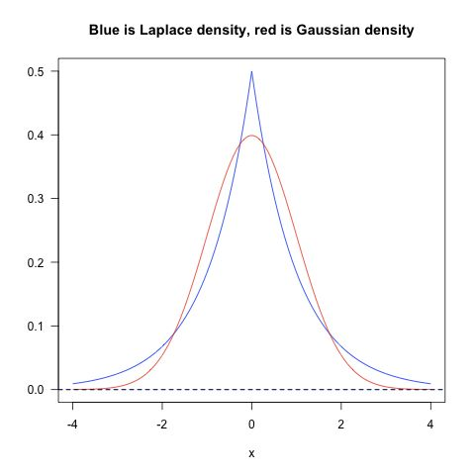
Normalization
How to Choose
L1是蓝色的线，L2是红色的线，很明显，L1的分布对极端值更能容忍。那么如果数据损失项使用L1 Norm，很明显，L1 Norm对outlier没有L2 Norm那么敏感；如果正则化损失项使用L1的话，那么使学习到的参数倾向于稀疏，使用L2 Norm则没有这种倾向。
实践中，根据Quaro的data scientist Xavier Amatriain 的经验，实际应用过程中，L1 nrom几乎没有比L2 norm表现好的时候，优先使用L2 norm是比较好的选择。

Slide 24
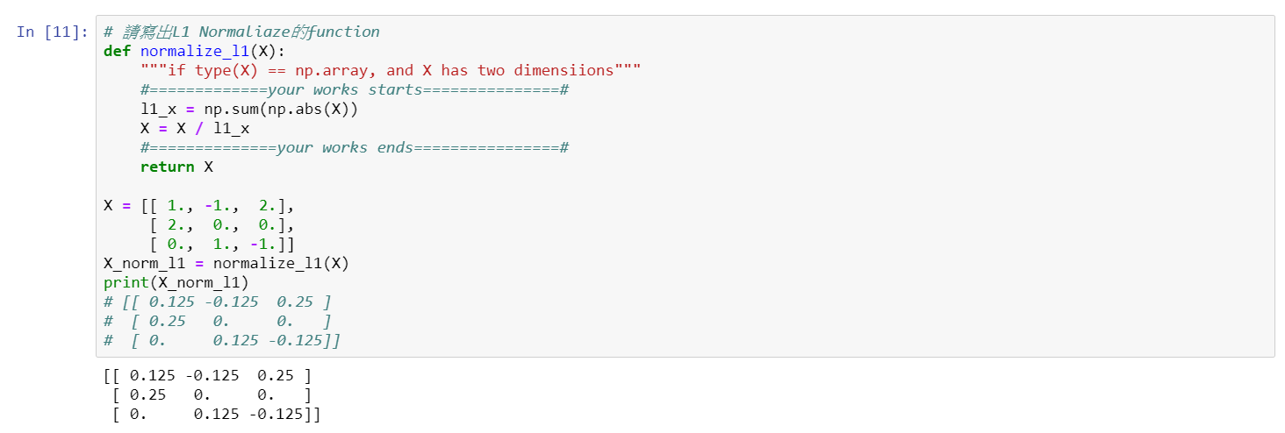
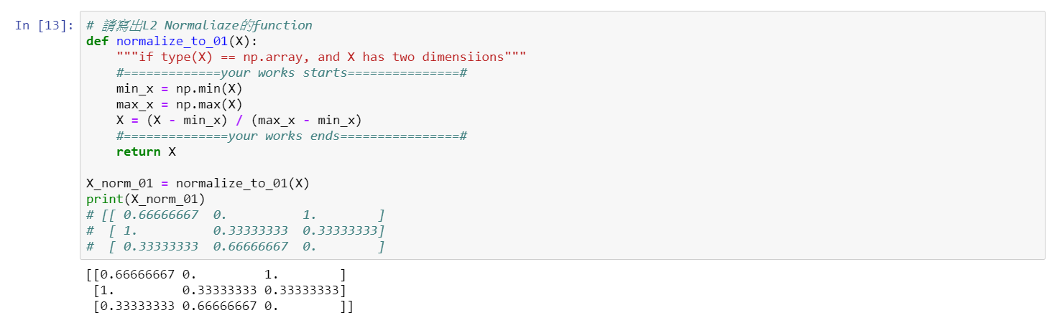
Normalization
Inplementation: L1

Slide 25
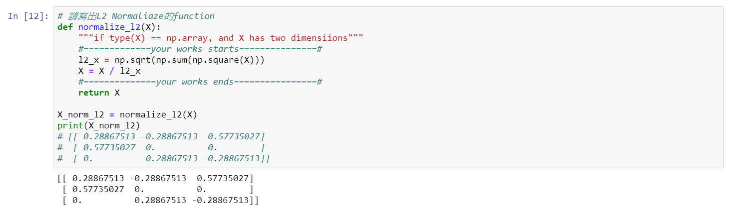
Normalization
Inplementation: L2

Slide 26
Normalization
Inplementation: Norm to 0~1

Slide 27
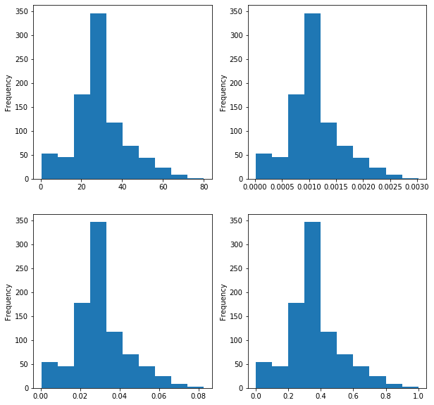
Normalization
Result

Slide 28
Table of Content
DataFrame Inspection
Missing Data
Outlier
Inconsistent Data e.g. Negative Age
Categorical Data e.g. Natural Language Data
Normalization
Feature Generation
Notes:
議題:
請問取log與normalize有什麼差別?

Slide 29
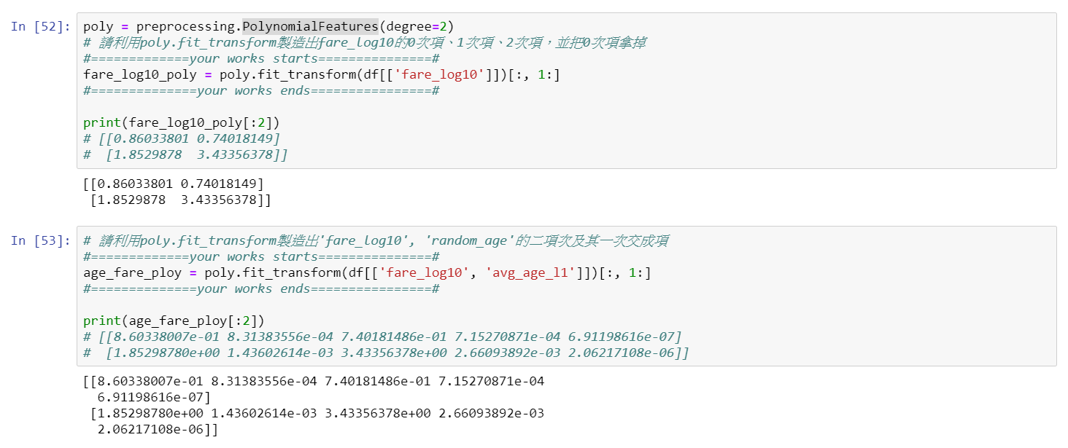
Feature Generation
PolynomialFeatures:
(𝑋1) => (1, 𝑋1, 𝑋1^2)
(𝑋1, 𝑋2) => (1, 𝑋1, 𝑋2, 𝑋1^2, 𝑋1 𝑋2, 𝑋2^2)

Slide 30
Thank you

