Slide 1
Machion Learning 01 ML Introduction
姓名 王選仲
興創知能 AI工程師
2020.05.02
jeremy4555@yahoo.com.tw
https://www.linkedin.com/in/hsuanchungwang/

Slide 2
Scope of AI
Deep Learning
Machine Learning
Expert System
AI

Slide 3
AI Evolution History
Output
Output
Output
Mapping from features
Mapping from features
Hand-designed program
Hand-designed features
Representation features
Input
Input
Input
Expert System
Machine Learning
Deep Learning

Slide 4
AI Evolution History
 | Expert System | ML | DL
Feature Extraction | Human | Human | Computer
Logic Define | Human | Computer | Computer

Slide 5
AI System Building
Decision Making
Data
Task Type
Algorithm
Evaluation
Technical
Implementation
pre- processing
model building
parameter tuning
deployment

Slide 6
Data
Data Source
IOT Sensors:
Time Series Data
Spatial Data
Crawler
html
json
Collect from Website
Structural Data
Database
 | SQL (關聯式資料庫) | NoSQL (非關聯式資料庫)
特性 | 易於紀錄物件關聯性 | 讀寫效能加，可scale up
適用情境 | 物件關聯複雜 | 物件關聯簡單 (單一table可以儲存)
產品 | MSSQL、Postgres、MySQL | MongoDB、ElasticSearch、
舉例 | 公司內部員工管理系統、訂單管理系統 | 爬蟲、IOT資料

Slide 7
Task Types
Clustering
Natural Language Processing (NLP)
Information Retrieval
Natural Language Understanding
Sentence Generation
Classfication
Regression
Computer Vision (CV)
Segmentation
Object Detection
Image Generation
Recommendation
Auto-control

Slide 8
Algorithms
Structural Data
Non Structural Data
Clustering
K-means
DBSCAN
Hierachical
Classification
SVM
Baysian
Decision Tree
Logistic Reg.
XGBOOST
LightGBM
CatBoost
Regression
Linear
Simple
Multiple
Deep Learning
DNN
CNN
RNN
LSTM
Autoencoder UNet
Mask-RCNN
GAN
RL

Slide 9
Algorithms
分群 (Clustering)
K-means
DBSCAN
Hierarchy
分類 (Classfication)
KNN
Decision Tree
Logistic Regression
Bayesian
SVM
Random Forest
XGBoost
lightGBM
檢索與推薦 (Information Retrieval)
Vector Space Model
BM25
Bayesian Model
推薦 (Recommendation)
Collaborative Filtering
Content-based Rencommendation
物件辨識 (Object Detection)
RCNN
Fast-RCNN
YOLO
圖像分割(Image Segmentation)
U-Net
Mask-RCNN
圖片、句子生產 (Image, Sentence Generation)
sequence to sequence (seq2seq)
Generative Adversarial Network (GAN)
自動控制、玩遊戲(Automatic control, gaming)
Reinforcement Learning (RL)

Slide 10
Evaluation
Training, Validation and Testing
Training: 60%
Validation: 20%, >1000 rows is recommended
Testing: 20%, >1000 rows is recommended
Evaluation Function
Category Data (Two or Multiple):
Accuracy
Precision & Recall
F1-Score
Continuous Data:
Mean Square Error (MSE)
Root Mean Square Error (RMSE)
Mean Absolute Error (MAE)
Segmentation:
Intersect of Union (IOU)

Slide 11
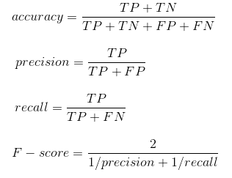
Evaluation - Category Data
Confusion Matrix
 |  | Model Predict
 |  | Positive | Negative
Label | Positive | TP | TN
 | Negative | FP | FN

Slide 12
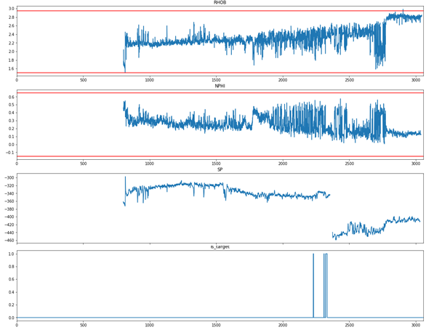
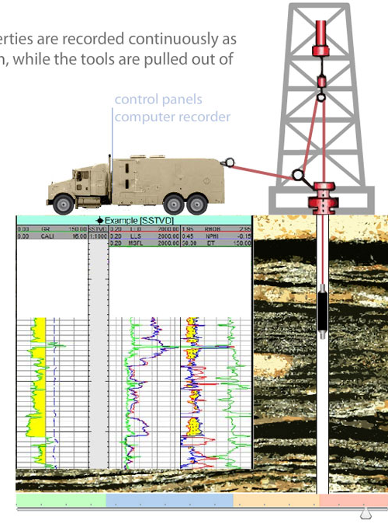
Evaluation - Category Data

Slide 13
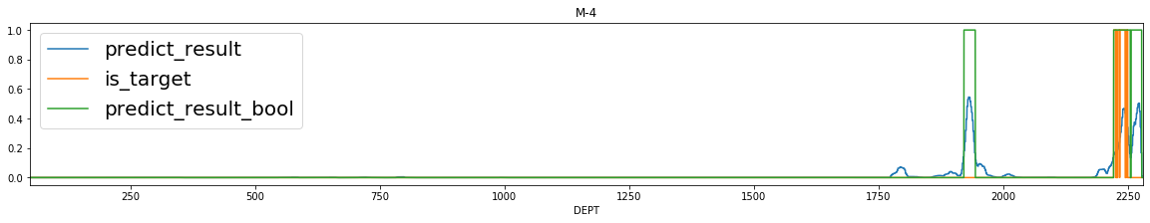
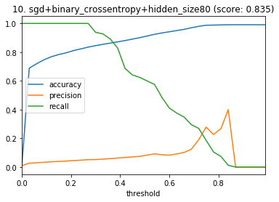
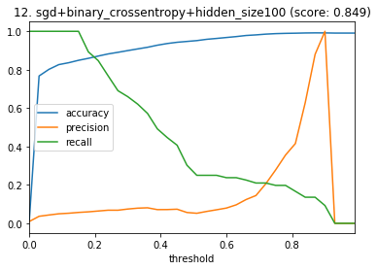
Evaluation - Category Data
預測結果(機率)
油層位置
預測結果(布林)
0.84

Slide 14
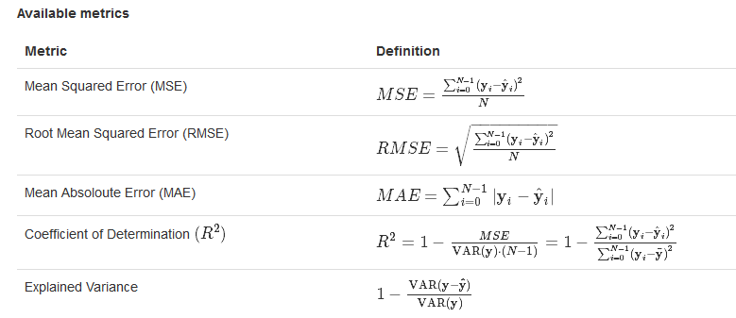
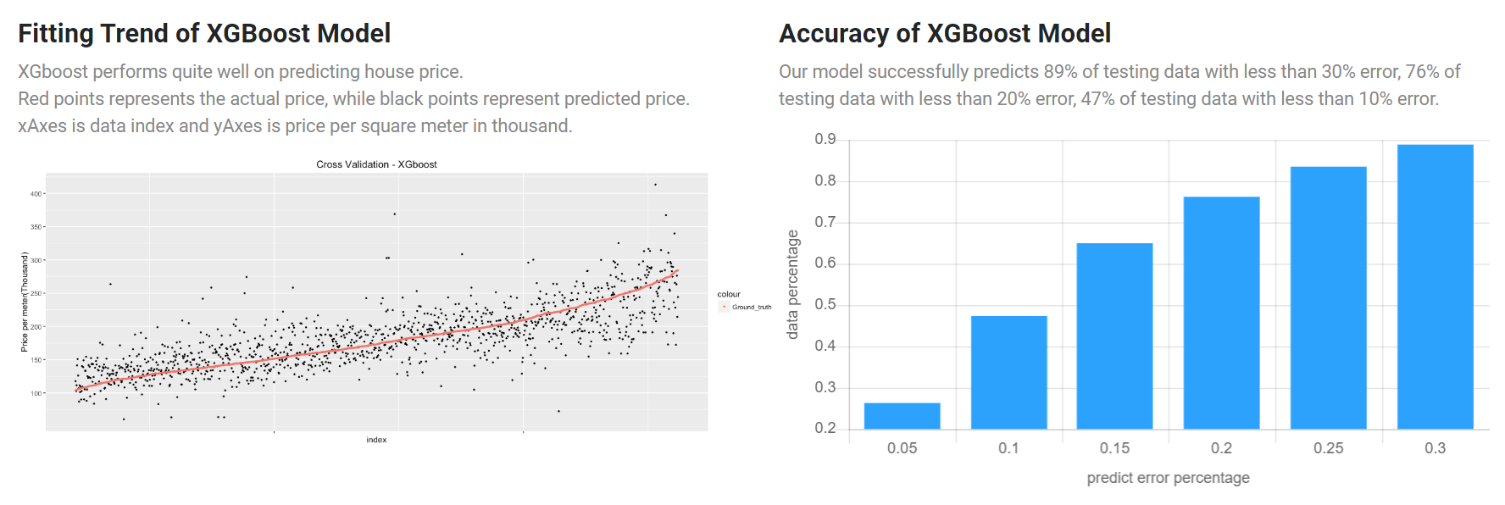
Evaluation - Continuous Data
Functions
Visualization

Slide 15
Evaluation - Segmentation
Intersection
IOU =
UNION

Slide 16
AI System Building
Decision Making
Data
Task Type
Algorithm
Evaluation
Technical
Implementation
pre- processing
model building
parameter tuning
deployment

Slide 17
Pre-Processing
Data Cleaning(資料清理)
Fill in missing values(填入遺漏值)
Identify or remove outliers(辨識並移除離群值)
Resolve inconsistencies(資料不一致)
Integration(資料整合)
Join tables
Different data sources: csv, json, xml, html, api, datebases
Transformation(資料轉換)
Normalization(正規化)
Aggregation(加總)
Feature Engineering(特徵值篩選)
Data discretization(資料切片)
data reduction(降維)

Slide 18
Model Building
AI Framework
ML: scikit-learn
DL: Tensorflow, Keras, PyTorch, Caffe
Hyper Parameters
Input Variables
Number of Layers

Slide 19
Parameter Tuning
Random Forest:
Learning Rate
Objective Function
Max Depth
…
Deep Learning:
Learning Rate
Loss Function
Optimizer
Iterrations
…

Slide 20
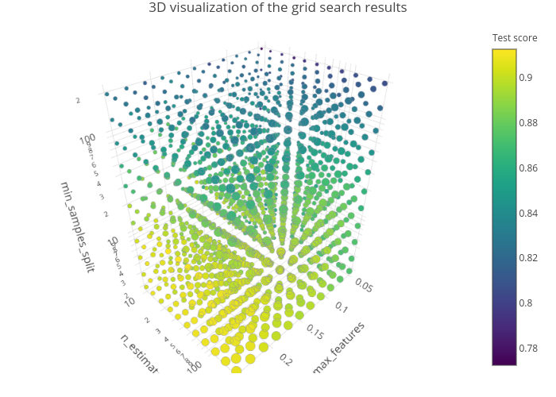
Parameter Tuning – Grid Search

Slide 21
Deployment
Access Software:
Desktop App
Website
Docker Container
Smart Phone App
System:
Windows
Ubuntu
Centos
Specification:
CPU
GPU
Memory
Device:
Computer
Smart Phone
Development Board (RaspberryPi or JetsonNano)

Slide 22
Thank you

