Slide 1
Artificial Intelligence
REAL ESTATE EVALUATOR
NLPist
September. 3, 2018 .伯樂 AI x CSR 人文智慧競賽

Slide 2



Ming-Hsien Tsai
NTHU
Engineer, Taiwan Accelerator
ex-Senior Business Researcher, Delta Electronics.
Hsuan-Chung Wang
NCCU
Python Engineer, ThinkTron
Sun-Ting Lee
NTU
Ph.D. Candidate in Economics

Slide 3

Sell it? Buy it? Or loan the money?
There is a problem…
Ok, how much?

Slide 4
What’s the Problem of House Evaluation?
NLPist
Huge Cost to get a reliable price
7 working days in average
$50,000 NTD per report

Slide 5
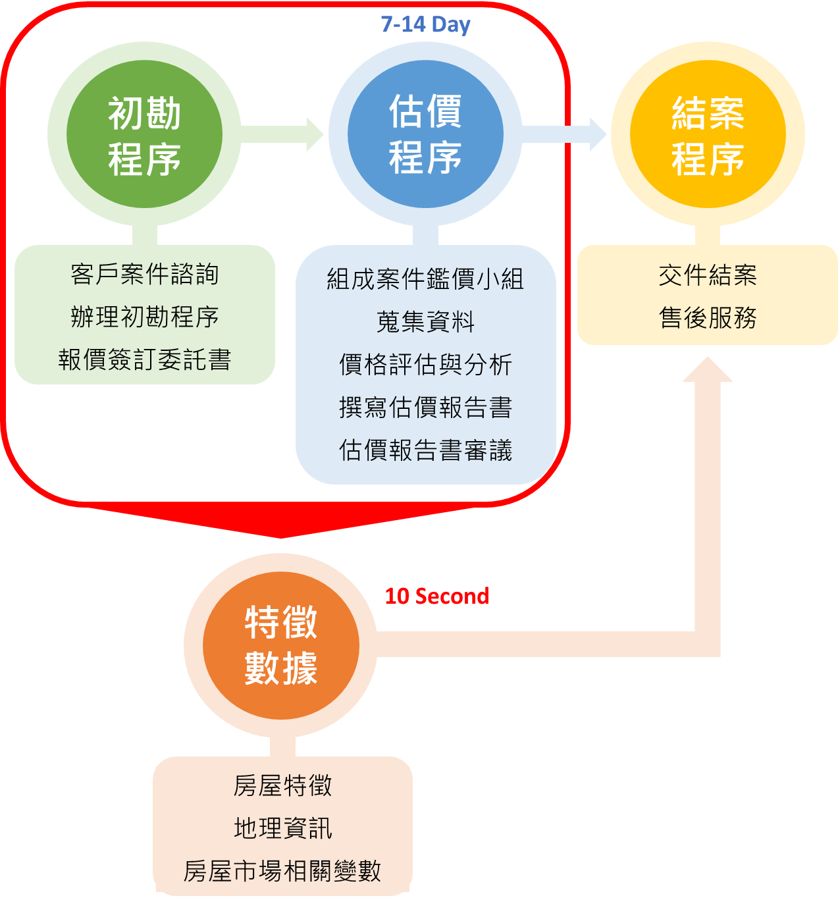
不動產估價事務所
Innovative
Business Model
Finishing evaluation
in 10 seconds
Decreasing 98% payment
for one report
A.I. Evaluator
XGBoost Model
Hedonic Model
立即取得評價資訊

Slide 6

Target Users
NLPist
貸款融資
資產證明
Financial Institutions
Corporation
買賣租賃
資產鑑價
General Public
民事訴訟
損害賠償
Judicial System
General Public
Who needs
the report of evaluation
Real Estate Evaluator
Target Users

Slide 7
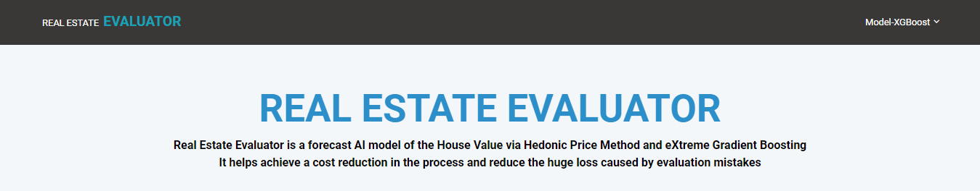
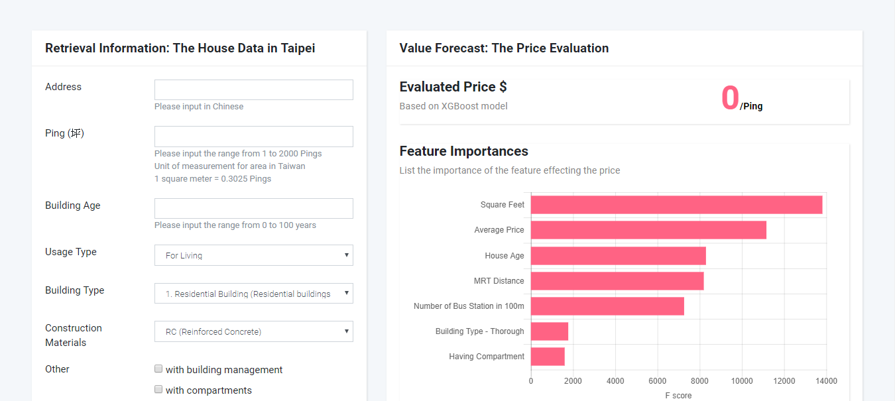
REAL ESTATE
A.I. EVALUATOR
using 2 models to enhance the prediction
including all the parameters human evaluator care about

Slide 8
Model Structure
NLPist
Parameters
actual selling price
supply of new building
criminal location
income level at village
electricity consumption rate
geographical features
….
Hedonic model
XGBoost model

Slide 9

NLPist
Database
Building
Geography
內政部不動產資訊平台
低度用電住宅
新售餘屋資料
綜合所得稅所得總額各縣市鄉鎮村里統計分析表
臺北市住宅竊盜點位資訊
Google Place Search
捷運站進出人次
便利商店分佈
公車站分佈
村里界圖
x

Slide 10
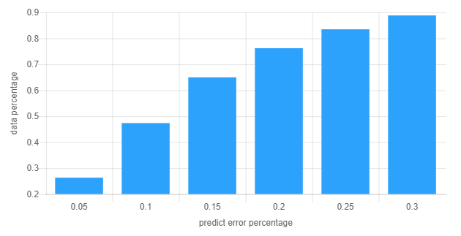
NLPist
Accuracy
Compared with actual selling price,
the Cross Validation presents:
89% of testing data with less than 30% error
76% of testing data with less than 20% error
47% of testing data with less than 10% error

Slide 11
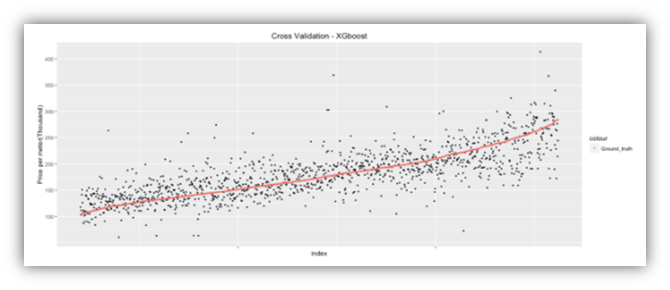
NLPist
Accuracy
Fitting Trend!
XGboost performs quite well on predicting house price:
Red points represents the actual price, while black points represent predicted price
xAxes is data index and yAxes is price per square meter in thousand

Slide 12
Schedule
NLPist
市場現況分析
傳統商模/競爭者
模型架構草案
A.I.模型選擇/變數選定
模型建立
修正
變數資料庫建立/模型導入測試
商業夥伴拜訪
不動產估價事務所
7/15
8/01
8/10
8/20

Slide 13


NLPist
Business Possibility
Phase 1.
Evaluator
Financial Industry / Court…
寶 x 不動產估價師事務所

Slide 14
NLPist
Demo Time
http://realestateevaluator-dev.ap-southeast-1.elasticbeanstalk.com/evaluator/

Slide 15
NLPist

