Slide 1
Web API

Slide 2
What is API?
APIs stand for Application Programming Interfaces. APIs can be considered as intermediaries or messengers that facilitate communication between two applications or between a user and an application.
API Function
The API receives a request and gives a response in return. For instance, when a user browses web applications like Facebook, YouTube, etc the API receives a request from the user and performs the required functionality which is the response.

Slide 3
WHAT ARE WEB APIS?
Web API is an open-source framework that allows developers to build Web Services. This framework implements HTTP protocols and hence they are also known as HTTP APIs. Web APIs allow interaction or communication between users and a device or between two applications.
Web Services built using APIs help to improve the ease of use.
Programming languages used to created Web API include Java, .NET, etc. JavaScript can be used to connect to Web APIs

Slide 4
FEATURES OF WEB API
It supports basic CRUD (Create Read Update and Delete) operations.
It also supports multiple text formats like XML and JSON.
Responses have HTTP status code which helps users to understand whether the API request was successful or not and whether the response was received or not.
One popular Web API is the Active Server Pages Network Enabled Technologies (ASP.NET Web) API.
It is open-source.

Slide 5
HTTP METHODS
HTTP methods are different functionalities of the HTTP protocol which helps to interact with the web. The different HTTP methods are as follows:
          HTTP GET
          HTTP POST
          HTTP PUT
          HTTP DELETE
          HTTP PATCH

Slide 6
HTTP METHODS - HTTP GET
HTTP GET - GET Requests are generally used to request a resource from a web application and not to modify it in any way. GET requests are considered to be safe methods since they do not allow any modification of a Web Resource.

Slide 7
HTTP METHODS - HTTP POST
HTTP POST - The POST method is used to create new resources. For instance, POST methods can be used to insert new data into the database.

Slide 8
HTTP METHODS - HTTP PUT
HTTP PUT - The PUT method is generally used to modify existing resources entirely on the web application. PUT requests are generally made on a single resource whereas POST requests are made on a collection of resources.

Slide 9
HTTP METHODS - HTTP DELETE
HTTP DELETE - As the name suggests, DELETE requests are used to delete an existing resource from a web application.

Slide 10
HTTP METHODS - HTTP PATCH
HTTP PATCH - The PATCH method is used to partially update an existing resource. For example, if a user login has been created and you want to change the password, the patch method is used since the whole row has not been modified but only the password section has been modified.

Slide 11
CONNECTING TO A WEB API
Suppose our objective is to connect to a bookstore web application and retrieve book details from its API.
To connect to the Web API we require the API endpoint. Let’s say the URL of the API endpoint is https://samplebookstore.com/books. Clicking on this link displays an array of objects in JSON format.
Now we will write our script.js file to connect to the API endpoint and retrieve data from it.

Slide 12
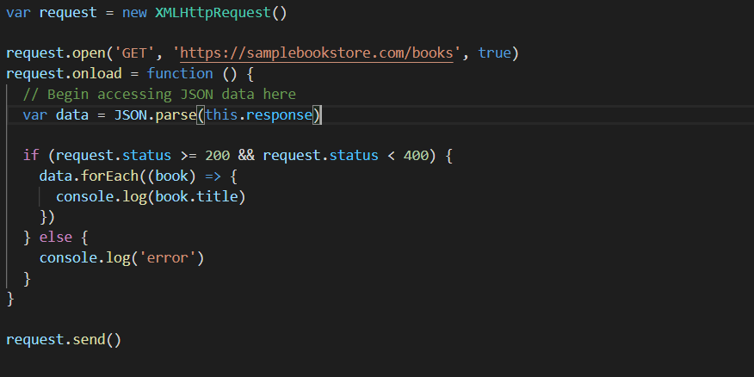
CONNECTING TO A WEB API
This is how our script.js file looks. The file helps to establish a connection to the API endpoint and retrieve the title of books.

Slide 13
How the Codes work
Initially, we create a request variable and assign an XMLHttpRequest object to it. After that we open a new connection to the API endpoint with the open() method where we specify the details of the URL API endpoint and the type of request as GET. Once the request completes, then we access the data using the onload() function.
We retrieve the data by parsing the response received using the JSON.parse() method and we use the data variable to store all the JSON data as an array of JSON objects.
Now using our if statement, we check whether our request was successful or not. If our request was successful we use a ‘for loop’ to loop through the JSON objects and retrieve the book title and display it in the console.
Finally, we send our request to the web application.

Slide 14
USES OF A WEB API
Some of the important uses of Web APIs are as follows:
Web APIs are used to retrieve data resources from a web application and allow the addition of new resources and the modification of existing resources.
Web APIs are used to build Web Services that are lightweight, maintainable, and easily scalable.
It can even be used to create RESTful web services. REST stands for Representational State Transfer.
Web APIs help in easy communication of devices and web applications.
Web APIs are best to use when developers want to create resource-oriented services.
It helps in the fast and efficient development of web services.

Slide 15
RESTful Web services
REST stands for REpresentational State Transfer.
REST is an architectural style not a protocol.
REST defines a set of architectural principles by which you can design Web services that focus on a system's resources, including how resource states are addressed and transferred over HTTP by a wide range of clients written in different languages.

Slide 16
HTTP Protocols for RESTful Web services
            HTTP GET
            HTTP POST
            HTTP PUT
            HTTP DELETE

Slide 17
HTTP Protocols for RESTful Web services
  To create a resource on the server, use POST.
  To retrieve a resource, use GET.
  To change the state of a resource or to update it, use PUT.
  To remove or delete a resource, use DELETE.

