Slide 1
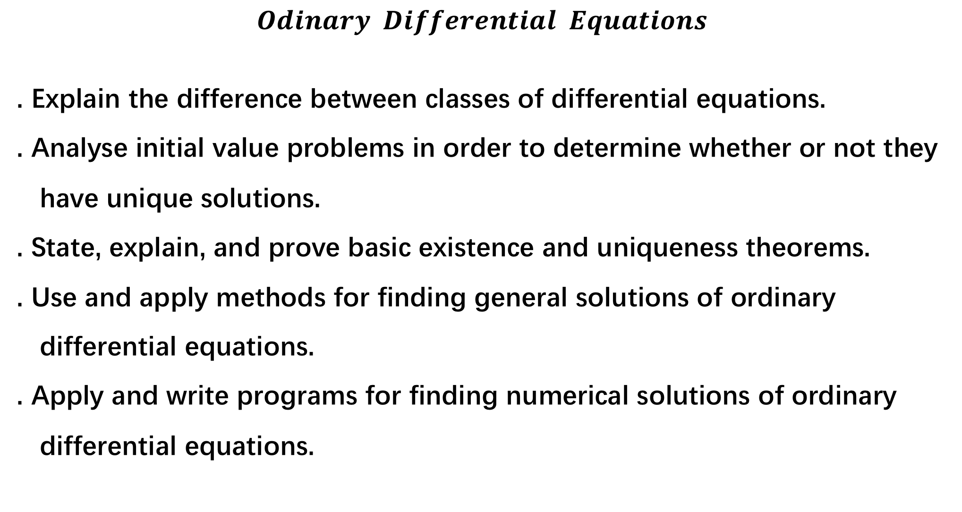
$$Odinary Differential Equations$$
. Explain the difference between classes of differential equations.
. Analyse initial value problems in order to determine whether or not they
have unique solutions.
. State, explain, and prove basic existence and uniqueness theorems.
. Use and apply methods for finding general solutions of ordinary
differential equations.
. Apply and write programs for finding numerical solutions of ordinary
differential equations.

Slide 2
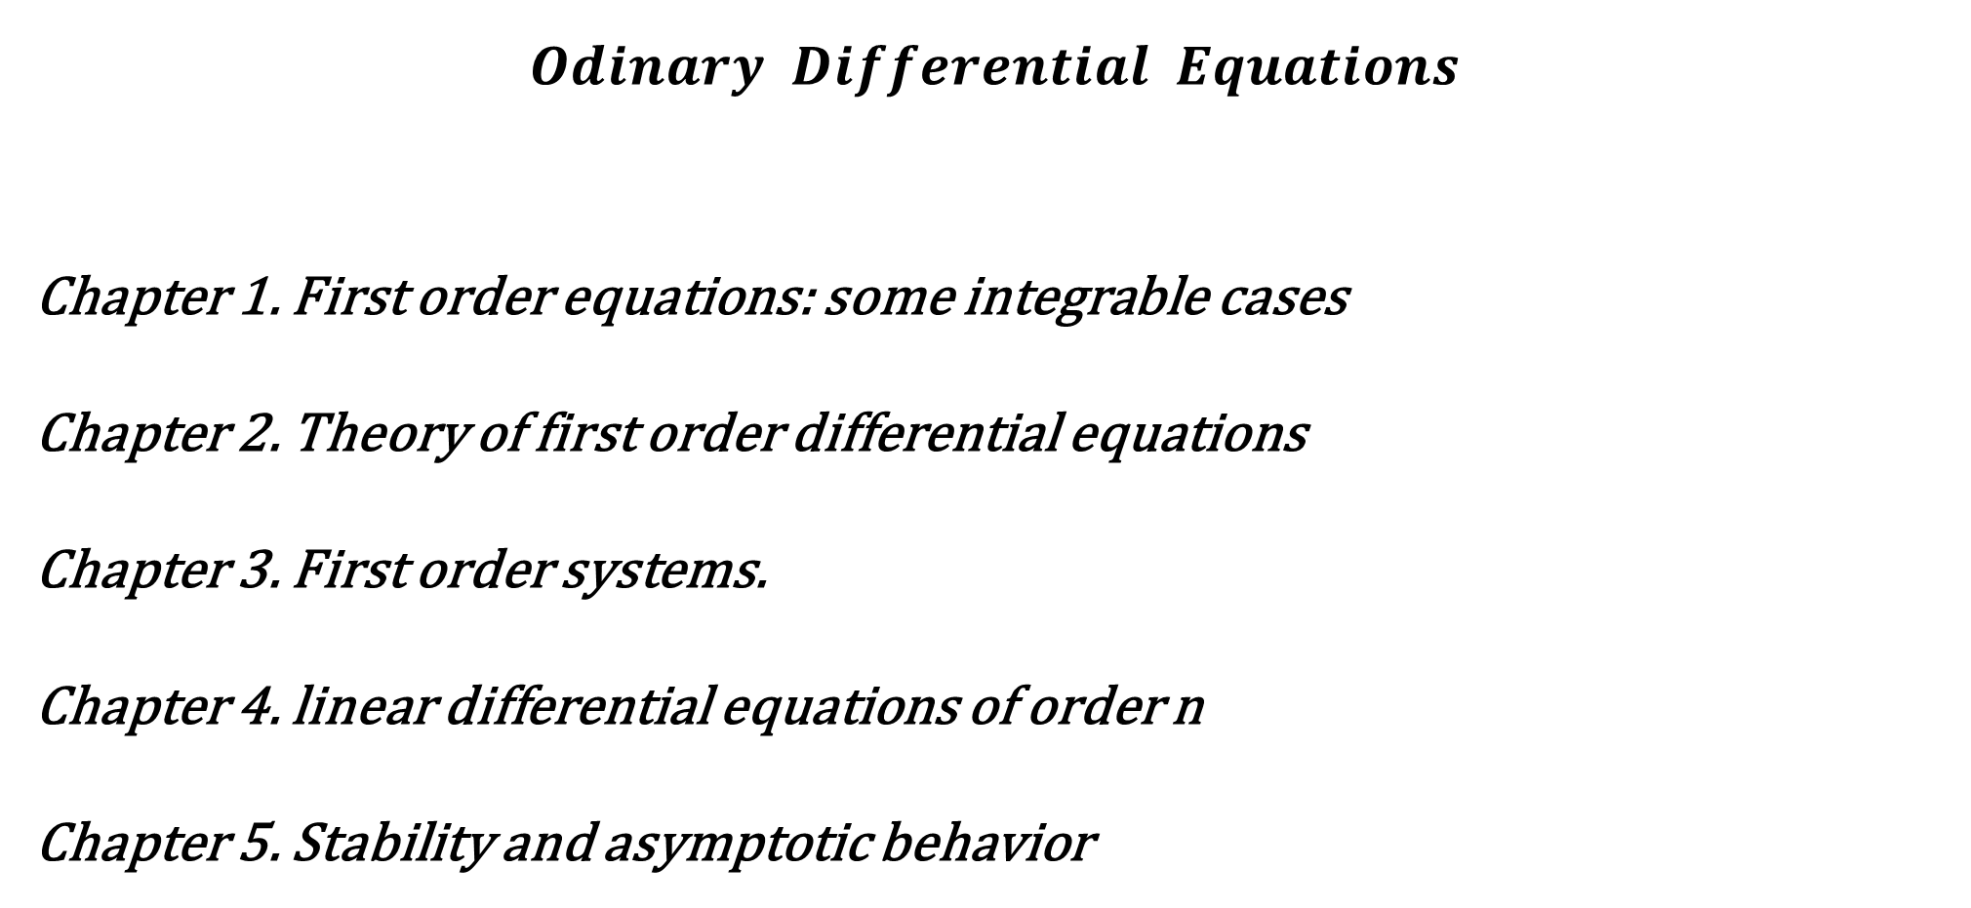
$$Odinary Differential Equations$$
Chapter 1. First order equations: some integrable cases
Chapter 2. Theory of first order differential equations
Chapter 3. First order systems.
Chapter 4. linear differential equations of order n
Chapter 5. Stability and asymptotic behavior

Slide 3
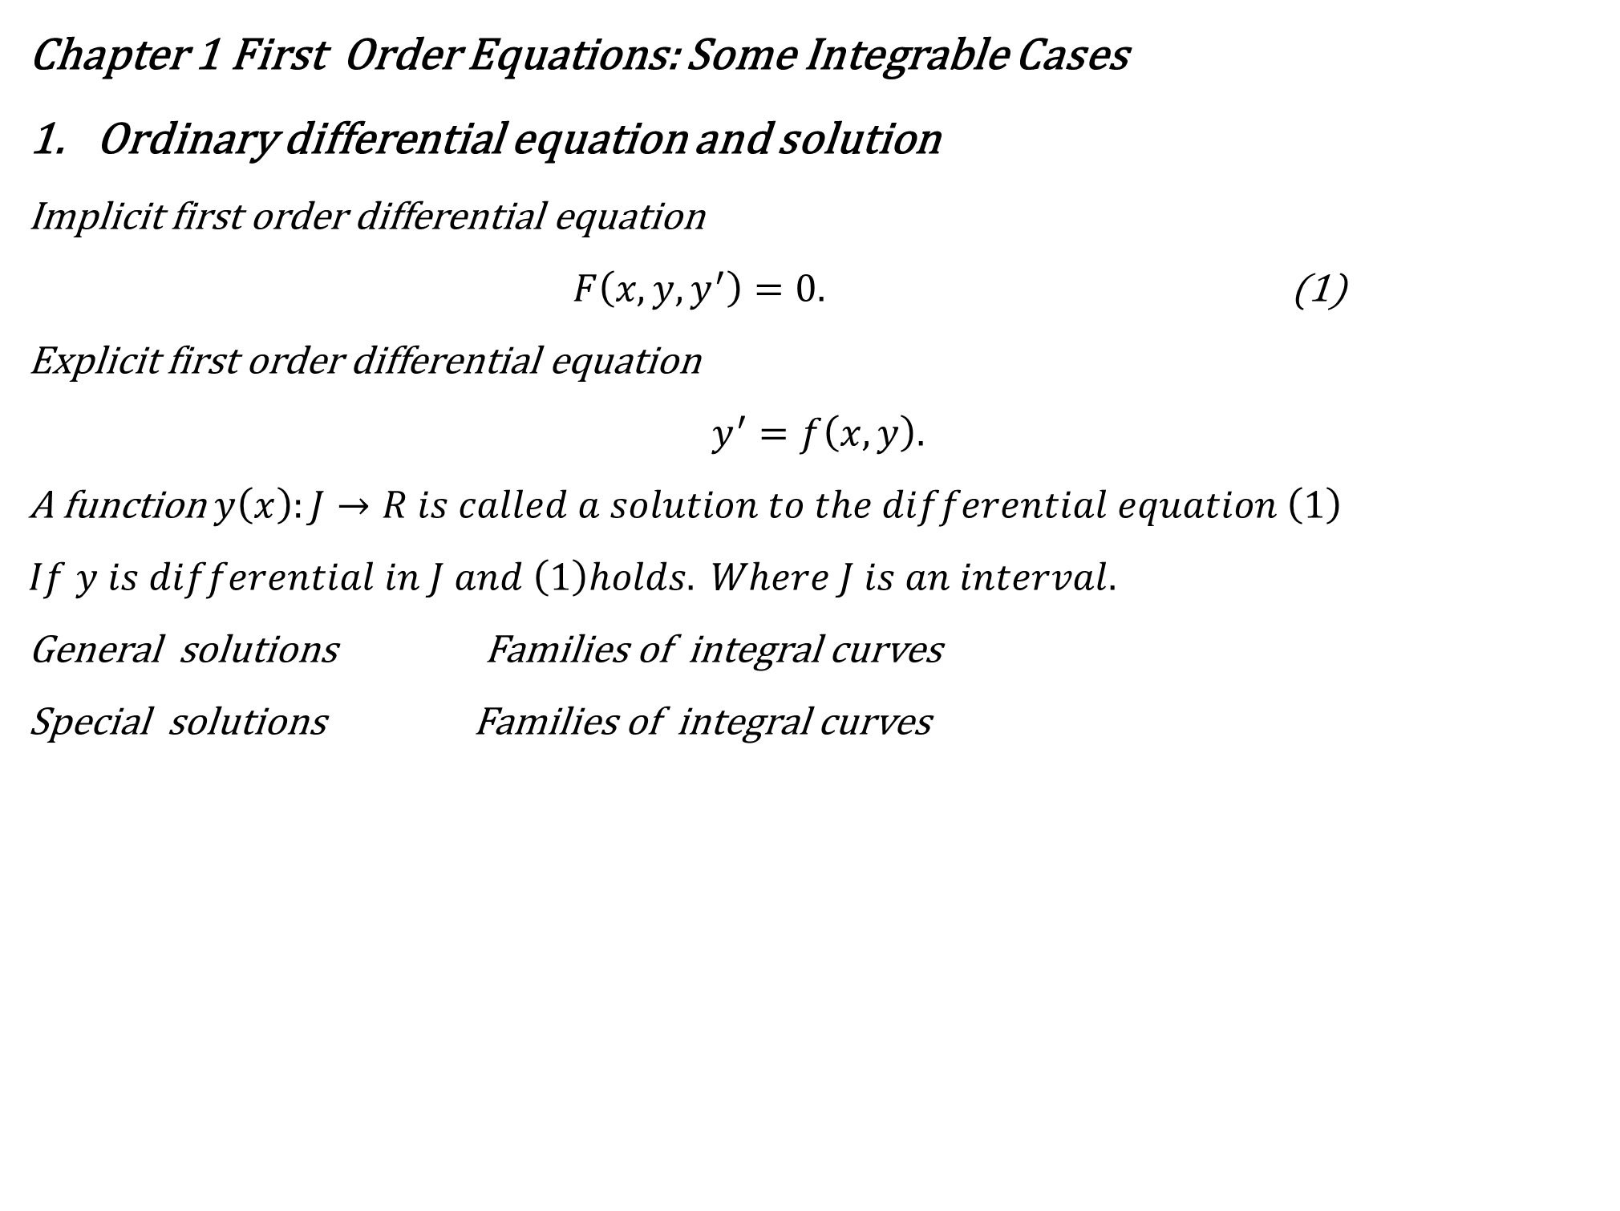
Chapter 1 First Order Equations: Some Integrable Cases
Ordinary differential equation and solution
Implicit first order differential equation
$F\left(x,y,y^{′}\right)=0.$ (1)
Explicit first order differential equation
$$y^{′}=f\left(x,y\right).$$
A function $y\left(x\right):J→R is called a solution to the differential equation \left(1\right)$
$$If y is differential in J and \left(1\right)holds. Where J is an interval.$$
General solutions Families of integral curves
Special solutions Families of integral curves

Slide 4
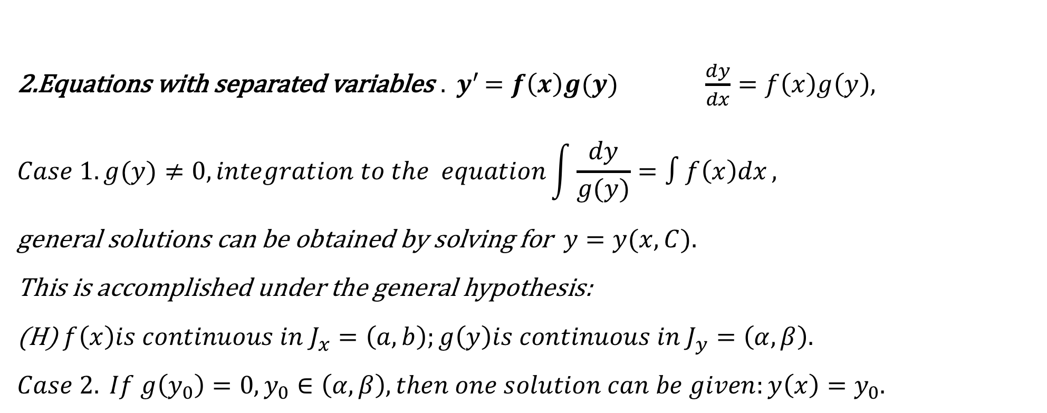
2.Equations with separated variables ${. y}^{′}=f\left(x\right)g(y)$ $\frac{dy}{dx}=f\left(x\right)g\left(y\right),$
$$Case 1. g(y)≠0, integration to the equation\int{\frac{dy}{g(y)}=∫f\left(x\right)dx},$$
general solutions can be obtained by solving for $y=y(x,C).$
This is accomplished under the general hypothesis:
(H) $f\left(x\right)is continuous in J_{x}=\left(a,b\right);g\left(y\right)is continuous in J_{y}=\left(α,β\right).$
$$Case 2. If g\left(y_{0}\right)=0,y_{0}∈\left(α,β\right),then one solution can be given:y\left(x\right)=y_{0}.$$

Slide 5
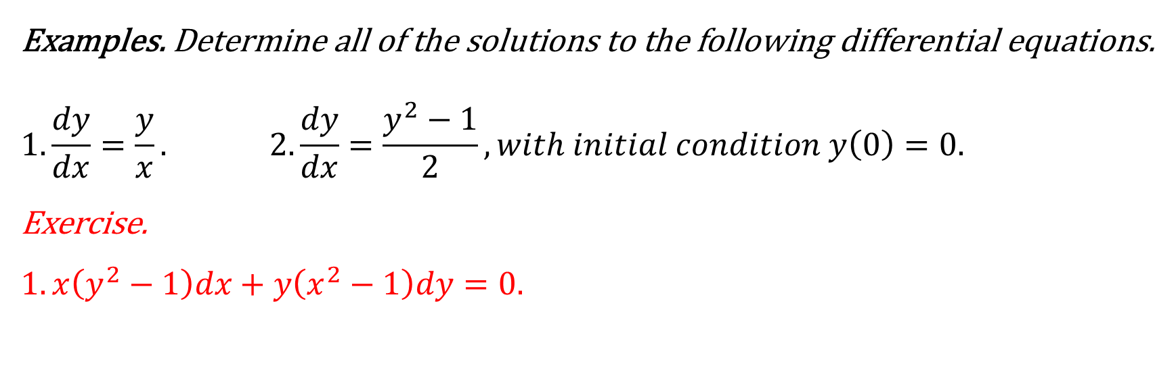
Examples. Determine all of the solutions to the following differential equations.
$$1.\frac{dy}{dx}=\frac{y}{x}. 2.\frac{dy}{dx}=\frac{y^{2}−1}{2}, with initial condition y\left(0\right)=0.$$
Exercise.
$$1. x\left(y^{2}−1\right)dx+y\left(x^{2}−1\right)dy=0.$$

Slide 6
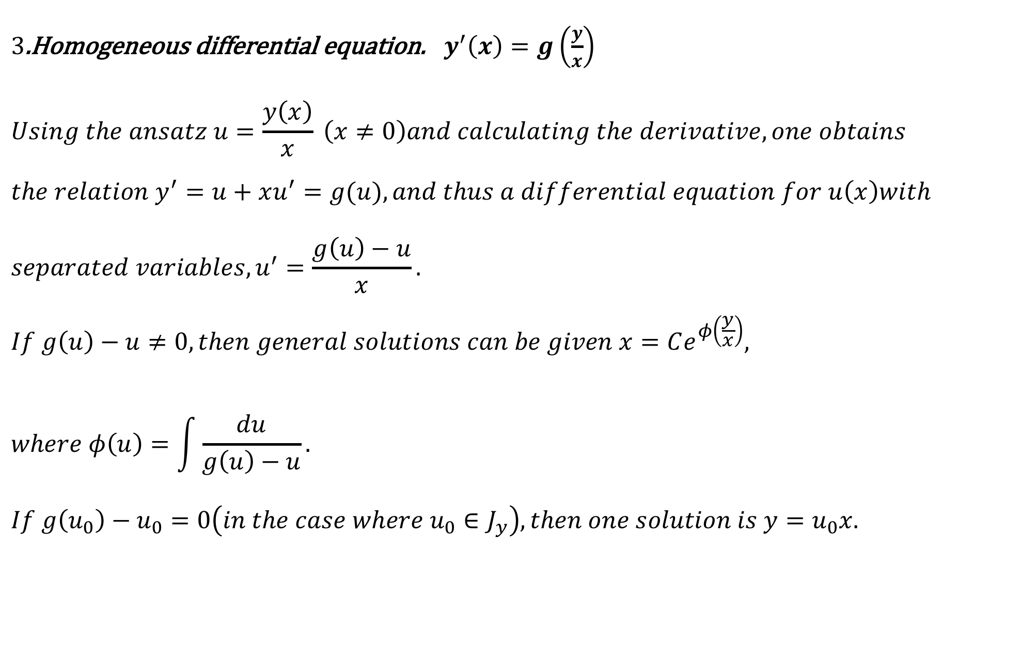
$3$.Homogeneous differential equation. ${ y}^{′}\left(x\right)=g\left(\frac{y}{x}\right)$
$$Using the ansatz u=\frac{y\left(x\right)}{x} \left(x≠0\right)and calculating the derivative, one obtains$$
$$the relation y^{′}=u+xu^{′}=g(u), and thus a differential equation for u\left(x\right)with$$
$$separated variables, u^{′}=\frac{g\left(u\right)−u}{x}.$$
$$If g\left(u\right)−u≠0, then general solutions can be given x=Ce^{φ\left(\frac{y}{x}\right)},$$
$$where φ\left(u\right)=\int{\frac{du}{g\left(u\right)−u}.}$$
$$If g\left(u_{0}\right)−u_{0}=0\left(in the case where u_{0}∈J_{y}\right), then one solution is y=u_{0}x.$$

Slide 7
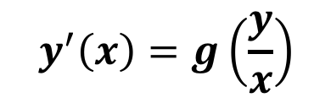
$${ y}^{′}\left(x\right)=g\left(\frac{y}{x}\right)$$
$$If g\left(u\right)−u≠0, then general solutions can be given x=Ce^{φ\left(\frac{y}{x}\right)},$$
$$If g\left(u_{0}\right)−u_{0}=0\left(in the case where u_{0}∈J_{y}\right), then one solution is y=u_{0}x.$$

Slide 8
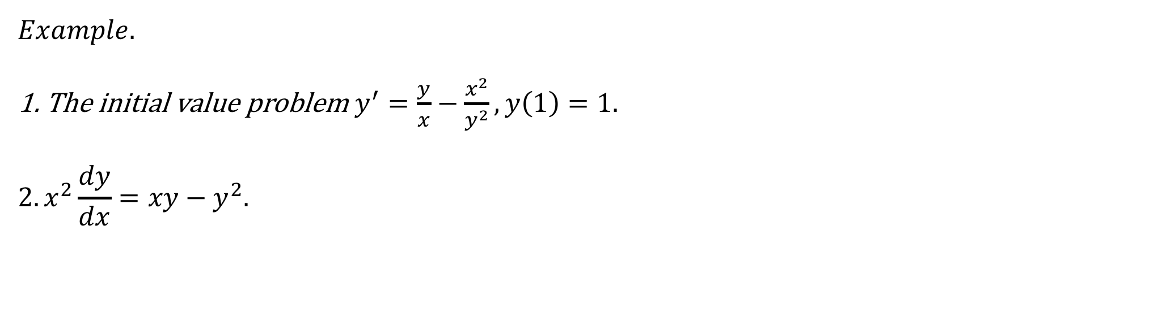
$Example$.
1. The initial value problem $y^{′}=\frac{y}{x}−\frac{x^{2}}{y^{2}},y\left(1\right)=1.$ $$2.x^{2}\frac{dy}{dx}=xy−y^{2}.$$

Slide 9
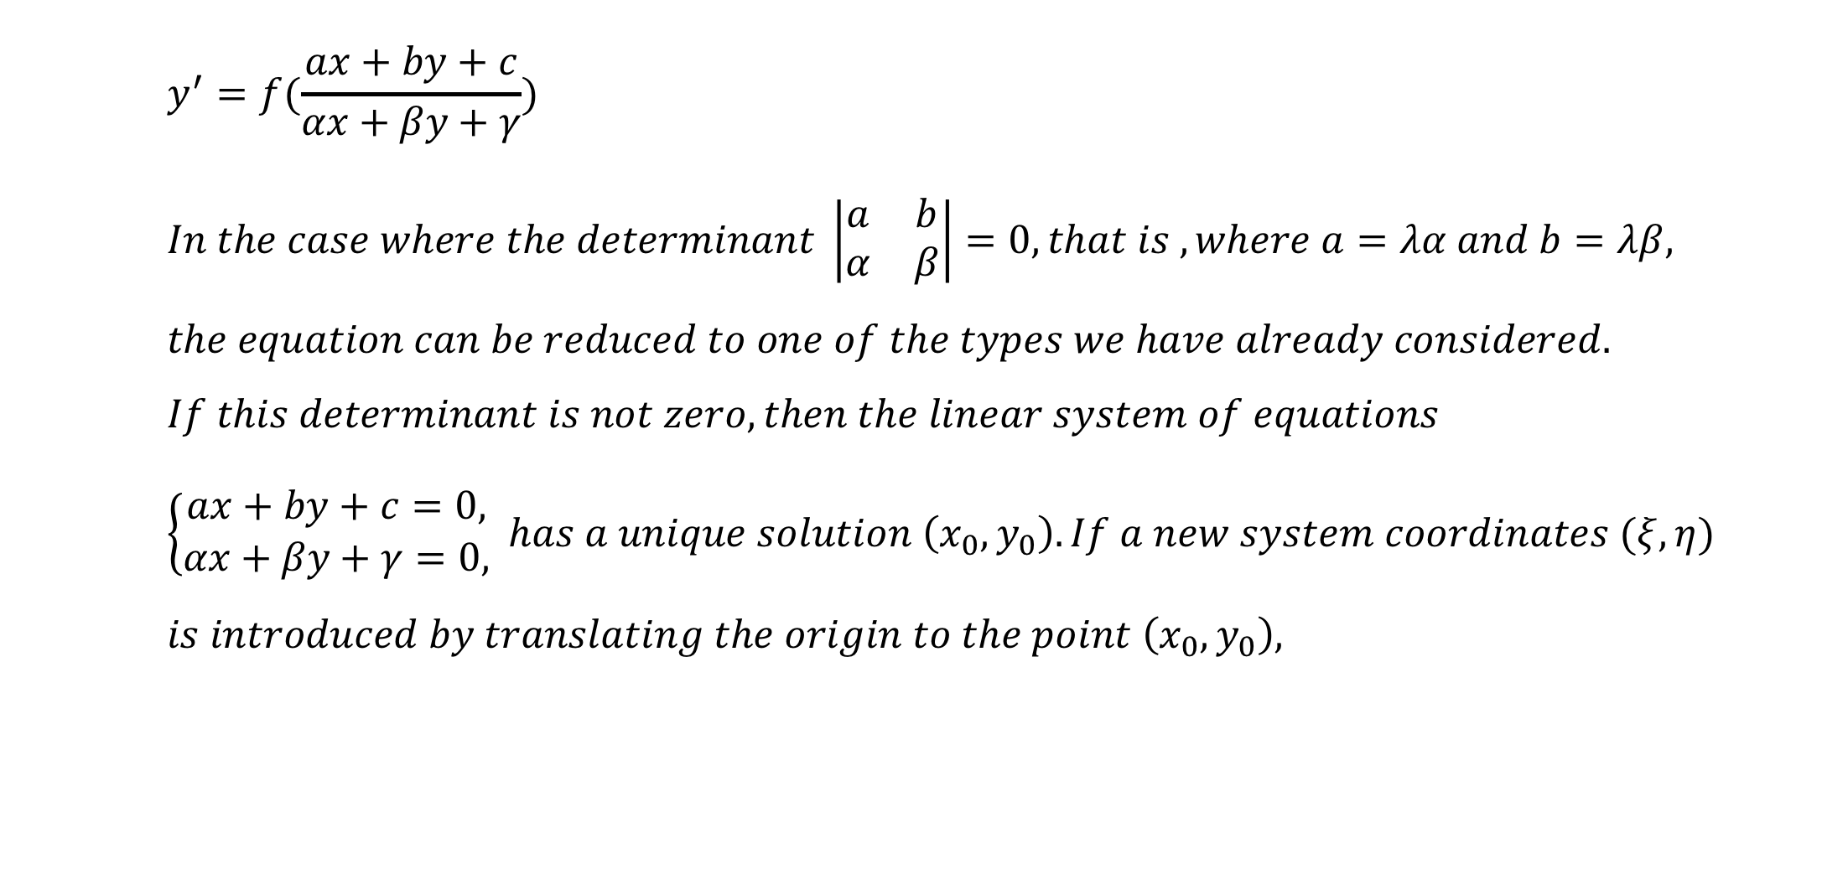
$$y^{′}=f(\frac{ax+by+c}{αx+βy+γ})$$
$$In the case where the determinant \left|\begin{matrix}a & b \\ α & β\end{matrix}\right|=0, that is , where a=λα and b=λβ,$$
$$the equation can be reduced to one of the types we have already considered.$$
$$If this determinant is not zero, then the linear system of equations$$
$$\left\{\begin{aligned}ax+by+c=0, \\ αx+βy+γ=0,\end{aligned} has a unique solution \left(x_{0},y_{0}\right). If a new system coordinates (ξ,η)\right.$$
$$is introduced by translating the origin to the point \left(x_{0},y_{0}\right),$$

Slide 10
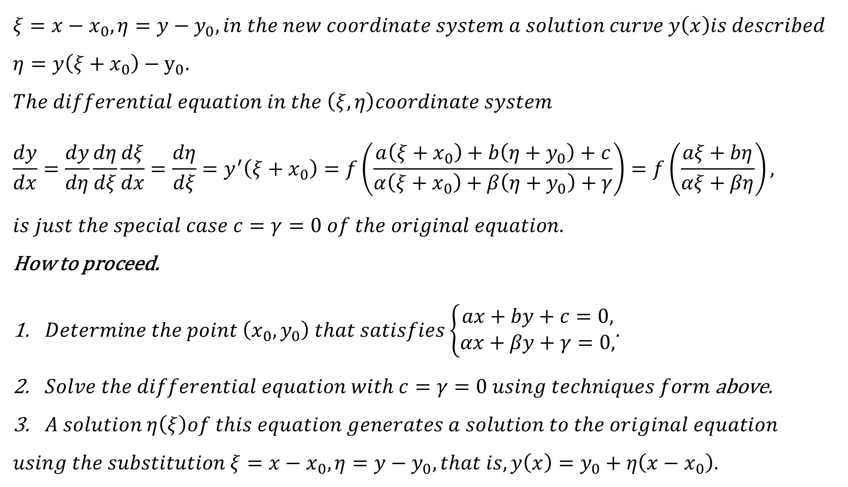
$$ξ=x−x_{0},η=y−y_{0}, in the new coordinate system a solution curve y\left(x\right)is described$$
$$η=y\left(ξ+x_{0}\right)−y_{0}.$$
$$The differential equation in the \left(ξ,η\right)coordinate system$$
$$\frac{dy}{dx}={\frac{dy}{dη}\frac{dη}{dξ}\frac{dξ}{dx}=\frac{dη}{dξ}=y}^{′}\left(ξ+x_{0}\right)=f\left(\frac{a\left(ξ+x_{0}\right)+b\left(η+y_{0}\right)+c}{α\left(ξ+x_{0}\right)+β\left(η+y_{0}\right)+γ}\right)=f\left(\frac{aξ+bη}{αξ+βη}\right),$$
$$is just the special case c=γ=0 of the original equation.$$
How to proceed.
$Determine the point \left(x_{0},y_{0}\right) that satisfies\left\{\begin{aligned}ax+by+c=0, \\ αx+βy+γ=0,\end{aligned}\right.$.
$Solve the differential equation with c=γ=0 using techniques form$above.
$A solution η\left(ξ\right)of this equation generates a solution to the original equation$
$$using the substitution ξ=x−x_{0},η=y−y_{0}, that is, y\left(x\right)=y_{0}+η\left(x−x_{0}\right).$$

Slide 11

$$Example.$$
$1. \frac{dy}{dx}$=$\frac{x−y+1}{x+y−3}.$ $$2. \left(2x+y+1\right)dx−\left(4x+2y−3\right)dy=0. \\ Exercises. \\ 1. \left(y^{2}−2xy\right)dx+x^{2}dy=0. \\ 2. \left(2x^{2}+3y^{2}−7\right)xdx−\left(3x^{2}+2y^{2}−8\right)ydy=0.$$

