Slide 1


Probability MA1061
DLI
Dr. Qingjie Guo

Slide 2
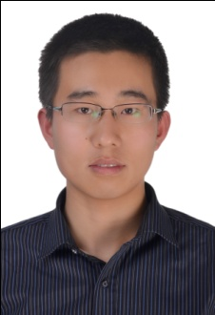
DLI
Dr. Guo
http://faculty.dlut.edu.cn/guoqingjie/zh_CN/index.htm

Slide 3
DLI
About me
My Office: C08-304-1
Phone number: 15998592997
Email：qjguo@dlut.edu.cn

Slide 4
DLI
Probability(64 hours)
Time and place of class
Time | class | weeks | Room
Tuesday | 1-2 | 1-5，8-18 | N303
Thursday | 3-4 | 1-5，8-18 | N303

Slide 5

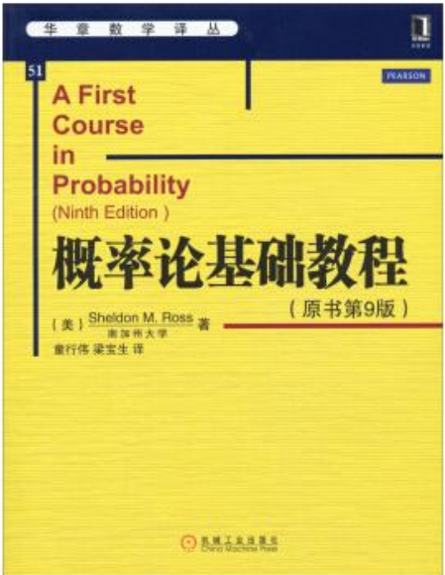
DLI
Textbooks：
Reference

Slide 6
DLI
Examination
Coursework： 20%
Class Test: 20%
Examination（Final）： 60%
>=40 Pass（in UK）
>=60 Pass（in china）
Else Fail
Examination（Final）
100 points about 2 hours

Slide 7
DLI
Probability
Combinatorial Analysis
Axioms of Probability
Conditional Probability and Independence
Random Variables
Continuous Random Variables
Jointly Distributed Random Variables
Properties of Expectation
Limit Theorems

Slide 8
DLI
About our lessons
Don't be absent from class
Listen carefully
Finish the homework on time
Think positively

