Slide 1
Chapter 22 Elementary Graph Algorithms
Guangyu Zou
Dalian University of Technology
gyzou@dlut.edu.cn

Slide 2
Outline
Representation of graphs
Breadth-first search
Depth-first search
Strongly connected components

Slide 3
Social Network
A social network is a social structure made up of a set of social actors (such as individuals or organizations) and a set of the dyadic ties between these actors.
The social network perspective provides a set of methods for analyzing the structure of whole social entities as well as a variety of theories explaining the patterns observed in these structures

Slide 4
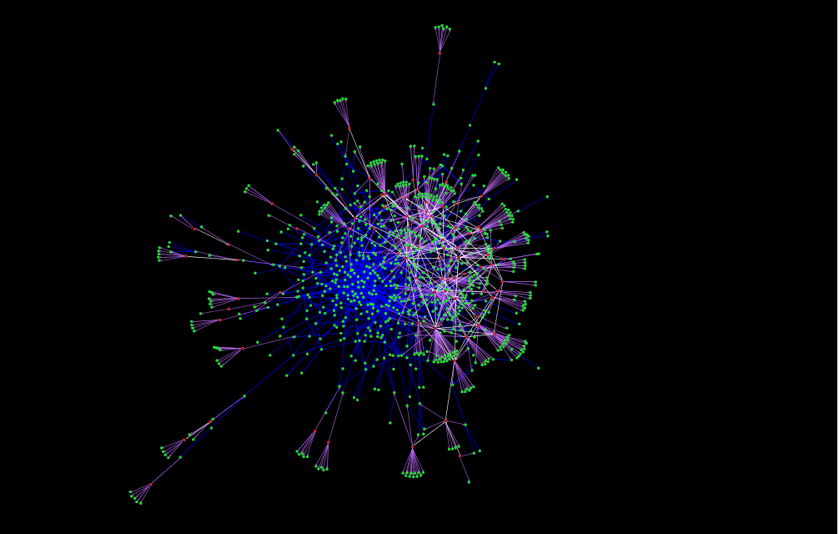
Generated Socio-technical Networks
Exploration-oriented Community

Slide 5
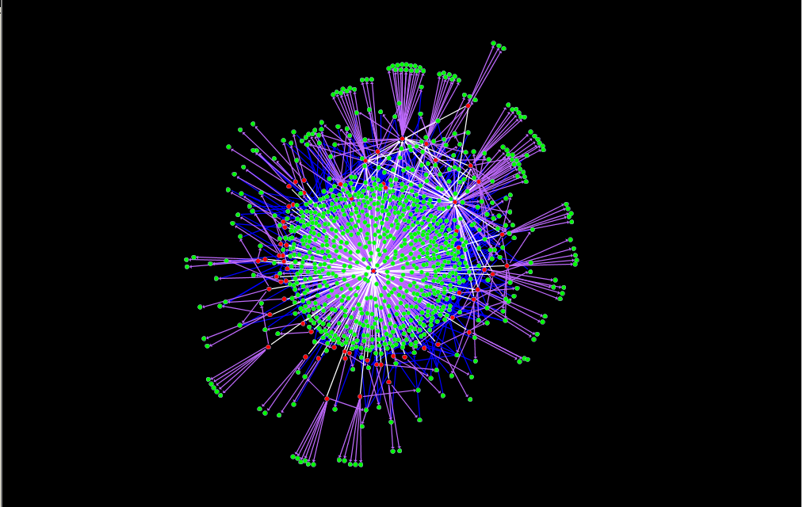
Generated Socio-technical Networks
Utility-oriented Community

Slide 6
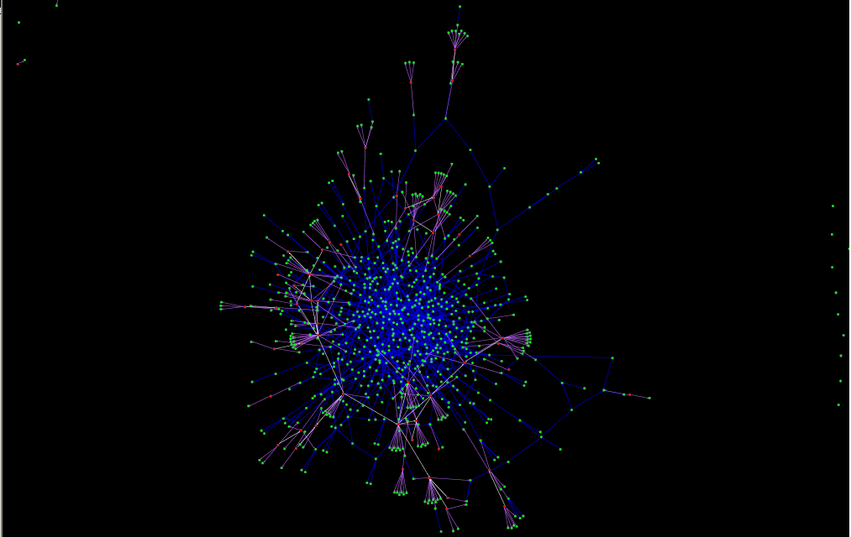
Generated Socio-technical Networks
Service-oriented Community

Slide 7
Representations of graphs
G(V, E)
V - Vertex, E - Edge
Directed
Undirected
Two representations
Adjacency lists
Adjacency matrix

Slide 8
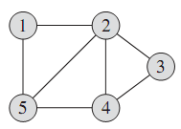
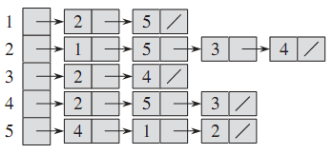
Adjacency lists -- Undirected
If (u,v) is an undirected edge, then u appears in v’s adjacency list and vice versa.

Slide 9
Adjacency Lists in C++
#include <stdio.h>
#include <map>
#include <list>
using namespace std;
int main() {
map<int, list<int>> adjacencyList;
list<int> node1_targets;
node1_targets.push_back(2);
node1_targets.push_back(5);
adjacencyList[1] = node1_targets;
list<int> node2_targets;
node2_targets.push_back(1);
node2_targets.push_back(5);
node2_targets.push_back(3);
node2_targets.push_back(4);
adjacencyList[2] = node2_targets;
for (map<int, list<int>>::iterator iter = adjacencyList.begin(); iter != adjacencyList.end(); ++iter) {
printf("%d -> ", iter->first);
for (list<int>::iterator jter = iter->second.begin(); jter != iter->second.end(); ++jter)
printf("%d ", *jter);
printf("\n");
}
}
unordered_map

Slide 10
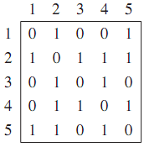
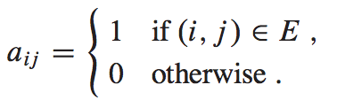
Adjacency matrix -- Undirected
symmetry

Slide 11
Adjacency Matrix in C++
void buildAdjacencyMatrix() {
int adjacencyMatrix[5][5];
memset(adjacencyMatrix, 0, 25*sizeof(int));
adjacencyMatrix[0][1] = adjacencyMatrix[0][4] = 1;
adjacencyMatrix[1][0] = adjacencyMatrix[1][2] = adjacencyMatrix[1][3] = adjacencyMatrix[1][4] = 1;
adjacencyMatrix[2][1] = adjacencyMatrix[2][3] = 1;
adjacencyMatrix[3][1] = adjacencyMatrix[3][2] = adjacencyMatrix[3][4] = 1;
adjacencyMatrix[4][0] = adjacencyMatrix[4][1] = adjacencyMatrix[4][3] = 1;
for (int i = 0; i < 5; ++i) {
for (int j = 0; j < 5; ++j)
printf("%3d", adjacencyMatrix[i][j]);
printf("\n");
}
}

Slide 12
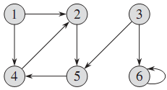
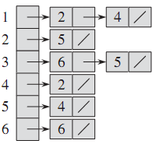
Adjacency lists -- Directed
A directed graph (or digraph) is a graph, or set of nodes connected by edges, where the edges have a direction associated with them

Slide 13
Adjacency Lists in C++
map<int, list<int>> adjacencyList;
list<int> node1_targets;
node1_targets.push_back(2);
node1_targets.push_back(4);
adjacencyList[1] = node1_targets;
list<int> node2_targets;
node2_targets.push_back(5);
adjacencyList[2] = node2_targets;
list<int> node3_targets;
node3_targets.push_back(6);
node3_targets.push_back(5);
adjacencyList[3] = node3_targets;
for (map<int, list<int>>::iterator iter = adjacencyList.begin(); iter != adjacencyList.end(); ++iter) {
printf("%d -> ", iter->first);
for (list<int>::iterator jter = iter->second.begin(); jter != iter->second.end(); ++jter)
printf("%d ", *jter);
printf("\n");
}
1 -> 2 4
2 -> 5
3 -> 6 5

Slide 14
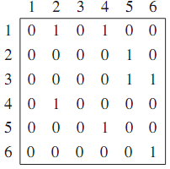
Adjacency matrix -- Directed

Slide 15
Adjacency Matrix in C++
int adjacencyMatrix[6][6];
memset(adjacencyMatrix, 0, 36*sizeof(int));
adjacencyMatrix[0][1] = adjacencyMatrix[0][3] = 1;
adjacencyMatrix[1][4] = 1;
adjacencyMatrix[2][4] = adjacencyMatrix[2][5] = 1;
adjacencyMatrix[3][1] = 1;
adjacencyMatrix[4][3] = 1;
adjacencyMatrix[5][5] = 1;
for (int i = 0; i < 6; ++i) {
for (int j = 0; j < 6; ++j)
printf("%3d", adjacencyMatrix[i][j]);
printf("\n");
}

Slide 16
Breadth-first search
Breadth-first search is so named because it expands the frontier between discovered and undiscovered vertices uniformly across the breadth of the frontier. That is, the algorithm discovers all vertices atdistance k from s before discovering any vertices at distance k+1.
Prim’s minimum-spanning tree algorithm (Section 23.2) and Dijkstra’s single-source shortest-paths algorithm (Section24.3) use ideas similar to those in breadth-first search.

Slide 17
Attributes of Vertices
Color
White: Undiscovered
Gray: Discovered but not complete
Black: Discovered, all adjacencies are not white.
Distance
u.d
Predecessor
u.π

Slide 18
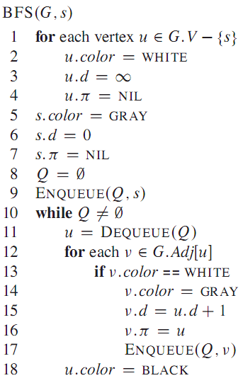
BFS
Why needing it?

Slide 19
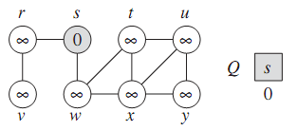
BFS

Slide 20
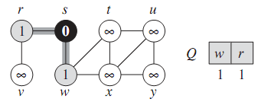
BFS

Slide 21
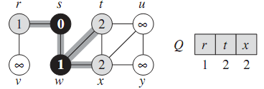
BFS

Slide 22
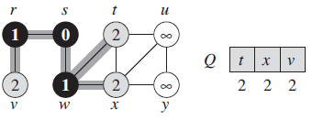
BFS

Slide 23
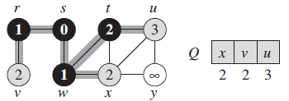
BFS

Slide 24
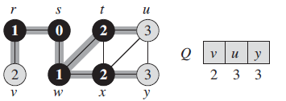
BFS

Slide 25
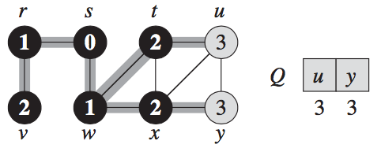
BFS

Slide 26
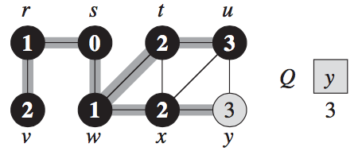
BFS

Slide 27
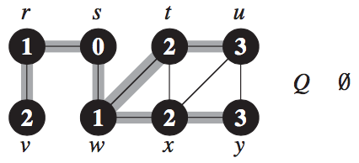
BFS

Slide 28
Complexity
The total time spent in scanning adjacency lists is O(E).
The overhead for initialization is O(V).
The total running time of the BFS procedure is
O(V+E)

Slide 29
Shortest paths
Define the shortest-path distance σ(s,v) from s to v as the minimum number of edges in any path from vertex s to vertex v; if there is no path from s to v, then the distance is ∞.
Breadth-first search is able to find single source distance.

Slide 30
Depth-first search
The strategy followed by depth-first search is, as its name implies, to search “deeper” in the graph whenever possible.
Depth-first search explores edges out of the most recently discovered vertex v that still has unexplored edges leaving it.
Once all of v’s edges have been explored, the search “backtracks” to explore edges leaving the vertex from which v was discovered.
This process continues until we have discovered all the vertices that are reachable from the original source vertex.

Slide 31
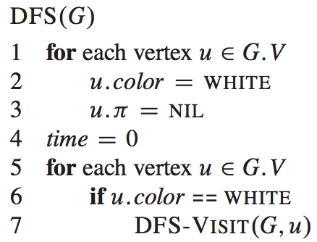
DFS
Why needing it?
Isolated nodes

Slide 32
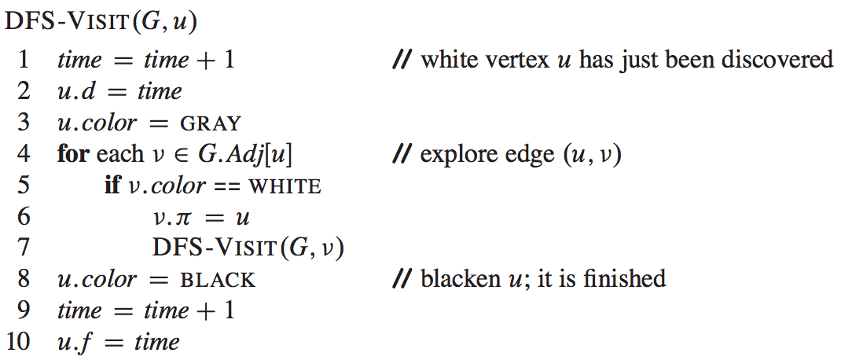
DFS
What is it similar to?
Pre-order traversal

Slide 33
Time Attribute
Depth-first search timestamps each vertex.
Each vertex v has two timestamps: the first timestamp v.d records when v is first discovered (and grayed), and the second timestamp v.f records when the search finishes examining v’s adjacency list (and blackens v).
Vertex u is WHITE before time u.d, GRAY between time u.d and time u.f, and BLACK thereafter.

Slide 34
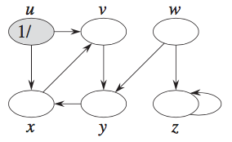
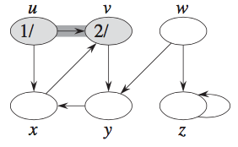
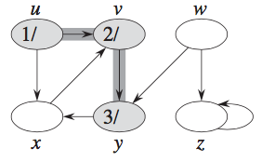
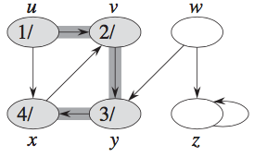
DFS

Slide 35
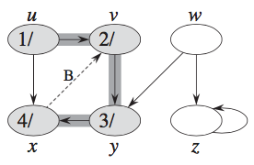
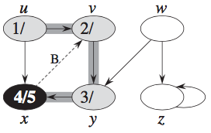
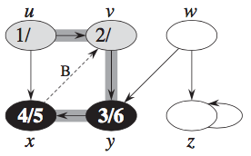
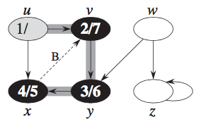
DFS

Slide 36
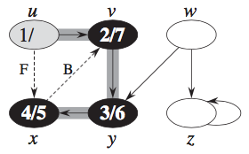
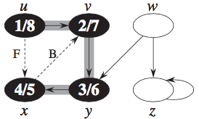
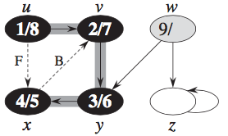
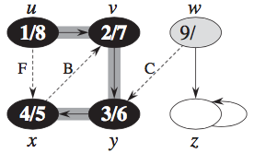
DFS

Slide 37
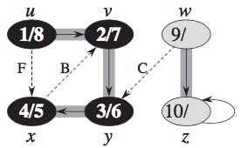
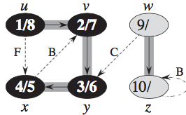
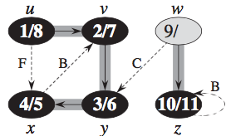
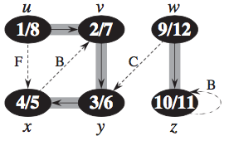
DFS

Slide 38
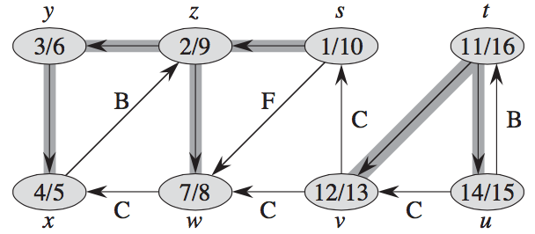
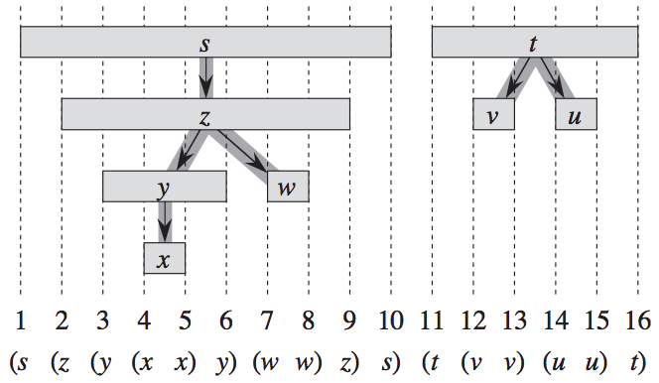
Parenthesis Structure

Slide 39
Parenthesis Theorem
the intervals (u.d, u.f) and (v.d, v.f) are entirely disjoint
neither u nor v is a descendant of the other in the depth-first forest,
the interval (u.d, u.f) is contained entirely within the interval (v.d, v.f)
u is a descendant of v in a depth-first tree, or
the interval (v.d, v.f) is contained entirely within the interval (u.d, u.f)
v is a descendant of u in a depth-first tree.

Slide 40
Topological sort
A topological sort of a dag (directed acyclic) G (V, E) is a linear ordering of all its vertices such that if G contains an edge (u, v), then u appears before v in the ordering.
If the graph contains a cycle, then no linear ordering is possible.
We can view a topological sort of a graph as an ordering of its vertices along a horizontal line so that all directed edges go from left to right.

Slide 41
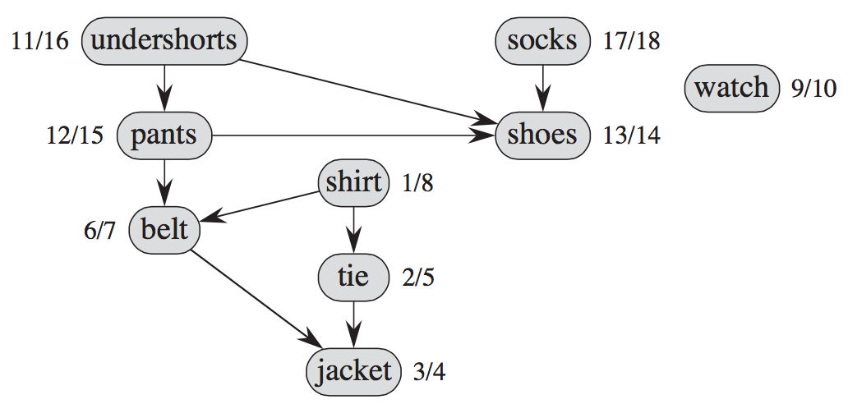
Applications of Topological Sort
Many applications use directed acyclic graphs to indicate precedences among events.

Slide 42
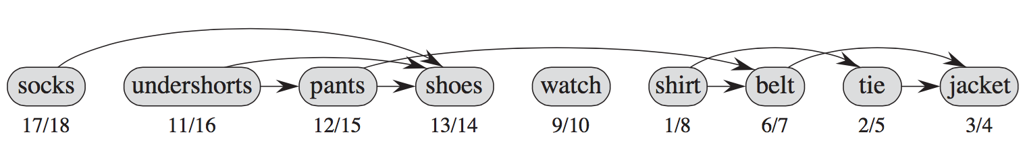
Applications of Topological Sort
vertices arranged from left to right in order of decreasing finishing time

Slide 43
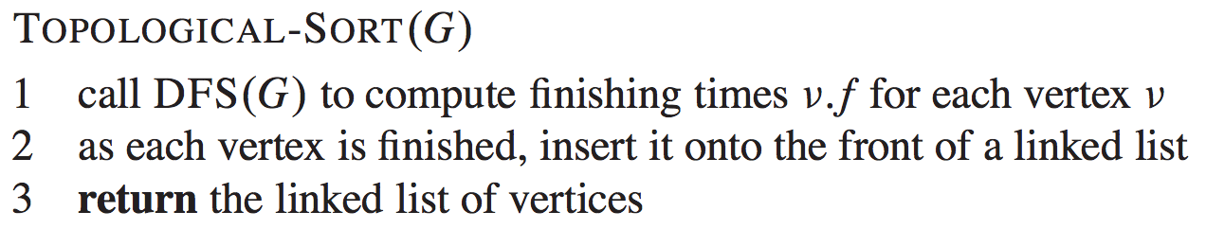
Topological Sort Algorithm
O(V+E)

Slide 44
Thinking Assignments
How to implement DFS using Stack
s

Slide 45
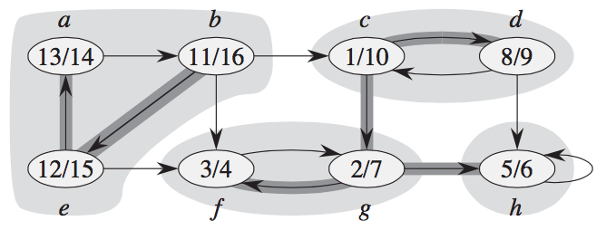
Strongly connected components
A strongly connected component of a directed graph G=(V,E) is a maximal set of vertices C in V such that for every pair of vertices u and v in C, we have both u -> v and v -> u; that is, vertices u and v are reachable from each other.

Slide 46
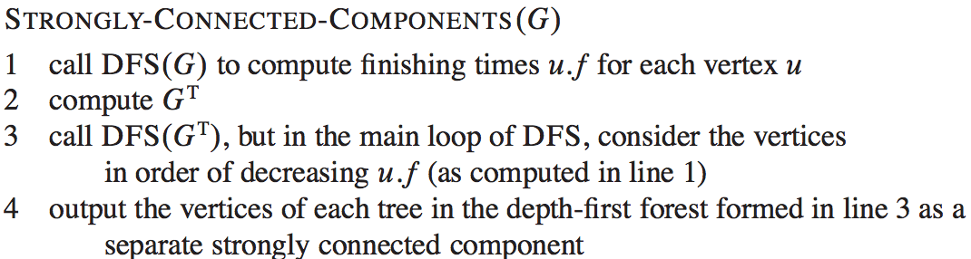
Strongly connected components

Slide 47
Transpose
The transpose of a directed graph G(V,E) is the graph G^{T}=(V,E^{T}), where G^{T} is G with all its edges reversed.
0 0 0 0 0 0
1 0 0 1 0 0
0 0 0 0 0 0
1 0 0 0 1 0
0 1 1 0 0 0
0 0 1 0 0 1

Slide 48
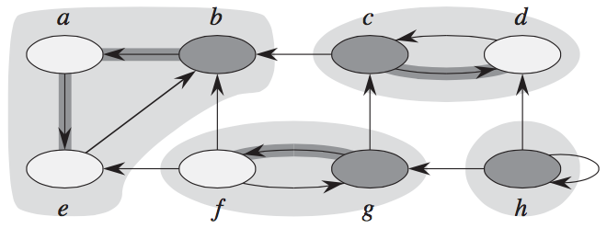
Example
Notes:
A one-way link as the example showing that it cannot find a strongly connected components by following the decreasing finishing time

Slide 49
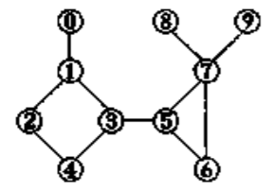
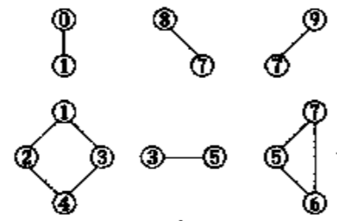
Bi-Connection Components
In a undirected graph, articulation point is the point, without which and associated edges, the graph is divided to more than one isolated components.

Slide 50
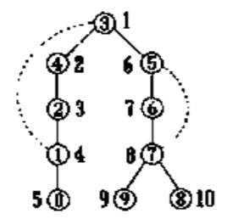
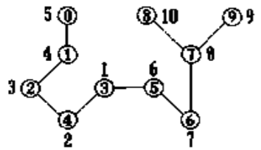
Bi-Connection Components
DFS traverse the graph and record the pre-order sequence number.

Slide 51
Sufficient and Necessary Conditions
For a root vertex, it has more than one children.
For any other vertex u, it has at least one child w that cannot go back to ancestor of u through w or w’s children.

