Slide 1
Chapter 23 & 24 Minimum Spanning Trees Single-Source Shortest Paths
Guangyu Zou
Dalian University of Technology
gyzou@dlut.edu.cn

Slide 2
Outline
Minimum Spanning Trees
Single-source Shortest Path

Slide 3
Minimum Spanning Tree
Electronic circuit designs often need to make the pins of several components electrically equivalent by wiring them together. To interconnect a set of n pins, we can use an arrangement of n - 1 wires, each connecting two pins. Of all such arrangements, the one that uses the least amount of wire is usually the most desirable.

Slide 4
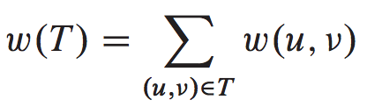
Mathematical Model of MST
Find an acyclic subset T 􏰑in E that connects all of the vertices and whose total weight
Since T is acyclic and connects all of the vertices, it must form a tree, which we call a spanning tree since it “spans” the graph G.
min
min

Slide 5
Two MST Algorithms
Kruskal’s algorithm
Prim’s algorithm

Slide 6
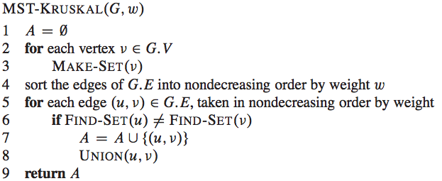
Kruskal’s algorithm

Slide 7
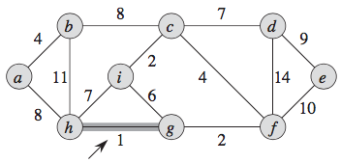
Example

Slide 8
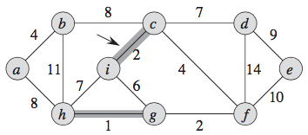

Slide 9
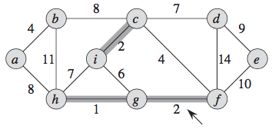

Slide 10
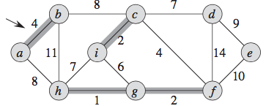

Slide 11
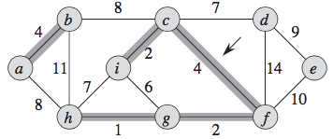

Slide 12
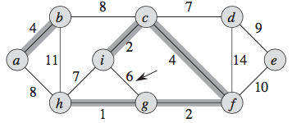

Slide 13
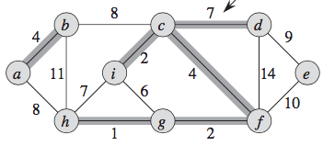

Slide 14
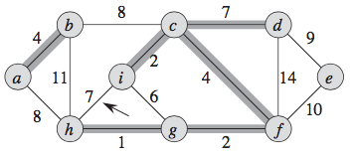

Slide 15
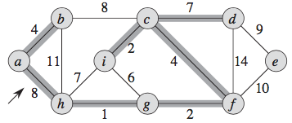

Slide 16
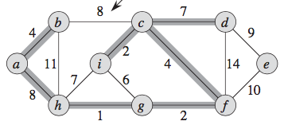

Slide 17
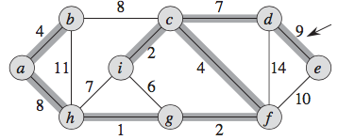

Slide 18
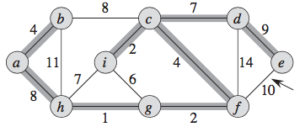

Slide 19
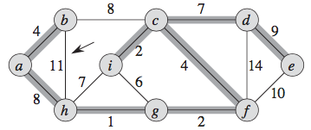

Slide 20
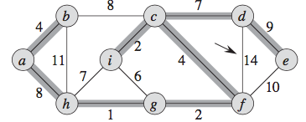

Slide 21
Complexity
O(V)
O(Elg(E))
O(E)
Total: O(Elg(E))

Slide 22
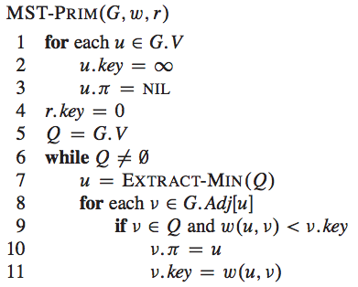
Prim’s algorithm

Slide 23
Priority queues
The heap data structure is not only used in sorting but also in priority queues. A priority queue is a data structure that maintain a set S of elements, each with an associated value call a key. Priority queues has many applications. A max (or min) priority queue should at least support the following operations:
Insert (S, x) O(log n)
Maximum/Minimum (S) O(1)
Extract-Max/Min (S) O(log n)
Increase-Key (S, x, k) O(log n)
Decrease-Key (S, x, k) O(log n)

Slide 24
Two Heap Operations
Heap-Extract-Max(A)
1 if heap-size[A] < 1
2 then error “heap underflow”
3 max ← A[1]
4 A[1] ←A[heap-size(A)]
5 heap-size(A) ← heap-size(A) - 1
6 Max-Heapify (A, 1)
7 return max
Heap-Maximum(A)
1 return A[1]
Thinking Assignment: Write Heap-Extract-Min(A)

Slide 25
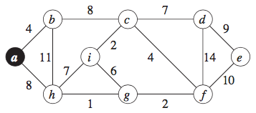
Example

Slide 26
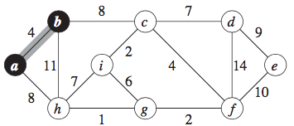

Slide 27
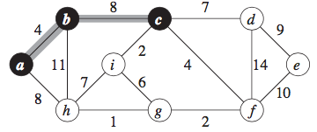

Slide 28
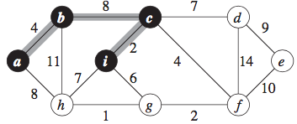

Slide 29
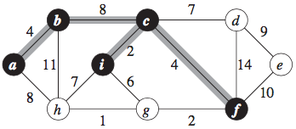

Slide 30
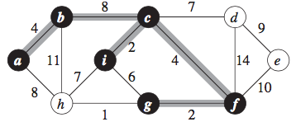

Slide 31
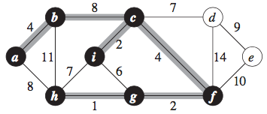

Slide 32
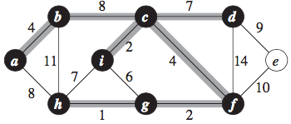

Slide 33
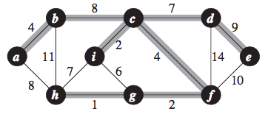

Slide 34
Complexity
O(V)
O(VlgV)
O(ElgV)
Total: O(ElgV)

Slide 35
Single Source Shortest Path
Given a road map on which the distance between each pair of adjacent intersections is marked, how can we determine this shortest route between Panjin and Beijing?
One possible way would be to enumerate all the routes from Panjin to Beijing, add up the distances on each route, and select the shortest.
For example, a route that passes through Harbin is obviously a poor choice.

Slide 36
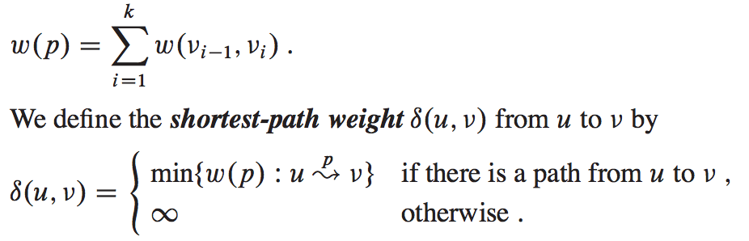
Shortest Path
In a shortest-paths problem, we are given a weighted, directed graph G(V,E) with weight function w: E→R mapping edges to real-valued weights. The weight w(p) of path is the sum of the weights of its constituent edges:

Slide 37
Variants
Single-destination shortest-paths problem: Find a shortest path to a given destination vertex t from each vertex 􏰍. By reversing the direction of each edge in the graph, we can reduce this problem to a single-source problem.
Single-pair shortest-path problem: Find a shortest path from u to v􏰍 for given vertices u and v􏰍. If we solve the single-source problem with source vertex u, we solve this problem also. Moreover, all known algorithms for this problem have the same worst-case asymptotic running time as the best single-source algorithms.
All-pairs shortest-paths problem: Find a shortest path from u to 􏰍v for every pair of vertices u and 􏰍. Although we can solve this problem by running a single- source algorithm once from each vertex, we usually can solve it faster. Additionally, its structure is interesting in its own right. Chapter 25 addresses the all-pairs problem in detail.

Slide 38
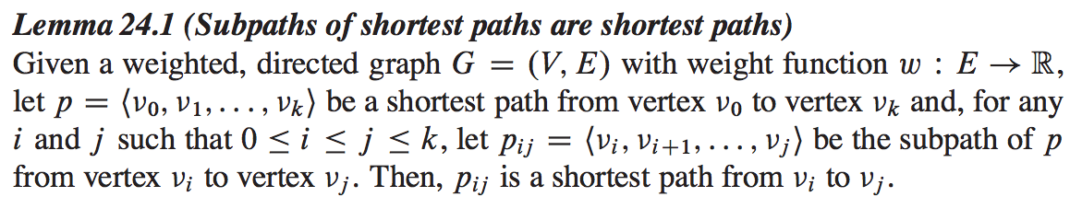
Optimal substructure of a shortest path

Slide 39
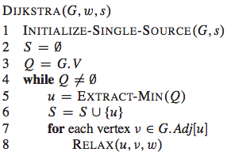
Dijkstra’s Algorithm

Slide 40
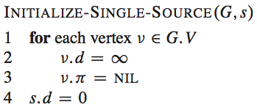
Dijkstra’s Algorithm

Slide 41
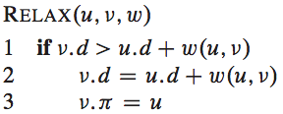
Dijkstra’s Algorithm

Slide 42
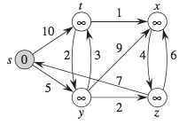
Dijkstra’s Algorithm

Slide 43
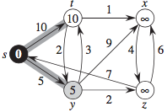
Dijkstra’s Algorithm

Slide 44
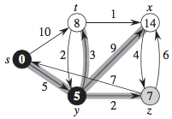
Dijkstra’s Algorithm

Slide 45
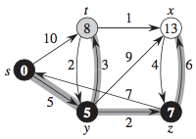
Dijkstra’s Algorithm

Slide 46
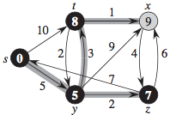
Dijkstra’s Algorithm

Slide 47
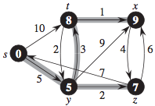
Dijkstra’s Algorithm

Slide 48
Complexity
O(V)
O(V)
O(lgV)
O(ElgV)
Total：O((V+E)lgV)

