Slide 1
Chapter 8 Sorting in Linear Time
Guangyu Zou
gyzou@dlut.edu.cn
Dalian University of Technology

Slide 2
Outline
Problems
Designing solution strategies
Developing algorithms
Writing algorithms that implement the strategies
Understand existing algorithms and modify/reuse
Understanding an algorithm by simulating its operation on an input
Ensuring/proving correctness
Analyzing and comparing performance/efficiency
Theoretically: Using a variety of mathematical tools
Empirically: Code, run and collect performance data
Choosing the best

Slide 3
Counting Sort
Counting sort assumes that each of the n input elements is an integer in the range 0 to k, for some integer k. When k = O(n), the sort runs in O(n) time.
Counting sort determines, for each input element x, the number of elements less than x. It uses this information to place element x directly into its position in the output array.

Slide 4
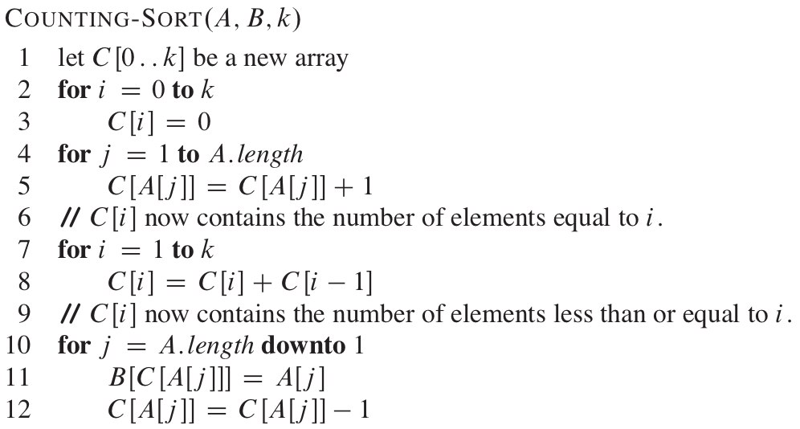
Pseudo Code

Slide 5
Questions
Can we iterate Array A from the beginning to the end?
The sequence after counting sort is sorted.
But it eliminates the property of stable.
Stable: numbers with the same value appear in the output array in the same order as they do in the input array.

Slide 6
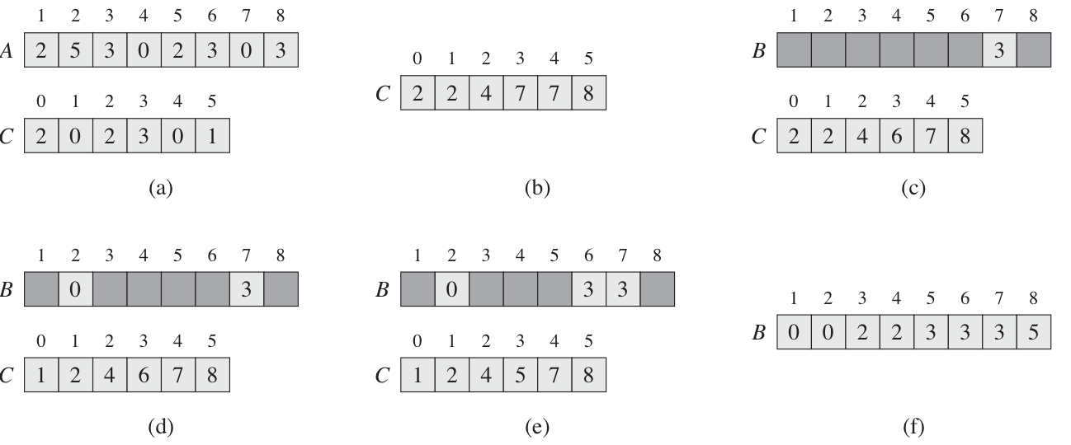
Operational Example

Slide 7
Issues
The max value in the array is extremely large.
The number of duplicates is extremely large.

Slide 8
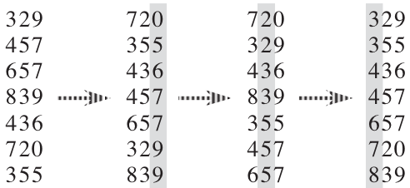
Radix sort

Slide 9
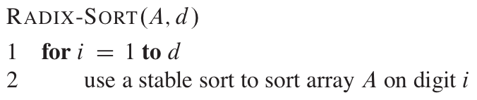
Pseudo Code

Slide 10
Digits Operations
How to get the lowest digit of a decimal?
X % 10
How to get the ith digit of a decimal?
X/10^{i-1} % 10
How to get the lowest digit of a binary?
X & 1
How to get the ith digit of a binary?
X >> i & 1

Slide 11
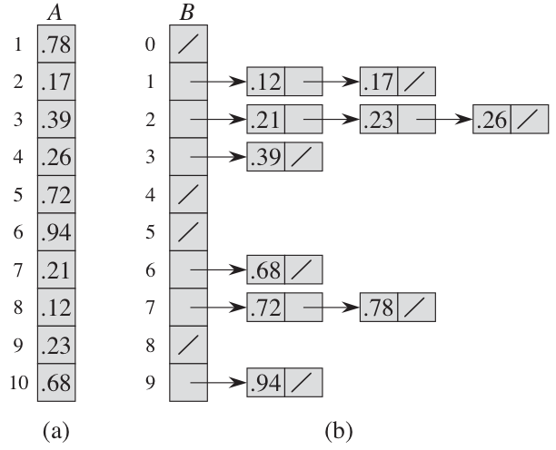
Bucket Sort

Slide 12
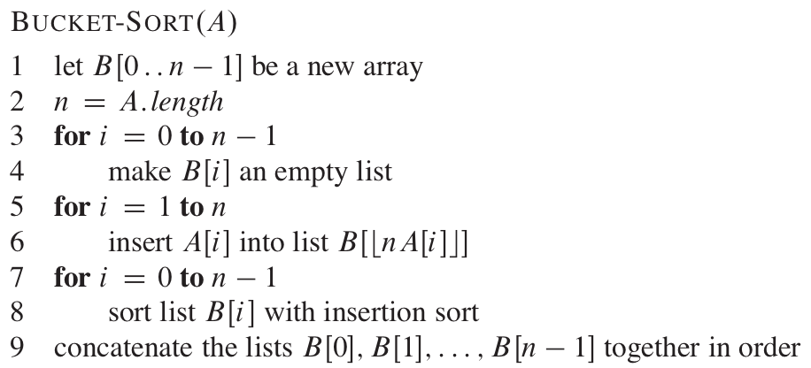
Bucket Sort

