Slide 1
Chapter 3 Growth of Functions
Guangyu Zou
gyzou@dlut.edu.cn
Dalian University of Technology

Slide 2
Outline
Problems
Designing solution strategies
Developing algorithms
Writing algorithms that implement the strategies
Understand existing algorithms and modify/reuse
Understanding an algorithm by simulating its operation on an input
Ensuring/proving correctness
Analyzing and comparing performance/efficiency
Theoretically: Using a variety of mathematical tools
Empirically: Code, run and collect performance data
Choosing the best

Slide 3
Asymptotic upper bound

Slide 4
Asymptotic tight upper bound

Slide 5
Asymptotic notation
⇒ g(n) is an asymptotic tight bound for f(n).

Slide 6
Big Theta Notation Asymptotically tight bound

Slide 7
Example:

Slide 8
Example:
In general,

Slide 9
Asymptotic lower bound

Slide 10
Asymptotically tight lower bound

Slide 11
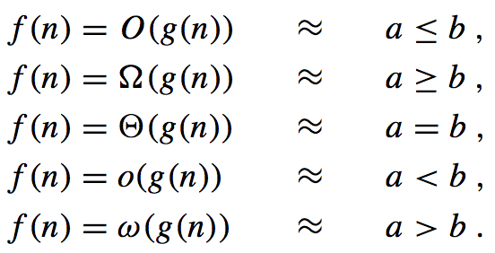
Analogy

Slide 12
Theorem 3.1
For any two functions f(n) and g(n), if and only if and .

Slide 13
Comparing functions
Transitivity
Reflexivity
Symmetry

Slide 14
Comparing functions
Transpose symmetry

Slide 15
Standard notations and common functions
Monotonicity:
A function f is monotonically increasing if m ≤ n implies f(m) ≤ f(n).
A function f is monotonically decreasing if m ≤ n implies f(m) ≥ f(n).
A function f is strictly increasing if m < n implies f(m) < f(n).
A function f is strictly decreasing if m < n implies f(m) > f(n).

Slide 16
Floor and ceiling

Slide 17
Modular
For any integer a and any positive integer n, the value a mod n is the remainder (or residue) of the quotient a/n :
a mod n =a -⎣a/n⎦n.
If(a mod n) = (b mod n). We write a ≡ b (mod n) and say that a is equivalent to b, modulo n.
We write a ≢ b (mod n) if a is not equivalent to b modulo n.

Slide 18
Logarithms
A function f(n) is polylogarithmically bounded if f(n)=O(lg^{k}n)
for any constants a,b > 0.
Any positive polynomial function grows faster than any polylogarithmic function.

Slide 19
Polynomials vs. Exponentials
Polynomials:
A function f is polynomially bounded if f(n)=O(n^{k}).
Exponentials:
Any exponential function with a base greater than 1 (e.g. c^{n} where c>1) grows faster than any polynomial function n^{b}, where b and c are constants.

Slide 20
Factorials

Slide 21
Basic efficiency classes
2**n exponential
n*2 quadratic
n*3 cubic
n^{n}
n* log n n-logn
n linear
log n logarithmic
n! factorial
1 constant
1 constant
log n logarithmic
n linear
n* log n n-logn
n*2 quadratic
n*3 cubic
2**n exponential
n! factorial
n^{n}

Slide 22
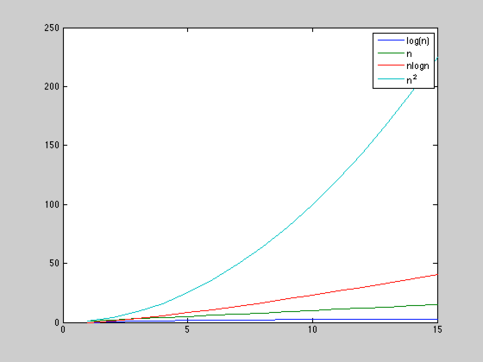

Slide 23
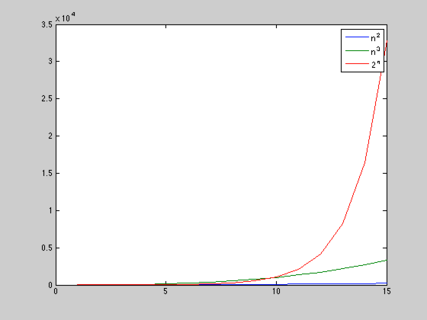

Slide 24
