Slide 1
Chapter 4 Divide and Conquer
Guangyu Zou
gyzou@dlut.edu.cn
Dalian University of Technology

Slide 2
Outline
Problems
Designing solution strategies
Developing algorithms
Writing algorithms that implement the strategies
Understand existing algorithms and modify/reuse
Understanding an algorithm by simulating its operation on an input
Ensuring/proving correctness
Analyzing and comparing performance/efficiency
Theoretically: Using a variety of mathematical tools
Empirically: Code, run and collect performance data
Choosing the best

Slide 3
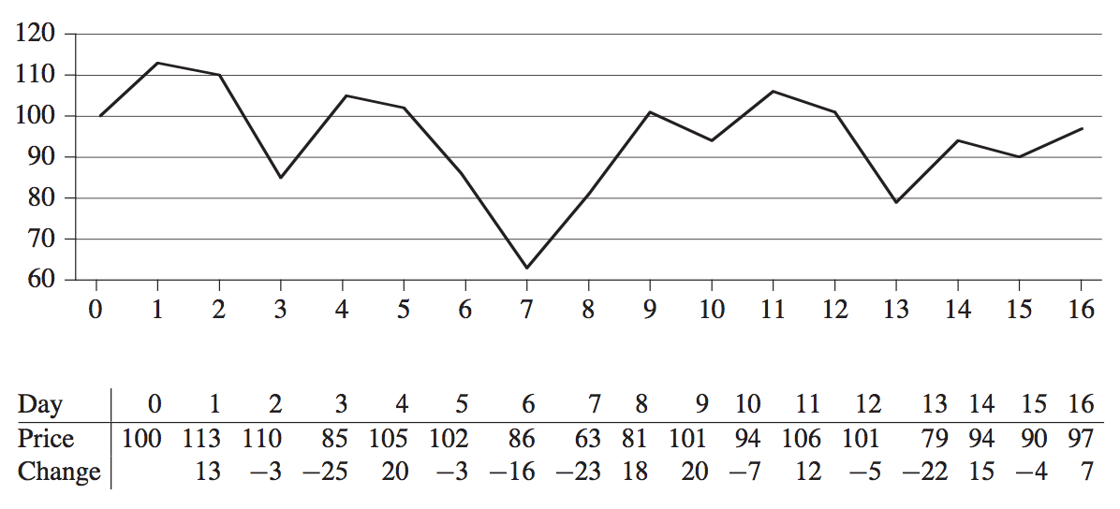
Maximum Subarray

Slide 4
Maximum Subarray
Brutal Force
Divide and Conquer
entirely in the left subarray
entirely in the right subarray
Crossing the middle point

Slide 5
Brutal Force
int MaxSubArrayBrutal(int A[], int n) {
int ret = INT32_MIN;
for (int i = 0; i < n-1; ++i)
for (int j = i+1; j < n; ++j)
ret = fmax(ret, SumSubArray(A, i, j));
return ret;
}
int SumSubArray(int A[], int begin, int end) {
int ret = 0;
for (int i = begin; i <= end; ++i)
ret += A[i];
return ret;
}

Slide 6
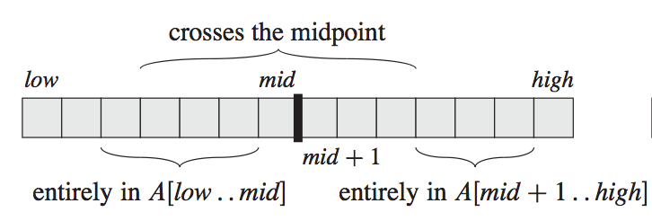
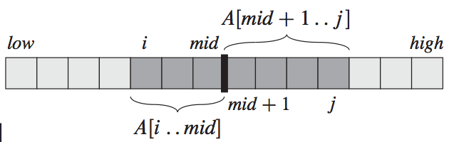
Maximum subarray

Slide 7
Maximum Subarray

Slide 9
MaxSubArray findMaxSubArray (int A[], int low, int high) {
MaxSubArray result;
if (low == high) {
result.low = low;
result.high = high;
result.sum = A[low];
}
else {
int mid = (low + high) / 2;
MaxSubArray leftResult = findMaxSubArray(A, low, mid);
MaxSubArray rightResult = findMaxSubArray(A, mid+1, high);
MaxSubArray midResult = findMaxCrossingSubArray(A, low, mid, high);
if (leftResult.sum > rightResult.sum
&& leftResult.sum > midResult.sum)
result = leftResult;
else if (rightResult.sum > leftResult.sum
&& rightResult.sum > midResult.sum)
result = rightResult;
else
result = midResult;
}
return result;
}
struct MaxSubArray
{
int low;
int high;
int sum;
};

Slide 10
MaxSubArray findMaxCrossingSubArray (int A[], int low, int mid, int high) {
MaxSubArray result;
int leftSum = INT32_MIN;
int sum = 0;
for (int i = mid; i >= low; i--) {
sum += A[i];
if (sum >= leftSum) {
leftSum = sum;
result.low = i;
}
}
sum = 0;
int rightSum = INT32_MIN;
for (int i = mid + 1; i <= high; ++i) {
sum += A[i];
if (sum >= rightSum) {
rightSum = sum;
result.high = i;
}
}
result.sum = leftSum + rightSum;
return result;
}

Slide 11
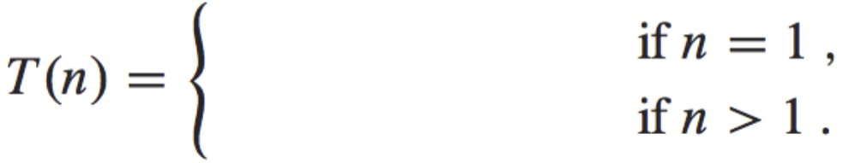


Complexity

Slide 12
Complexity Analysis of Recursive Algorithms
Analysis of divide and conquer algorithms (e.g. mergesort) often creates expressions that have a recursive component.
The equation that describes these functions is called a recurrence relation

Slide 13
Dynamic Programming
Dynamic programming is a method for solving a complex problem by breaking it down into a collection of simpler subproblems. (Chapter 15)
Overlapping subproblems
Optimal substructure
Divide & Conquer is a strategy that solves a problem by combining optimal solutions to non-overlapping subproblems.

Slide 14
Maximum Subarray
Optimal substructure
D[i] = Max(D[i-1] + A[i], A[i])
D[i] is the maximum sum until index i
A[i] is the ith element in array A

Slide 15
Maximum Subarray DP V1
No. | 1 | 2 | 3 | 4 | 5 | 6 | 7 | 8 | 9 | 10 | 11 | 12 | 13 | 14 | 15 | 16
Change | 13 | -3 | -25 | 20 | -3 | -16 | -23 | 18 | 20 | -7 | 12 | -5 | -22 | 15 | -4 | 7
DP | 13 | 10 | -15 | 20 | 17 | 1 | -22 | 18 | 38 | 31 | 43 | 38 | 16 | 31 | 27 | 34
int MaxSubArrayDP(int A[], int n) {
int* dp = new int[n];
dp[0] = A[0];
int ret = dp[0];
for (int i = 1; i < n; ++i) {
dp[i] = fmax(dp[i-1] + A[i], A[i]);
ret = fmax(dp[i], ret);
}
delete[] dp;
return ret;
}
Time
O(n)
Space
O(n)
Are there any ways to reduce the space cost?
How to get the starting and the ending index of the maximum subarray?

Slide 16
Best Time to Buy and Sell Stock
#121 at https://leetcode.com Difficulty: medium
Say you have an array for which the ith element is the price of a given stock on day i.
If you were only permitted to complete at most one transaction (ie, buy one and sell one share of the stock), design an algorithm to find the maximum profit.

Slide 17
Best Time to Buy and Sell Stock
Buy at the lowest point and then sell at the highest point.

Slide 18
Best Time to Buy and Sell Stock
int maxProfit(int prices[], int n) {
int preLow = prices[0];
int ret = INT32_MIN;
for (int i = 1; i < n; ++i) {
ret = fmax(ret, prices[i] - preLow);
preLow = fmin(preLow, prices[i]);
}
return ret;
}

Slide 19
Thinking Assignments
What if at most 2 transactions are allowed in the problem of best time to buy/sell stock?
How to generalize the solution with at most k transactions allowed?

Slide 20
Fibonacci numbers
F₀ = 1; F₁ = 1; F_{n} = F_{n-1}+F_{n-2}
Fib (n: integer)
1 if n<0 then
2 error
3 else if n=0 or 1 then
4 return 1
5 else return Fib(n-1)+Fib(n-2)

Slide 21
What do we do?
Develop a pair of equations (called “recurrences” or “recurrence relations”) that characterize the behavior of a recursive algorithms and solve those to obtain the algorithm’s complexity.

Slide 22
Develop Recurrence Relations
Determine what the base case(cases) is (are).
Determine steps that will be executed when the input size matches the base case(s).
Calculate the complexity of those steps.
Write the first part of the RR as T(base case input sizes) = what you calculated

Slide 23
Develop Recurrence Relations
Determine steps that will be executed when the input size is n, different from the base case(s).
Determine how many recursive calls (and with what input size in relation to the original input size of n) will be made.
Calculate the complexity of those steps, excluding the recursive calls.
Write the second part of the RR as T(n) = T(input size for first recursive call) + T(input size for next recursive call) +…+complexity of other steps.

Slide 24
Recursive algorithm example
T(n)= c₁ when n < 2
T(n)=T(n-1)+T(n-2)+c₂ otherwise
Fib (n: integer)
1 if n<0 then
2 error
3 else if n=0 or 1 then
4 return 1
5 else return Fib(n-1)+Fib(n-2)

Slide 25
Solving Recurrences
Recursion-tree method
Master method
Substitution method
Changing variables method
Backward substitution method
Forward substitution method

Slide 26
Divide & Conquer Algorithms
Recursive algorithms that reduce the input size each time by a factor & apply itself to these smaller inputs until the base case is reached
Example: Merge Sort

Slide 27
Recurrence relations of Merge Sort

Slide 28
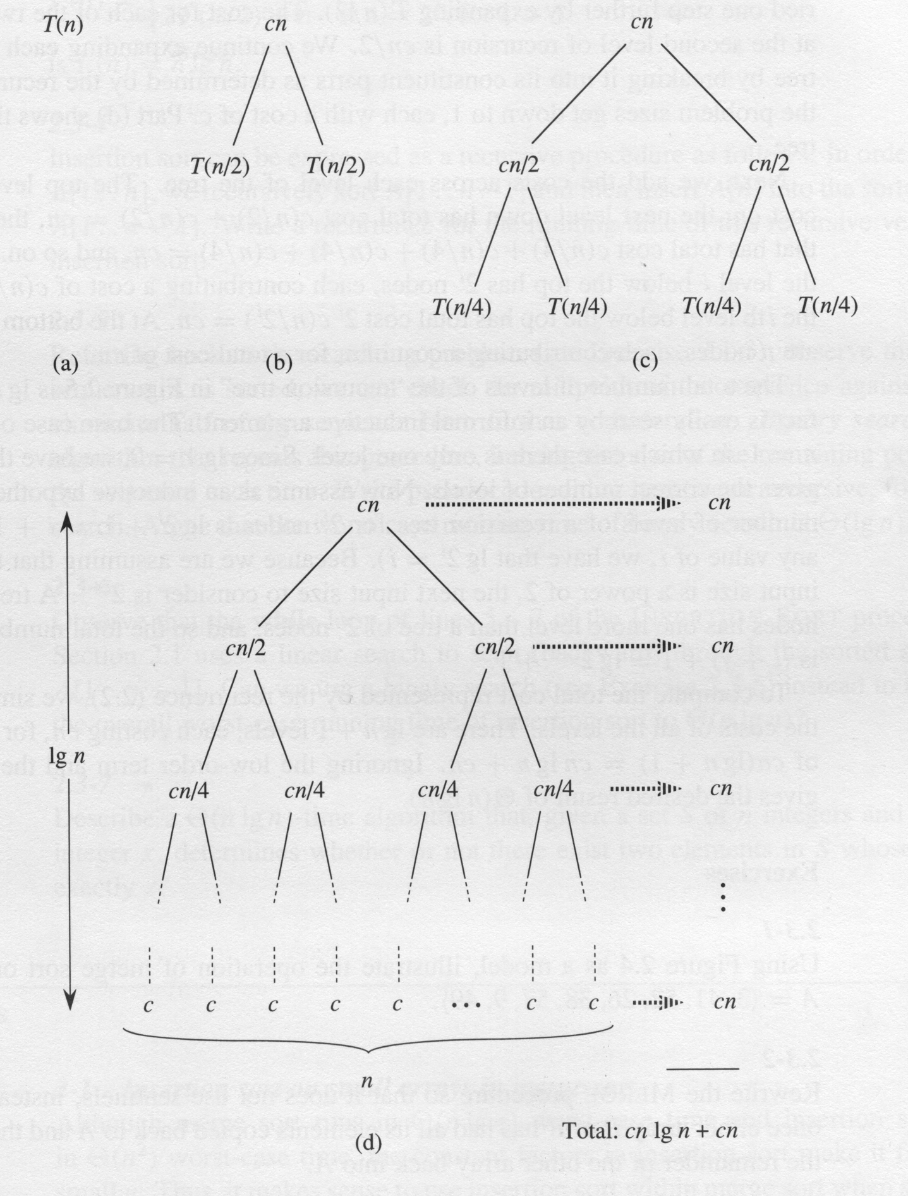
Recursion Tree
O(nlgn)

Slide 29
Analysis of Merge Sort

Slide 30
D & C Algorithms
General form of divide-and-conquer algorithm recurrences
Recursion tree method can be used to solve these kinds of recurrences, like we did for Merge Sort

Slide 31
Another Example
Suppose a divide-and-conquer algorithm has these recurrences

Slide 32
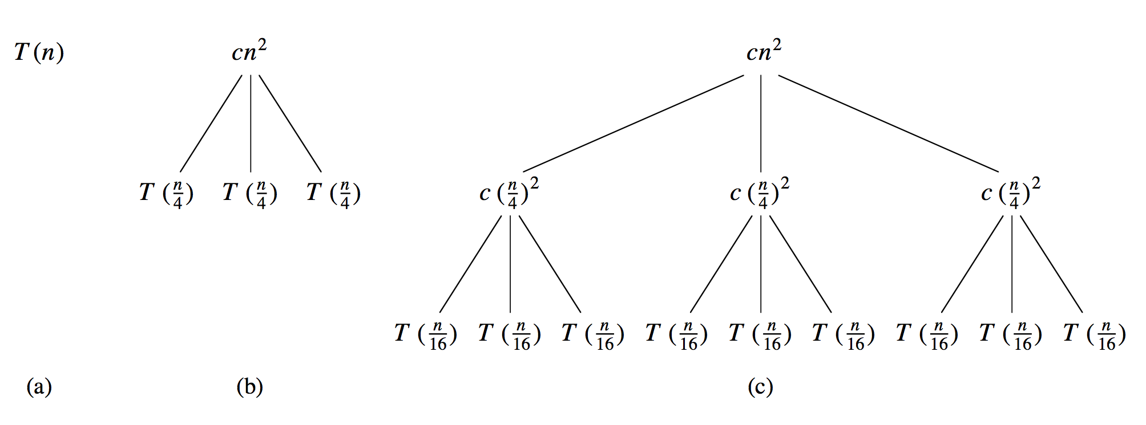
Recursion-tree method

Slide 33
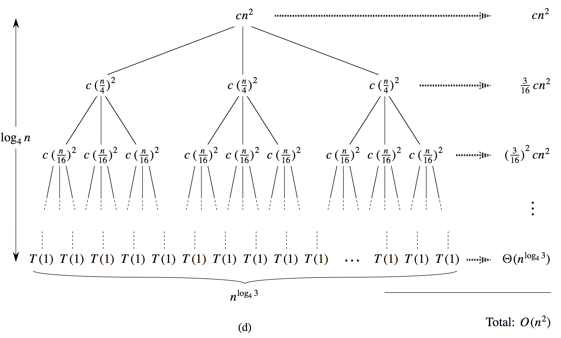

Slide 34
The cost of the entire tree

Slide 35
The master method
Theorem 4.1 (pp. 53)
Learn how to apply
Omit proofs (Section 4.6)

Slide 36
The Master Theorem
If T(n)=aT(n/b) + f(n) (and T(base case)=some constant) and a and b are constants, then:

Slide 39
When master method doesn’t apply
The master method does not apply to the recurrence
even though it has the proper form: a = 2, b=2, f(n)= n lgn, and It might seem that case 3 should apply, since f(n)= nlgn is asymptotically larger than
The problem is that it is not polynomially larger.

Slide 40
The substitution method
The substitution method for solving recurrence entails two steps:
Guess the form of the solution.
Use mathematical induction to find the constants and show that the solution works.
If the inductive step of the proof fails, your guess is probably wrong.

Slide 41
How do you guess?
1. If a recurrence is similar to one you have seen, guess a similar solution.
2. Draw the recursion tree to get an idea of what the solution might be.
3. Trial and error.

Slide 42
Example of (1)
Guess
Now show

Slide 43
Base case
However,

Slide 44
Now Assume
We have to show

Slide 45
Example of (2)
Guess a solution using the recursion tree method
Then prove that it is correct

Slide 47
We need to prove by induction that
Base case

Slide 48
Now Assume
We have to show

Slide 49
Subtleties
Guess
Show
Base Case: works
Assume
Inductive Step

Slide 50
Instead, show
I.e., assume
Then

Slide 51
Avoiding pitfalls
Guess
Works for the base case: T(1)<=c*1,c=1
Show
Assume
You cannot find such a positive constant.
This is an example of inductive proof failure suggesting that your guess is WRONG

Slide 52
Another example
T(n)=3T(⎣n/4⎦) + cn², T(1) = c
Guess T(n)=O(n²)
We want to show that T(n) ≤ dn² for some constant d > 0. Works for the base case (why?) . So assume T(n/4) ≤ d(n/4)²

Slide 53
Changing variables method

Slide 54
Method of backward substitutions
Start with the recurrence relation for T(n), and repeatedly expand its right hand side by substituting for the T terms. After several such expansions, look for and find a pattern that allows you to express T(n) as a closed-form formula. If such a formula is evident, confirm its validity by direct substitution into the recurrence relations.

Slide 55
T(n)=T(n-1)+n; T(0)=1
T(n-1)=T(n-2)+(n-1)
So T(n)=T(n-2)+n+(n-1)
T(n-2)=T(n-3)+(n-2)
So T(n)=T(n-3)+n+(n-1) +(n-2)
T(n-3)=T(n-4)+(n-3)
So T(n)=T(n-4)+n+(n-1) +(n-2)+(n-3)
Eventually, T(n)=T(n-n)+n+(n-1) +(n-2)+(n-3)+
…+(n-(n-1))=T(0)+n+(n-1)+(n-2)+(n-3)+…+1

Slide 56
Method of forward substitutions
Start with the recurrence relation for T(base case), and repeatedly calculate non-base cases, e.g., T(1), T(2) etc. After several such calculations, look for and find a pattern that allows you to express T(n) as a closed-form formula. If such a formula is evident, confirm its validity by direct substitution into the recurrence relations.

Slide 57
T(n)=T(n-1)+1; T(0)=1
T(1)=T(0)+1=1+1=2
T(2)=T(1)+1=2+1=3
T(3)=T(2)+1=3+1=4
T(4)=T(3)+1=4+1=5
T(5)=T(4)+1=5+1=6
…
T(n)=n+1

Slide 58
Complexity of Recursive Algorithms
First develop the recurrences from the algorithm
Then solve them
Recursion tree method
Master method
Substitution method
Changing variables method
Backward substitution method
Forward substitution method

Slide 59
Summary
We have discussed several tools and techniques for mathematically determining the complexity of algorithms:
For non-recursive algorithms, calculate T(n) by adding up the (cost * # of executions) of each step
For recursive algorithms, develop the recurrence relations and solve them using a variety of techniques to obtain T(n)
Once you obtain an exact expression for T(n) [or through various approximations an upper or lower bound for T(n)] as a function of n, then you can determine the order of complexity of the algorithm.

Slide 60
Empirical Complexity
Another approach is to determine T(n) by plotting it as a graph of actual time taken by the algorithm versus input size by:
Coding the algorithm in a programming language
Randomly generating inputs of different sizes: typically from small sizes up to 100K’s or millions
Running the program on each of these inputs and measuring the time taken using the system clock
Plotting time against input size
Determining the appropriate g(n) that fits this graph or provides an upper or lower bound
This function g will then give you the order of complexity of the algorithm

