Slide 1
Chapter 7 Quicksort
Guangyu Zou
gyzou@dlut.edu.cn
Dalian University of Technology

Slide 2
Outline
Problems
Designing solution strategies
Developing algorithms
Writing algorithms that implement the strategies
Understand existing algorithms and modify/reuse
Understanding an algorithm by simulating its operation on an input
Ensuring/proving correctness
Analyzing and comparing performance/efficiency
Theoretically: Using a variety of mathematical tools
Empirically: Code, run and collect performance data
Choosing the best

Slide 3
Description of quicksort
Divide
Conquer
Combine

Slide 4

Tony Hoare
British computer scientist, born 11 January 1934.
Develop quicksort, Hoare logic, and Communicating Sequential Processes.
Experiences
Classics and Philosophy at Merton College, Oxford, 1956
PhD. Moscow State University, 1960
Prof at Queen's University Belfast
Prof at University of Oxford
Honors
ACM Turing Award, 1980
Fellow of the Royal Society, 1982
Knighted for services to education and computer science, 2000
IEEE John von Neumann Medal, 2011

Slide 5
Pseudocode

Slide 6
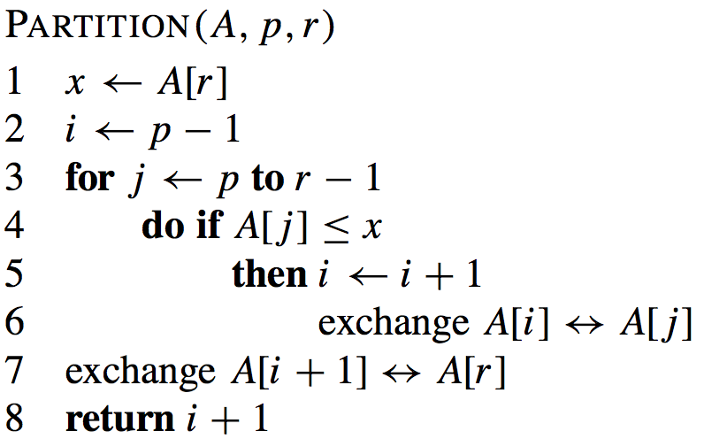
QuickSort

Slide 7
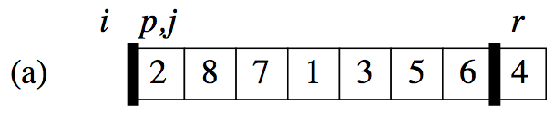
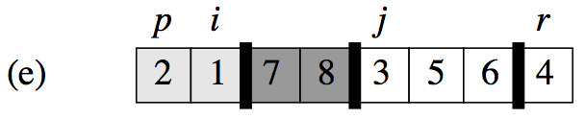
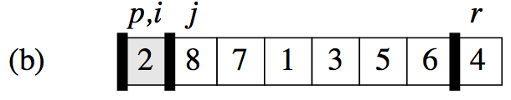
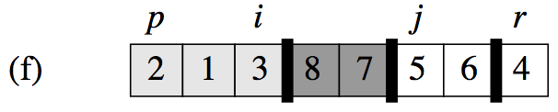
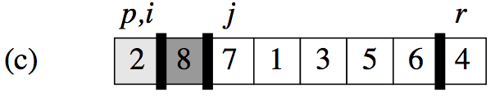
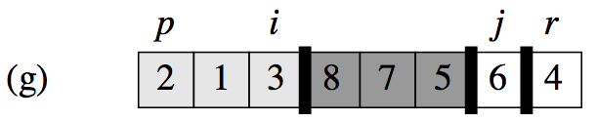
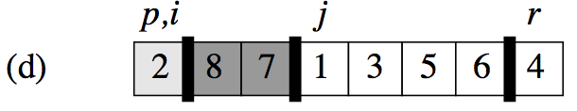
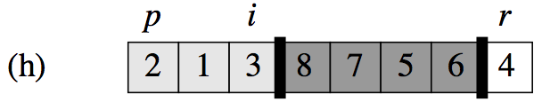
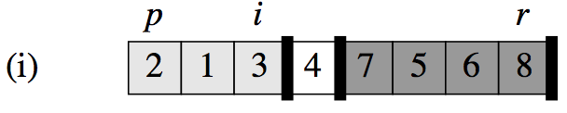
Example

Slide 8
Correctness
LI（Loop Invariant）
Find a suitable LI
Initialization：It is true prior to the first iteration of the loop.
Maintenance: If it is true before an iteration of the loop, it remains true before the next iteration.
Termination: When the loop terminates, the invariant gives us a useful property that helps show that the algorithm is correct.

Slide 9
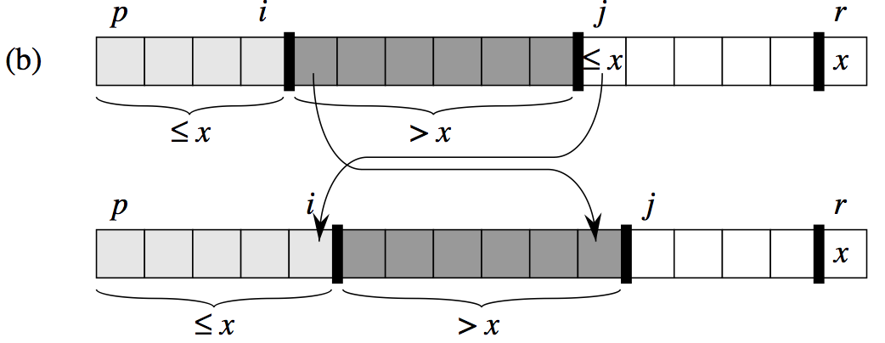
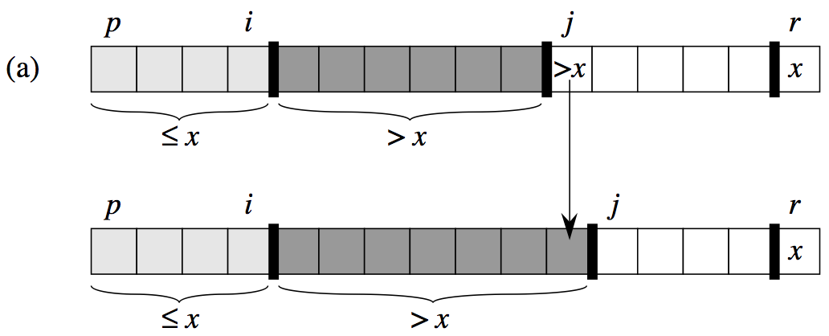
Correctness
LI：The numbers between p and i are lower than or equal to the pivot, while all numbers between i＋1 and j－1 are greater than the pivot.
Initialization：Before the first iteration, it is empty between p and i, as well as between i＋1 and j－1. LI Holds。
Maintenance
Termination：j＝r，the numbers between p and i are lower than or equal to the pivot, while all numbers between i＋1 and j－1 are greater than the pivot.

Slide 10
Complexity
Partition on A[p…r] is Θ(n) where n = r –p +1
T(n) = T(size of left partition) + T(size of right partition) + Θ(n)
T(1) = Θ(1)
What are the possibilities for the partition sizes?

Slide 11
Quicksort Recurrences
Worst Case
T(n) = T(0) + T(n-1) + Θ(n)
= T(n-1) + Θ(n)
= T(n-1) + cn
T(1) = Θ(1) = c
You can easily show by backward substitution method (do this as an exercise to improve your skills) that these recurrences have the solution T(n) = Θ(n²)
This is the worst case partitioning!
Can you think of an input that will produce this kind of partition in every recursive call?

Slide 12
Quicksort Recurrences
Partitioning can also divide the array equally: one partition of size floor(n/2) and the other of size ceiling(n/2)-1
T(n) ≤ 2T(n/2) + Θ(n)
T(1) = Θ(1)
You can easily show by applying the master method case 2 (do this as an exercise to improve your skills) that if T(n) = 2T(n/2) + Θ(n) then T(n) = Θ(nlgn) . So in this case Quicksort is O(nlgn)
This is the best case partitioning. In fact, the split doesn’t have to be 50-50. This complexity holds whenever the split is of constant proportionality.

Slide 13

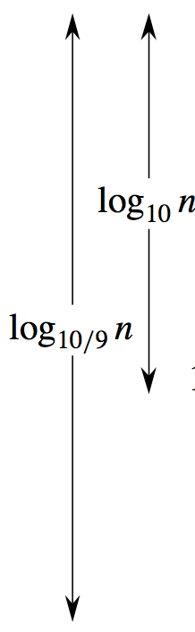
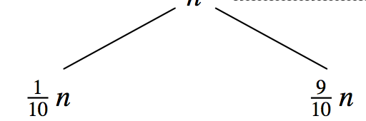
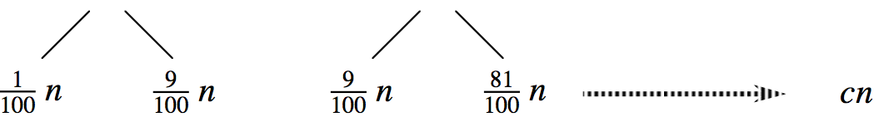
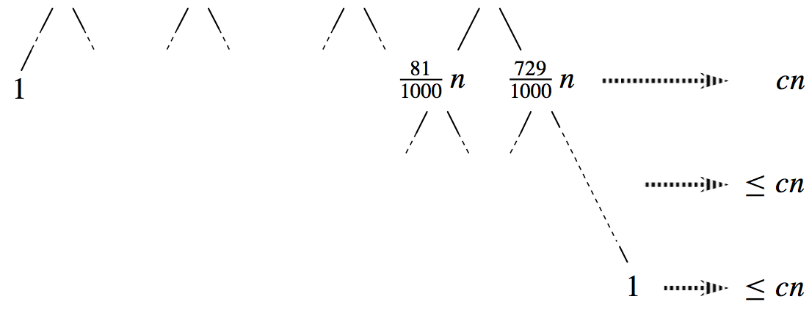

Recursive Tree

Slide 14
Average Case Performance
Good and bad splits tend to balance out in practice (see p. 103)
So the average performance of quicksort is also O(nlgn)
To get this balance, in practice we don’t pick A[r] as the pivot; instead a median-of-three approach is used to pick the pivot.

Slide 15
Random Sampling
Another way to make sure of random distribution of good and bad splits is to choose randomly so that any of the r-p+1 elements in the array has an equal chance of being picked.

Slide 16
Randomized Quicksort
Randomized-Partition (A,p,r)
i←Random(p,r)
Exchange A[r] ↔ A[i]
Return Partition(A,p,r)
Modify quicksort to call this partition procedure

Slide 17
Thinking Assignments
Prove the correctness of Partition using mathematical induction.
Rewrite QuickSort using loops.
Prove the correctness of QuickSort using LI.

