Slide 1
Chapter 10.1 Stacks and queues
Guangyu Zou
gyzou@dlut.edu.cn
Dalian University of Technology

Slide 2
Outline
Problems
Designing solution strategies
Developing algorithms
Writing algorithms that implement the strategies
Understand existing algorithms and modify/reuse
Understanding an algorithm by simulating its operation on an input
Ensuring/proving correctness
Analyzing and comparing performance/efficiency
Theoretically: Using a variety of mathematical tools
Empirically: Code, run and collect performance data
Choosing the best

Slide 3
Definition of Data Structure
Data Structures: The way data is organized in a computer to facilitate access and modification.
Commonly-used data structures (Container)
Stack, Queue, Heap, Linked list, Binary tree, Hash table, Binary search tree, Graph, Red black tree

Slide 4
Fundamental Data Structures
Point
struct Point
{
double x;
double y;
};
template <class T>
class Point
{
public:
T x;
T y;
};

Slide 5
Fundamental Data Structures
Array
Pros
Access any specific element in O(1)
Cons
Fixed size
Search in low efficiency

Slide 6
Fundamental Data Structures
Vector
Pros
Access any specific element in O(1)
Dynamically adjust size
Cons
Search in low efficiency

Slide 7
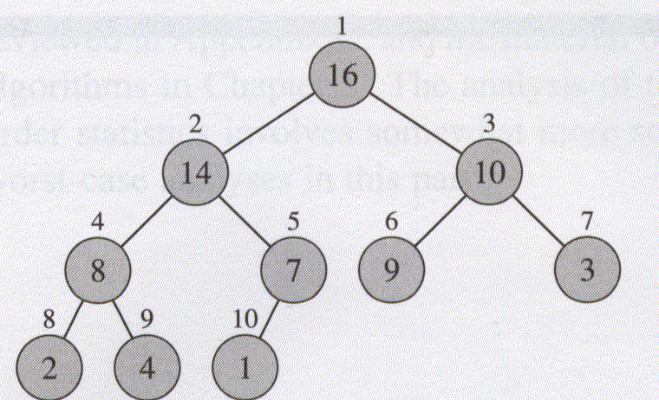
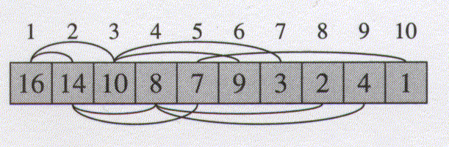
Fundamental Data Structures
Heap
Pros
Get the max/min in O(1)
Dynamically adjust size
Cons
Search in low efficiency

Slide 8
Fundamental Data Structures
Stack
last-in, first-out, or LIFO
Push
Pop
Queue
first-in, first-out, or FIFO,
Enqueue
Dequeue

Slide 9
Stack
Top
5
Top
4
Top
Push
3
Pop
Top
2
Top
1
Top

Slide 10
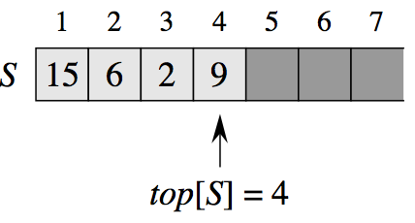
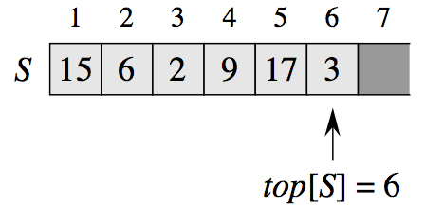
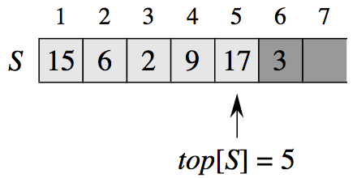
Stacks
Implement a stack using an array

Slide 11
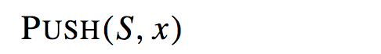


Push
Any problems?
Overflow

Slide 12
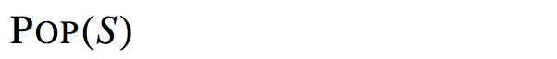

Pop

Slide 13
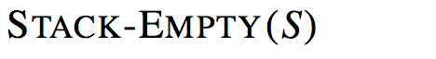



Stack-empty

Slide 14
C++ Implementation
class CStack
{
public:
CStack(int arg)
{
size = arg;
topIndex = -1;
}
~CStack()
{
}
private:
int size;
int topIndex;
vector<int> elements;
};

Slide 15
Performance
All stack operations can be implemented in O(1) time.
Two common ways to actually implement this data structure:
use an array
use a linked list
Why two?
Tradeoffs?

Slide 16
Queue
Tail
Head
5
Tail
Head
4
Tail
Head
Enqueue
3
Dequeue
Tail
Head
2
Tail
Head
1
Tail
Head

Slide 17
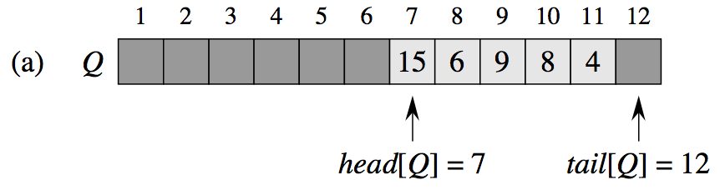
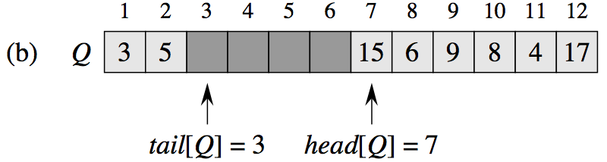
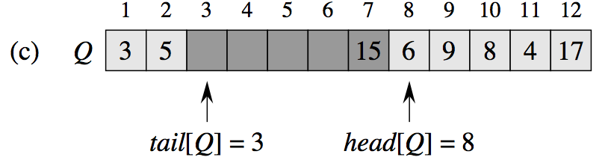
Queue
Implement a queue using an array

Slide 18
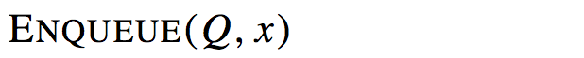



Enqueue

Slide 19
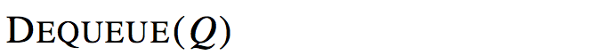




Dequeue

Slide 20
C++ Implementation
class CQueue {
private:
vector<int> elements;
int head;
int tail;
int size;
public:
CQueue(int arg) {
head = tail = 0;
size = arg;
}
~CQueue() {
}

Slide 21
Implement a queue using stacks
How to implement a queue using two stacks
Tail <- Enqueue
5
4
3
2
Head <- Dequeue
1
Inbox
Outbox
Queue

Slide 22
Algorithm I using stacks to implement a queue
Enqueue
Push to stack Inbox
Dequeue
If Outbox is empty
Push all elements of Inbox to Outbox, then pop from Outbox
Otherwise
Pop from Outbox

Slide 23
Complexity
Enqueue
Θ(1)
Dequeue
Worst case O(n)
Best case Θ(1)

Slide 24
Further Thinking
Improve the performance of dequeue to Θ(1)
Tail <- Enqueue
Head <- Dequeue
3
2
1
In_outbox
Auxiliary
Queue

Slide 25
Algorithm II using stacks to implement a queue
Enqueue
Push all elements of InOutbox to Auxiliary
Push the new element to InOutbox
Push all elements of Auxiliary to InOutbox
Dequeue
Pop from InOutbox

Slide 26
Complexity
Enqueue
O(n)
Dequeue
Θ(1)

Slide 27
Implement a stack using two queues
Tail
Tail
4
3
2
1
Head
Head
Queue1
Queue2
Stack

Slide 28
Algorithm I using two queues to implement a stack
Push
Insert the new element to the non-empty queue
Pop
Insert the first n-1 elements of non-empty queue to the second queue
Dequeue the n-th element

Slide 29
Complexity
Push
Θ(1)
Pop
O(n)

Slide 30
Further Thinking
Improve the performance of pop to Θ(1)
Tail
Tail
2
3
1
Head
Head
Queue1
Queue2
Stack

Slide 31
Algorithm II using two queues to implement a stack
Push
Insert all elements of queue 1 to queue 2
Enqueue the new element to queue1
Insert all elements of queue 2 back to queue 1
Pop
Dequeue from queue1

Slide 32
Complexity
Push
O(n)
Pop
Θ(1)

Slide 33
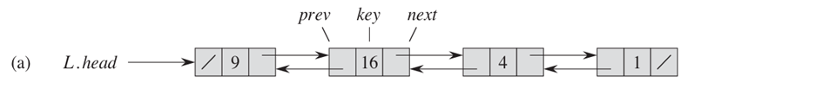
LinkedList

Slide 34





Searching a linked list

Slide 35






Inserting into a linked list

Slide 36





Deleting from a linked list
How to delete a node with key equal x?

Slide 37
Sentinels -- A circular, doubly linked list

Slide 38



LIST-DELETE
x
L.nil
x.prev
x. next.prev =x.prev
x.next
P
0
N
P
1
N
P
2
N
P
3
N
x.prev.next=x.next

Slide 39




LIST-SEARCH

Slide 40





LIST-INSERT
x.prev=L.nil
x
L.nil.next.prev = x
L.nil
P
0
N
P
1
N
P
2
N
P
3
N
L.nil.next=x
x. next = L.nil.next

Slide 41
Thinking Assignments
How to insert a node to a specific position rather than to the beginning of a linked list?
List_insert(L, cur, x)
cur
x.prev=cur
x
cur.next.prev = x
cur.next
L.nil
P
0
N
P
3
N
P
5
N
P
2
N
cur.next=x
x. next = cur.next

Slide 42
Implementation
class CNode {
public:
CNode* prev;
CNode* next;
int key;
CNode (int arg) {
key = arg;
}
};

Slide 43
Implementation
class CLinkedList {
CNode* nil;
public:
CLinkedList () {
}
void Delete (CNode* x) {
}
}

Slide 44
Implementation
void Insert (CNode* x) {
}
CNode* Search (int key) {
}
void Print() {
}

Slide 45
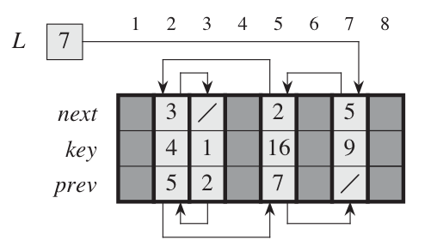
Implementing pointers and objects

