Slide 1
Data Structure and Algorithms －－LinkedList
Guangyu Zou
Dalian University of Technology
gyzou@dlut.edu.cn

Slide 2
LinkedList
A linked list is a data structure in which the objects are arranged in a linear order.
Array
The linear order is determined by the array indices.
Fixed size
LinkedList
The order is determined by a pointer in each object.
Dynamic allocation

Slide 3
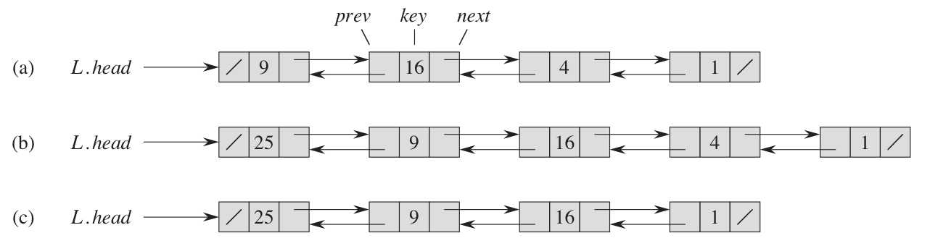
Doubly LinkedList
class CNode {
public:
CNode* prev;
CNode* next;
int key;
CNode (int arg) {
key = arg;
prev = 0;
next = 0;
}
};
Insert an element with key = 25
class LinkedList {
CNode* head;
public:
LinkedList() {
head = 0;
}
};
Delete the element with key = 4

Slide 4
Operations of LinkedList
Searching
Inserting
Deleting

Slide 5
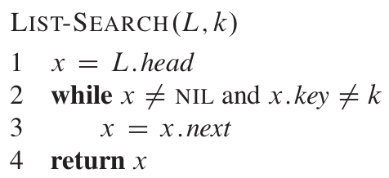
Searching a linked list
CNode* Search (int key) {
CNode* currentNode = head;
while (currentNode->key != key && currentNode != 0) {
currentNode = currentNode->next;
}
return currentNode;
}
Recursively Search？

Slide 6
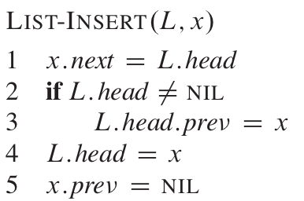
Inserting into a linked list
void Insert(CNode* node) {
node->next = head;
if (head)
head->prev = node;
head = node;
node->prev = 0;
}

Slide 7
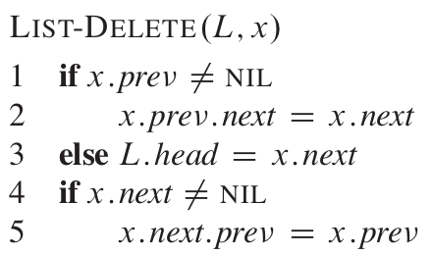
Deleting from a linked list
void Delete(CNode* node) {
if (node->prev)
node->prev->next = node->next;
else
head = node->next;
if (node->next)
node->next->prev = node->prev;
}
How to delete a node with key equal x?
CNode* foundNode = list.Search(5);
list.Delete(foundNode);

Slide 8
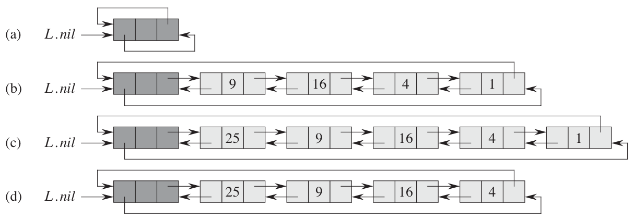
Sentinels -- A circular, doubly linked list

Slide 9
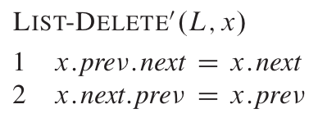
LIST-DELETE
x
L.nil
x.prev
x. next.prev =x.prev
x.next
P
0
N
P
1
N
P
2
N
P
3
N
x.prev.next=x.next

Slide 10
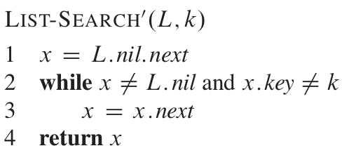
LIST-SEARCH

Slide 11
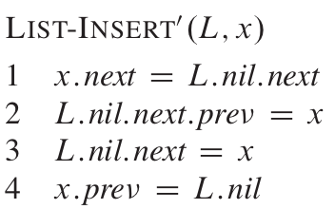
LIST-INSERT
x.prev=L.nil
x
L.nil.next.prev = x
L.nil
P
0
N
P
1
N
P
2
N
P
3
N
L.nil.next=x
x. next = L.nil.next

Slide 12
Implementation
class CNode {
public:
CNode* prev;
CNode* next;
int key;
CNode (int arg) {
key = arg;
}
};

Slide 13
Implementation
class CLinkedList {
CNode* nil;
public:
CLinkedList () {
nil = new CNode(-1);
nil->next = nil;
nil->prev = nil;
}
void Delete (CNode* x) {
}
}

Slide 14
Implementation
void Print() {
CNode* node = nil->next;
while (node != nil) {
cout<<node->key<<endl;
node = node->next;
}
}

Slide 15
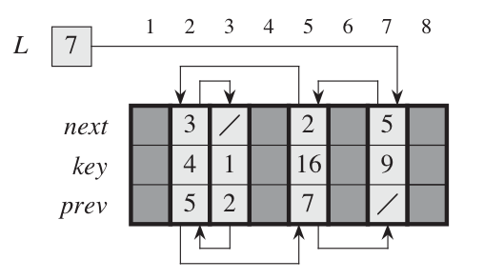
Implementing pointers and objects

