Slide 1
Chapter 10.2 Binary Trees
Guangyu Zou
Dalian University of Technology
gyzou@dlut.edu.cn

Slide 2
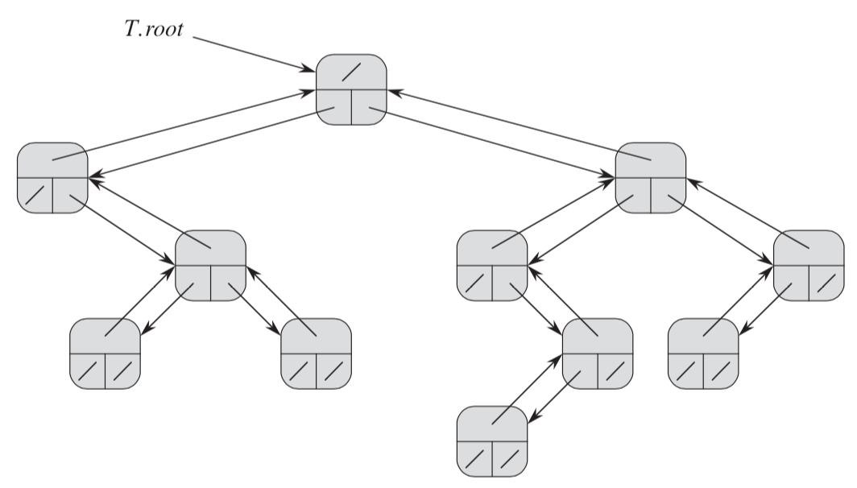
Binary Tree
Each node x has the attributes
x: p (top),
x: left (lower left),
x:right (lower right),
key.

Slide 3
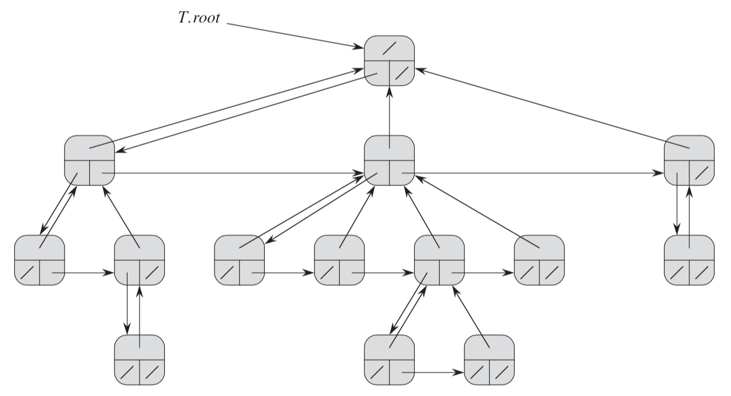
Rooted trees with unbounded branching
Each node x has attributes x:p (top),
x:left-child (lower left),
x:right-sibling (lower right),
Key.

Slide 4
C++ Implementation
class CTreeNode {
public:
char key;
CTreeNode* left;
CTreeNode* right;
CTreeNode (char arg) {
key = arg;
left = 0;
right = 0;
}
};

Slide 5
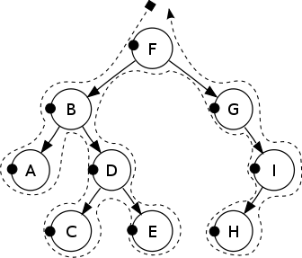
C++ Implementation
CTreeNode nodeA('A');
CTreeNode nodeB('B');
CTreeNode nodeC('C');
CTreeNode nodeD('D');
CTreeNode nodeE('E');
CTreeNode nodeF('F');
CTreeNode nodeG('G');
CTreeNode nodeH('H');
CTreeNode nodeI('I');

Slide 6
C++ Implementation
nodeB.left = &nodeA;
nodeB.right = &nodeD;
nodeD.left = &nodeC;
nodeD.right = &nodeE;
nodeF.left = &nodeB;
nodeF.right = &nodeG;
nodeG.right = &nodeI;
nodeI.left = &nodeH;

Slide 7
Tree Traversal
Pre-order
In-order
Post-order

Slide 8
Pre-order
Visit the root.
Traverse the left subtree.
Traverse the right subtree.

Slide 9
Pre-order
Pre-order: F, B, A, D, C, E, G, I, H

Slide 10
C++ Implementation
void PreOrder(CTreeNode* root) {
if (!root)
return;
cout<<root->key<<endl;
PreOrder(root->left);
PreOrder(root->right);
}

Slide 11
In-order
Traverse the left subtree.
Visit the root.
Traverse the right subtree.

Slide 12
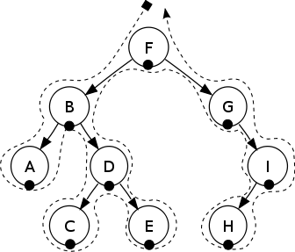
In-order
In-order: A, B, C, D, E, F, G, H, I

Slide 13
C++ Implementation
void InOrder(CTreeNode* root) {
}

Slide 14
Post-order
Traverse the left subtree.
Traverse the right subtree.
Visit the root.

Slide 15

Post-order
Post-order: A, C, E, D, B, H, I, G, F

Slide 16
C++ Implementation
void PostOrder(CTreeNode* root) {
}

Slide 17
Thinking Assignments
How to generate the binary tree given pre-order, in-order, or post-order sequence?
How many sequences does it require?
One?
Two?
Three?
How to get the height of a tree?

Slide 18
Searching a sorted compact list
Sorted
key[i] < key[next[i]] 􏰀􏰀 for all i = 1, 2, … , n such that next[i] != NIL.
Compact
Data are stored in the first n positions of an array.

Slide 19
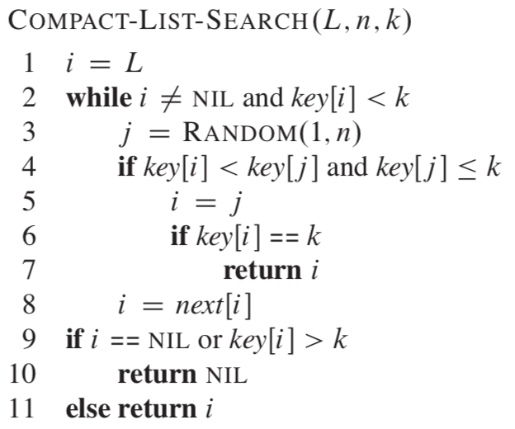
Searching a sorted compact list
Any Problem?

Slide 20
Binary Search
int BinarySearch(int* array, int left, int right, int key) {
int index = -1;
while (left <= right) {
int mid = (left + right)/2;
if (key < array[mid])
right = mid-1;
else if (key > array[mid])
left = mid+1;
else {
index = mid;
break;
}
}
return index;
}

Slide 21
Binary Search
int main() {
int array[] = {2, 6, 5, 3, 4, 5};
int target = 6;
int size = sizeof(array)/sizeof(int);
std::sort(array, array+size); // available in C++
int index = BinarySearch(array, 0, size-1, target);
printf("The index of searched number %d is %d\n", target, index);
return 0;
}

