Slide 1
Recursion
Guangyu Zou
gyzou@dlut.edu.cn
Dalian University of Technology

Slide 2
Outline
Problems
Designing solution strategies
Developing algorithms
Writing algorithms that implement the strategies
Understand existing algorithms and modify/reuse
Understanding an algorithm by simulating its operation on an input
Ensuring/proving correctness
Analyzing and comparing performance/efficiency
Theoretically: Using a variety of mathematical tools
Empirically: Code, run and collect performance data
Choosing the best

Slide 3
MERGE-SORT(A,p,r)
1 if p < r
2 then q←⎣(p+r)/2⎦
3 MERGE-SORT(A,p,q)
4 MERGE-SORT(A,q+1,r)
5 MERGE(A,p,q,r)
void merge_sort(int a[],int p,int r)
{
if(p<r)
{
int q=(p+r)/2;
merge_sort(a,p,q);
merge_sort(a,q+1,r);
merge(a,p,q,r);
}
}
递归终止条件
排序左半边
排序右半边
合并两半边

Slide 4
Sum with Iteration
Sum of [0, 1, 2, …, n]
int sum(int n) {
int ret = 0;
for (int i = 0; i <= n; ++i)
ret += i;
return ret;
}
O(n)
int sumV2(int n) {
return n * (n + 1) / 2;
}
O(1)

Slide 5
Recursive call
int sum(int arg)
{
if (arg == 0) return 0;
else return arg + sum(arg - 1); }
0+1+2+3+4+5
5+sum(4)
4+sum(3)
3+sum(2)
2+sum(1)
1+sum(0)
5+sum(4) = 15
4+sum(3) = 10
3+sum(2) = 6
2+sum(1) = 3
sum(1) = 1+sum(0) = 1
push
pop

Slide 6
sum
int sum(int arg)
{
if (arg == 0) return 0;
else return arg + sum(arg - 1); }
递归终止条件
当前值与剩余所有值的和
How to implement sum with the first one plus the rest?

Slide 7
Find-Max
function find-max(A:array [i...j] of integer)
k: integer
1 if i=j then return A[i]
else
2 k← find-max(A:array [i+1...j])
3 if k>A[i] then return k else return A[i]
递归终止条件
当前值与剩余所有值的最大值比较

Slide 8
Recursive call
[3,1,2,5,4]
max(3, [1,2,5,4])
max(1, [2,5,4])
max(2, [5,4])
max(5, [4])
[4]
5
5
5
5
4
push
pop

Slide 9
Fibonacci numbers
F₀ = 1; F₁ = 1; F_{n} = F_{n-1}+F_{n-2}
Fib (n: integer)
1 if n<0 then
2 error
3 else if n=0 or 1 then
4 return 1
5 else return Fib(n-1)+Fib(n-2)
递归终止条件
递归终止条件
递归关系

Slide 10
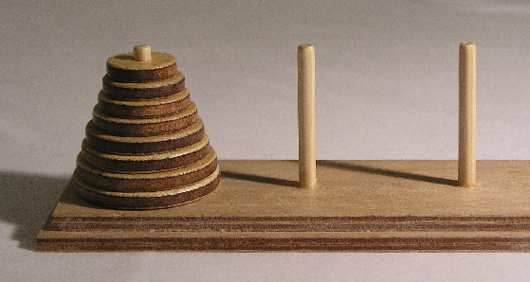

Hanoi Tower
Only one disk can be moved at a time.
Each move consists of taking the upper disk from one of the stacks and placing it on top of another stack i.e. a disk can only be moved if it is the uppermost disk on a stack.
No disk may be placed on top of a smaller disk.

Slide 11
A
B
C
1
2
3
A
B
C
1
2
A
B
C
1

Slide 12
Hanoi Tower
If n = 1
Move disc 1 from origin to destination.
If n > 1
Move the top n-1 disc from origin to the auxiliary pole through destination.
Move the disc n from origin to destination.
Move the n-1 disc from the auxiliary pole to destination through the origin.

Slide 13
void HanoiTower( int n, char from, char aux, char to )
{
if(n==1){
printf("Move disc 1 from %c to %c\n", from, to);
return;
}
else{
HanoiTower(n-1,from,to,aux);
printf("Move disc %d from %c to %c\n", n, from, to);
HanoiTower(n-1,aux,from,to);
}
}
递归终止条件
移动n－1个盘子从from到aux
移动1个盘子从from到to
移动n－1个盘子从aux到to
T(n) = 2T(n-1) + 1 = 2^n - 1
2.00985E+22 years
T(99) = 2^99 – 1 = 6.33825E+29 seconds

Slide 14
Key Takeaways
Iteration
Known -> Unknown
Recursion
Unknown -> Known

Slide 15
Exercises
Factorial
Find minimum

