Slide 1
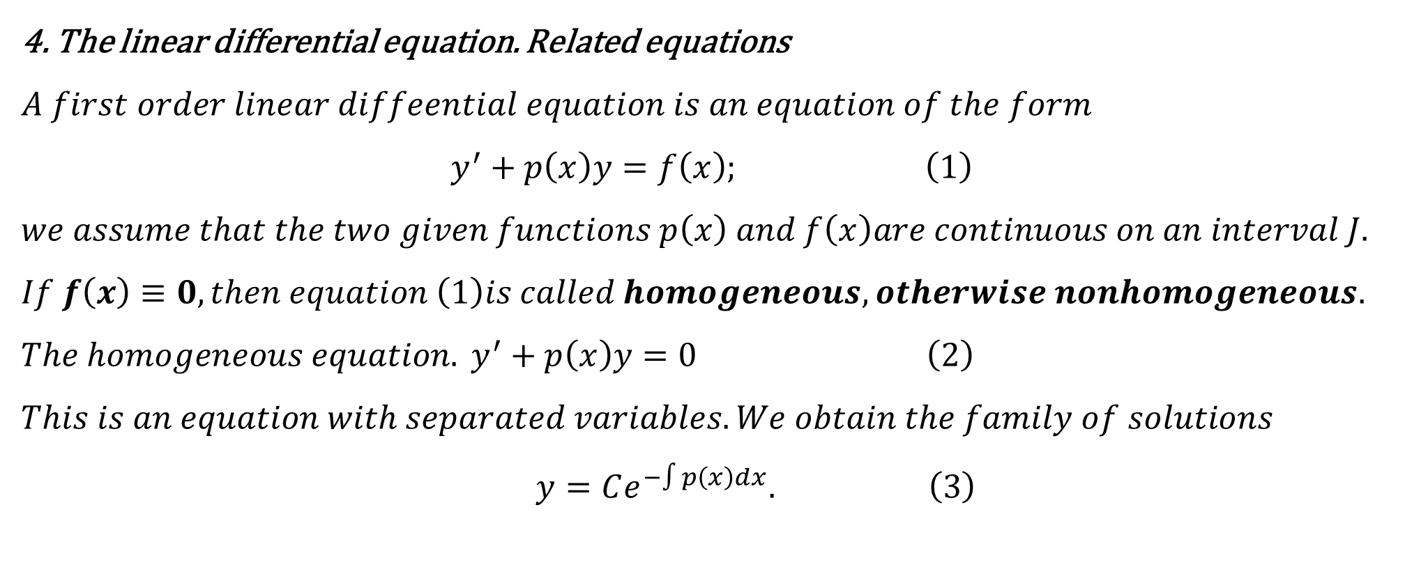
4. The linear differential equation. Related equations
$$A first order linear diffeential equation is an equation of the form$$
$$y^{′}+p\left(x\right)y=f\left(x\right); \left(1\right)$$
$$we assume that the two given functions p\left(x\right) and f\left(x\right)are continuous on an interval J.$$
$$If f\left(x\right)≡0,then equation \left(1\right)is called homogeneous,otherwise nonhomogeneous.$$
$The homogeneous equation. y^{′}+p\left(x\right)y=0$ $\left(2\right)$
$$This is an equation with separated variables. We obtain the family of solutions$$
$y=Ce^{−∫p\left(x\right)dx}.$ $\left(3\right)$

Slide 2
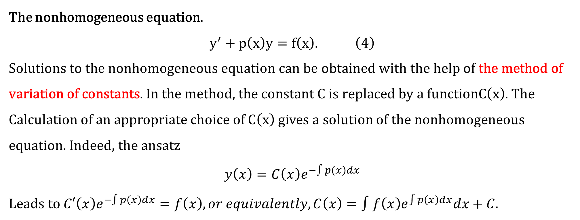
The nonhomogeneous equation.
$$y^{′}+p\left(x\right)y=f\left(x\right). \left(4\right)$$
$\text{Solutions} \text{to} \text{the} \text{nonhomogeneous} \text{equation} \text{can} \text{be} \text{obtained} \text{with} \text{the} \text{help} \text{of} \text{the} \text{method} \text{of} \text{variation} \text{of} \text{constants}\text{. }\text{In} \text{the} \text{method}\text{, }\text{the} \text{constant} \text{C} \text{is} \text{replaced} \text{by} \text{a} \text{function}C\left(x\right)$. The
Calculation of an appropriate choice of $C\left(x\right)$ gives a solution of the nonhomogeneous equation. Indeed, the ansatz
$$y\left(x\right)=C\left(x\right)e^{−∫p\left(x\right)dx}$$
Leads to $C′\left(x\right)e^{−∫p\left(x\right)dx}=f\left(x\right), or equivalently, C\left(x\right)=∫f\left(x\right)e^{∫p\left(x\right)dx}dx+C$.

Slide 3
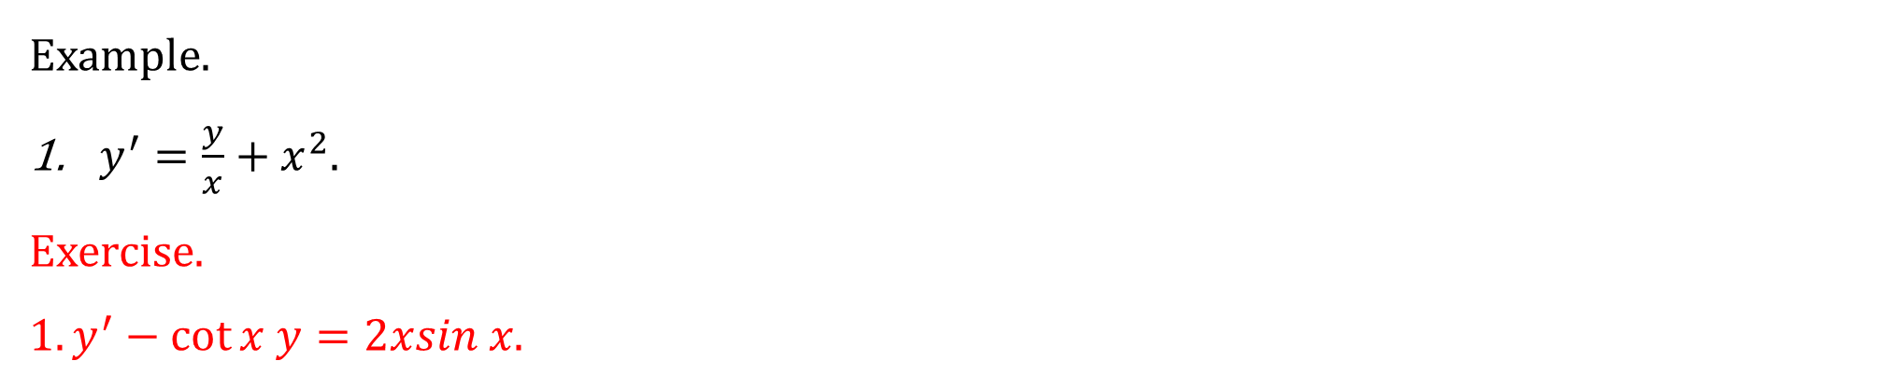
Example.
$y^{′}=\frac{y}{x}+x^{2}.$
Exercise. $1.y^{′}−\cot{x y=2xsin x}$.

Slide 4

$$Example. y^{′}=\frac{y}{x}+x^{2}. \\ Solution. Solve the realted homogeneous ODE y^{′}=\frac{y}{2x}, we have y=Cx. \\ Setting y=c\left(x\right)x is the solution of the original ODE, c\left(x\right)=\frac{x^{2}}{2}+c can be obtained. \\ y=\left(\frac{x^{2}}{2}+c\right)x is the general solution .$$

Slide 5
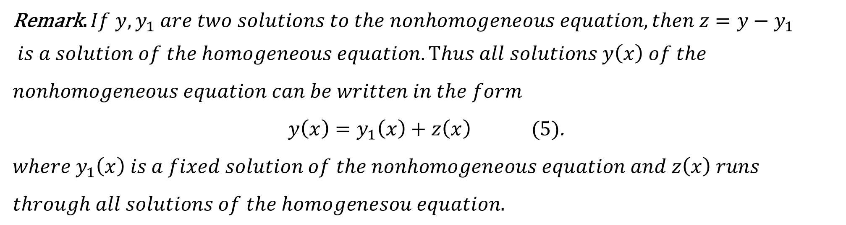
Remark. $If y,y_{1} are two solutions to the nonhomogeneous equation, then z=y−y_{1}$
$is a solution of the homogeneous equation. Thus all solutions y\left(x\right) of the$
$$nonhomogeneous equation can be written in the form$$
$y\left(x\right)=y_{1}\left(x\right)+z\left(x\right) (5)$.
$$where y_{1}\left(x\right) is a fixed solution of the nonhomogeneous equation and z\left(x\right) runs$$
$$through all solutions of the homogenesou equation.$$

Slide 6
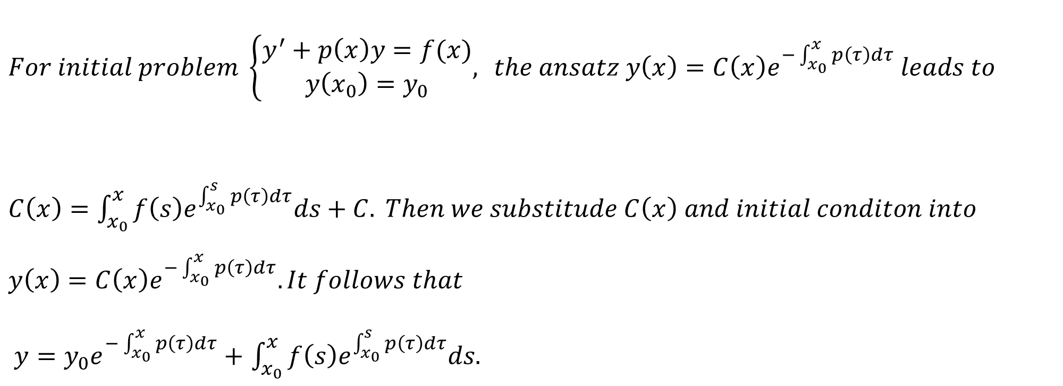
$$For initial problem \left\{\begin{aligned}y^{′}+p\left(x\right)y=f(x) \\ y\left(x_{0}\right)=y_{0}\end{aligned}, \right. the ansatz y\left(x\right)=C\left(x\right)e^{−\int_{x_{0}}^{x}{p\left(τ\right)dτ}} leads to$$
$C\left(x\right)=$ $\int_{x_{0}}^{x}{f\left(s\right)e^{\int_{x_{0}}^{s}{p\left(τ\right)dτ}}ds}+C. Then we substitude C\left(x\right) and initial conditon into$
$$y\left(x\right)=C\left(x\right)e^{−\int_{x_{0}}^{x}{p\left(τ\right)dτ}}. It follows that$$ $y=y_{0}e^{−\int_{x_{0}}^{x}{p\left(τ\right)dτ}}+$ $\int_{x_{0}}^{x}{f\left(s\right)e^{\int_{x_{0}}^{s}{p\left(τ\right)dτ}}ds}$.

Slide 7
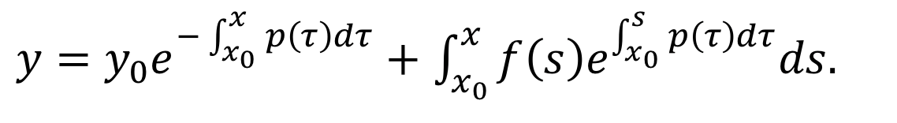
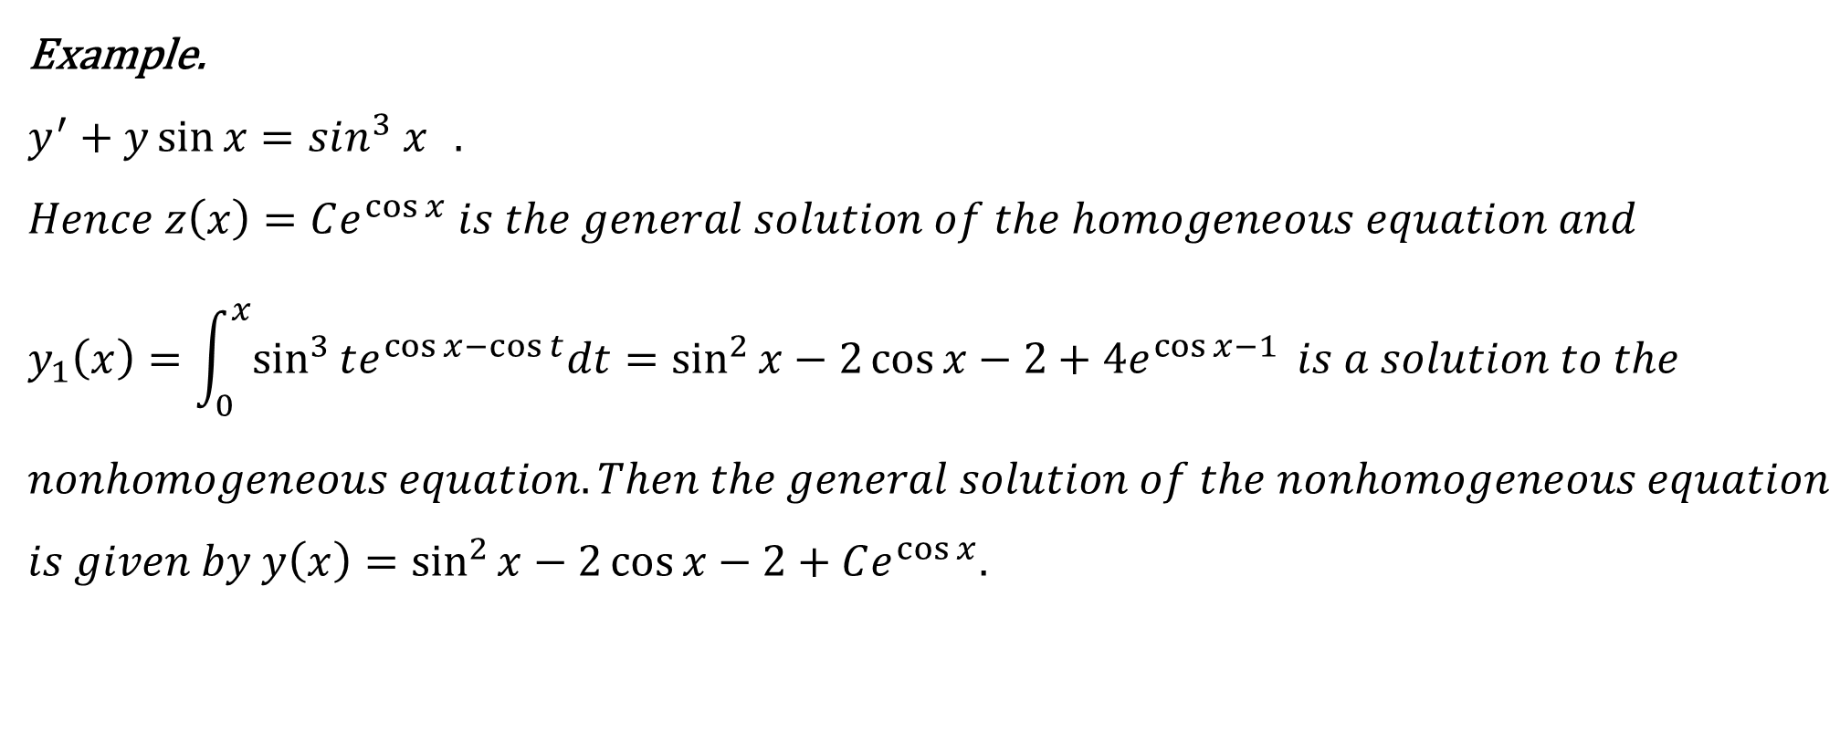
Example.
$$y^{′}+y\sin{x}=sin^{3} x{ }.$$
$$Hence z\left(x\right)=Ce^{\cos{x}} is the general solution of the homogeneous equation and$$
$$y_{1}\left(x\right)=\int_{0}^{x}{\sin^{3}{te^{\cos{x}−\cos{t}}dt}=\sin^{2}{x−2\cos{x−2+4e^{\cos{x−1}}}}} is a solution to the$$
$$nonhomogeneous equation. Then the general solution of the nonhomogeneous equation$$
$$is given by y\left(x\right)=\sin^{2}{x}−2\cos{x}−2+Ce^{\cos{x}}.$$

Slide 8
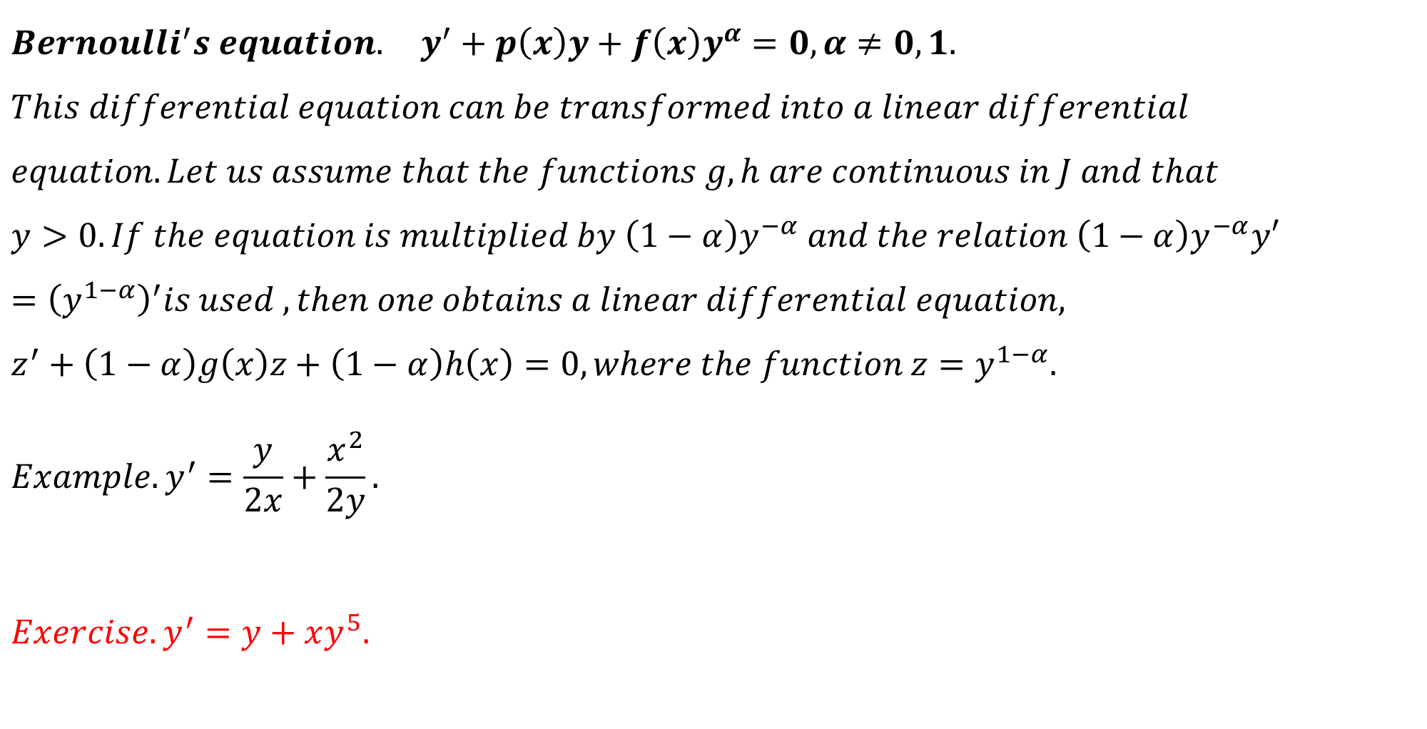
$$Bernoulli^{′}s equation. y^{′}+p\left(x\right)y+f\left(x\right)y^{α}=0, α≠0,1.$$
$$This differential equation can be transformed into a linear differential \\ equation. Let us assume that the functions g,h are continuous in J and that \\ y>0. If the equation is multiplied by \left(1−α\right)y^{−α} and the relation \left(1−α\right)y^{−α}y′ \\ ={\left(y^{1−α}\right)}^{′}is used , then one obtains a linear differential equation, \\ z^{′}+\left(1−α\right)g\left(x\right)z+\left(1−α\right)h\left(x\right)=0, where the function z=y^{1−α}. \\ Example. y^{′}=\frac{y}{2x}+\frac{x^{2}}{2y}.$$
$$Exercise. y^{′}=y+xy^{5}.$$

Slide 9

$$Example. y^{′}=\frac{y}{2x}+\frac{x^{2}}{2y}. \\ Solution. set y^{2}=z, the ODE transforms into z^{′}−\frac{z}{x}=x^{2}. \\ use the method of variation of constants to solve the nonhomogeneous ODE, \\ we have z=\left(\frac{x^{2}}{2}+c\right)x, so the general solution of the original ODE is \\ y=±\sqrt{\left(\frac{x^{2}}{2}+c\right)x}.$$

Slide 10
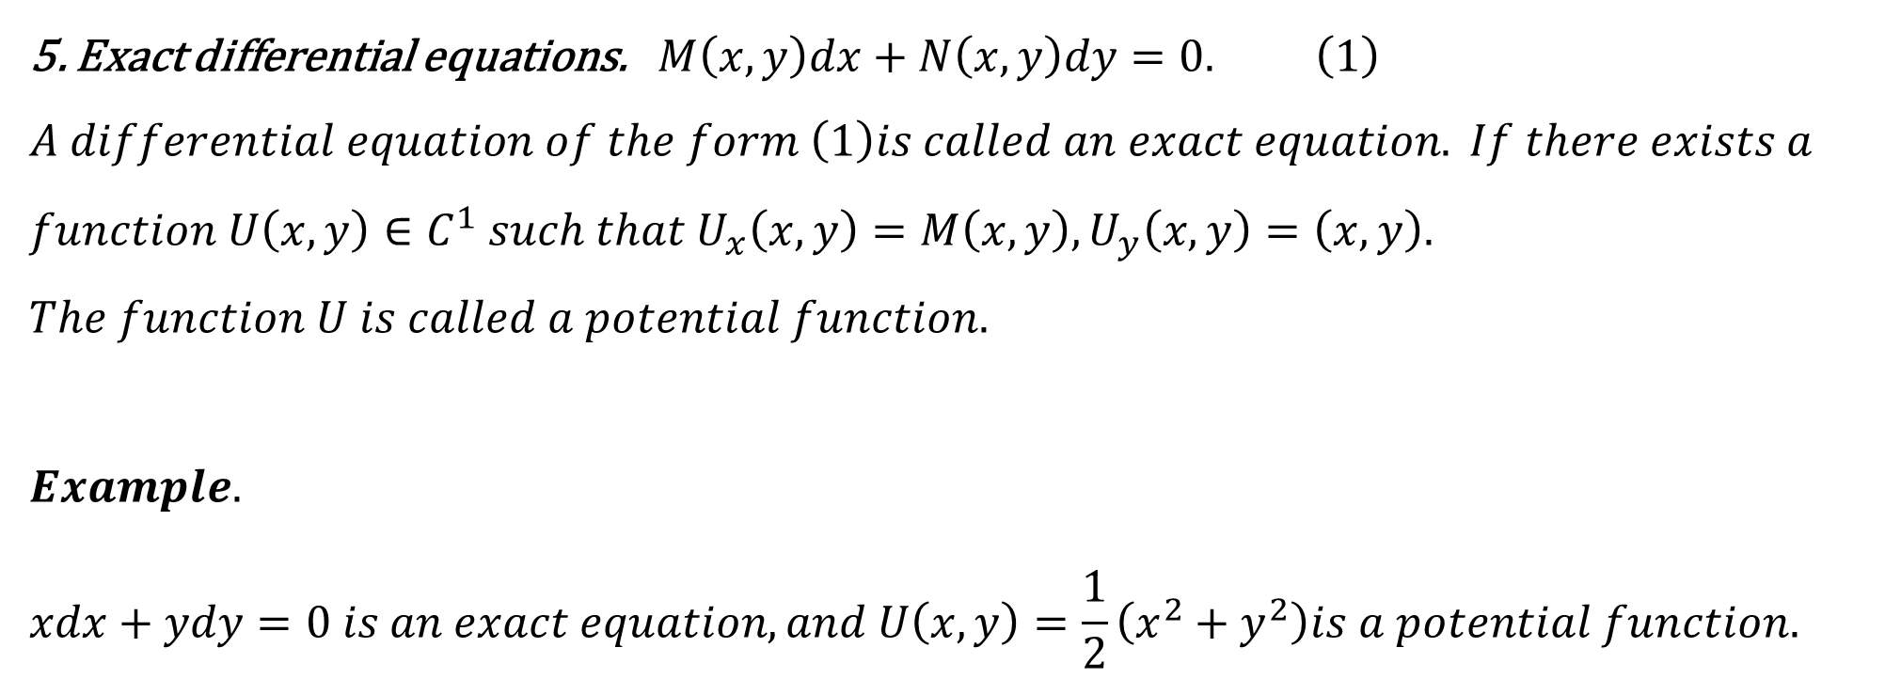
5. Exact differential equations.$M\left(x,y\right)dx+N\left(x,y\right)dy=0. \left(1\right)$ $$A differential equation of the form \left(1\right)is called an exact equation. If there exists a \\ function U\left(x,y\right)∈C^{1} such that U_{x}\left(x,y\right)=M\left(x,y\right), U_{y}\left(x,y\right)=\left(x,y\right). \\ The function U is called a potential function.$$
$$Example. \\ xdx+ydy=0 is an exact equation, and U\left(x,y\right)=\frac{1}{2}\left(x^{2}+y^{2}\right)is a potential function.$$

Slide 11
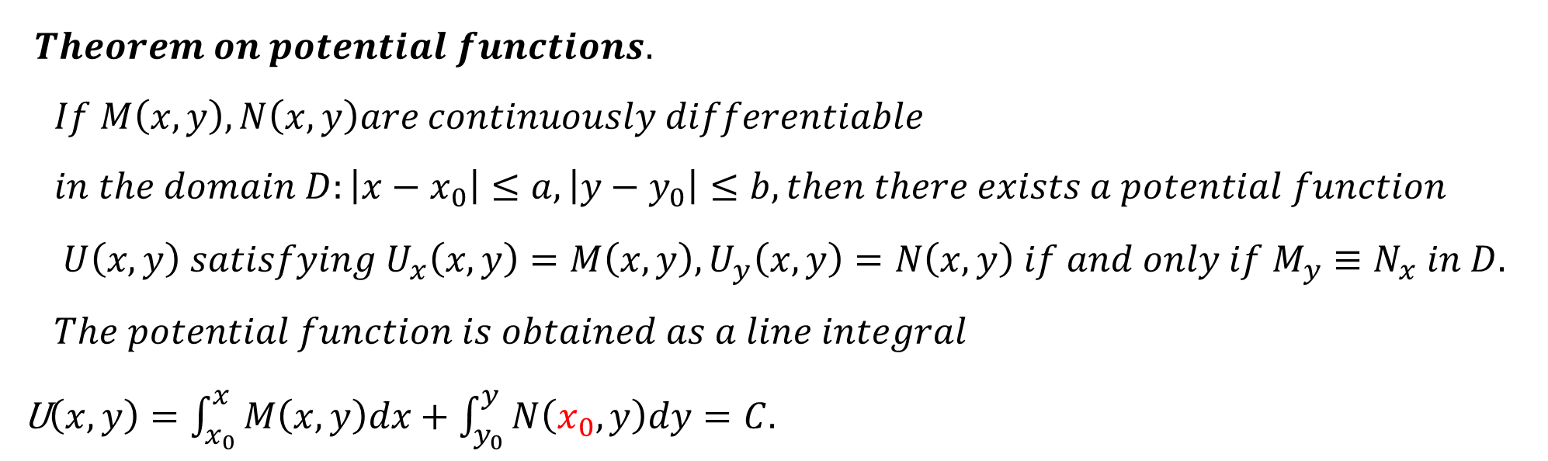
$Theorem on potential functions.$
$$If M\left(x,y\right),N\left(x,y\right)are continuously differentiable \\ in the domain D:\left|x−x_{0}\right|≤a,\left|y−y_{0}\right|≤b, then there exists a potential function \\ U\left(x,y\right) satisfying{ U}_{x}\left(x,y\right)=M\left(x,y\right), U_{y}\left(x,y\right)=N\left(x,y\right) if and only if M_{y}≡N_{x} in D. \\ The potential function is obtained as a line integral$$ U$\left(x,y\right)=\int_{x_{0}}^{x}{M\left(x,y\right)dx}+\int_{y_{0}}^{y}{N\left(x_{0},y\right)dy}=C.$

Slide 12

$$Example. \left(3x^{2}+6xy^{2}\right)dx+\left(6x^{2}y+4y^{3}\right)dy=0. \\ M\left(x,y\right) and N\left(x,y\right)are continuous differentiable on the xOy−plane. Let^{′}s set x_{0}=0, \\ y_{0}=0. Then potential functions are given by \int_{0}^{x}{\left(3x^{2}+6xy^{2}\right)dx+\int_{0}^{y}{4y^{3}dy}=C}.$$ $Example. \left\{\begin{aligned}xydx+\frac{1}{2}\left(x^{2}+y\right)dy=0 \\ y\left(0\right)=2\end{aligned}.\right.$
U$\left(x,y\right)=\int_{x_{0}}^{x}{M\left(x,y\right)dx}+\int_{y_{0}}^{y}{N\left(x_{0},y\right)dy}=C.$

Slide 13
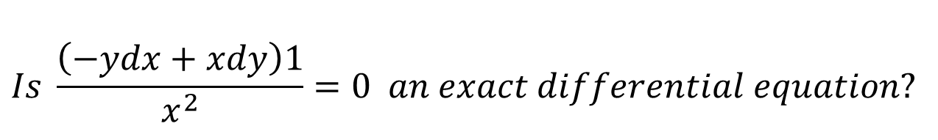
$$Is−ydx+xdy=0 an exact differential equation?$$
$$Is \frac{\left(−ydx+xdy\right)1}{x^{2}}=0 an exact differential equation?$$

