Slide 1
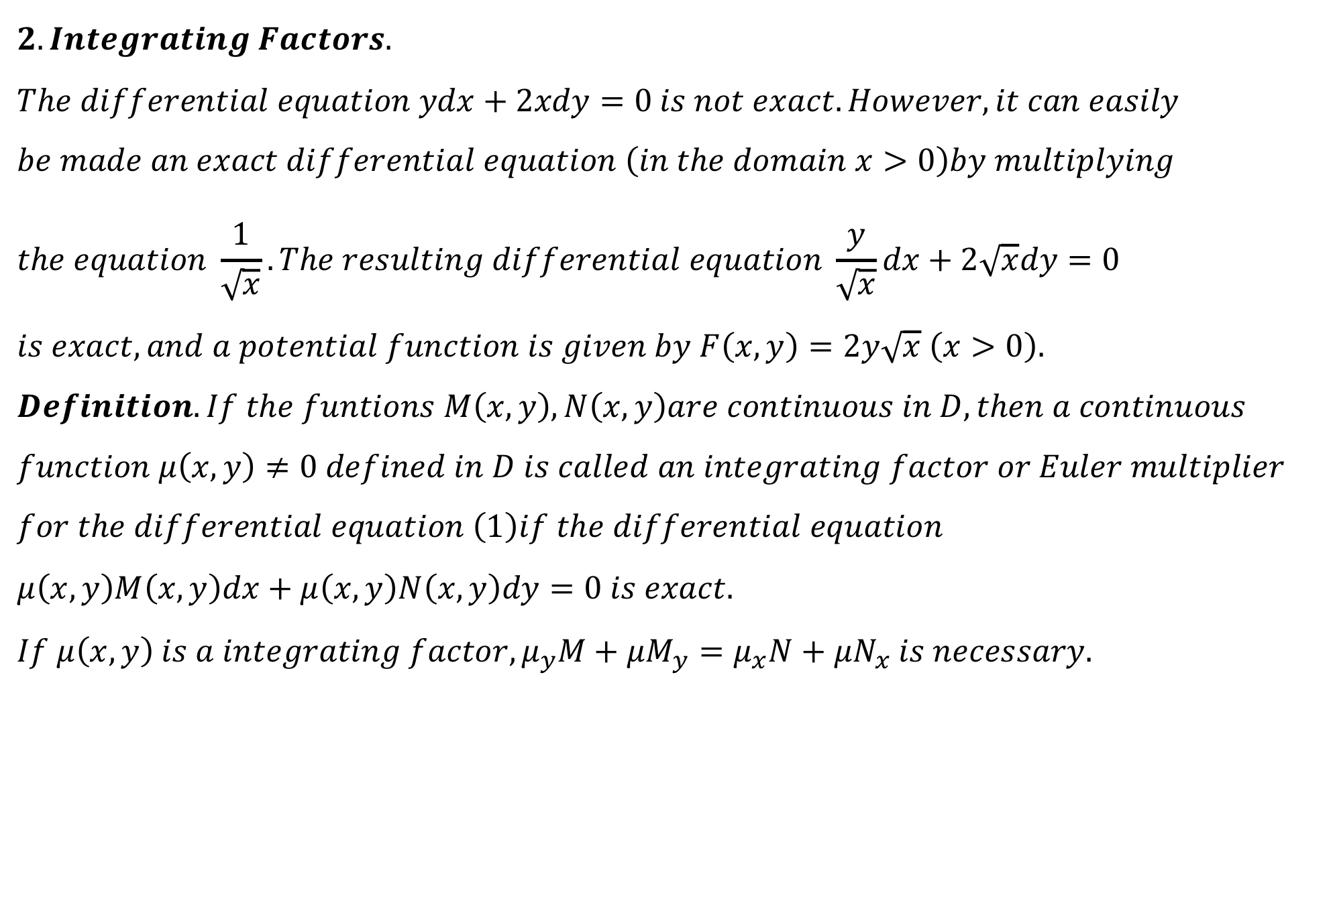
$$2. Integrating Factors.$$
$$The differential equation ydx+2xdy=0 is not exact. However, it can easily \\ be made an exact differential equation \left(in the domain x>0\right)by multiplying \\ the equation \frac{1}{\sqrt{x}}. The resulting differential equation \frac{y}{\sqrt{x}}dx+2\sqrt{x}dy=0 \\ is exact, and a potential function is given by F\left(x,y\right)=2y\sqrt{x} \left(x>0\right).$$
$$Definition. If the funtions M\left(x,y\right), N\left(x,y\right)are continuous in D, then a continuous \\ function μ\left(x,y\right)≠0 defined in D is called an integrating factor or Euler multiplier \\ for the differential equation \left(1\right)if the differential equation \\ μ\left(x,y\right)M\left(x,y\right)dx+μ\left(x,y\right)N\left(x,y\right)dy=0 is exact.$$
$$If μ\left(x,y\right) is a integrating factor, μ_{y}M+μM_{y}=μ_{x}N+μN_{x} is necessary.$$

Slide 2
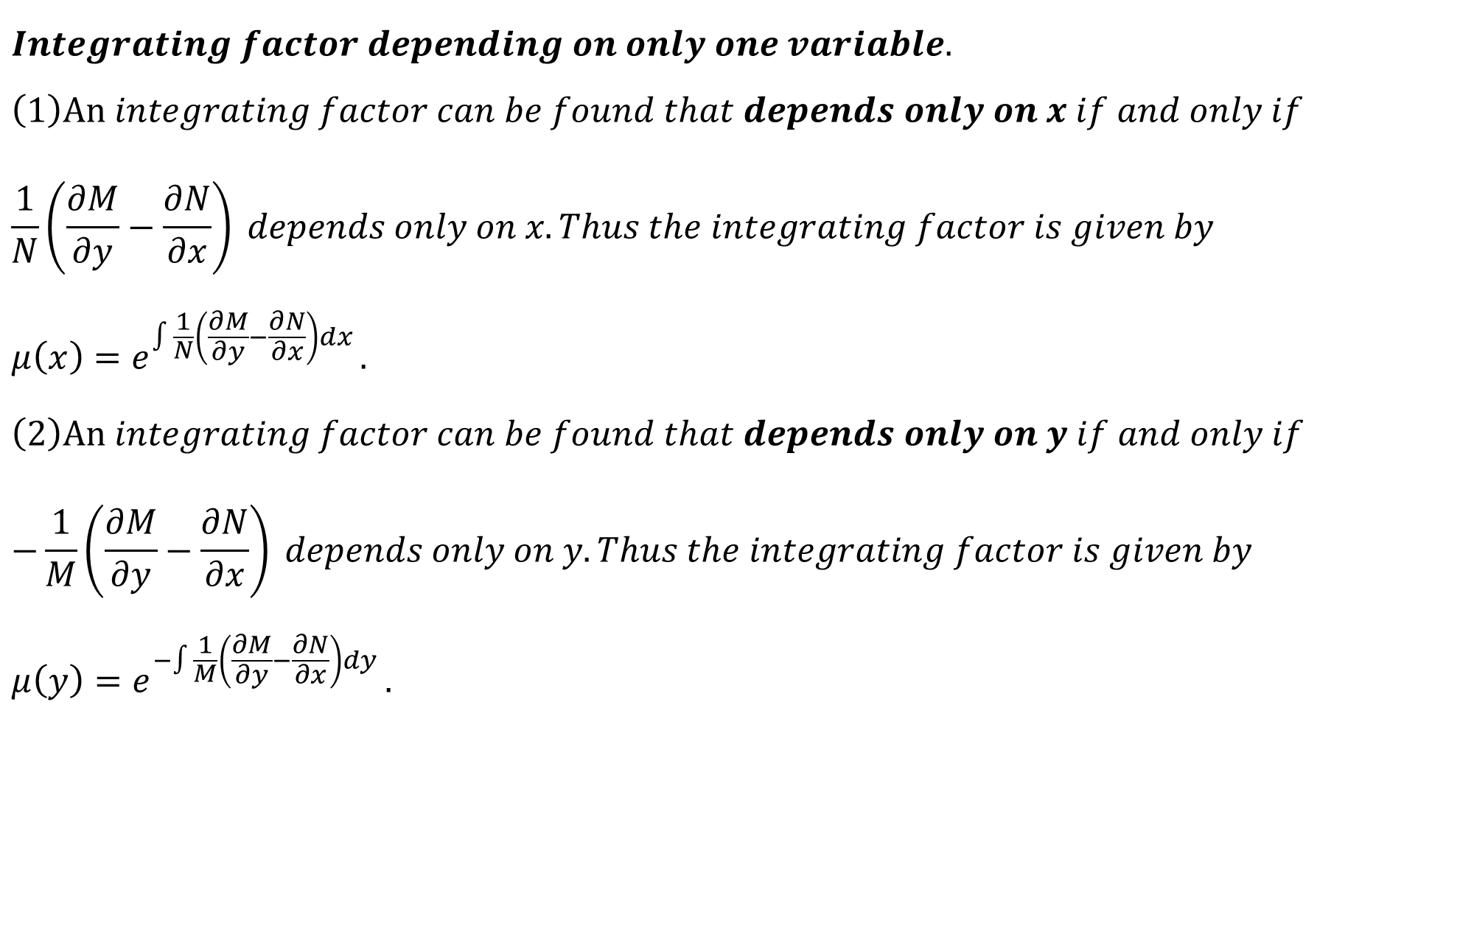
$$Integrating factor depending on only one variable. \\ \left(1\right)An integrating factor can be found that depends only on x if and only if \\ \frac{1}{N}\left(\frac{∂M}{∂y}−\frac{∂N}{∂x}\right) depends only on x. Thus the integrating factor is given by \\ μ\left(x\right)=e^{∫\frac{1}{N}\left(\frac{∂M}{∂y}−\frac{∂N}{∂x}\right)dx }.$$
$$\left(2\right)An integrating factor can be found that depends only on y if and only if \\ −\frac{1}{M}\left(\frac{∂M}{∂y}−\frac{∂N}{∂x}\right) depends only on y. Thus the integrating factor is given by \\ μ\left(y\right)=e^{−∫\frac{1}{M}\left(\frac{∂M}{∂y}−\frac{∂N}{∂x}\right)dy }.$$

Slide 3

$$Example. \\ 1. −ydx+xdy=0 \\ 2.\left(3x+6xy+3y^{2}\right)dx+\left(2x^{2}+3xy\right)dy=0. \\ \frac{1}{N}\left(\frac{∂M}{∂y}−\frac{∂N}{∂x}\right) depends only on x μ\left(x\right)=e^{∫\frac{1}{N}\left(\frac{∂M}{∂y}−\frac{∂N}{∂x}\right)dx }. \\ −\frac{1}{M}\left(\frac{∂M}{∂y}−\frac{∂N}{∂x}\right) depends only on y μ\left(y\right)=e^{−∫\frac{1}{M}\left(\frac{∂M}{∂y}−\frac{∂N}{∂x}\right)dy }. \\ Exercises. \\ 1. e^{−y}dx−(2y+xe^{−y})dy=0 \\ 2.\left(x^{2}+y^{2}+x\right)dx+xydy=0.$$

Slide 4
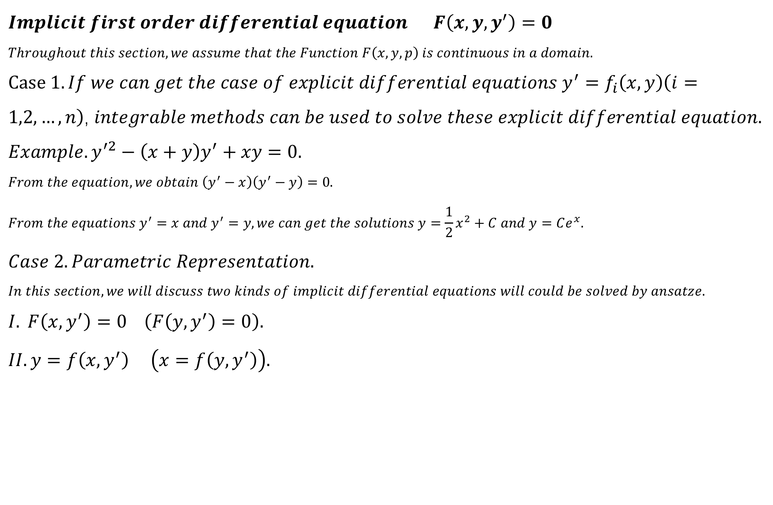
$$Implicit first order differential equation F\left(x,y,y^{′}\right)=0 \\ Throughout this section, we assume that the Function F\left(x,y,p\right) is continuous in a domain.$$ $Case 1. If we can get the case of explicit differential equations y^{′}=f_{i}\left(x,y\right)\left(i=1,2,…,n\right)$, $integrable methods can be used to solve these explicit differential equation.$ $$Example. y^{′2}−\left(x+y\right)y^{′}+xy=0. \\ From the equation, we obtain \left(y^{′}−x\right)\left(y^{′}−y\right)=0. \\ From the equations y^{′}=x and y^{′}=y, we can get the solutions y=\frac{1}{2}x^{2}+C and y=Ce^{x}.$$
$$Case 2. Parametric Representation. \\ In this section, we will discuss two kinds of implicit differential equations will could be solved by ansatze.$$
$$I. F\left(x,y^{′}\right)=0 \left(F\left(y,y^{′}\right)=0\right). \\ II. y=f\left(x,y^{′}\right) \left(x=f\left(y,y^{′}\right)\right).$$

Slide 5
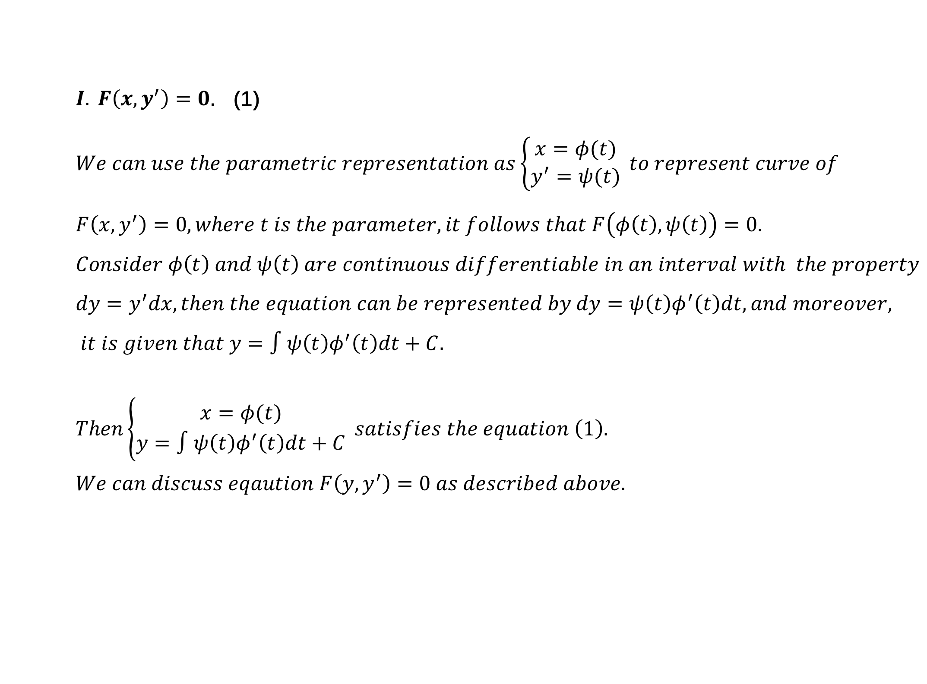
$I. F\left(x,y^{′}\right)=0$. (1)
$$We can use the parametric representation as\left\{\begin{aligned}x=φ(t) \\ y^{′}=ψ(t)\end{aligned}\right. to represent curve of$$
$$F\left(x,y^{′}\right)=0, where t is the parameter, it follows that F\left(φ\left(t\right),ψ\left(t\right)\right)=0. \\ Consider φ\left(t\right) and ψ\left(t\right) are continuous differentiable in an interval with the property \\ dy=y^{′}dx, then the equation can be represented by dy=ψ\left(t\right)φ^{′}\left(t\right)dt, and moreover,$$
$$it is given that y=∫ψ\left(t\right)φ^{′}\left(t\right)dt+C. \\ Then\left\{\begin{aligned}x=φ(t) \\ y=∫ψ\left(t\right)φ^{′}\left(t\right)dt+C\end{aligned}\right. satisfies the equation \left(1\right). \\ We can discuss eqaution F\left(y,y^{′}\right)=0 as described above.$$

Slide 6
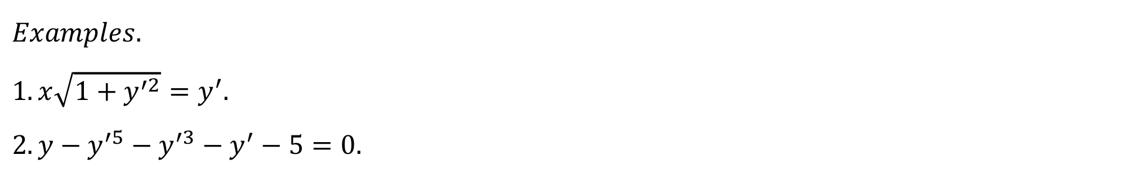
$$Examples. \\ 1. x\sqrt{1+y^{′2}}=y^{′}. \\ 2.y−y^{′5}−y^{′3}−y^{′}−5=0.$$

Slide 7
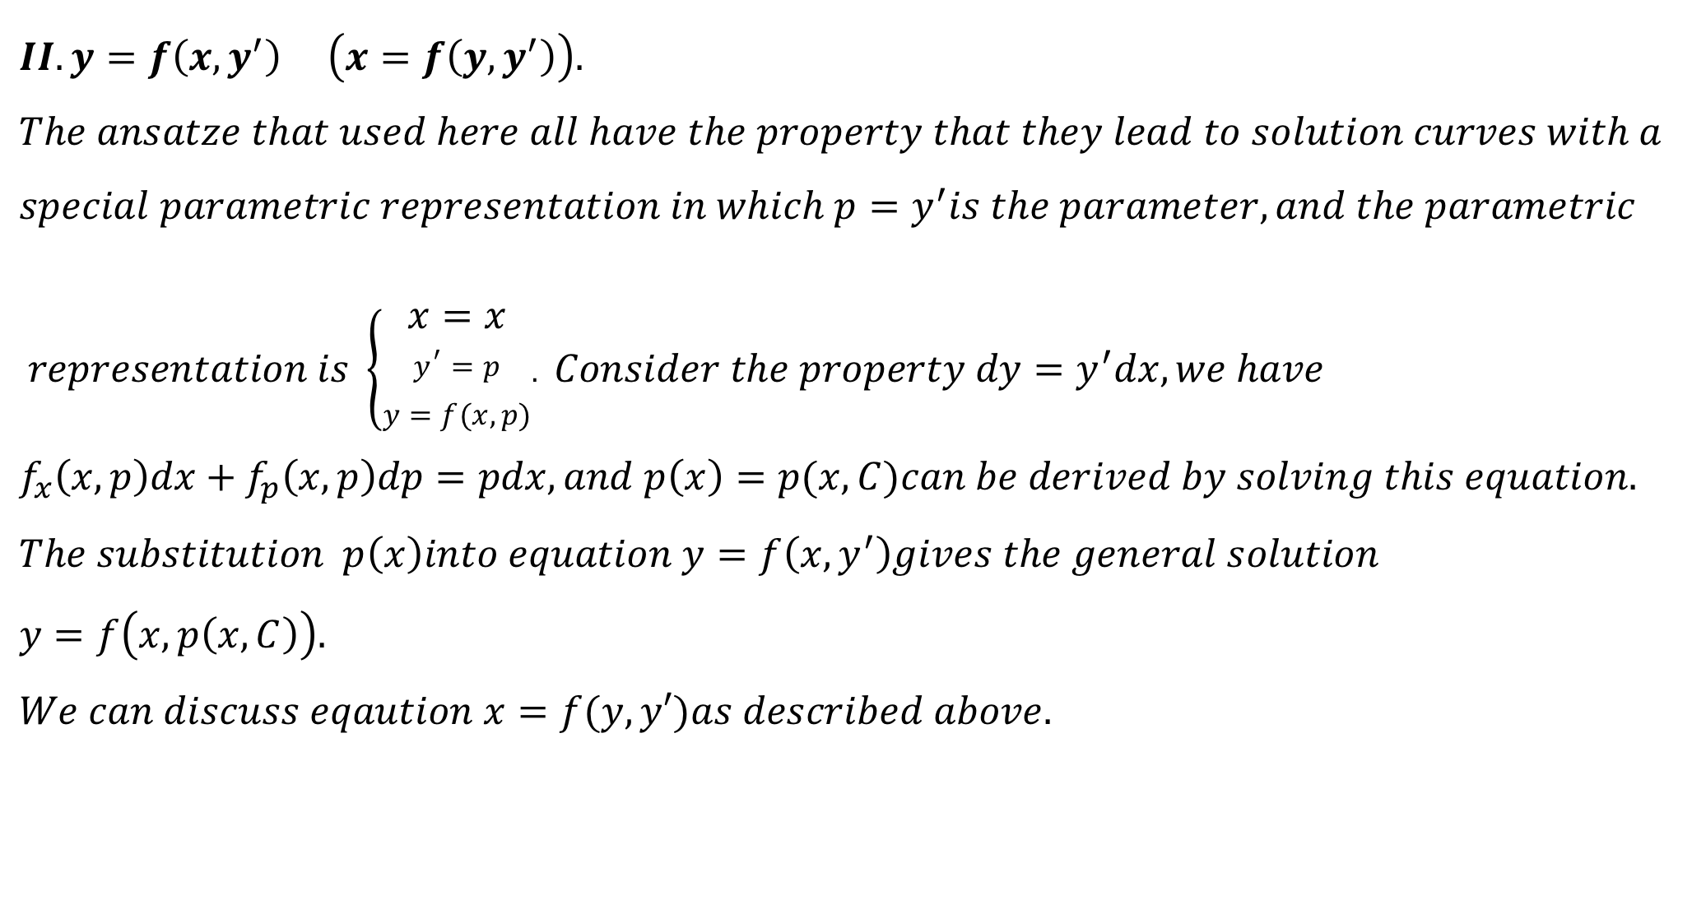
$$II. y=f\left(x,y^{′}\right) \left(x=f\left(y,y^{′}\right)\right). \\ The ansatze that used here all have the property that they lead to solution curves with a \\ special parametric representation in which p=y^{′}is the parameter, and the parametric$$
$$representation is \left\{\begin{aligned}x=x \\ y^{′}=p \\ y=f(x,p)\end{aligned}.\right. Consider the property dy=y^{′}dx, we have$$
$$f_{x}\left(x,p\right)dx+f_{p}\left(x,p\right)dp=pdx, and p\left(x\right)=p(x,C)can be derived by solving this equation.$$
$$The substitution p\left(x\right)into equation y=f\left(x,y^{′}\right)gives the general solution \\ y=f\left(x,p\left(x,C\right)\right). \\ We can discuss eqaution x=f(y,y′)as described above.$$

Slide 8
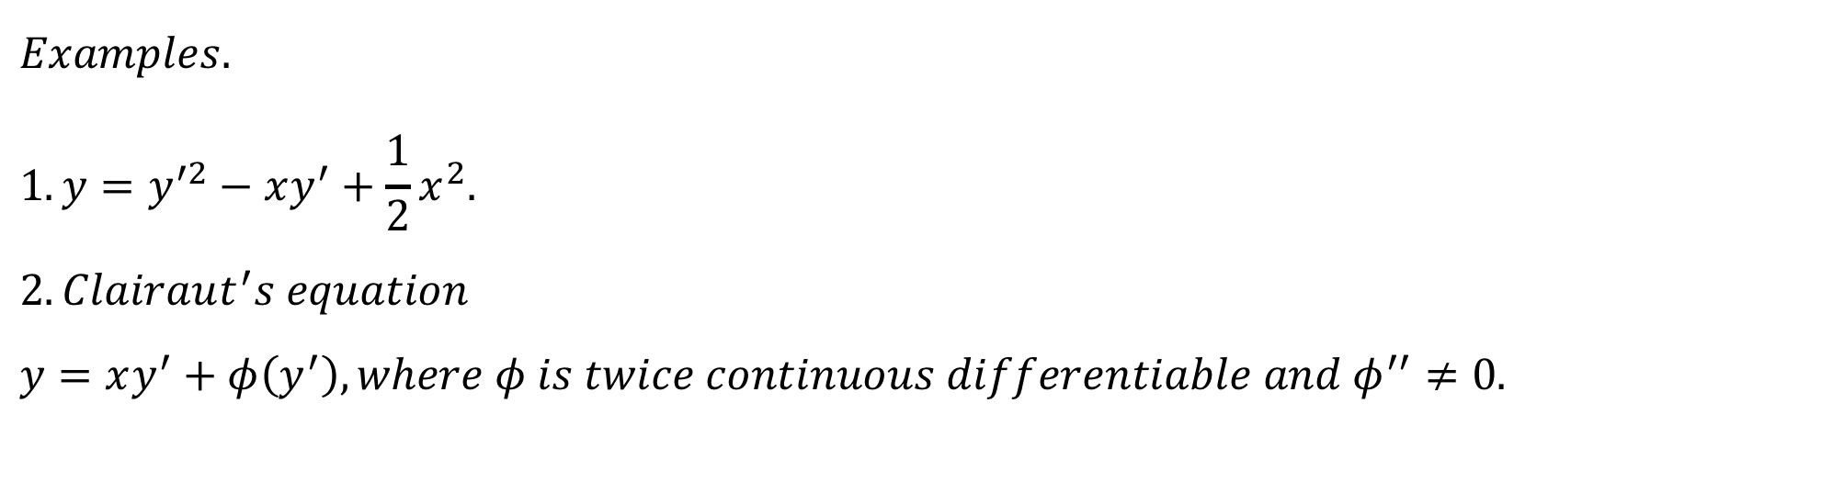
$$Examples. \\ 1. y=y^{′2}−xy^{′}+\frac{1}{2}x^{2}. \\ 2. Clairaut^{′}s equation \\ y=xy^{′}+φ\left(y^{′}\right), where φ is twice continuous differentiable and φ^{′′}≠0.$$

Slide 9

$$Some special nth order ODEs \\ Case 1. F\left(x,y^{\left(k\right)},y^{\left(k+1\right)},…,y^{\left(n\right)}\right)=0 \\ Set y^{(k)}=z, then the ODE transforms into F\left(x,z,z′,…,z^{\left(n−k\right)}\right)=0$$ $$Example. \\ y^{(5)}−\frac{1}{x}y^{\left(4\right)}=0.$$

Slide 10

$$Some special nth order ODEs \\ Case 2. F\left(y,y′,…,y^{\left(n\right)}\right)=0 \\ Set y^{′}=p, then the ODE transforms into \tilde{F}\left(y,p,p′,…,p^{\left(n−1\right)}\right)=0 p=p\left(y\right).$$ $$Example. \\ y^{′′}+y=0.(y^{′′}=\frac{d^{2}y}{dx^{2}}=\frac{dp}{dy}\frac{dy}{dx}=p\frac{dp}{dy})$$

Slide 11

$Exercises 1. Determine all the solutions to the following differential equations.$
$$\left(1\right)\frac{dy}{dx}=\frac{\sqrt{1−y^{2}}}{\sqrt{1−x^{2}}}.$$
$$\left(2\right) x^{2}\frac{dy}{dx}=xy−y^{2}.$$
(3) $y^{′}=\frac{y+1}{x+2}−\exp\left(\frac{y+1}{x+2}\right).$
$$\left(4\right)y^{′}−y\cot{x=2x\sin{x}.} \\ \left(5\right)\left(y^{2}e^{xy}+3x^{2}y\right)dx+\left(x^{3}+\left(1+xy\right)e^{xy}\right)dy=0 is exact in R^{2}.$$

