Slide 1
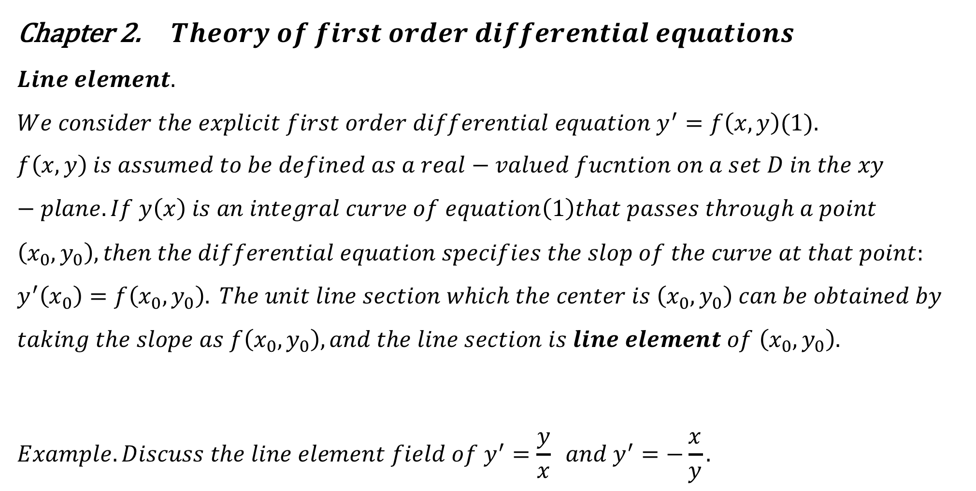
Chapter 2. $Theory of first order differential equations$
$$Line element. \\ We consider the explicit first order differential equation y^{′}=f\left(x,y\right)(1). \\ f\left(x,y\right) is assumed to be defined as a real−valued fucntion on a set D in the xy−plane. If y\left(x\right) is an integral curve of equation\left(1\right)that passes through a point \\ \left(x_{0},y_{0}\right), then the differential equation specifies the slop of the curve at that point: \\ y^{′}\left(x_{0}\right)=f\left(x_{0},y_{0}\right). The unit line section which the center is \left(x_{0},y_{0}\right) can be obtained by \\ taking the slope as f\left(x_{0},y_{0}\right), and the line section is line element of \left(x_{0},y_{0}\right).$$
$$Example. Discuss the line element field of y^{′}=\frac{y}{x} and y^{′}=−\frac{x}{y}.$$

Slide 2
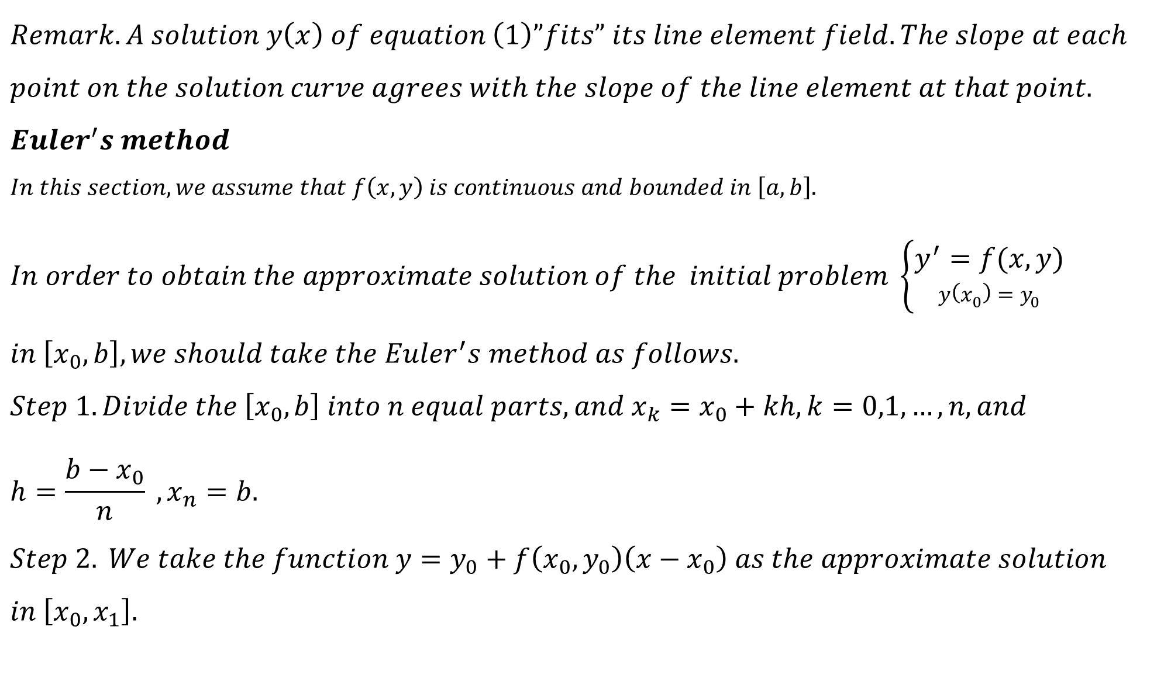
$$Remark. A solution y\left(x\right) of equation \left(1\right)”fits” its line element field. The slope at each \\ point on the solution curve agrees with the slope of the line element at that point.$$
$$Euler^{′}s method \\ In this section, we assume that f\left(x,y\right) is continuous and bounded in \left[a,b\right].$$
$$In order to obtain the approximate solution of the initial problem \left\{\begin{aligned}y^{′}=f(x,y) \\ y\left(x_{0}\right)=y_{0}\end{aligned}\right.$$
$$in \left[x_{0},b\right], we should take the Euler^{′}s method as follows. \\ Step 1. Divide the \left[x_{0},b\right] into n equal parts, and x_{k}=x_{0}+kh,k=0,1,…,n, and \\ h=\frac{b−x_{0}}{n} , x_{n}=b. \\ Step 2. We take the function y=y_{0}+f\left(x_{0},y_{0}\right)\left(x−x_{0}\right) as the approximate solution$$ $in \left[x_{0},x_{1}\right].$

Slide 3

$$Step 3. We get y_{1}=y_{0}+f\left(x_{0},y_{0}\right)\left(x_{1}−x_{0}\right) as the approximation of y\left(x_{1}\right).$$
$$Step 4. We take the function y=y_{1}+f\left(x_{1},y_{1}\right)\left(x−x_{1}\right) as the approximate solution \\ in \left[x_{1},x_{2}\right], and we can get y_{2}≈y\left(x_{2}\right) from the function.$$
$$Step 5. And so on. y_{k}=y_{k−1}+f\left(x_{k−1},y_{k−1}\right)h, k=1,2,…,n.$$
$$So the line segments we obtained in \left[x_{0},b\right] are the approximation of y\left(x\right).$$

Slide 4
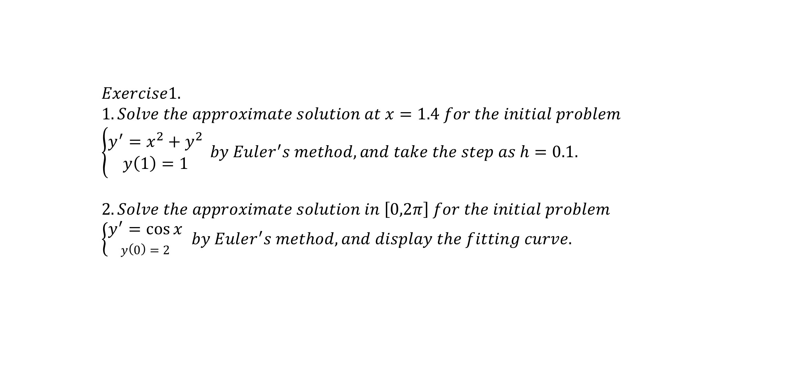
$$Exercise1.$$
$$1.Solve the approximate solution at x=1.4 for the initial problem$$ $\left\{\begin{aligned}y^{′}=x^{2}+y^{2} \\ y\left(1\right)=1\end{aligned}\right. by Euler^{′}s method, and take the step as h=0.1.$
$$2. Solve the approximate solution in \left[0,2π\right] for the initial problem \\ \left\{\begin{aligned}y^{′}=\cos{x} \\ y\left(0\right)=2\end{aligned} \right.by Euler^{′}s method, and display the fitting curve.$$

Slide 5
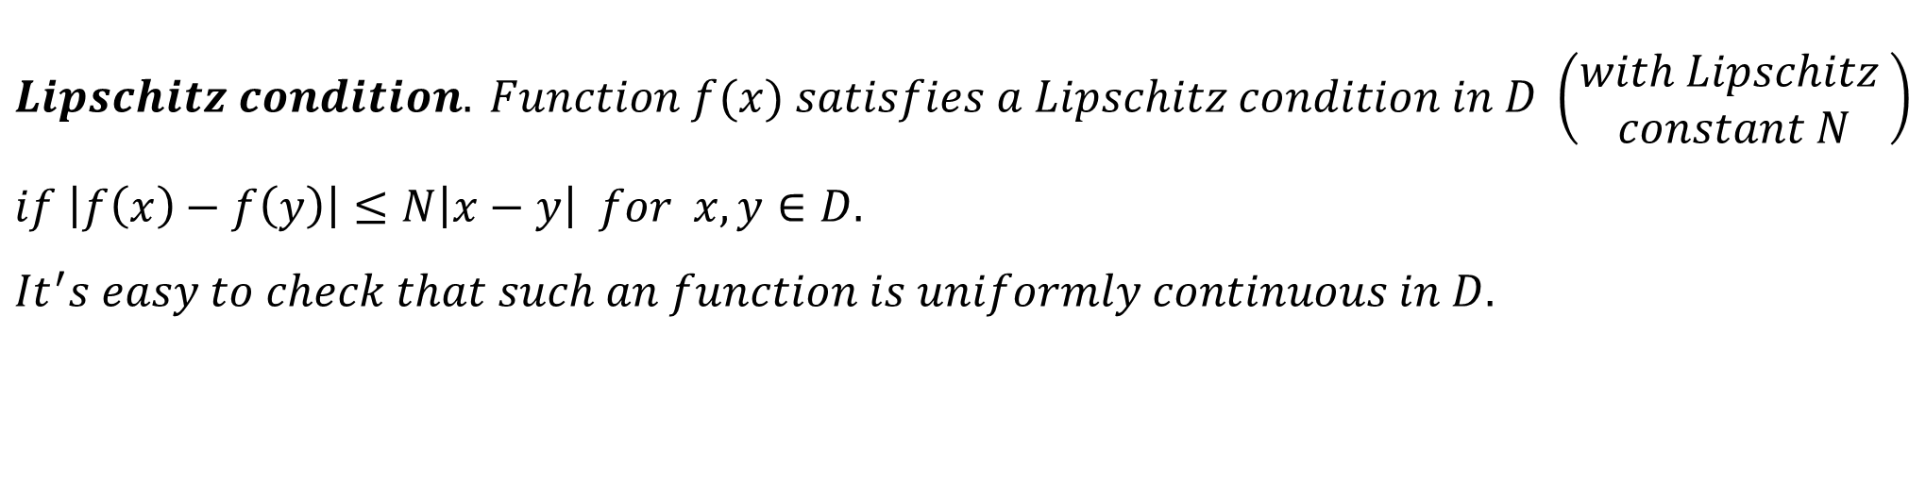
$$Lipschitz condition. Function f(x) satisfies a Lipschitz condition in D \left(\begin{aligned}with Lipschitz \\ constant N\end{aligned}\right) \\ if \left|f\left(x\right)−f\left(y\right)\right|≤N\left|x−y\right| for x,y∈D.$$
$${It}^{′}s easy to check that such an function is uniformly continuous in D.$$

Slide 6
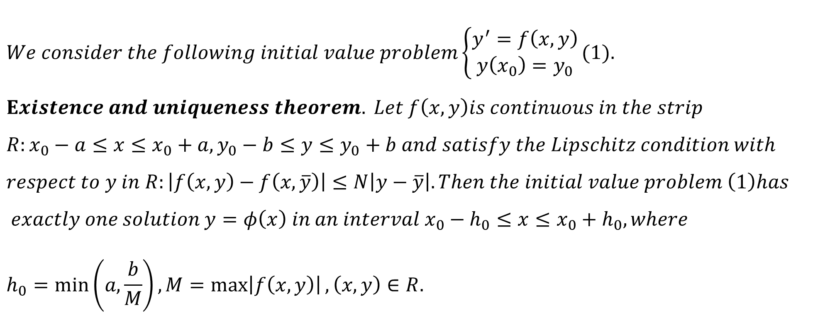
$$We consider the following initial value problem\left\{\begin{aligned}y^{′}=f\left(x,y\right) \\ y\left(x_{0}\right)=y_{0}\end{aligned}\right.(1). \\ Existence and uniqueness theorem. Let f\left(x,y\right)is continuous in the strip \\ R:x_{0}−a≤x≤x_{0}+a,y_{0}−b≤y≤y_{0}+b and satisfy the Lipschitz condition with \\ respect to y in R:\left|f\left(x,y\right)−f\left(x,\overline{y}\right)\right|≤N\left|y−\overline{y}\right|. Then the initial value problem \left(1\right)has$$
$$exactly one solution y=φ\left(x\right) in an interval x_{0}−h_{0}≤x≤x_{0}+h_{0}, where \\ h_{0}=\min\left(a,\frac{b}{M}\right),M=\max\left|f\left(x,y\right)\right|,\left(x,y\right)∈R.$$

Slide 7
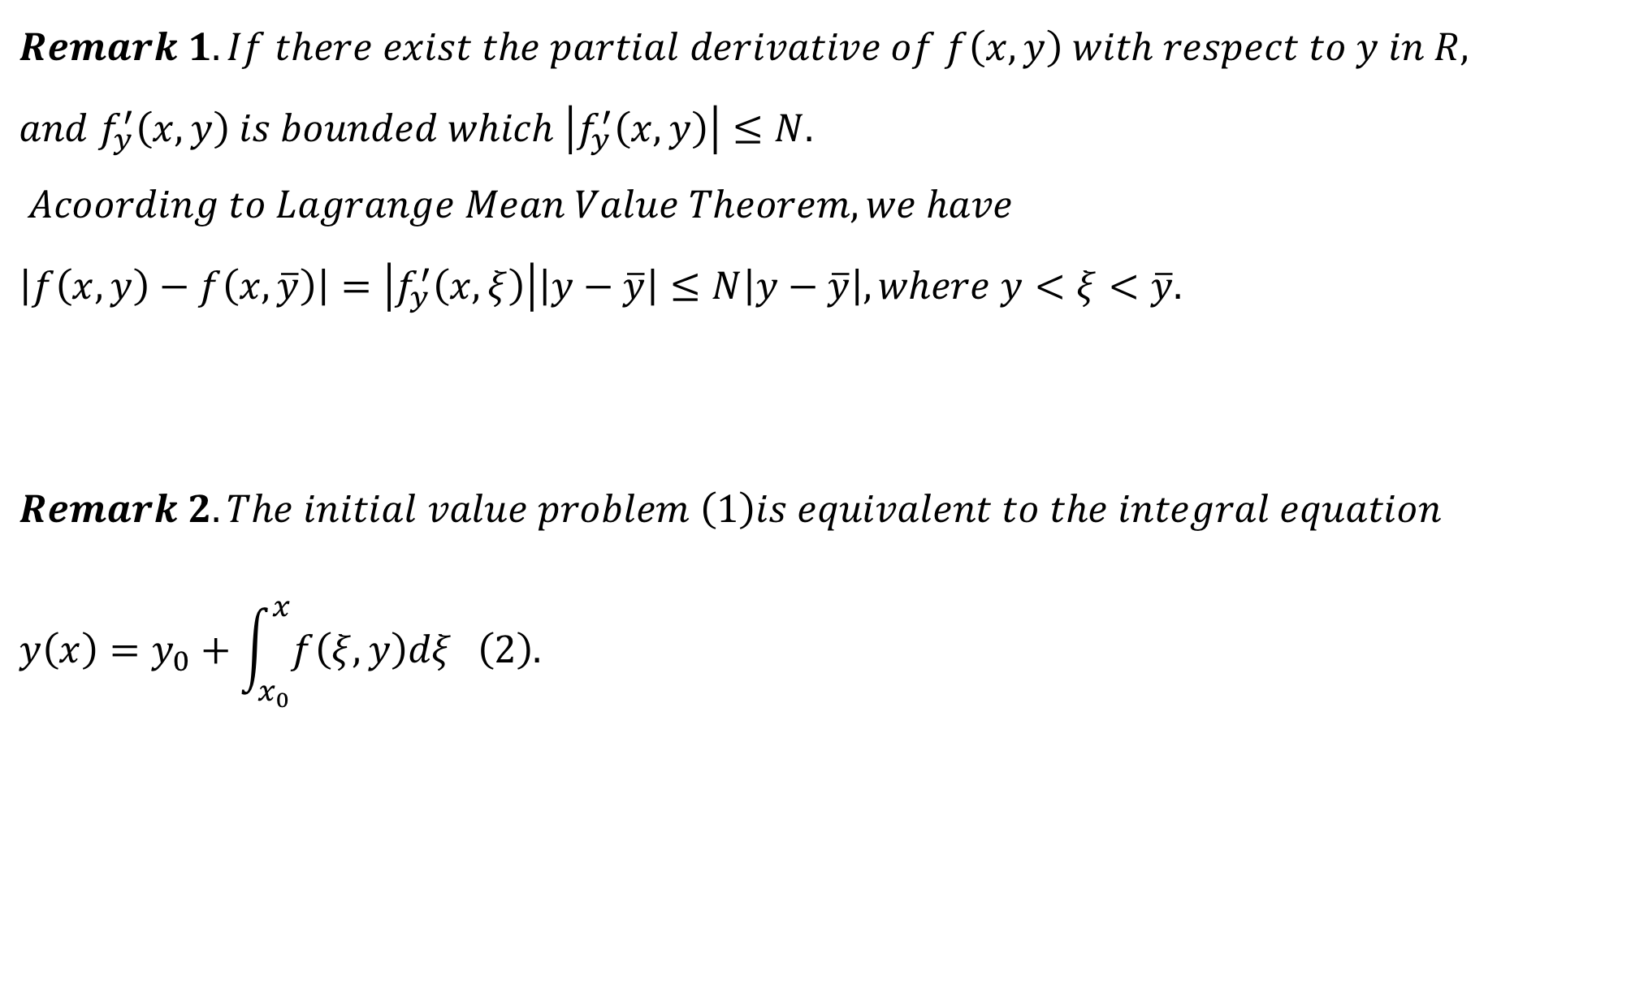
$$Remark 1. If there exist the partial derivative of f\left(x,y\right) with respect to y in R, \\ and f_{y}^{′}\left(x,y\right) is bounded which \left|f_{y}^{′}\left(x,y\right)\right|≤N. \\ Acoording to Lagrange Mean Value Theorem, we have \\ \left|f\left(x,y\right)−f\left(x,\overline{y}\right)\right|=\left|f_{y}^{′}\left(x,ξ\right)\right|\left|y−\overline{y}\right|≤N\left|y−\overline{y}\right|, where y<ξ<\overline{y}.$$
$$Remark 2. The initial value problem \left(1\right)is equivalent to the integral equation \\ y\left(x\right)=y_{0}+\int_{x_{0}}^{x}{f\left(ξ,y\right)dξ }\left(2\right).$$

Slide 8
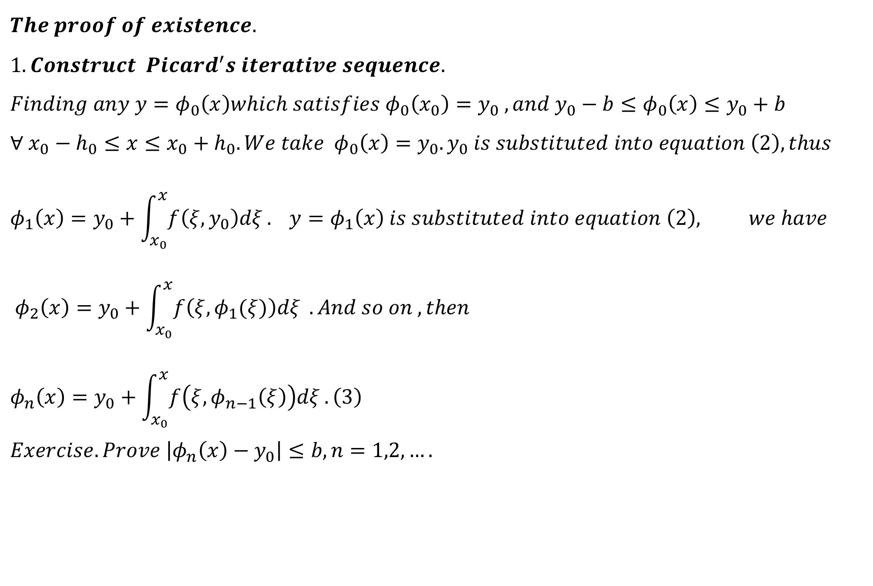
$$The proof of existence. \\ 1.Construct Picard^{′}s iterative sequence. \\ Finding any y=φ_{0}\left(x\right)which satisfies φ_{0}\left(x_{0}\right)=y_{0} ,and {y_{0}−b≤φ}_{0}\left(x\right)≤y_{0}+b \\ ∀ x_{0}−h_{0}≤x≤x_{0}+h_{0}. We take φ_{0}\left(x\right)=y_{0}.y_{0} is substituted into equation \left(2\right), thus \\ φ_{1}\left(x\right)=y_{0}+\int_{x_{0}}^{x}{f\left(ξ,y_{0}\right)dξ}. y=φ_{1}\left(x\right) is substituted into equation \left(2\right), we have \\ φ_{2}\left(x\right)=y_{0}+\int_{x_{0}}^{x}{f\left(ξ,φ_{1}(ξ)\right)dξ }. And so on ,then \\ φ_{n}\left(x\right)=y_{0}+\int_{x_{0}}^{x}{f\left(ξ,φ_{n−1}\left(ξ\right)\right)dξ}.\left(3\right) \\ Exercise. Prove \left|φ_{n}\left(x\right)−y_{0}\right|≤b,n=1,2,….$$

Slide 9
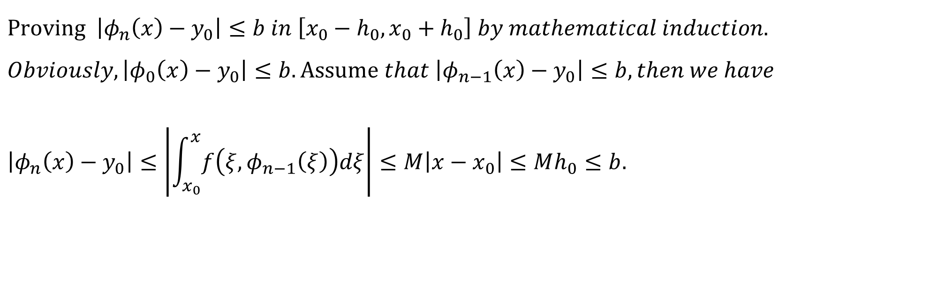
$$Proving \left|φ_{n}\left(x\right)−y_{0}\right|≤b in \left[x_{0}−h_{0},x_{0}+h_{0}\right] by mathematical induction. \\ Obviously, \left|φ_{0}\left(x\right)−y_{0}\right|≤b. Assume that \left|φ_{n−1}\left(x\right)−y_{0}\right|≤b, then we have$$
$$\left|φ_{n}\left(x\right)−y_{0}\right|≤\left|\int_{x_{0}}^{x}{f\left(ξ,φ_{n−1}\left(ξ\right)\right)dξ}\right|≤M\left|x−x_{0}\right|≤Mh_{0}≤b.$$

Slide 10
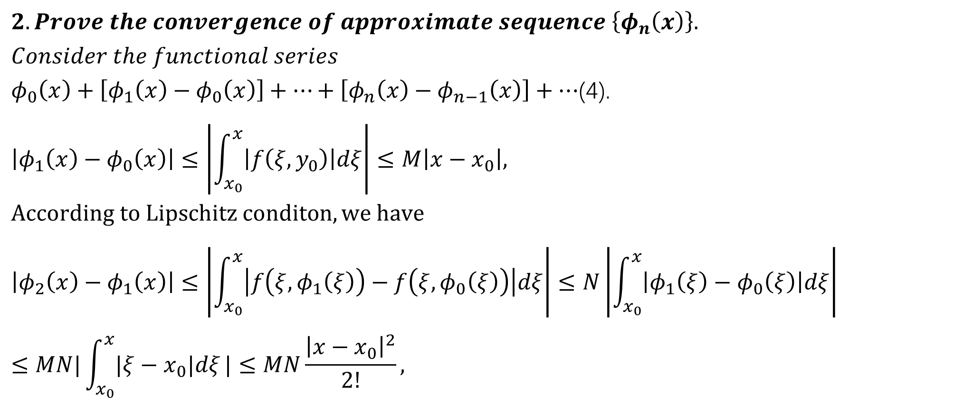
$$2. Prove the convergence of approximate sequence \left\{φ_{n}\left(x\right)\right\}. \\ Consider the functional series$$ $φ_{0}\left(x\right)+\left[φ_{1}\left(x\right)−φ_{0}\left(x\right)\right]+…+\left[φ_{n}\left(x\right)−φ_{n−1}\left(x\right)\right]+…$(4).
$$\left|φ_{1}\left(x\right)−φ_{0}\left(x\right)\right|≤\left|\int_{x_{0}}^{x}{\left|f\left(ξ,y_{0}\right)\right|dξ}\right|≤M\left|x−x_{0}\right|, \\ According to Lipschitz conditon,we have$$
$$\left|φ_{2}\left(x\right)−φ_{1}\left(x\right)\right|≤\left|\int_{x_{0}}^{x}{\left|f\left(ξ,φ_{1}\left(ξ\right)\right)−f\left(ξ,φ_{0}\left(ξ\right)\right)\right|dξ}\right|≤N\left|\int_{x_{0}}^{x}{\left|φ_{1}\left(ξ\right)−φ_{0}\left(ξ\right)\right|dξ}\right|$$
$$≤MN|\int_{x_{0}}^{x}{|ξ−x_{0}|dξ}|≤MN\frac{{\left|x−x_{0}\right|}^{2}}{2!},$$

Slide 11
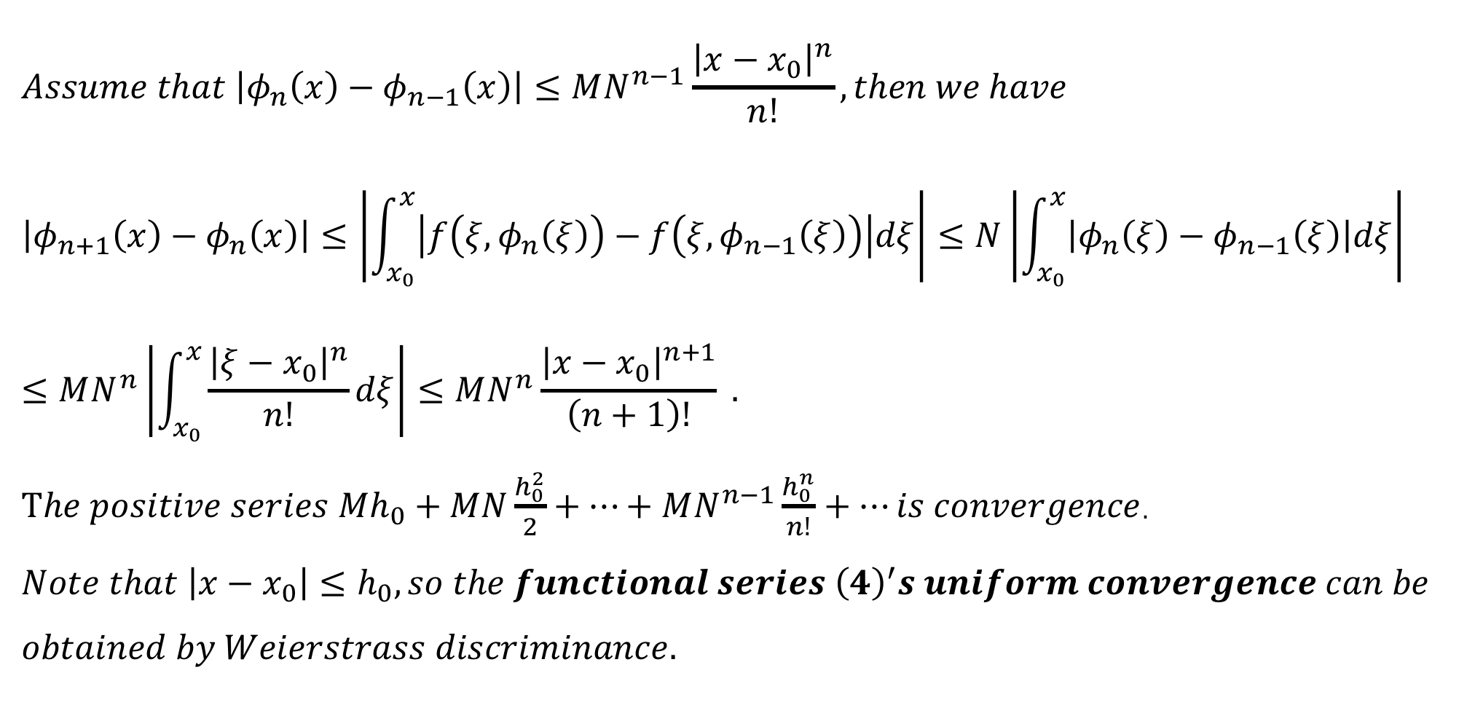
$$Assume that \left|φ_{n}\left(x\right)−φ_{n−1}\left(x\right)\right|≤MN^{n−1}\frac{{\left|x−x_{0}\right|}^{n}}{n!}, then we have \\ \left|φ_{n+1}\left(x\right)−φ_{n}\left(x\right)\right|≤\left|\int_{x_{0}}^{x}{\left|f\left(ξ,φ_{n}\left(ξ\right)\right)−f\left(ξ,φ_{n−1}\left(ξ\right)\right)\right|dξ}\right|≤N\left|\int_{x_{0}}^{x}{\left|φ_{n}\left(ξ\right)−φ_{n−1}\left(ξ\right)\right|dξ}\right|$$
$$≤MN^{n}\left|\int_{x_{0}}^{x}{\frac{{\left|ξ−x_{0}\right|}^{n}}{n!}dξ}\right|≤MN^{n}\frac{{\left|x−x_{0}\right|}^{n+1}}{\left(n+1\right)!} .$$ $The positive series Mh_{0}+MN\frac{h_{0}^{2}}{2}+…+MN^{n−1}\frac{h_{0}^{n}}{n!}+…is convergence$.
$$Note that \left|x−x_{0}\right|≤h_{0}, so the functional series {\left(4\right)}^{′}s uniform convergence can be$$
$$obtained by Weierstrass discriminance.$$

Slide 12
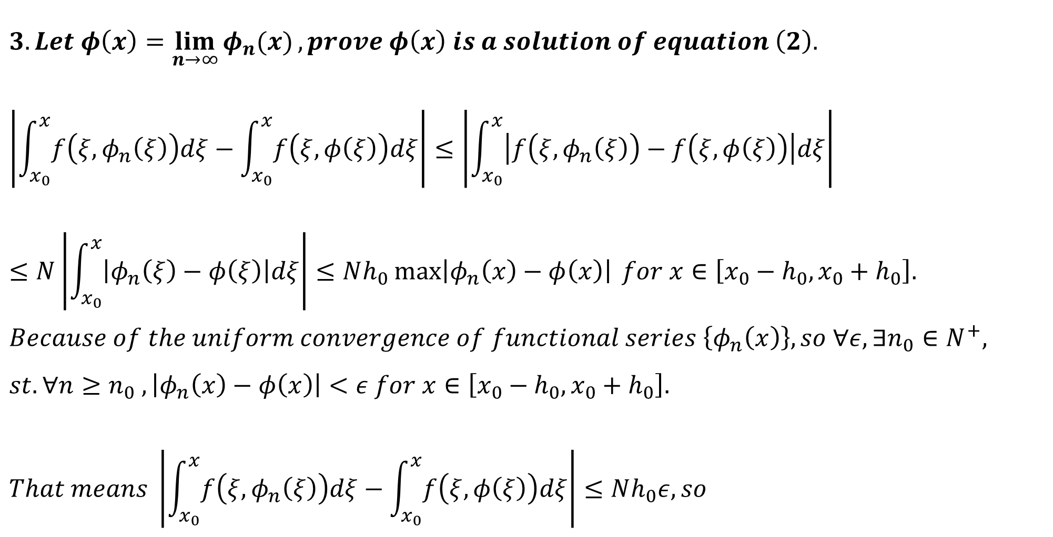
$3. Let φ\left(x\right)=\lim_{n→∞}{φ_{n}(x)}, prove φ\left(x\right) is a solution of equation \left(2\right).$
$$\left|\int_{x_{0}}^{x}{f\left(ξ,φ_{n}\left(ξ\right)\right)dξ}−\int_{x_{0}}^{x}{f\left(ξ,φ\left(ξ\right)\right)dξ}\right|≤\left|\int_{x_{0}}^{x}{\left|f\left(ξ,φ_{n}\left(ξ\right)\right)−f\left(ξ,φ\left(ξ\right)\right)\right|dξ}\right| \\ ≤N\left|\int_{x_{0}}^{x}{\left|φ_{n}\left(ξ\right)−φ\left(ξ\right)\right|dξ}\right|≤Nh_{0}\max\left|φ_{n}\left(x\right)−φ\left(x\right)\right| for x∈\left[x_{0}−h_{0},x_{0}+h_{0}\right]. \\ Because of the uniform convergence of functional series \left\{φ_{n}\left(x\right)\right\}, so ∀ε,∃n_{0}∈N^{+}, \\ st. ∀n≥n_{0} ,\left|φ_{n}\left(x\right)−φ\left(x\right)\right|<ε for x∈\left[x_{0}−h_{0},x_{0}+h_{0}\right]. \\ That means \left|\int_{x_{0}}^{x}{f\left(ξ,φ_{n}\left(ξ\right)\right)dξ}−\int_{x_{0}}^{x}{f\left(ξ,φ\left(ξ\right)\right)dξ}\right|≤Nh_{0}ε, so$$

Slide 13

$$\lim_{n→∞}{\int_{x_{0}}^{x}{f\left(ξ,φ_{n}\left(ξ\right)\right)dξ =}}\int_{x_{0}}^{x}{f\left(ξ,φ\left(ξ\right)\right)dξ}$$
$$\lim_{n→∞}{φ_{n}\left(x\right)=y_{0}+\lim_{n→∞}{\int_{x_{0}}^{x}{f\left(ξ,φ_{n−1}\left(ξ\right)\right)dξ}} is obtained by taking limit of equation (3)}. \\ That is φ\left(x\right)=y_{0}+\int_{x_{0}}^{x}{f\left(ξ,φ\left(ξ\right)\right)dξ}, thus the φ\left(x\right)is a solution of equation \left(2\right).$$

Slide 14
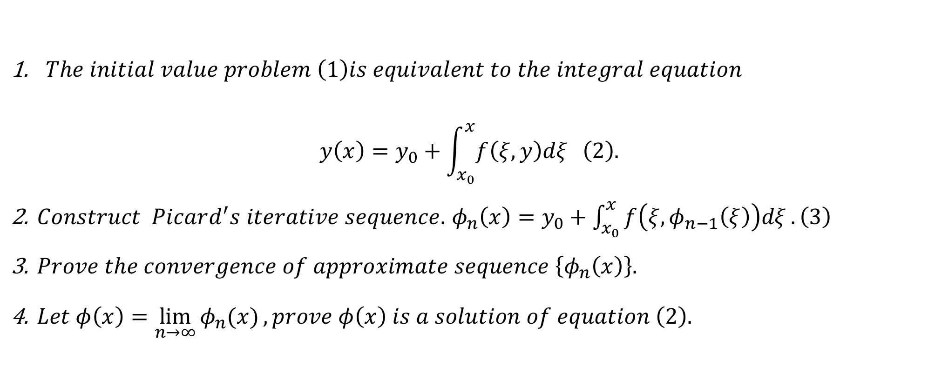
$The initial value problem \left(1\right)is equivalent to the integral equation$ $y\left(x\right)=y_{0}+\int_{x_{0}}^{x}{f\left(ξ,y\right)dξ }\left(2\right).$
$Construct Picard^{′}s iterative sequence.$ $φ_{n}\left(x\right)=y_{0}+\int_{x_{0}}^{x}{f\left(ξ,φ_{n−1}\left(ξ\right)\right)dξ}.\left(3\right)$
$Prove the convergence of approximate sequence \left\{φ_{n}\left(x\right)\right\}.$
$Let φ\left(x\right)=\lim_{n→∞}{φ_{n}(x)}, prove φ\left(x\right) is a solution of equation \left(2\right).$

Slide 15
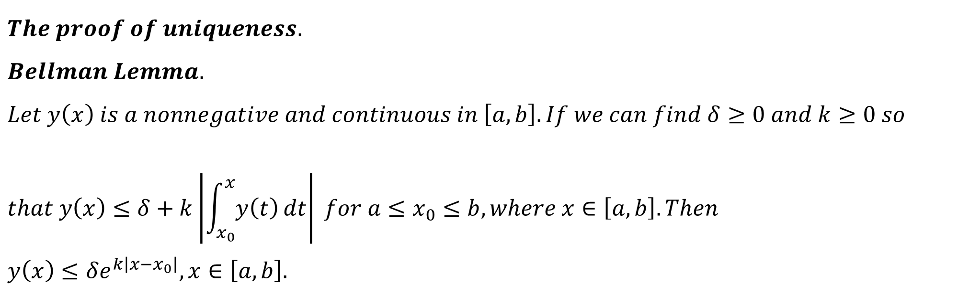
$$The proof of uniqueness. \\ Bellman Lemma. \\ Let y\left(x\right) is a nonnegative and continuous in \left[a,b\right]. If we can find δ≥0 and k≥0 so \\ that y\left(x\right)≤δ+k\left|\int_{x_{0}}^{x}{y\left(t\right)}dt\right| for {a≤x}_{0}≤b, where x∈\left[a,b\right]. Then \\ y\left(x\right)≤δe^{k\left|x−x_{0}\right|}, x∈\left[a,b\right].$$

Slide 16
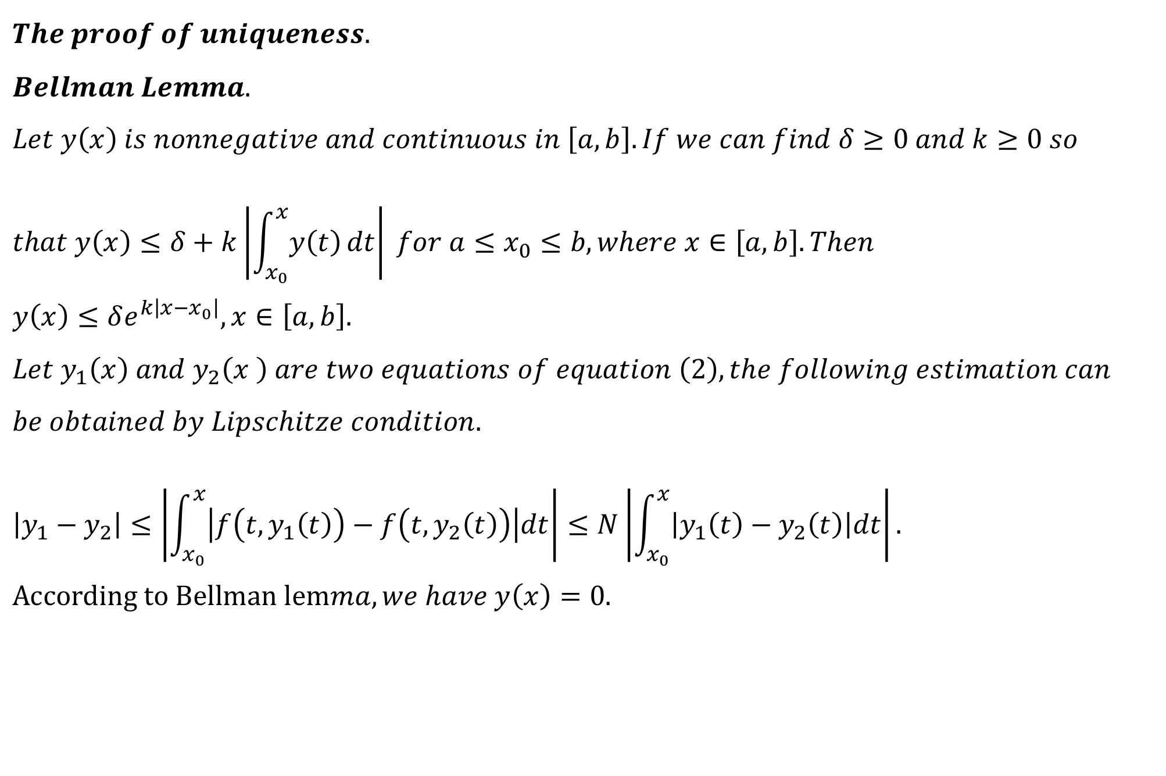
$$The proof of uniqueness. \\ Bellman Lemma. \\ Let y\left(x\right) is nonnegative and continuous in \left[a,b\right]. If we can find δ≥0 and k≥0 so \\ that y\left(x\right)≤δ+k\left|\int_{x_{0}}^{x}{y\left(t\right)}dt\right| for {a≤x}_{0}≤b, where x∈\left[a,b\right]. Then \\ y\left(x\right)≤δe^{k\left|x−x_{0}\right|}, x∈\left[a,b\right].$$
$$Let y_{1}\left(x\right) and y_{2}\left(x \right) are two equations of equation \left(2\right), the following estimation can \\ be obtained by Lipschitze condition. \\ \left|y_{1}−y_{2}\right|≤\left|\int_{x_{0}}^{x}{\left|f\left(t,y_{1}\left(t\right)\right)−f\left(t,y_{2}\left(t\right)\right)\right|dt}\right|≤N\left|\int_{x_{0}}^{x}{\left|y_{1}\left(t\right)−y_{2}\left(t\right)\right|dt}\right|. \\ According to Bellman lemma, we have y\left(x\right)=0.$$

Slide 17

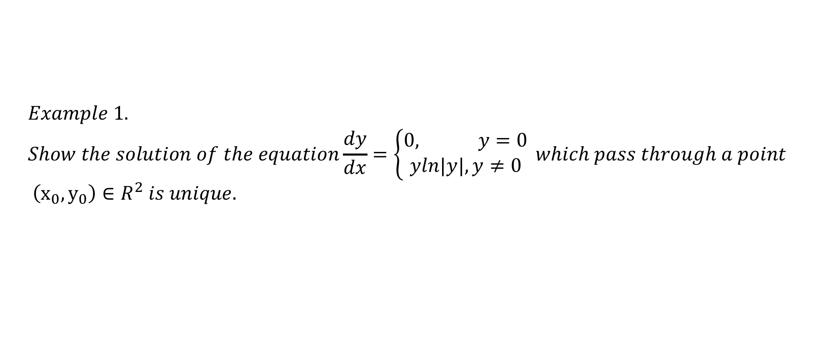
$$Example 1. \\ Show the solution of the equation\frac{dy}{dx}=\left\{\begin{aligned}0, y=0 \\ yln|y|, y≠0\end{aligned}\right. which pass through a point \\ \left(x_{0},y_{0}\right)∈R^{2} is unique.$$
$$Lipschitz condition is not the necessary condition for existence and uniqueness \\ of solution for the initial problem.$$

Slide 18
$$Example 2. \\ Discuss the uniqueness of the solution of \frac{dy}{dx}=3y^{\frac{2}{3}}.$$

Slide 19
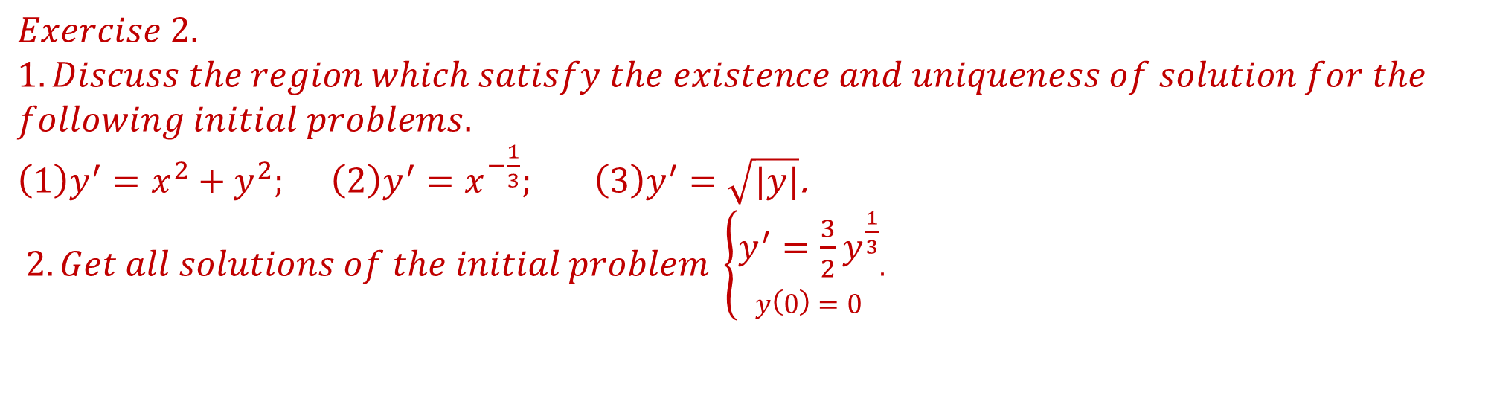
$$Exercise 2.$$
$$1.Discuss the region which satisfy the existence and uniqueness of solution for the \\ following initial problems.$$ $\left(1\right)y^{′}=x^{2}+y^{2}; \left(2\right)y^{′}=x^{−\frac{1}{3}}; \left(3\right)y^{′}=\sqrt{|y|}$.
$2. Get all solutions of the initial problem \left\{\begin{aligned}y^{′}=\frac{3}{2}y^{\frac{1}{3}} \\ y\left(0\right)=0\end{aligned}.\right.$

Slide 20
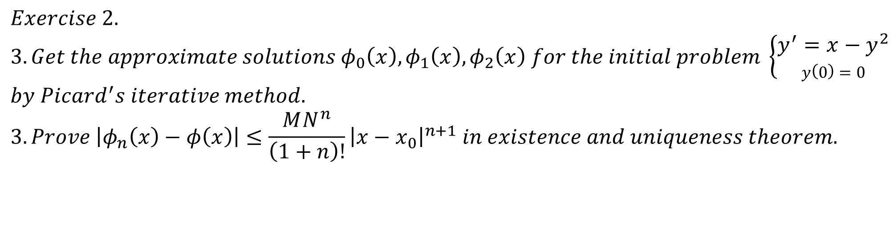
$$Exercise 2.$$
$$3. Get the approximate solutions φ_{0}\left(x\right),φ_{1}\left(x\right),φ_{2}\left(x\right) for the initial problem \left\{\begin{aligned}y^{′}=x−y^{2} \\ y\left(0\right)=0\end{aligned} \right.$$
$$by Picard^{′}s iterative method. \\ 3.Prove \left|φ_{n}\left(x\right)−φ\left(x\right)\right|≤\frac{MN^{n}}{\left(1+n\right)!}{\left|x−x_{0}\right|}^{n+1} in existence and uniqueness theorem.$$

Slide 21
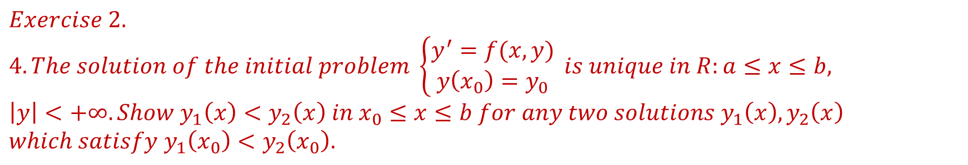
$$Exercise 2.$$
$$4. The solution of the initial problem \left\{\begin{aligned}y^{′}=f(x,y) \\ y\left(x_{0}\right)=y_{0}\end{aligned}\right. is unique in R:a≤x≤b, \\ \left|y\right|<+∞. Show y_{1}\left(x\right)<y_{2}\left(x\right) in x_{0}≤x≤b for any two solutions y_{1}\left(x\right),y_{2}\left(x\right) \\ which satisfy y_{1}\left(x_{0}\right)<y_{2}\left(x_{0}\right).$$

Slide 22
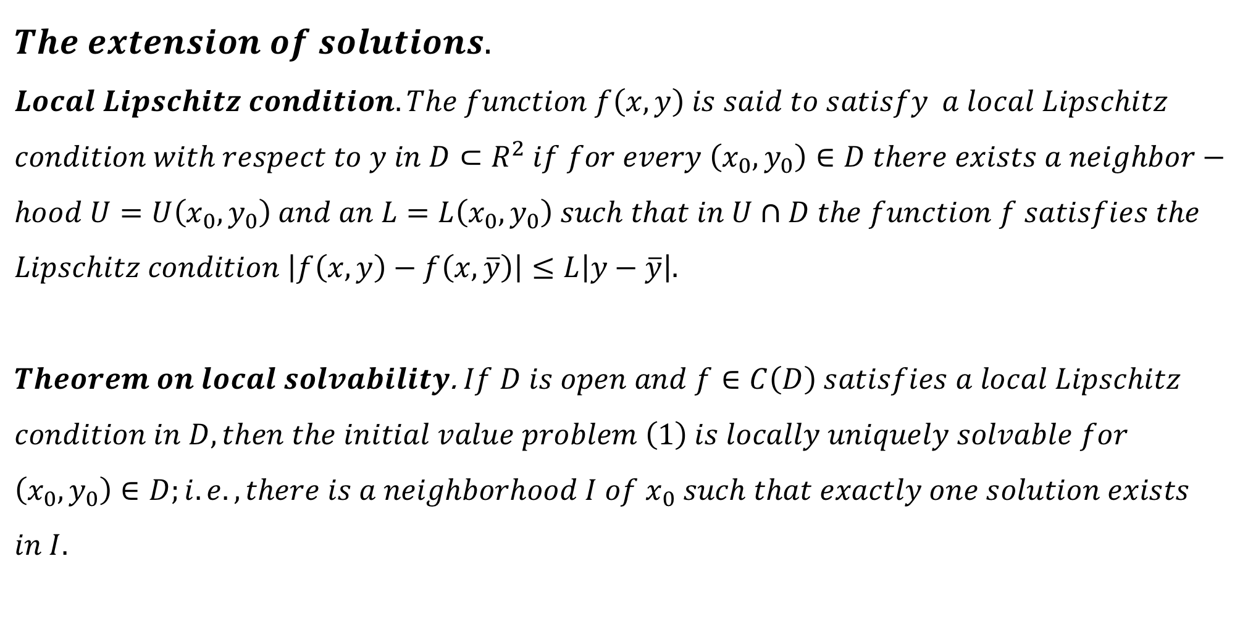
$$The extension of solutions.$$
$$Local Lipschitz condition. The function f\left(x,y\right) is said to satisfy a local Lipschitz \\ condition with respect to y in D⊂R^{2} if for every \left(x_{0},y_{0}\right)∈D there exists a neighbor− \\ hood U=U\left(x_{0},y_{0}\right) and an L=L\left(x_{0},y_{0}\right) such that in U∩D the function f satisfies the \\ Lipschitz condition \left|f\left(x,y\right)−f\left(x,\overline{y}\right)\right|≤L\left|y−\overline{y}\right|.$$
$Theorem on local solvability$. $If D is open and f∈C\left(D\right) satisfies a local Lipschitz$ $$condition in D, then the initial value problem \left(1\right) is locally uniquely solvable for \\ \left(x_{0},y_{0}\right)∈D;i.e., there is a neighborhood I of x_{0} such that exactly one solution exists \\ in I.$$

Slide 23
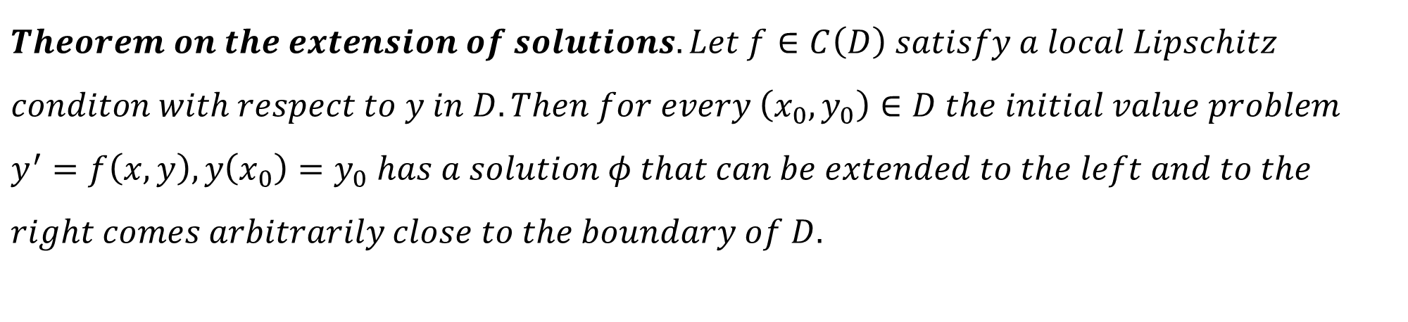
$$Theorem on the extension of solutions. Let f∈C\left(D\right) satisfy a local Lipschitz \\ conditon with respect to y in D. Then for every \left(x_{0},y_{0}\right)∈D the initial value problem \\ y^{′}=f\left(x,y\right),y\left(x_{0}\right)=y_{0} has a solution φ that can be extended to the left and to the \\ right comes arbitrarily close to the boundary of D.$$

Slide 24
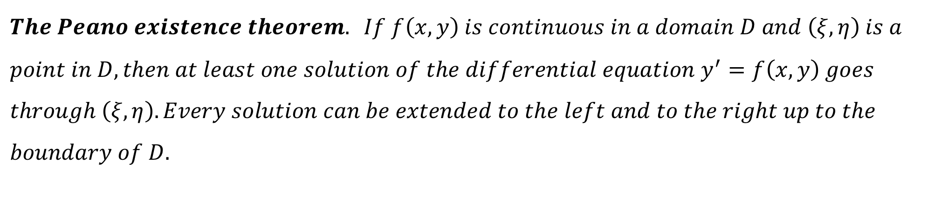
$$The Peano existence theorem. If f\left(x,y\right) is continuous in a domain D and \left(ξ,η\right) is a \\ point in D, then at least one solution of the differential equation y^{′}=f\left(x,y\right) goes \\ through \left(ξ,η\right). Every solution can be extended to the left and to the right up to the \\ boundary of D.$$

Slide 25
$$Example 1.$$
$$Discuss the existence of the solutions of y^{′}=y^{2},y\left(1\right)=1 and{ y}^{′}=y^{2},y\left(3\right)=−1.$$

Slide 26

$$Example 2.$$
$$Discuss the existence of the solution of y^{′}=−\frac{1}{x^{2}}\cos{\frac{1}{x}}.$$

Slide 27
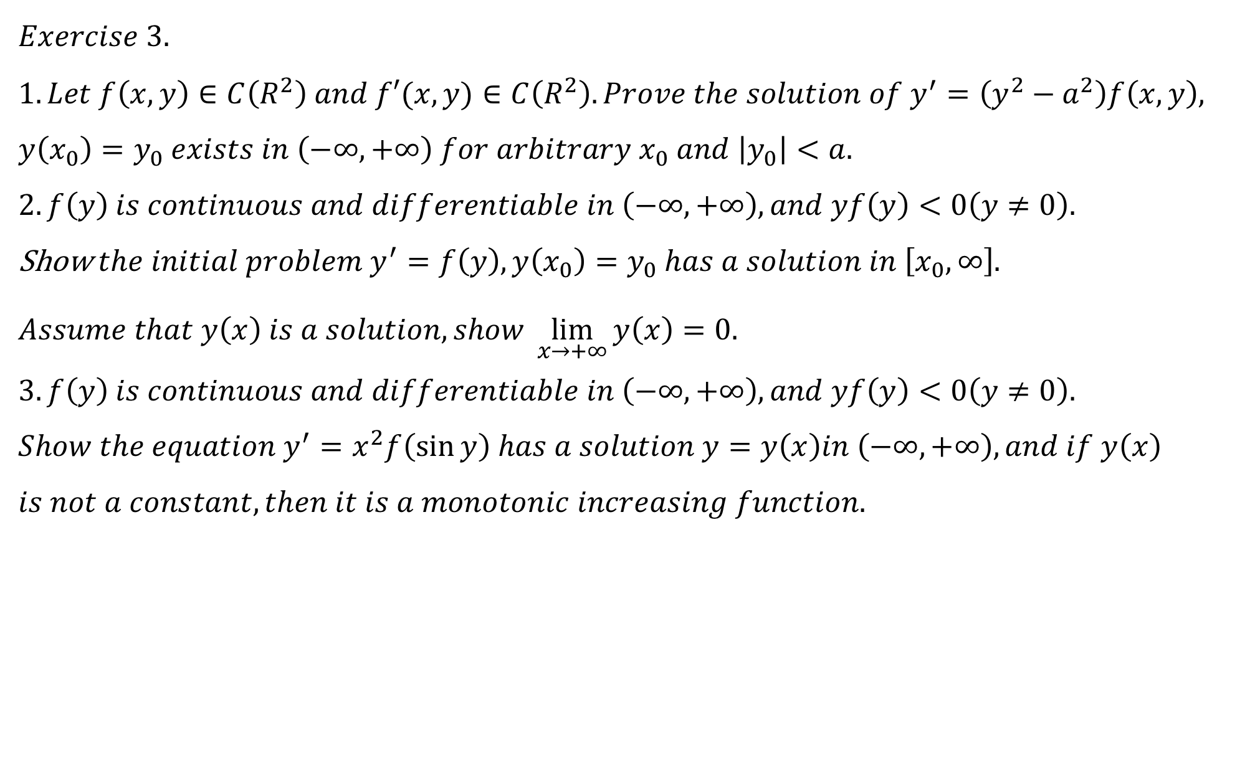
$$Exercise 3.$$
$$1. Let f\left(x,y\right)∈C\left(R^{2}\right) and f′(x,y)∈C\left(R^{2}\right). Prove the solution of{ y}^{′}=\left(y^{2}−a^{2}\right)f\left(x,y\right),$$
$$y\left(x_{0}\right)=y_{0} exists in \left(−∞,+∞\right) for arbitrary x_{0} and \left|y_{0}\right|<a. \\ 2. f\left(y\right) is continuous and differentiable in \left(−∞,+∞\right), and yf\left(y\right)<0\left(y≠0\right).$$ Show $the initial problem y^{′}=f\left(y\right),y\left(x_{0}\right)=y_{0} has a solution in \left[x_{0},∞\right].$ $$Assume that y\left(x\right) is a solution, show \lim_{x→+∞}{y\left(x\right)=0.} \\ 3.f\left(y\right) is continuous and differentiable in \left(−∞,+∞\right), and yf\left(y\right)<0\left(y≠0\right). \\ Show the equation y^{′}=x^{2}f\left(\sin{y}\right) has a solution y=y\left(x\right)in \left(−∞,+∞\right), and if y\left(x\right) \\ is not a constant, then it is a monotonic increasing function.$$

Slide 28
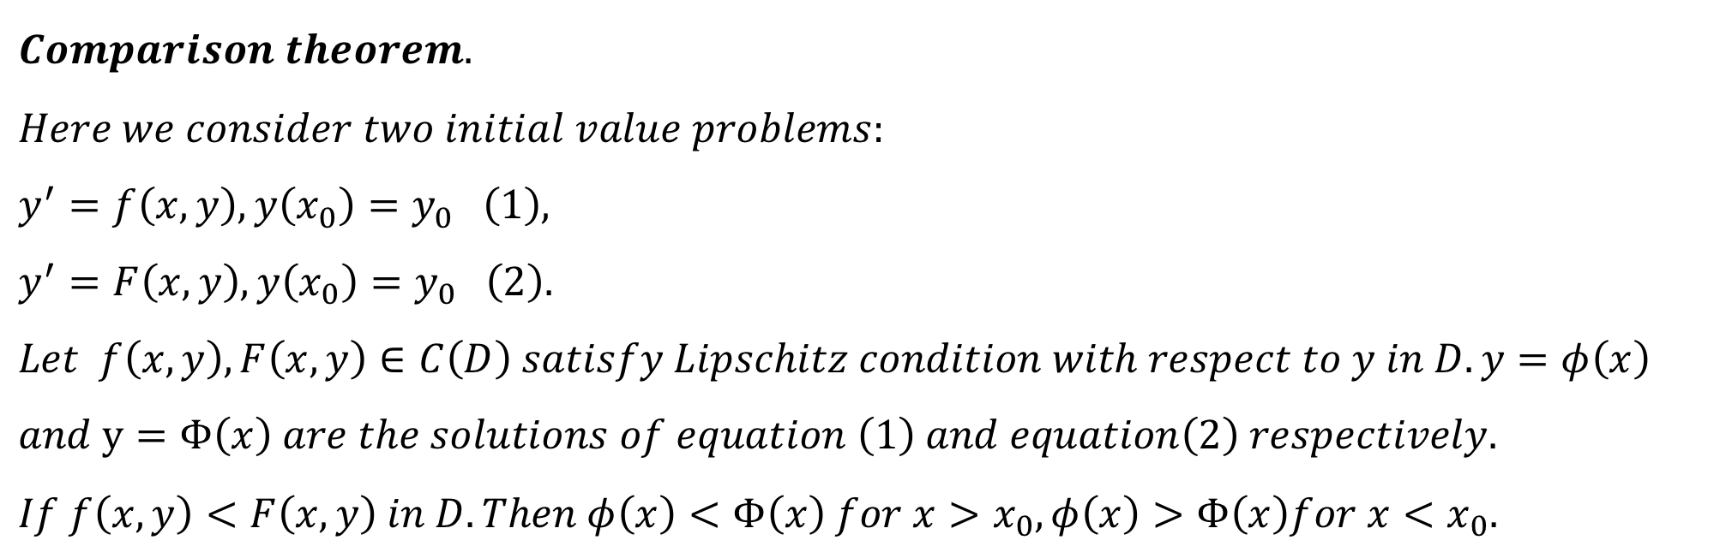
$$Comparison theorem. \\ Here we consider two initial value problems:$$
$$y^{′}=f\left(x,y\right),y\left(x_{0}\right)=y_{0} \left(1\right), \\ y^{′}=F\left(x,y\right),y\left(x_{0}\right)=y_{0} \left(2\right). \\ Let f\left(x,y\right),F\left(x,y\right)∈C\left(D\right) satisfy Lipschitz condition with respect to y in D. y=φ\left(x\right) \\ and y=Φ\left(x\right) are the solutions of equation \left(1\right) and equation\left(2\right) respectively. \\ If f\left(x,y\right)<F\left(x,y\right) in D. Then φ\left(x\right)<Φ\left(x\right) for x>x_{0}, φ\left(x\right)>Φ\left(x\right)for x<x_{0}.$$

Slide 29

$$Upper solutions, Lower solutions. \\ Let f\left(x,y\right) be defined in D, D⊂R^{2} arbitary. The function v\left(x\right) is called a lower \\ solution \left(or subsolution \right)and w\left(x\right) is called an upper solution \left(or supersolution\right) \\ of the initial value problem y^{′}=f\left(x,y\right) in J=\left[x_{0},x_{0}+h_{0}\right], y\left(x_{0}\right)=y_{0}, \\ if it is differentiable in J and \\ v^{′}<f\left(x,v\right) in J, v\left(x_{0}\right)≤y_{0}, lower solution,$$
$$w^{′}>f\left(x,w\right) in J, w\left(x_{0}\right)≥y_{0}, upper solution.$$
$$Naturally, v\left(x\right)<y\left(x\right)<w\left(x\right) in J_{0}:x_{0}<x≤x_{0}+h_{0}.$$

Slide 30
$$Example .$$
$$We consider the equation y^{′}=x^{2}+y^{2}, y\left(0\right)=1.$$

Slide 31
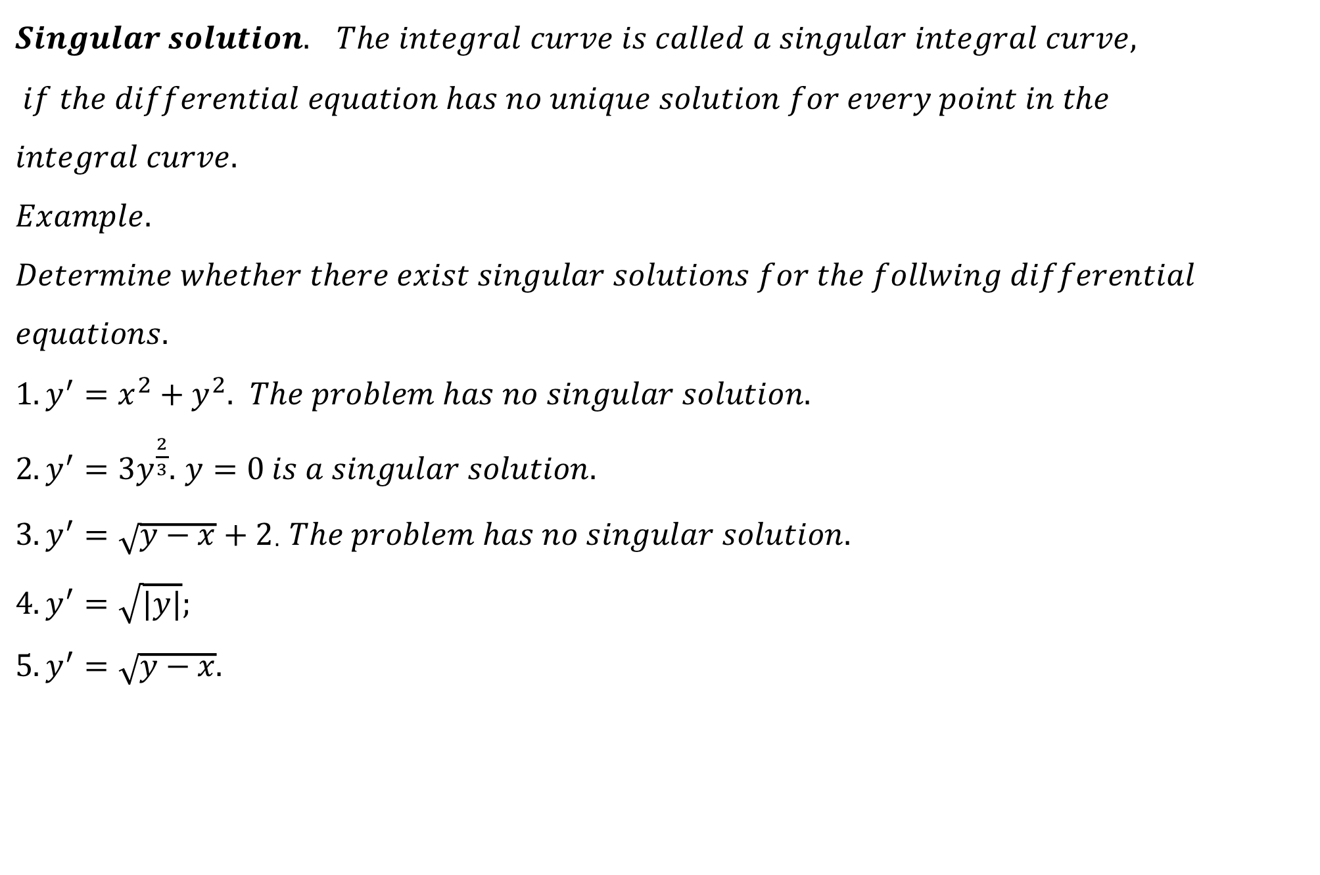
$$Singular solution. The integral curve is called a singular integral curve, \\ if the differential equation has no unique solution for every point in the \\ integral curve. \\ Example. \\ Determine whether there exist singular solutions for the follwing differential \\ equations.$$ $1. y^{′}=x^{2}+y^{2}.$ $The problem has no singular solution.$ $2.y^{′}=3y^{\frac{2}{3}}.$ $y=0 is a singular solution.$ $3. y^{′}=\sqrt{y−x}+2$. $The problem has no singular solution.$ $$4.y^{′}=\sqrt{|y|}; \\ 5. y^{′}=\sqrt{y−x}.$$

Slide 32
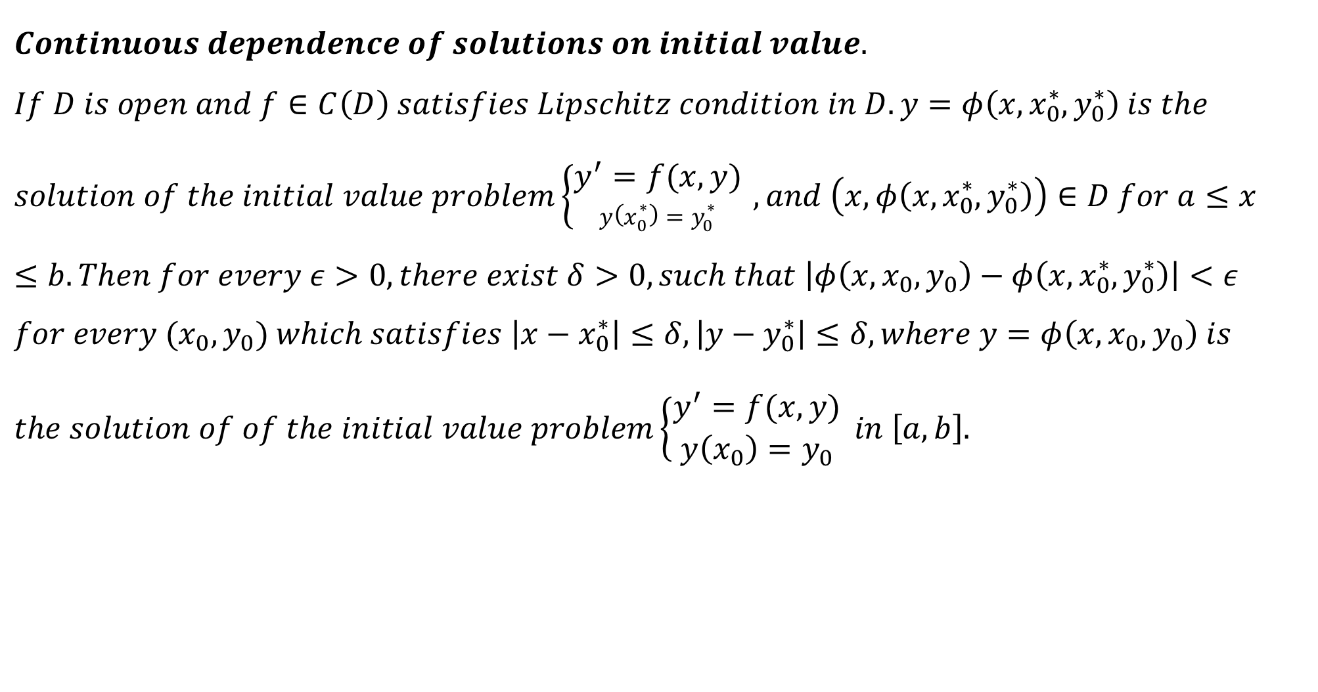
$$Continuous dependence of solutions on initial value. \\ If D is open and f∈C\left(D\right) satisfies Lipschitz condition in D. y=φ\left(x,x_{0}^{∗},y_{0}^{∗}\right) is the \\ solution of the initial value problem\left\{\begin{aligned}y^{′}=f(x,y) \\ y\left(x_{0}^{∗}\right)=y_{0}^{∗}\end{aligned} \right., and \left(x,φ\left(x,x_{0}^{∗},y_{0}^{∗}\right)\right)∈D for a≤x≤b. Then for every ε>0, there exist δ>0, such that \left|φ\left(x,x_{0},y_{0}\right)−φ\left(x,x_{0}^{∗},y_{0}^{∗}\right)\right|<ε \\ for every {(x}_{0},y_{0}) which satisfies \left|x−x_{0}^{∗}\right|≤δ,\left|y−y_{0}^{∗}\right|≤δ, where y=φ\left(x,x_{0},y_{0}\right) is \\ the solution of of the initial value problem\left\{\begin{aligned}y^{′}=f(x,y) \\ y\left(x_{0}\right)=y_{0}\end{aligned} \right.in \left[a,b\right].$$

Slide 33
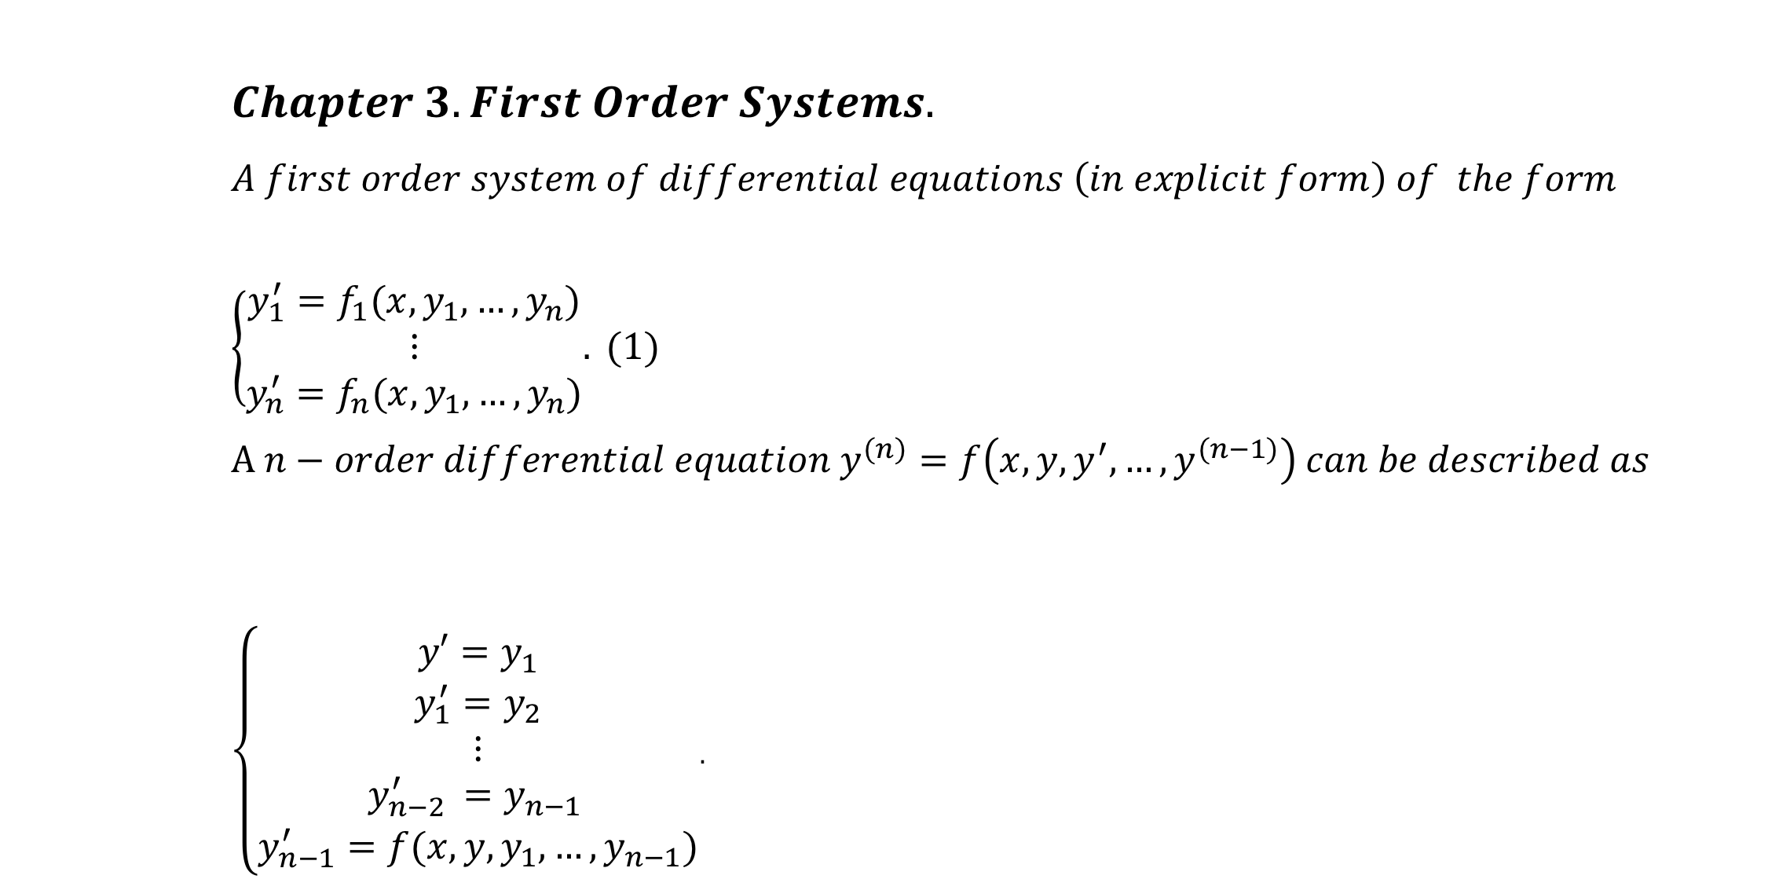
$$Chapter 3. First Order Systems. \\ A first order system of differential equations \left(in explicit form\right) of the form \\ \left\{\begin{aligned}y_{1}^{′}=f_{1}(x,y_{1},…,y_{n}) \\ ⋮ \\ y_{n}^{′}=f_{n}(x,y_{1},…,y_{n})\end{aligned}.\right. (1) \\ A n−order differential equation y^{(n)}=f\left(x,y,y^{′},…,y^{(n−1)}\right) can be described as$$ $\left\{\begin{aligned}y′=y_{1} \\ y_{1}^{′}=y_{2} \\ ⋮ \\ y_{n−2 }^{′}=y_{n−1 } \\ y_{n−1}^{′}=f(x,y,y_{1},…,y_{n−1})\end{aligned}\right.$.

Slide 34
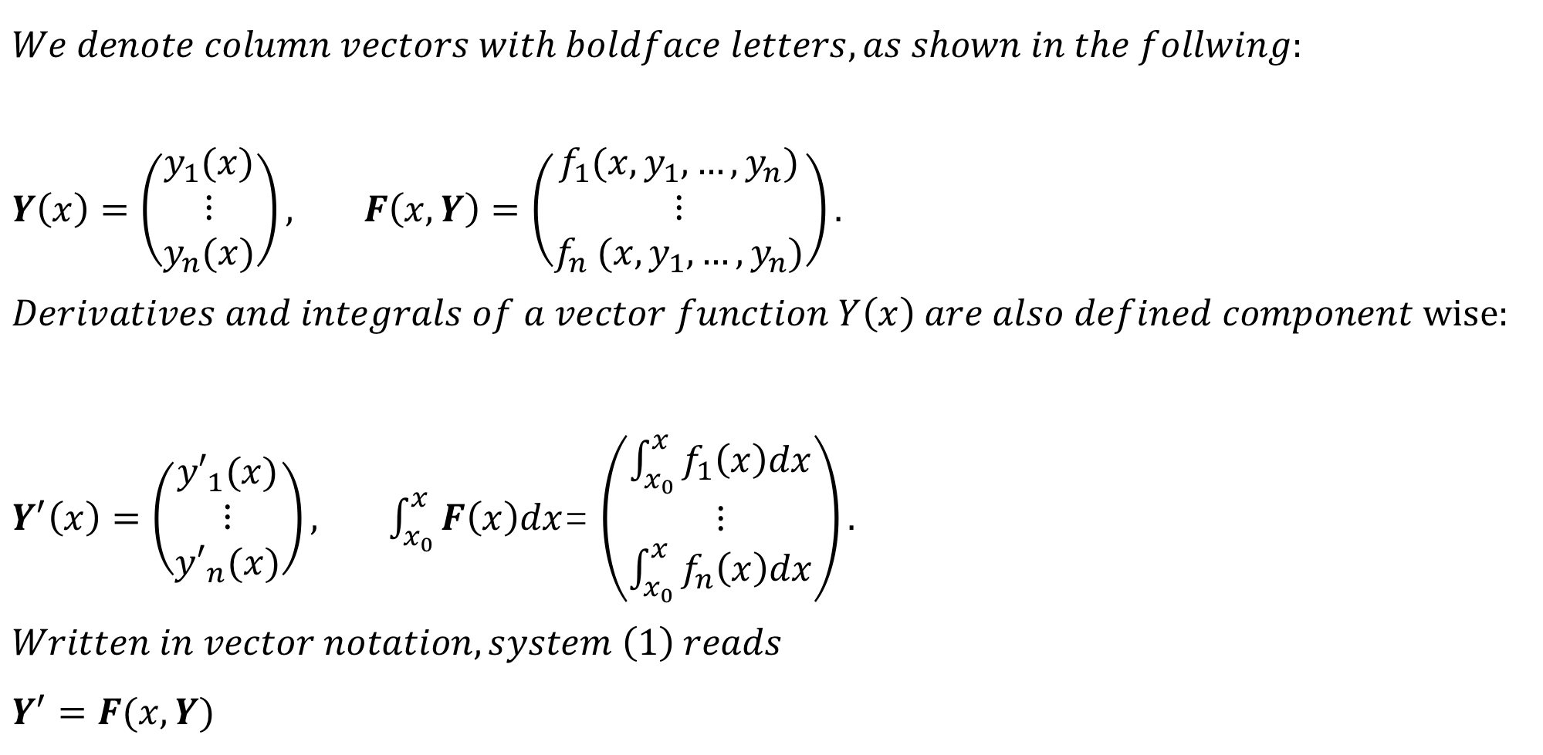
$$We denote column vectors with boldface letters, as shown in the follwing:$$ $Y\left(x\right)=\left(\begin{matrix}y_{1}(x) \\ ⋮ \\ y_{n}(x)\end{matrix}\right), F\left(x,Y\right)=$ $\left(\begin{matrix}f_{1}(x,y_{1},…,y_{n}) \\ ⋮ \\ f_{n} (x,y_{1},…,y_{n})\end{matrix}\right).$ $$Derivatives and integrals of a vector function Y\left(x\right) are also defined component wise:$$ $Y^{′}\left(x\right)=\left(\begin{matrix}{y′}_{1}(x) \\ ⋮ \\ {y′}_{n}(x)\end{matrix}\right), \int_{x_{0}}^{x}{F\left(x\right)dx}$= $\left(\begin{matrix}\int_{x_{0}}^{x}{f_{1}\left(x\right)dx} \\ ⋮ \\ \int_{x_{0}}^{x}{f_{n}\left(x\right)dx}\end{matrix}\right).$ $$Written in vector notation, system \left(1\right) reads \\ Y^{′}=F(x,Y)$$

Slide 35
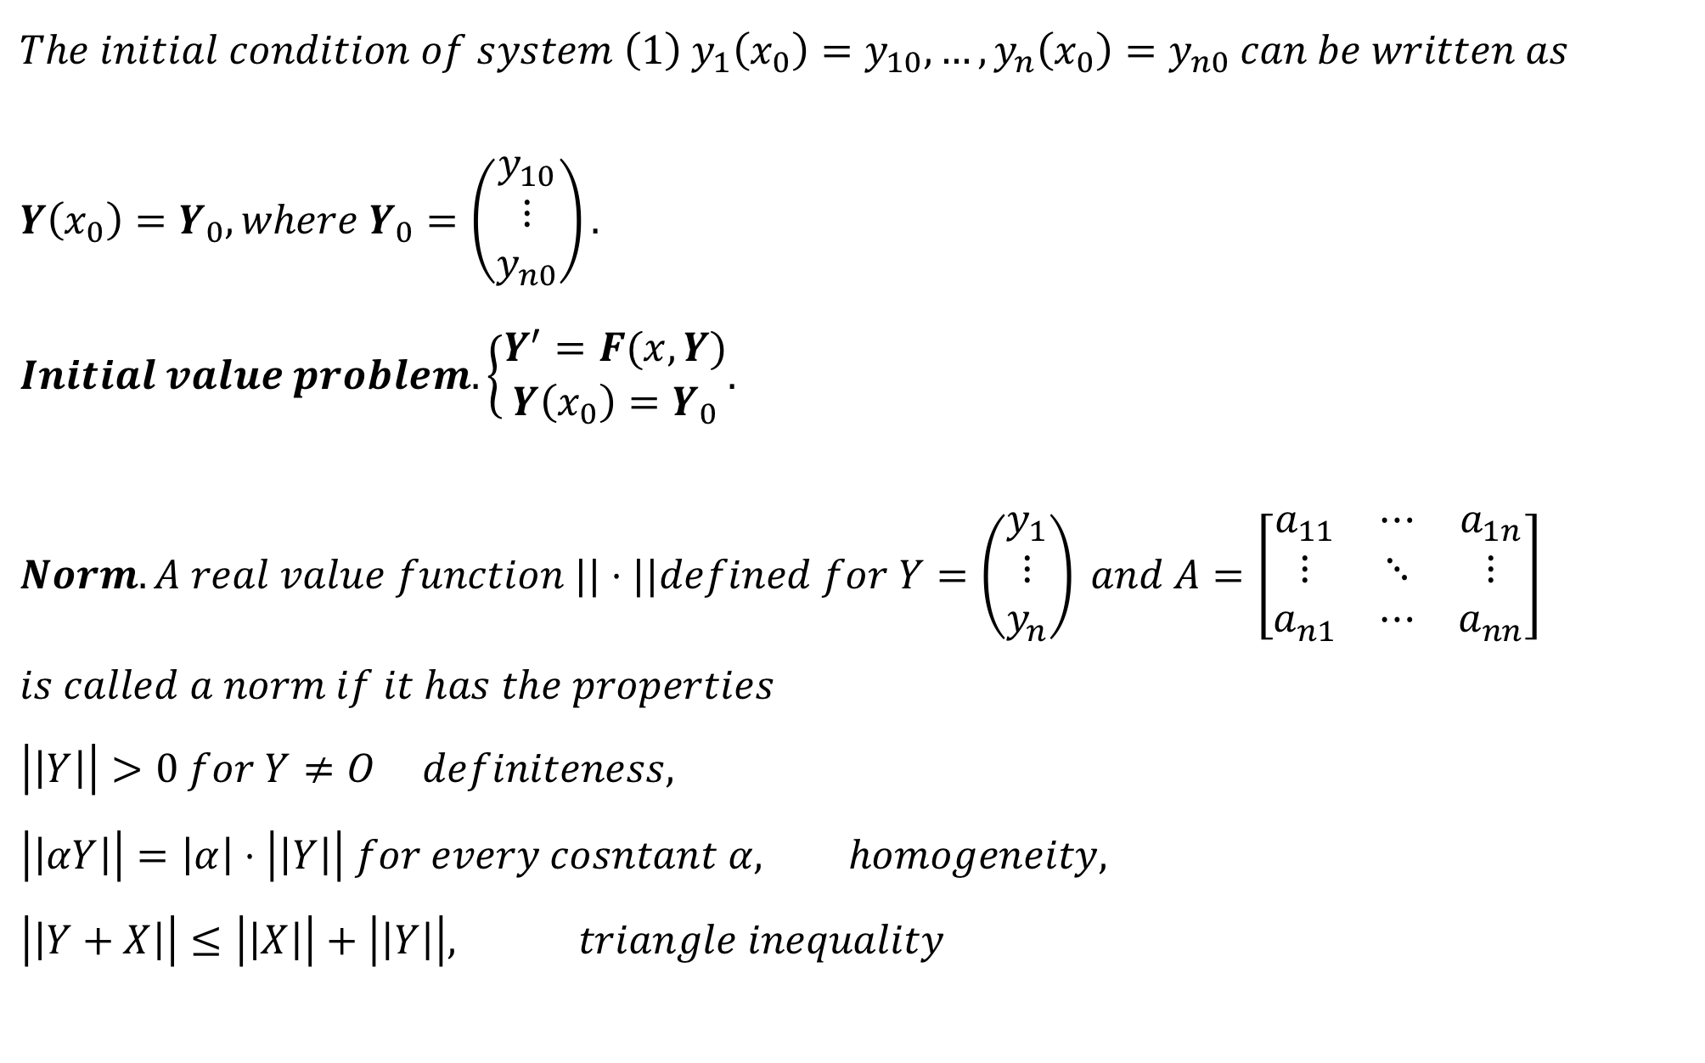
$$The initial condition of system \left(1\right) y_{1}\left(x_{0}\right)=y_{10}, …, y_{n}\left(x_{0}\right)=y_{n0} can be written as \\ Y\left(x_{0}\right)=Y_{0}, where Y_{0}=\left(\begin{matrix}y_{10} \\ ⋮ \\ y_{n0}\end{matrix}\right). \\ Initial value problem. \left\{\begin{aligned}Y^{′}=F(x,Y) \\ Y\left(x_{0}\right)=Y_{0}\end{aligned}.\right. \\ Norm.A real value function ||⋅||defined for Y=\left(\begin{matrix}y_{1} \\ ⋮ \\ y_{n}\end{matrix}\right) and A=\left[\begin{matrix}a_{11} & ⋯ & a_{1n} \\ ⋮ & ⋱ & ⋮ \\ a_{n1} & ⋯ & a_{nn}\end{matrix}\right] \\ is called a norm if it has the properties \\ \left|\left|Y\right|\right|>0 for Y≠O definiteness, \\ \left|\left|αY\right|\right|=\left|α\right|⋅\left|\left|Y\right|\right| for every cosntant α, homogeneity, \\ \left|\left|Y+X\right|\right|≤\left|\left|X\right|\right|+\left|\left|Y\right|\right|, triangle inequality$$

Slide 36
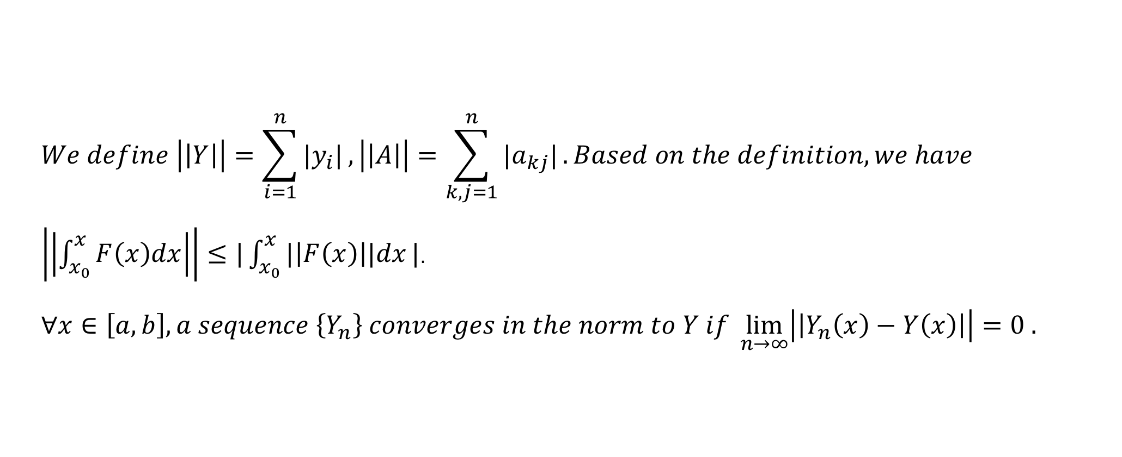
$$We define \left|\left|Y\right|\right|=\sum_{i=1}^{n}{|y_{i}|},\left|\left|A\right|\right|=\sum_{k,j=1}^{n}{|a_{kj}|}. Based on the definition, we have$$ $\left|\left|\int_{x_{0}}^{x}{F\left(x\right)dx}\right|\right|≤|\int_{x_{0}}^{x}{|\left|F\left(x\right)\right||dx}|$. $$∀x∈\left[a,b\right], a sequence \left\{Y_{n}\right\} converges in the norm to Y if \lim_{n→∞}\left|\left|Y_{n}\left(x\right)−Y\left(x\right)\right|\right|=0 .$$

Slide 37
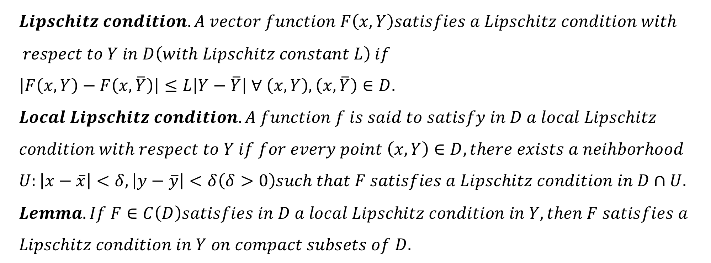
$$Lipschitz condition. A vector function F\left(x,Y\right)satisfies a Lipschitz condition with \\ respect to Y in D\left(with Lipschitz constant L\right) if \\ \left|F\left(x,Y\right)−F\left(x,\overline{Y}\right)\right|≤L\left|Y−\overline{Y}\right| ∀ \left(x,Y\right),\left(x,\overline{Y}\right)∈D. \\ Local Lipschitz condition. A function f is said to satisfy in D a local Lipschitz \\ condition with respect to Y if for every point \left(x,Y\right)∈D, there exists a neihborhood \\ U:\left|x−\overline{x}\right|<δ,\left|y−\overline{y}\right|<δ\left(δ>0\right)such that F satisfies a Lipschitz condition in D∩U. \\ Lemma. If F∈C\left(D\right)satisfies in D a local Lipschitz condition in Y, then F satisfies a \\ Lipschitz condition in Y on compact subsets of D.$$

Slide 38
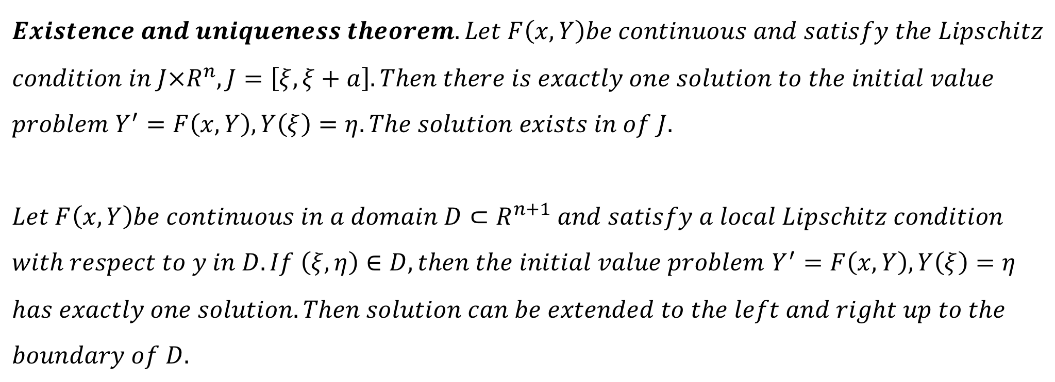
$$Existence and uniqueness theorem. Let F\left(x,Y\right)be continuous and satisfy the Lipschitz \\ condition in J×R^{n}, J=\left[ξ,ξ+a\right]. Then there is exactly one solution to the initial value \\ problem Y^{′}=F\left(x,Y\right), Y\left(ξ\right)=η. The solution exists in of J.$$
$$Let F\left(x,Y\right)be continuous in a domain D⊂R^{n+1} and satisfy a local Lipschitz condition$$ $with respect to y in D. If \left(ξ,η\right)∈D, then the initial value problem$ $Y^{′}=F\left(x,Y\right), Y\left(ξ\right)=η$ $$has exactly one solution. Then solution can be extended to the left and right up to the \\ boundary of D.$$

