Slide 1
Social Media Impacts on Stock Market Trends
Twitter Feeds vs Tesla Stocks
Yuvraj Bhati | Behnam Hashemi | Mohammad A. Jilani | Gobinath Thangaiya
UofT Data Analytics Bootcamp, April-Sept 2021

Slide 2
Overview
In this analysis we are trying to implement a machine learning model to predict trends in segments of stock market based on the effects of certain celebrities' interaction with the market through their social media feeds. To do so, we are going to feed the model with an API from Twitter and historical stock data from Yahoo_fin. Stocks Market values encompassing a 10-year time interval.
We selected Twitter feeds and Yahoo_fin data as they are real world big data with a noticeable complexity in their nature, which could be regarded appropriate to use for a machine learning model created to statistically verify any significant correlation between the two entities.
To pragmatically carry out the analysis, we need to be more specific and select a segment of the stock market and focus on Twitter feeds from a world-renowned entrepreneur to minimize any confounding factors.
To discard or minimize any probable similarities with any other project, we will be using Yahhoo_fin stock market dataset with a time interval of our choosing that is unique to this project, and statistical approach most fit for this dataset and case.

Slide 3
Study Questions
1- How do tweets impact the stock prices?
2- Are there any keywords which actually make an impact on Tesla stock price?
3- What are the greatest increase in the stock price related to this condition?
4- What are the greatest decrease in the stock price related to this condition?
5- Are an individual's tweets significant enough to move a specific segment of the market?

Slide 4
Methods
Data Sources
Yahoo_fin
Yahoo_fin library was used to get historical historical data for (TSLA) Tesla Stock price from 2011 till date.
Twitter API
This project streams real-time data from Twitter, performs natural language processing on the contents of the tweet, and displays the results. The Twitter data is filtered by a query word and processed to determine sentiment of the tweet.
In this study, we will use data from such a powerful microblogging platform to examine how a digital behemoth, a global icon, may influence the emotions of millions of people connected to it, and how these feelings, in turn, affect the rise and fall of an organization's stock price. Aside from being a fantastic communication tool, Twitter is a gold mine for text and social web analysis.

Slide 5
Methods (Cont’d)
Analytical Model and Tools
For the Machine Learning model, we used bag-of-words method to extract the features.
We also used the pandas library to clean the data and join twitter datasets.
We also made use of Principal Component Analysis(PCA), train_test_split method from sklearn library and Postgresql database and Flask for our project dashboard.

Slide 6
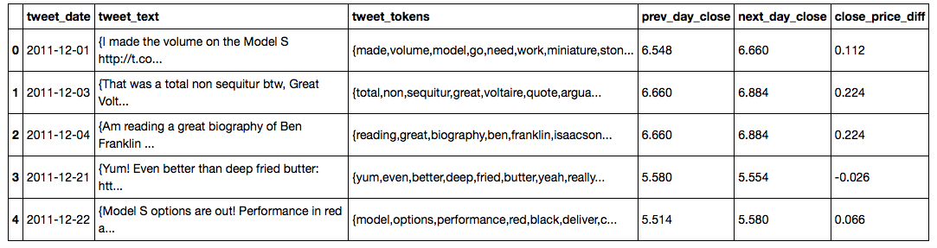
Results
The DataFrame

Slide 7
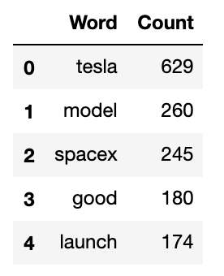
Results
X To be changed to a Pie Chart alongside some other stats

Slide 8
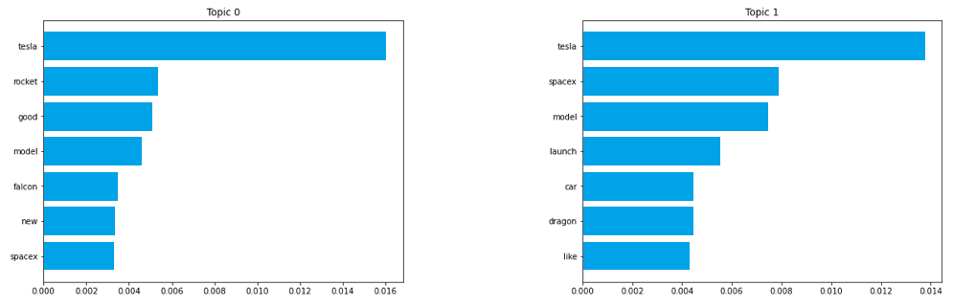
Results (Cont’d)

Slide 9
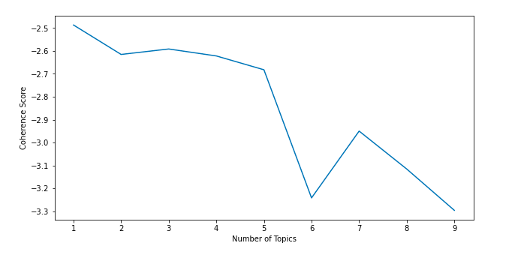
Results (Cont’d)

Slide 10
Discussion

Slide 11
Conclusion

Slide 12
