Slide 1
Social Media Impacts on Stock Market Trends
Twitter Feeds vs Tesla Stocks
Yuvraj Bhati | Behnam Hashemi | Mohammad A. Jilani | Gobinath Thangaiya
UofT Data Analytics Bootcamp, April-Sept 2021

Slide 2
Overview
In this analysis we are trying to implement a machine learning model to predict trends in segments of stock market based on the effects of social media feeds from their direct stakeholders.
Tasks completed:
Applying for a Twitter developed account and getting approved to get their APIs
Employ the Twitter API (2021 data)
Use Historical Tweet data for 2010-2020 from Kaggle
Import historical stock data from Yahoo_fin. Jan 1, 2011 to Sept 1, 2021.

Slide 3
Study Questions
1- How do tweets impact the stock prices?
2- Are there any keywords which actually make an impact on Tesla stock price?
3- What are the greatest increase in the stock price related to this condition?
4- What are the greatest decrease in the stock price related to this condition?
5- Are an individual's tweets significant enough to move a specific segment of the market?

Slide 4
Methods
Data Sources
1- Yahoo_fin
Yahoo_fin library was used to get historical historical data for (TSLA) Tesla Stock price from 2011 till date.
2- Twitter API
For 2021 data to date
3- Kaggle datasets
We used Kaggle dataset re Tweets for th 2010-2020 time interval.

Slide 5
Methods (Cont’d)
Analytical Model and Tools
We used two different models for the project and chose the one most appropriate for the purpose:
1- Principal Component Analysis(PCA)
2- Topic Modeling and Latent Dirichlet Allocation (LDA)

Slide 6
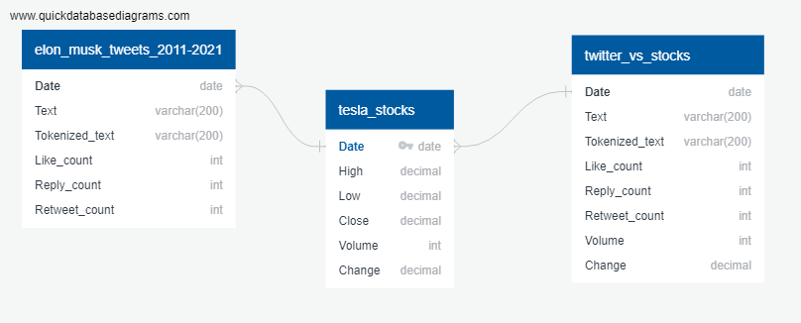
ERD

Slide 7
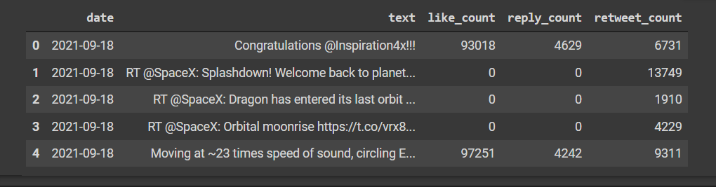
DataFrame

Slide 8
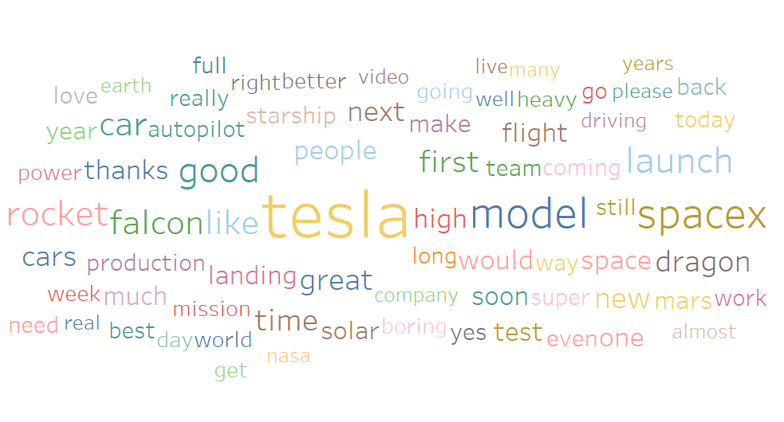

Slide 9
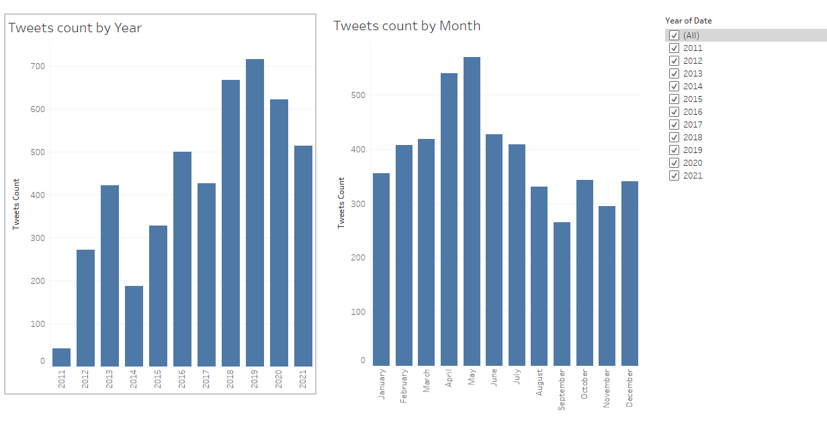

Slide 10
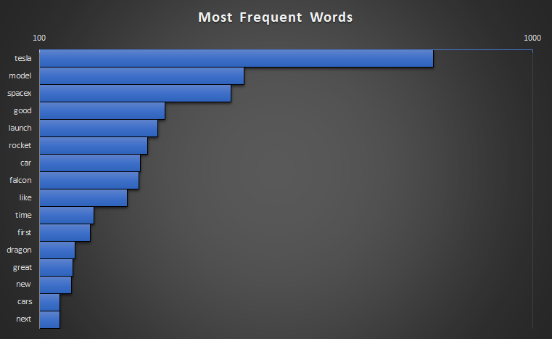

Slide 11
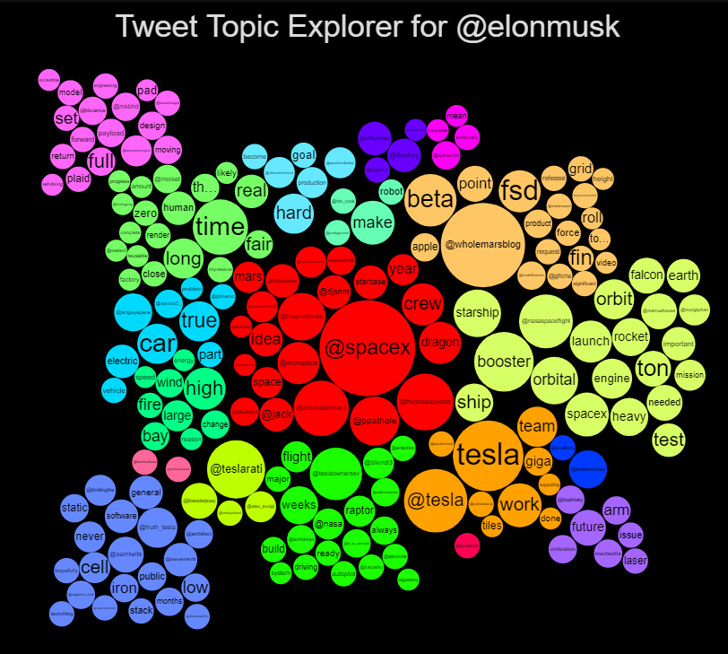
Notes:
http://tweettopicexplorer.neoformix.com/#n=elonmusk

Slide 12
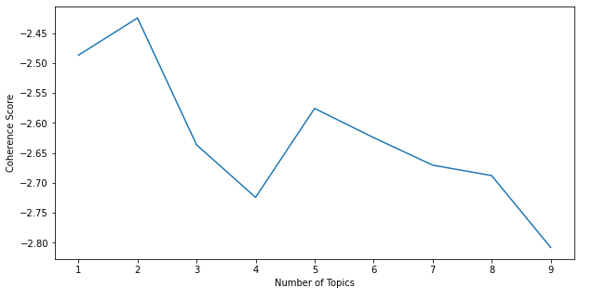
Results (Cont’d)

Slide 13
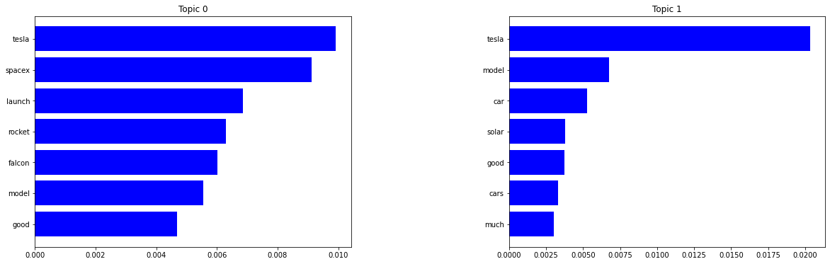
Results (Cont’d)

Slide 14
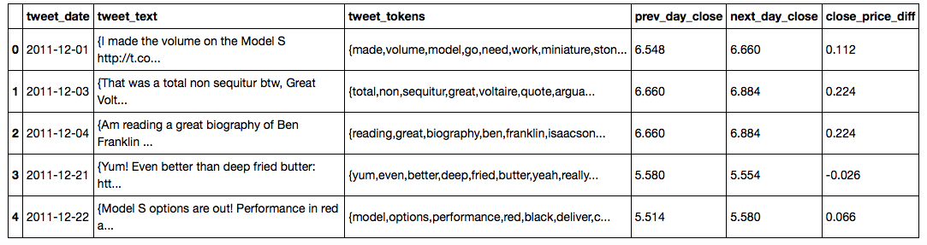
Results
The DataFrame

Slide 15
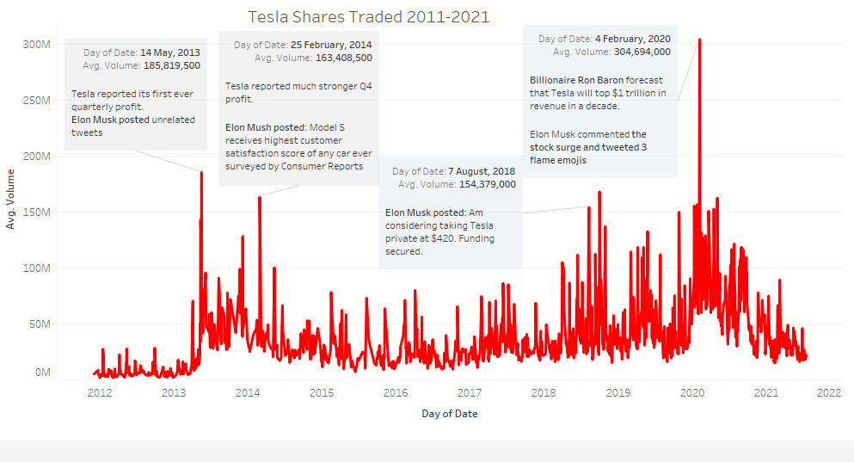

Slide 16
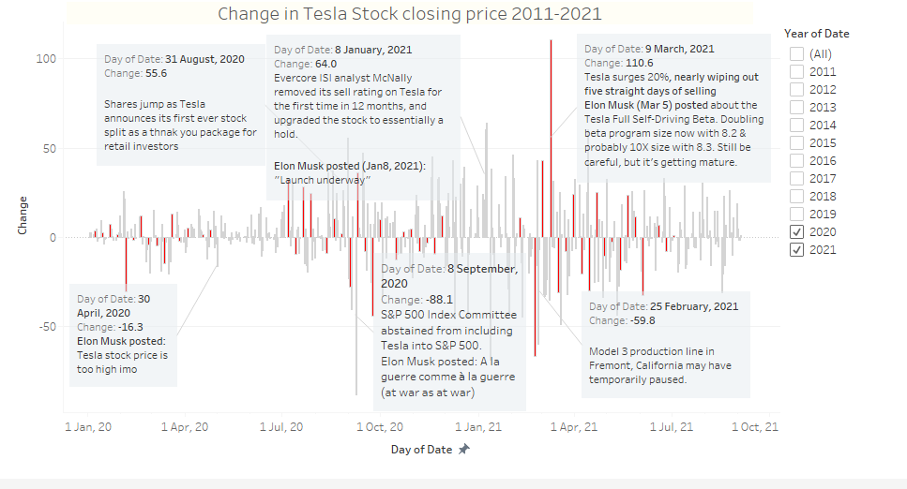

Slide 17
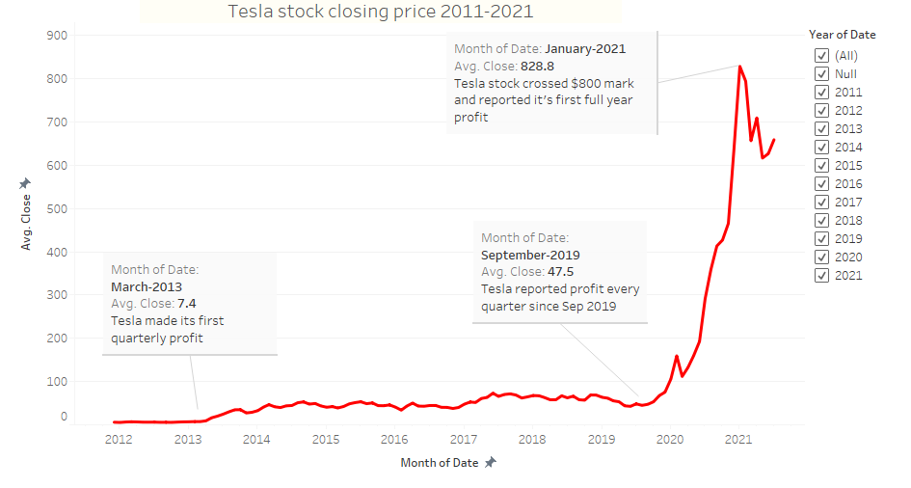

Slide 18
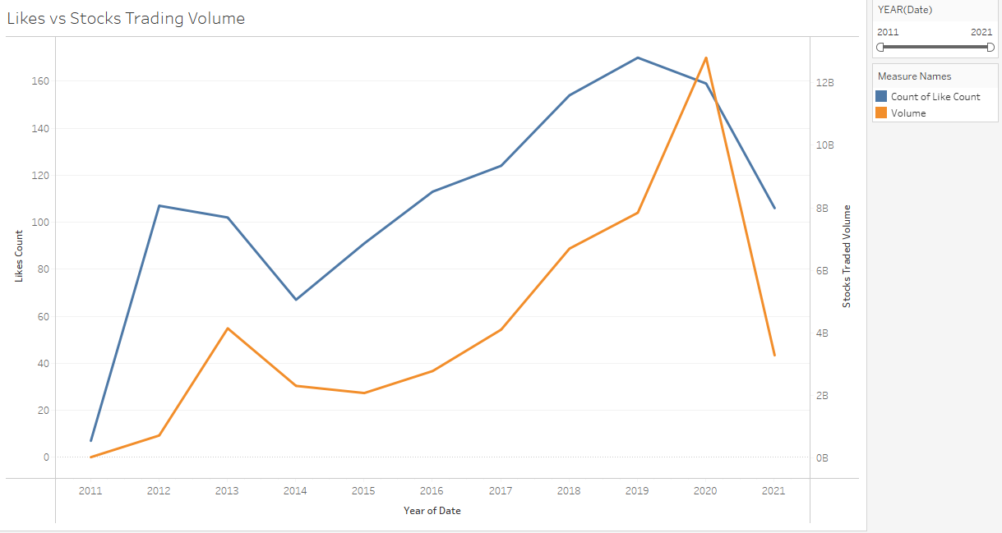

Slide 19
