Slide 1

NETFLIX CLONE
Project Supervisor : Dr. R.M. Gomathi, M.Tech., Ph.D.,
Name of the Student : GOBIGA B
Register Number: 39120032
10 April 2022
Department of IT

Slide 2
Presentation Outline
Course Certificate
Introduction
Objectives
System Architecture
Implementation
Methodology
System Requirements
Application Snapshots
Conclusion
References

Slide 3
Course Certificate
10 April 2022
Department of IT

Slide 4
INTRODUCTION
Video streaming has received much attention for some time now, and its popularity has grown manifold in the last decade, particularly with the deployment of widely known video streaming services, such as YouTube, Netflix, Hulu, Daily Motion, and others.
Video streaming now accounts for a large share of the total traffic the Internet, and as such the transmission mechanisms used by video servers have an impact not only on the quality of the video presentation to the clients, but also on the total traffic impact on the network.
As a result, many new techniques for video streaming have developed.
Wireless networks and mobile computing now feature in most distributed applications, leading to a substantially new challenge for video streaming: the computing/memory/energy capabilities of small mobile devices, and the low-quality channels interconnecting them and linking them to the Internet, impose limitations on the quality of videos that can be streamed.
10 April 2022
Department of IT

Slide 5
INTRODUCTION(contn..)
It also suggests the need for multiple encoding levels for each title, so that devices and networks of different characteristics can be supported. Streaming is the continuous transmission of audio or video files from a server to a client.
In simpler terms, streaming is what happens when consumers watch TV or listen to podcasts on Internet-connected devices. With streaming, the media file being played on the client device is stored remotely, and is transmitted a few seconds at a time over the Internet.
10 April 2022
Department of IT

Slide 6
Objectives
To create a Netflix clone using React.JS, Typescript & Firebase.
This is built using React.JS as a Front-end & Firebase as Back-end. It's not a replica, and it doesn't have all the features of Netflix website. it's a similar version of Netflix with my own design touch, showing my abilities in React.JS to build something advanced like Netflix.
It contains the home page, sign-in page, sign-up page, browse page, and movie player.
10 April 2022
Department of IT

Slide 7
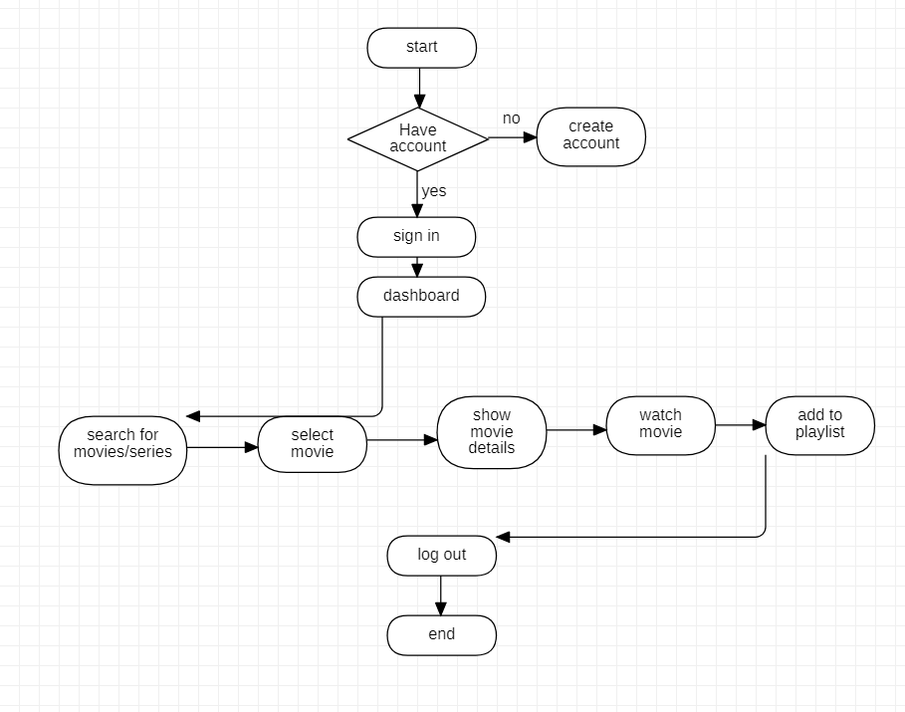
SYSTEM ARCHITECTURE/IDEATION MAP

Slide 8
Project Implementation
HOME PAGE
The Home Page consists of 5 main sections:
1) Header, which includes: Logo ,Sign-In button, Feature title and subtitle.
2) Optform: It's a text input field and a button, It redirects you to the sign-up page once you click on the button.
3) Jumbotron: This section contains some images and paragraphs beside it, showing the advantages of Netflix.
4) Frequently Asked Questions
5) Footer: It contains useful links users may need it.
SIGN-IN PAGE
The Sign-in Page consists of 3 main sections:
1) Header, which includes: Logo, redirects you to the home page when you click on it.
2) Sign-in Form, which includes :Email address input field, Password input field, Sign-in Button, Link to Sign-up Page.
3) Footer:It contains useful links users may need it.
10 April 2022
Department of IT

Slide 9
CONTN..
SIGN-UP PAGE
The Sign-up Page consists of 3 main sections:
1) Header, which includes Logo
2) Sign-up Form, which includes: First Name input field, Email address input field, Password input field, Sign-up Button, Link to Sign-in Page.
3) Footer: It contains useful links users may need it.
BROWSE PAGE
The Browse Page consists of 5 main sections:
Header, which includes: LogoCategories Links, Featured Movie Title & Description, Play Button.
2) Movies Slides: It's a slides shows the movies based on their genre. The genres and all movie information had been retrieved from the Firebase database.
3) Movie Card: It's an image represent the movie, when you hover over it became bigger and it will show its card feature if you click on it.
4) Card Feature: it's another section that appears under the movie slide if you click on any movie card, it contains more information about the movie like title, description, a special background represent the movie, and play button.
5) Video Player: it's a video player that has full controls, appears in the middle of the screen when you click on any play button, and you have to click on the play icon in the video player after it show up because it doesn't have an autoplay option currently.
6) Footer: It contains useful links users may need it.
10 April 2022
Department of IT

Slide 10
BENEFITS:
1)Creates space for community building.
2)Creates a platform for budding creators.
3) Various contents bring diversity in people by making them aware of different culture.
10 April 2022
Department of IT

Slide 11
System Requirements:
SOFTWARE REQUIREMENT
Front-end: ReactJS
Back-end: Firebase
HARDWARE REQUIREMENT
RAM : 4GB
Processor Intel Core i3 and above
10 April 2022
Department of IT

Slide 12
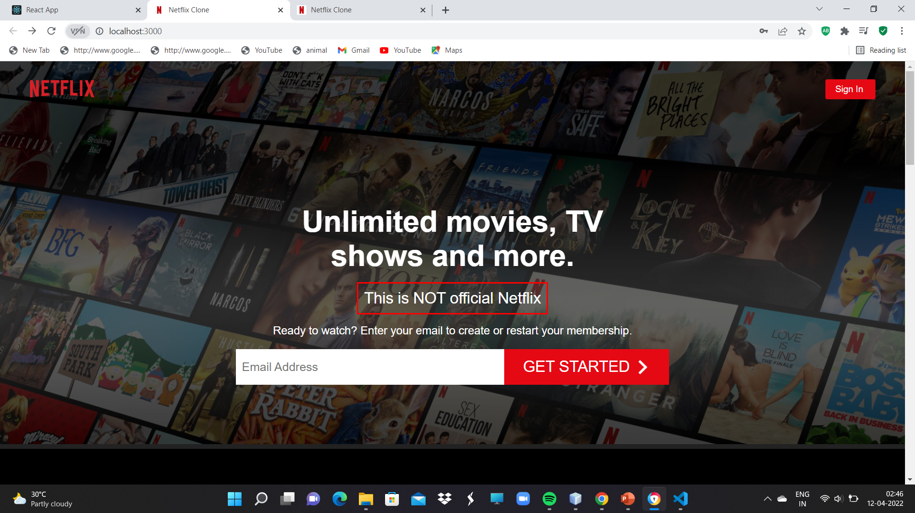
Snap Shots
HOME PAGE:

Slide 13
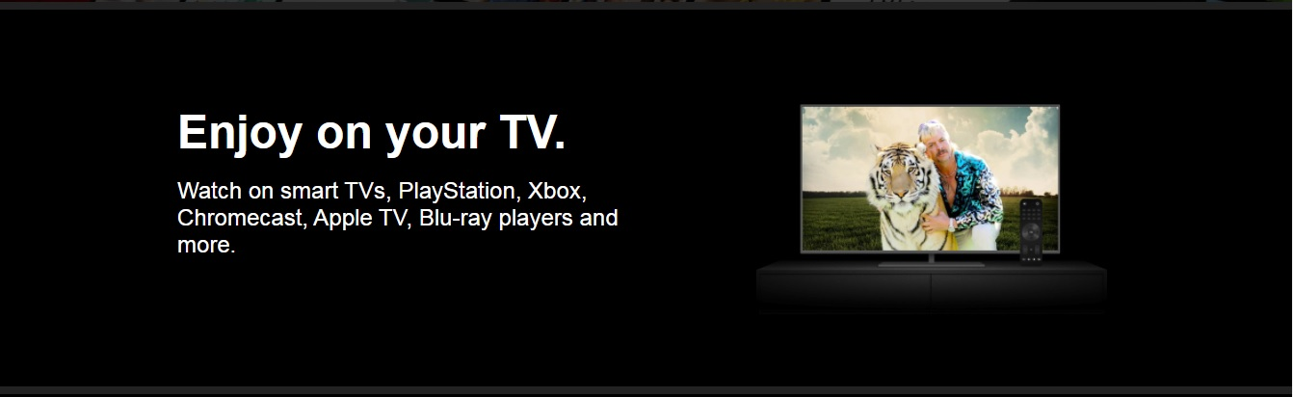
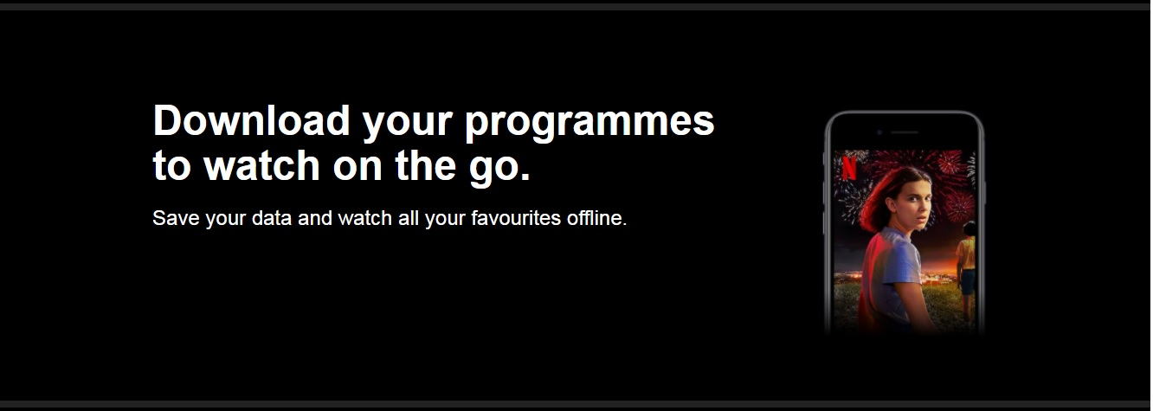
10 April 2022
Department of IT

Slide 14
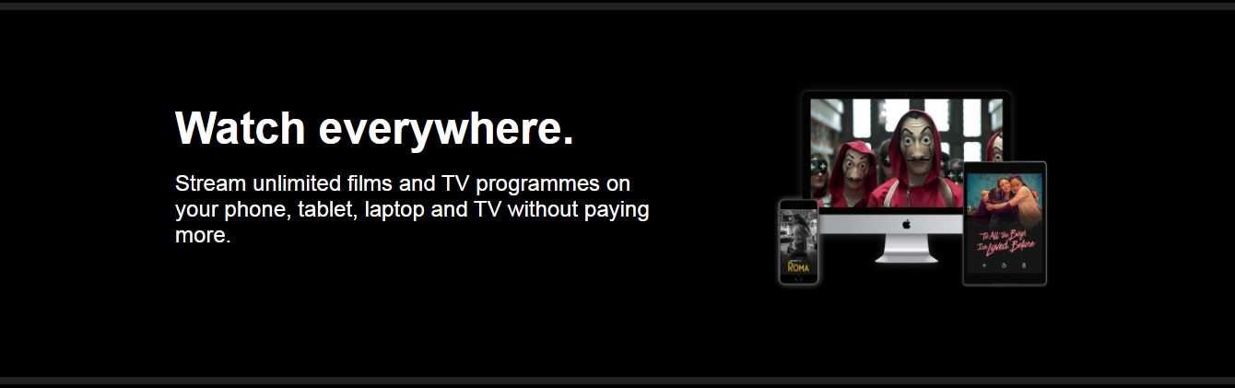
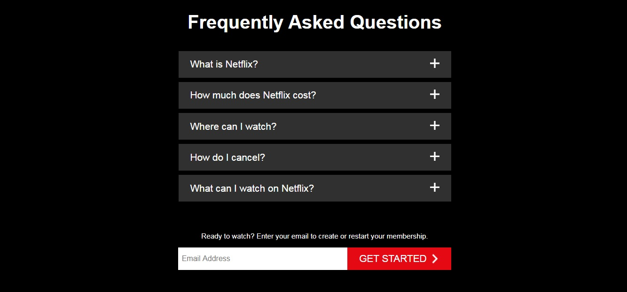
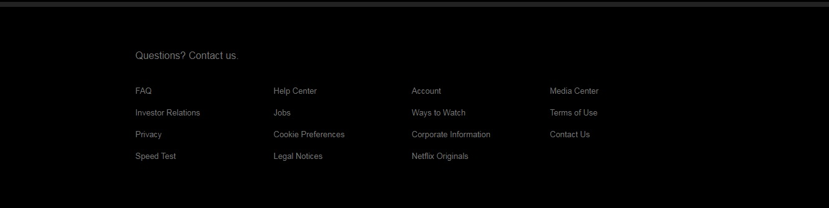
10 April 2022
Department of IT

Slide 15
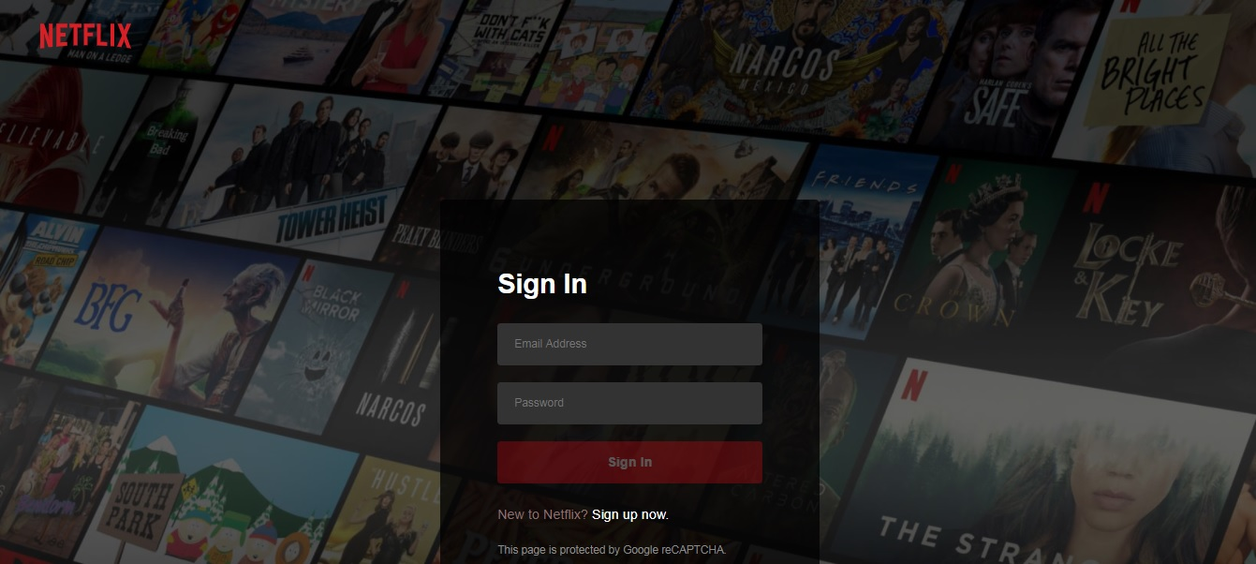
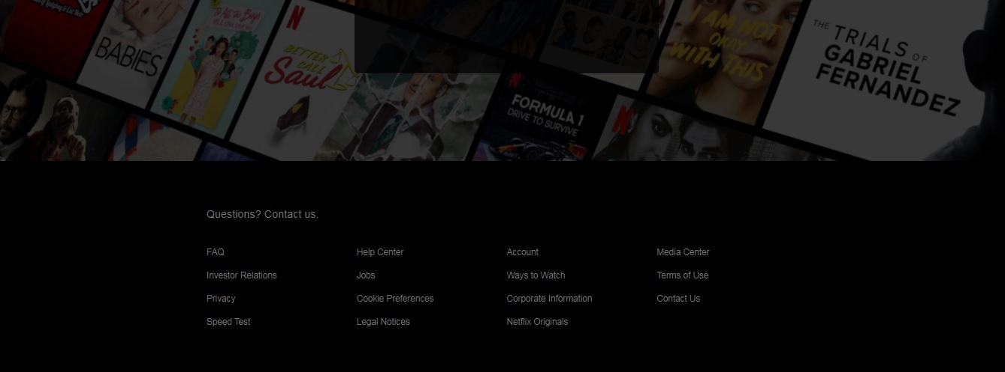
SIGN IN PAGE:
10 April 2022
Department of IT

Slide 16
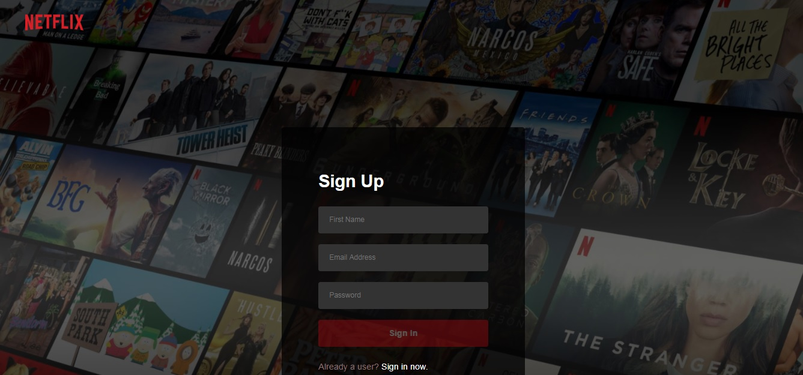
SIGN UP PAGE:
10 April 2022
Department of IT

Slide 17
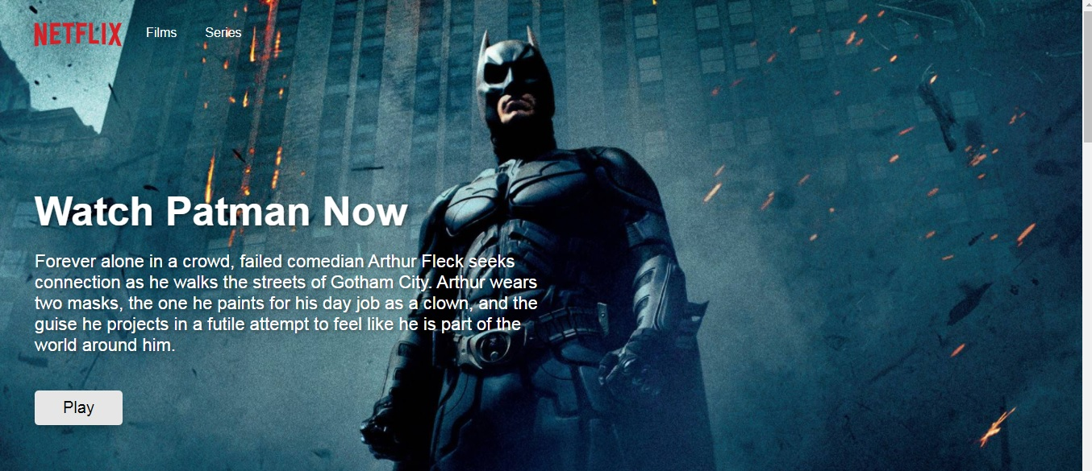
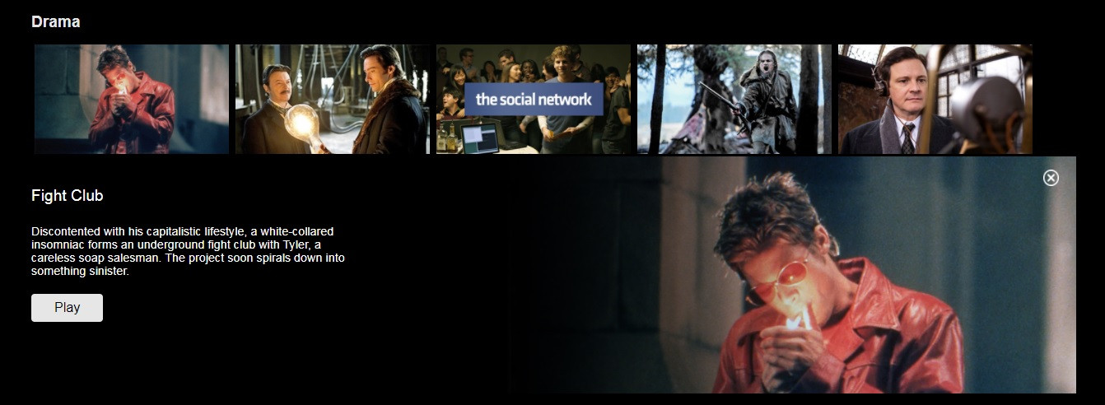
BROWSE PAGE:
10 April 2022
Department of IT

Slide 18
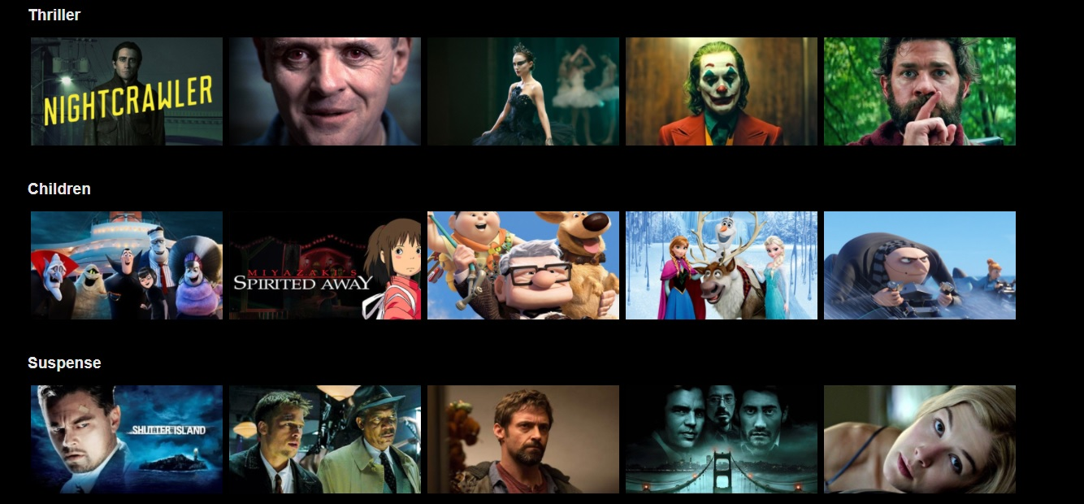
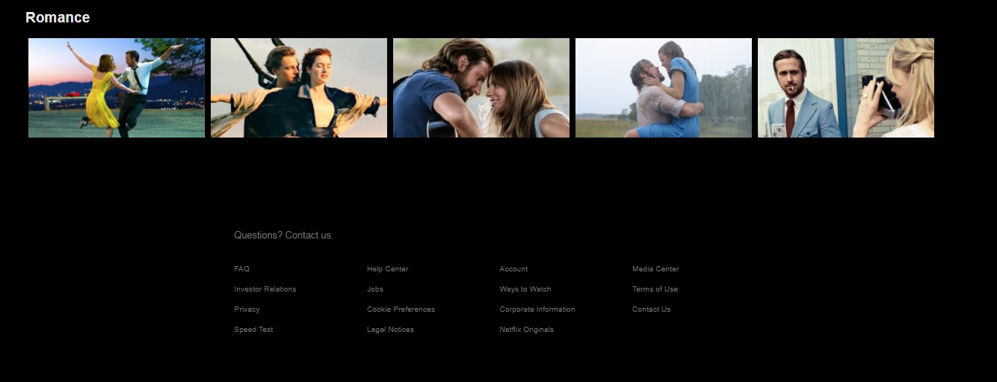
10 April 2022
Department of IT

Slide 19
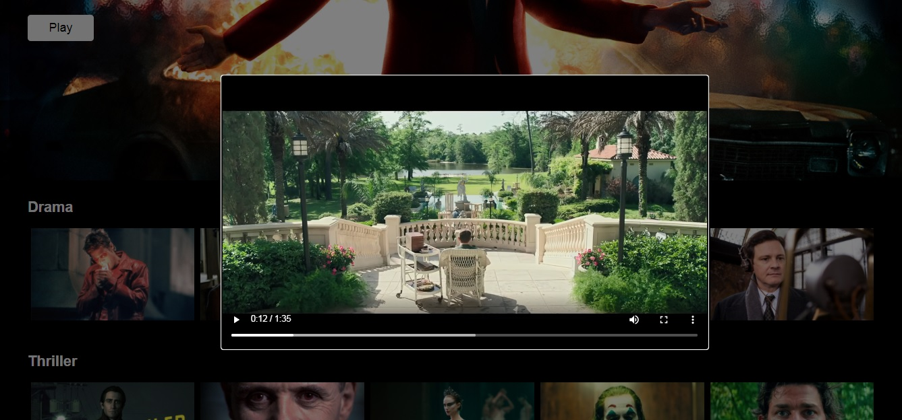
TRAILER COMPONENT:
10 April 2022
Department of IT

Slide 20
Conclusion
Video Streaming is a technology that has completely changed the entertainment industry as well as consumption models among audience members.
A lot has changed since that very first Real Player transmission in 1995. Since then, technology has been constantly improving, making content delivery and access easier no matter the platform trying to access it.
Various contents bring diversity in people by making them aware of different culture.

Slide 21
Reference
1.www.w3schools.com
2.www.tutorialpoint.com
3. Clever Programmer- Youtube

