Slide 1

A Project Report On: Implementation of Vision Transformer on Diabetic Retinopathy Dataset
Presented by(Group No.-21):
Name | Roll No.
Harsh Anand | 2206038
Srijan Sarvshresth | 2106010
Gobinda Prasad Bag | 2206005
Under the Supervision of : Dr. Anshul Sharma Department of Computer Science and Engineering National Institute of Technology Patna

Slide 2
Contents:
Problem Statement
Motivation
Dataset Description
The Proposed Methodology(ViT and CNN)
Implementation Details
Performance Metrics
Discussion about Results
Comparison of Results between ViT(proposed model) and CNN(existing model)
References

Slide 3
Problem Statement
Goal: Automate Grading of Diabetic Retinopathy from fundus images using Vision Transformer(ViT).
Challenge: Existing methods struggle with fine-grained lesions.
Solution: ViT with attention mechanisms for better accuracy and interpretability.

Slide 4
Motivation
Medical Urgency: DR causes blindness; early detection is vital and in rural areas where eye specialists are very few.
CNN Limitations: Struggles with long-range lesion dependencies.
ViT Advantages:
- Captures global context
- Scales with data
- uses attention mechanism.

Slide 5
Dataset Description
Dataset taken from Kaggle diabetic retinopathy detection competition https://www.kaggle.com/c/ diabetic-retinopathy-detection(as per given in the Research Paper https://openaccess.thecvf.com/content/CVPR2021/papers/Sun_Lesion-Aware_Transformers_for_Diabetic_Retinopathy_Grading_CVPR_2021_paper.pdf )
Dataset details:
Number of Training Images : 35126
Number of Testing Images : 53576
We have trainingLabels which has two columns named ‘image’ and ‘level’.
Number of classes : 5 (labelled 0 to 4)

Slide 6
The Proposed Methodology
Model Architectures used :
-Vision Transformer(ViT),and
-CNN

Slide 7
Introduction to Vision Transformer
A Vision Transformer (ViT) is a type of deep learning model used to analyze images. It is based on the Transformer architecture, which was originally designed for natural language processing (NLP) tasks, like translating languages or understanding text. ViT applies this same concept to images.
#Applications of Vision Transformers:
Image classification
Object detection
Image segmentation
Medical image analysis

Slide 8
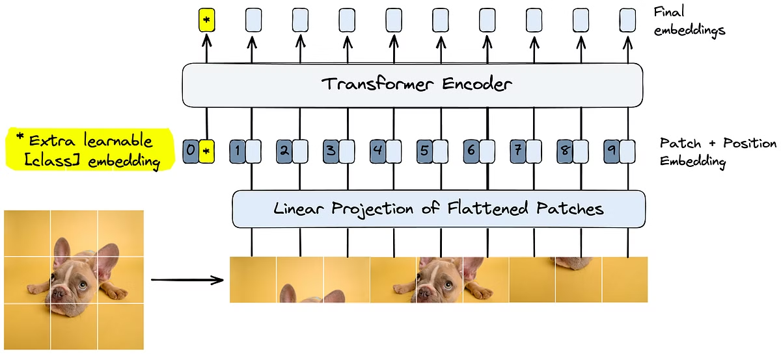
Vision Transformer

Slide 9
Principles:
Key Principles:Breaks down images into patches, similar to words in a sentence.
Breakthrough Design:Applies transformer layers directly to these patches.
Global Context: Enables the model to capture global relationships within the image.

Slide 10
Working of Vision Transformer
Splitting the Image into Patches- Instead of processing the whole image at once (like CNNs do), the Vision Transformer splits the image into smaller patches. Each of these patches is treated like a separate unit, similar to how words are treated in a Transformer for language tasks.
Linear Projection of Flattened Patches- Each patch (small image) is flattened (converted into a long 1D list of numbers instead of a 2D square).Then, a linear projection (a simple mathematical transformation) is applied to convert the patch into a vector of numbers. This step turns image patches into meaningful numerical representations that the Transformer can understand.
Adding Positional Encoding- Transformers don’t inherently understand spatial relationships (where each patch comes from in the image).To help with this, Positional Encoding is added to each patch’s numerical representation. This ensures that the Transformer knows where each patch was originally located in the image.

Slide 11
Working of Vision Transformer(continued)
Adding the Special [CLS] Token- A special token called the [CLS] (Class Token) is added to the sequence. This token acts as a summary of the entire image and will later be used to make the final classification. This is similar to how Transformers process text, where a special token is used to gather all the necessary information.
Transformer Encoder- The Transformer Encoder processes all the patch embeddings together using Multi-Head Self-Attention (MHSA) and Feedforward Neural Networks. This allows the model to learn relationships between different parts of the image (e.g., how the dog’s nose relates to its eyes).This is the core of the Vision Transformer, as it enables the model to understand the image globally.
Output Final Embeddings- After passing through the Transformer Encoder, each patch now has a refined numerical representation. The [CLS] token stores the most important information, summarizing the whole image.

Slide 12
Working of Vision Transformer(continued)
Final Classification- The final representation of the [CLS] token is sent to a simple Feedforward Neural Network (MLP head). This network makes the final prediction about what the image contains (e.g., dog, cat, airplane, etc.). The output is passed through a Softmax function to determine the final class probabilities.
Summary of the Entire Process 1. Divide Image into Patches → Cut the image into small square sections.2. Convert Patches into Vectors → Flatten each patch and apply a transformation.3. Add Positional Encoding → Help the Transformer understand spatial information.4. Add a Special [CLS] Token → A token that will store the final image representation.5. Process Through Transformer Encoder → Learn relationships between patches using self-attention. 6.Extract the Final Embedding → The refined representation of the image.7. Pass Through Classifier → Predict the final label (e.g., dog, cat).
Why is Vision Transformer Important? Captures long-range dependencies → Understands relationships between distant parts of the image. More flexible than CNNs → Doesn't rely on fixed filters like convolutional networks. Scales well with data → Performs well when trained on large datasets.

Slide 13
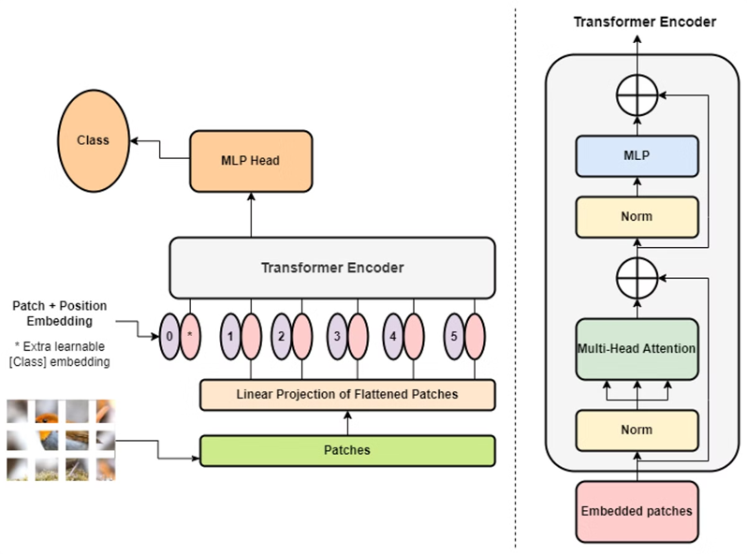
How Image is Processed:

Slide 14
Introduction to CNN
Convolutional Neural Networks (CNNs) are a type of deep learning model that are very effective for analyzing images. In this research, CNNs are used to automatically detect diabetic retinopathy (DR)—a disease that damages the retina due to diabetes.
The main idea behind CNNs is to allow computers to "see" and learn patterns from images in a way that mimics how the human brain works. For example, CNNs can identify key features in eye images such as blood vessel damage, hemorrhages, or exudates, which are important for diagnosing DR.
CNNs reduce the need for manual feature extraction. Instead of telling the computer what to look for, CNNs learn what features are important directly from the images.

Slide 15
CNN Architecture
A CNN is made up of several key layers, each performing a specific task:
Input Layer:
Takes in the original image (e.g., a fundus photo of the retina).
Convolutional Layers:
These layers apply filters (small matrices) to the image to extract features such as edges, textures, or shapes.
Early layers detect simple features, while deeper layers detect more complex patterns like lesions or blood vessel abnormalities.

Slide 16
(continued)
Activation Functions (e.g., ReLU):
These introduce non-linearity, helping the network learn complex patterns.
Pooling Layers (e.g., Max Pooling):
Reduce the size of the feature maps and make the model faster and more robust by keeping only the most important information.
Fully Connected Layers:
These layers make final predictions by combining all the extracted features and mapping them to output classes (e.g., different stages of DR: no DR, mild, moderate, etc.).
Output Layer (Softmax):
Produces probabilities for each DR class, and the class with the highest probability is the final prediction.

Slide 17
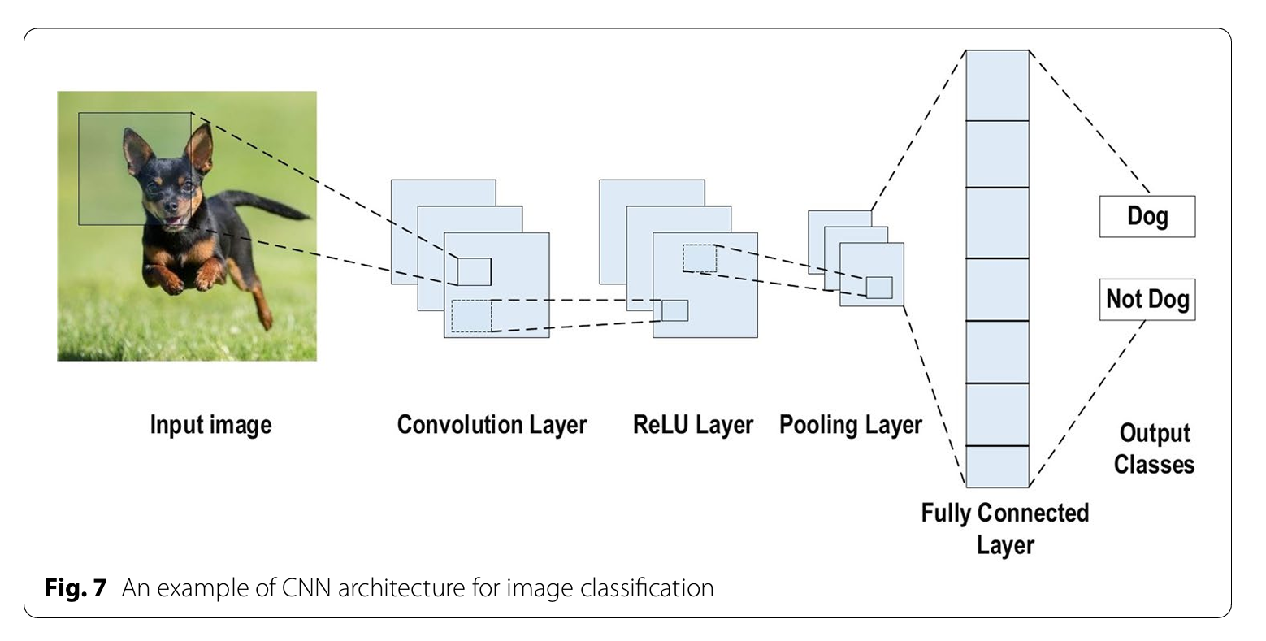
An example of CNN Architecture for image Classification:

Slide 18
Implementation Details of ViT
This implementation fine-tunes a pretrained ViT-B_16 (Vision Transformer) from torchvision. The model's final 4 encoder layers are unfrozen for training, while the rest remain frozen to retain pretrained features. The original classification head is replaced with a custom multi-layer MLP head:
Linear → BatchNorm1d → SiLU → Dropout(0.5)
Linear → BatchNorm1d → SiLU → Dropout(0.3)
Linear → Output (NUM_CLASSES)
The optimizer used is AdamW with separate learning rates: 1e-4 for encoder layers and 3e-4 for the custom head. A ReduceLROnPlateau scheduler adjusts learning rate based on validation accuracy.

Slide 19
Implementation Details of CNN
PyTorch pipeline detects diabetic retinopathy using a custom CNN. Images and labels are loaded via a custom Dataset class, with separate transforms for training (augmentation + normalization) and validation (normalization). The CNN includes two Conv layers, ReLU, MaxPooling, and two FC layers with dropout. Data is split (80% train, 20% val), loaded in batches. The model is trained for 10 epochs with cross-entropy loss and Adam optimizer. Accuracy and F1-score are tracked. After training, loss/accuracy curves and a confusion matrix are plotted, and a classification report is generated for final model evaluation.

Slide 20
Performance Metrics of ViT Model
Epoch | Train Loss | Train Acc (%) | Val Loss | Val Acc (%) | Val F1 Score | Learning Rate
1 | 0.0314 | 91.25 | 0.5972 | 59 | 0.615 | 1.00e-04
2 | 0.029 | 89.75 | 0.7438 | 56 | 0.6256 | 1.00e-04
3 | 0.0313 | 92.25 | 0.5112 | 65 | 0.6807 | 1.00e-04
4 | 0.015 | 94.5 | 0.384 | 78 | 0.8001 | 1.00e-04
5 | 0.0068 | 97.25 | 0.2364 | 83 | 0.8398 | 1.00e-04
6 | 0.0048 | 98.5 | 0.356 | 77 | 0.7899 | 1.00e-04
7 | 0.0162 | 98.25 | 0.2194 | 87 | 0.8757 | 1.00e-04
8 | 0.0085 | 95.5 | 0.4554 | 81 | 0.8111 | 1.00e-04
9 | 0.0079 | 96.56 | 0.4156 | 84 | 0.8513 | 1.00e-04
10 | 0.0039 | 99.25 | 0.6962 | 61 | 0.6576 | 5.00e-05
11 | 0.0032 | 99.25 | 0.879 | 60 | 0.6335 | 5.00e-05
12 | 0.0051 | 97.25 | 0.4953 | 78 | 0.7842 | 5.00e-05
13 | 0.0016 | 99.75 | 0.3836 | 80 | 0.8117 | 2.50e-05
14 | 0.0017 | 99.5 | 0.4066 | 81 | 0.8219 | 2.50e-05
15 | 0.0019 | 99.25 | 0.3528 | 85 | 0.8585 | 2.50e-05
16 | 0.0009 | 100 | 0.4119 | 85 | 0.8527 | 1.25e-05
17 | 0.002 | 99.25 | 0.3164 | 83 | 0.8389 | 1.25e-05
18 | 0.001 | 100 | 0.3307 | 82 | 0.8307 | 1.25e-05
19 | 0.0008 | 100 | 0.431 | 83 | 0.8363 | 6.25e-06
20 | 0.0008 | 100 | 0.3655 | 83 | 0.8363 | 6.25e-06
21 | 0.001 | 99.75 | 0.3634 | 82 | 0.83 | 6.25e-06
22 | 0.0006 | 100 | 0.3327 | 83 | 0.8348 | 3.13e-06
23 | 0.0006 | 100 | 0.3594 | 84 | 0.8445 | 3.13e-06
24 | 0.0006 | 100 | 0.3728 | 84 | 0.8445 | 3.13e-06
25 | 0.0009 | 99.75 | 0.3547 | 84 | 0.8445 | 1.56e-06
26 | 0.0008 | 100 | 0.4528 | 85 | 0.8527 | 1.56e-06
27 | 0.0009 | 100 | 0.3976 | 83 | 0.8348 | 1.56e-06
28 | 0.0009 | 100 | 0.3917 | 84 | 0.8445 | 7.81e-07
29 | 0.0006 | 100 | 0.346 | 84 | 0.8445 | 7.81e-07
30 | 0.0011 | 100 | 0.4237 | 84 | 0.8445 | 7.81e-07

Slide 21
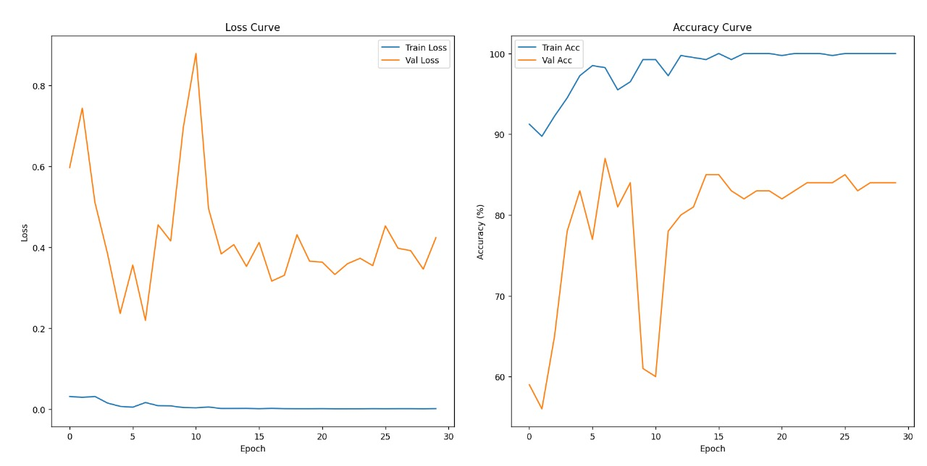
(continued)

Slide 22
Performance Metrics of CNN Model
Epoch | Train Loss | Train Acc (%) | Val Loss | Val Acc (%) | Val F1 Score
1 | 0.8661 | 73.63 | 0.8622 | 72.86 | 0.6142
2 | 0.9005 | 73.35 | 0.8688 | 72.86 | 0.6142
3 | 0.8538 | 73.66 | 0.8563 | 72.86 | 0.6142
4 | 0.8391 | 73.64 | 0.8535 | 72.86 | 0.6142
5 | 0.8391 | 73.64 | 0.8535 | 72.86 | 0.6142

Slide 23
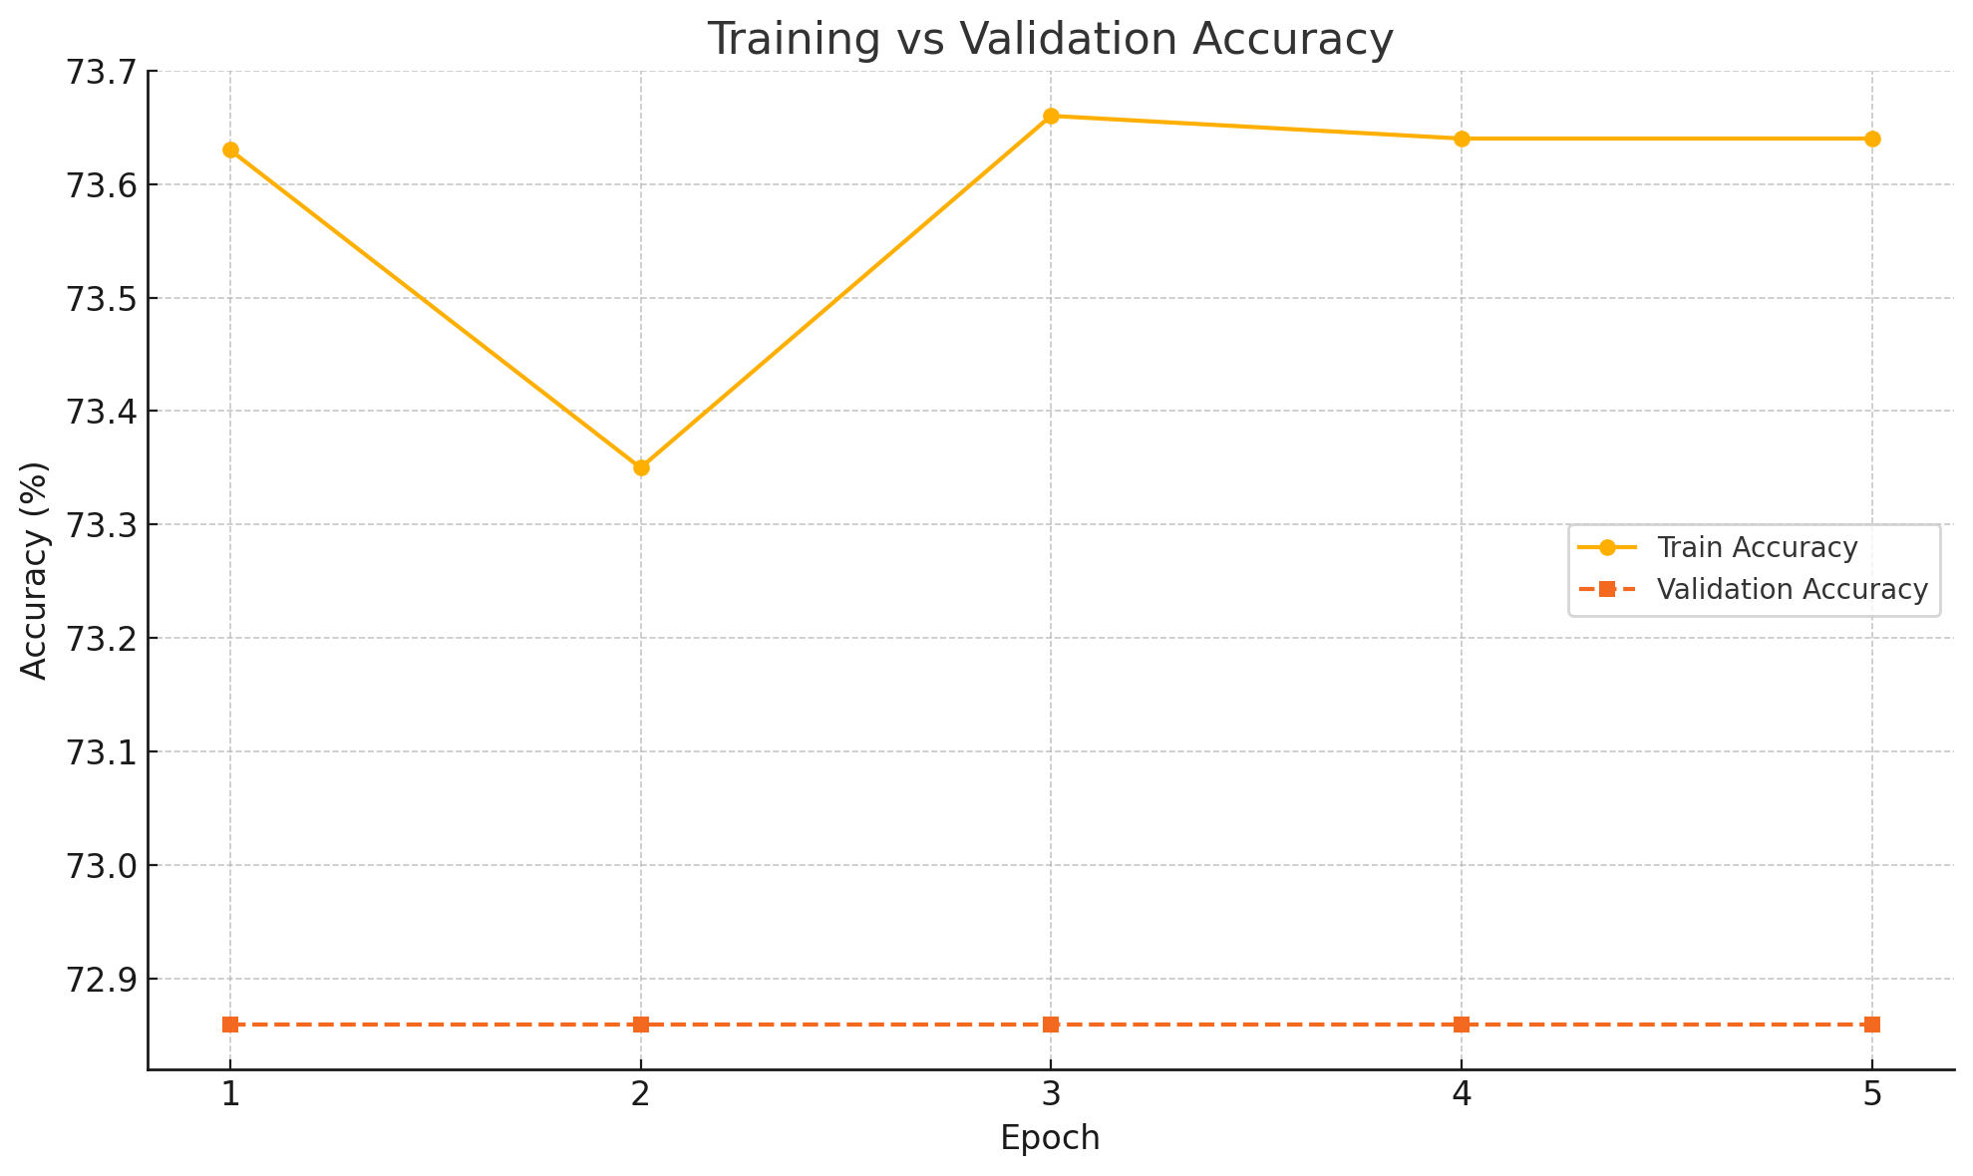
(continued)

Slide 24
Discussion about Results of ViT:
Peak Accuracy: 87%(Epoch 7).
Overfitting noticed after 20 epochs.
Dropout and learning rate decay helped.
Graphs and performance metrics are shown in tabular format.

Slide 25
Discussion about Results of CNN:
Training Performance:
The training accuracy showed slight fluctuations during the first three epochs (73.63% → 73.35% → 73.66%) and then stabilized at 73.64% in the last two epochs. The training loss consistently decreased from 0.8661 to 0.8391, indicating that the model is continuing to fit the training data effectively.
Validation Performance:
The validation accuracy remained completely stagnant at 72.86% across all five epochs. Similarly, the validation F1 Score stayed constant at 0.6142, suggesting the model is not improving in terms of generalization to unseen data. The validation loss slightly decreased from 0.8622 to 0.8535, but the change is minimal and not reflected in performance metrics.

Slide 26
(continued)
Interpretation:
The model demonstrates limited learning capacity on the validation data, as all validation metrics plateau after the first epoch.
While the training performance improves modestly, the stagnant validation metrics indicate the model may be underfitting or encountering a data-related bottleneck (e.g., class imbalance or lack of diversity).
There are no signs of overfitting as the training accuracy is not significantly higher than the validation accuracy.

Slide 27
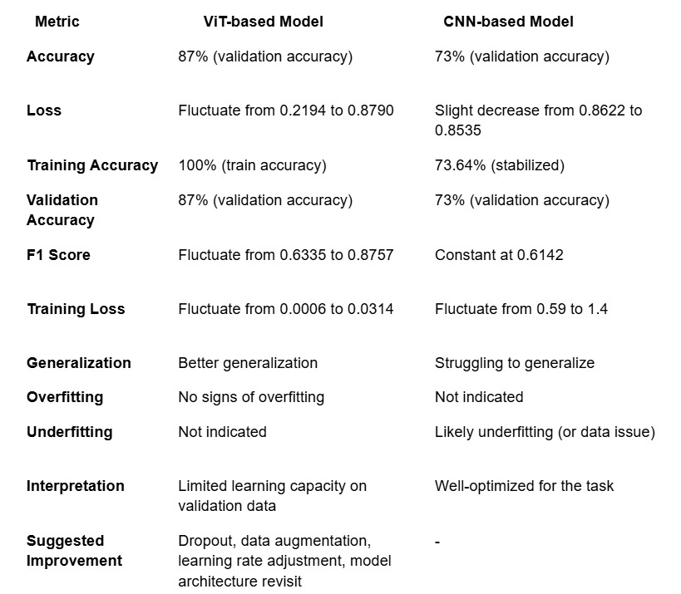
Comparison of Results between ViT(proposed model) and CNN(existing model):

Slide 28
References:
V. Vaswani et al., "Attention Is All You Need," Advances in Neural Information Processing Systems, vol. 30, 2017. [Online]. Available: https://arxiv.org/abs/1706.03762.
A. Dosovitskiy et al., "An Image is Worth 16x16 Words: Transformers for Image Recognition at Scale," International Conference on Learning Representations (ICLR), 2021. [Online]. Available: https://arxiv.org/abs/2010.11929.
X. Liu and W. Chi, "A Cross-Lesion Attention Network for Accurate Diabetic Retinopathy Grading With Fundus Images," IEEE Transactions on Instrumentation and Measurement, vol. 72, pp. 1-11, 2023, doi: 10.1109/TIM.2023.3260387.
R. Sun, Y. Li, T. Zhang, Z. Mao, F. Wu, and Y. Zhang, "Lesion-Aware Transformers for Diabetic Retinopathy Grading," in Proceedings of the IEEE/CVF Conference on Computer Vision and Pattern Recognition (CVPR), June 2021, pp. 10938–10947. Available: https://openaccess.thecvf.com/content/CVPR2021/html/Sun_Lesion-Aware_Transformers_for_Diabetic_Retinopathy_Grading_CVPR_2021_paper.html

Slide 29
(continued)
Alzubaidi, L., Zhang, J., Humaidi, A.J., Al-Dujaili, A., Duan, Y., Al-Shamma, O., Santamaría, J., Fadhel, M.A., Al-Amidie, M., & Farhan, L. (2021). Review of deep learning: concepts, CNN architectures, challenges, applications, future directions. Journal of Big Data, 8(1), 1–74. https://doi.org/10.1186/s40537-021-00444-8
Pratt, H., Coenen, F., Broadbent, D.M., Harding, S.P., & Zheng, Y. (2016, July). Convolutional Neural Networks for Diabetic Retinopathy. In Proceedings of the Medical Imaging Understanding and Analysis Conference (MIUA 2016) (pp. 1–6). Loughborough, UK.

Slide 30
Thank you

