Slide 1


Solving the inverse problem of time independent Fokker–Planck equation with a self supervised neural network method
Wei Liu, Connie Khor Li Kou, Kun Hee Park & Hwee Kuan Lee

Slide 2


Introduction
Fokker–Planck equation (FPE) is used to describe the probability density function (pdf) of the random variable in stochastic processes.
One-dimensional and time-independent example:
Wide range applications in modeling real-world phenomena.
Gaussian white noise
pdf
Stochastic differential equation
FPE

Slide 3
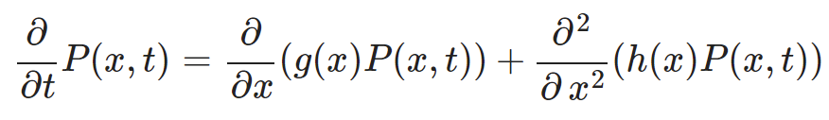
Problem Definition
One-dimensional and time-independent FPE:
Observation
Unknown Mechanism
Known: P(x,t) is measured and assumed to satisfy FPE
Unknown: g(x) and h(x)
Challenge: the measured P(x,t) is noisy
Goal: train a neural netowork to find out g(x) and h(x), and to denoise P(x,t)

Slide 4

Neural Network Overview
Both input and prediction are distributions.
Multiple predictions to surpress the noise effect.
g(x) and h(x) are built-in inside FPE-NN as the only trainable weights.
P(x, t), g(x), and h(x) are discretized over variable x and denoted as P(t), g, and h, respectively.
P(t - nΔt), ..., P(t + nΔt)
P(t)
FPE- based Neural Network (FPE-NN)
Input
Prediction

Slide 5
Neural Network Overview
Both Input and output/prediction are distributions.
The only trainable weights of the neural network is g(x) and h(x).
P(x, t), g(x), and h(x) are discretized over variable x and denoted as P(t), g, and h, respectively.
Multiple predictions to surpress the noise effect.
Loss function is generated by comparing predicend distributions to traget distributions.
P(t - nΔt), ..., P(t + nΔt)
P(t - nΔt), ..., P(t + nΔt)
P(t)
FPE- based Neural Network (FPE-NN)
Input
Prediction
Traget

Slide 6
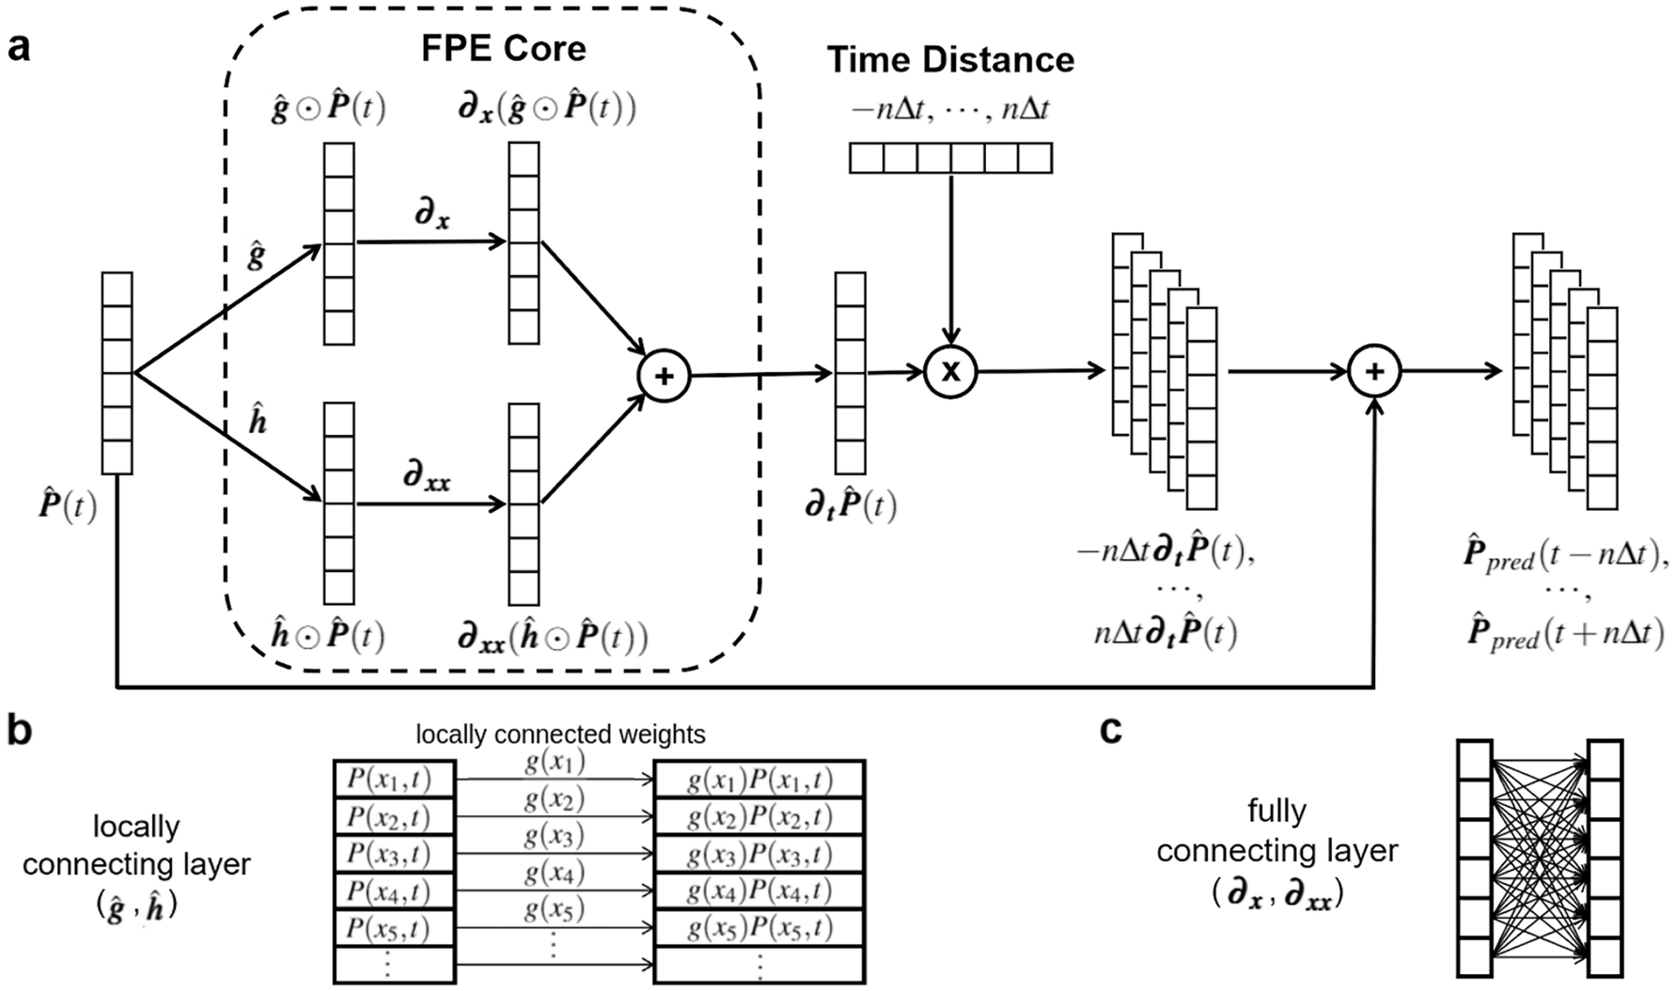
Neural Network Architecture
: element-wise multiplication
, : matrices to compute derivatives¹
discretized form
[1] Long, Z., et al. arXiv:1710.09668 (2018)

Slide 7

Neural Network Architecture
g and h are the only trainable weights in FPE-NN

Slide 8
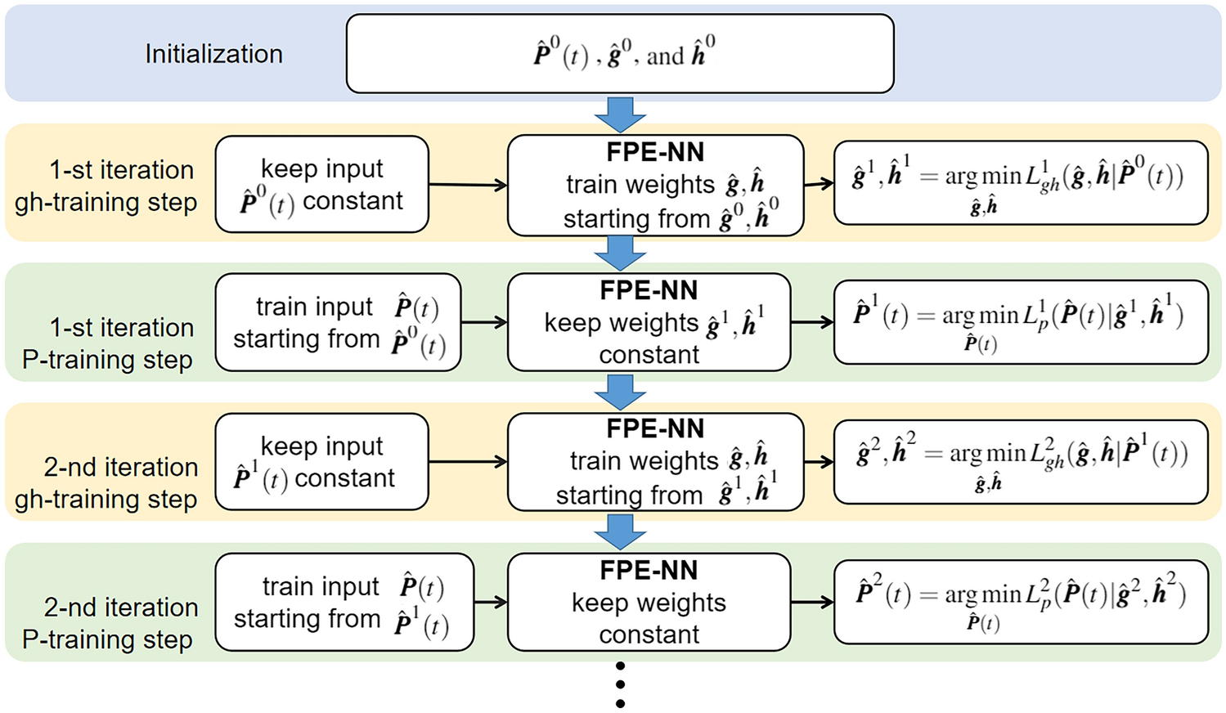
Training Process

Slide 9
gh-training Step
FPE-NN
train weights (g, h)
Input
Prediction
Traget

Slide 10
P-training Step
FPE-NN
Input
train input
Prediction
Traget

Slide 11
Training Process

Slide 12
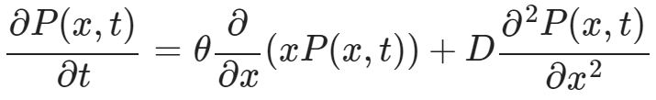
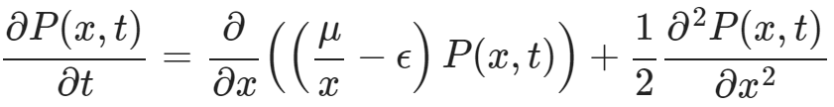
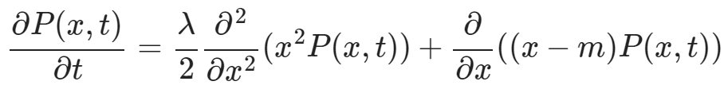

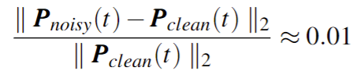
Numerical Studies
Validated with simulated data
Three FPE examples have been used to model real-world phenomena in different area
Noise were added to the simulated data
Example 1 (meteorology)²:
Example 2 (biology)³:
Example 3 (economics)⁴:
constant
random noise
[2] Lin, C. A. & Koshyk, J. N. Clim. Dyn. 2, 101–115 (1987)
[3] Fogedby, H. C. & Metzler, R. Phys. Rev. Lett. 98, 070601 (2007).
[4] Cordier, S., et al. J. Stat. Phys. 120, 253–277 (2005).

Slide 13
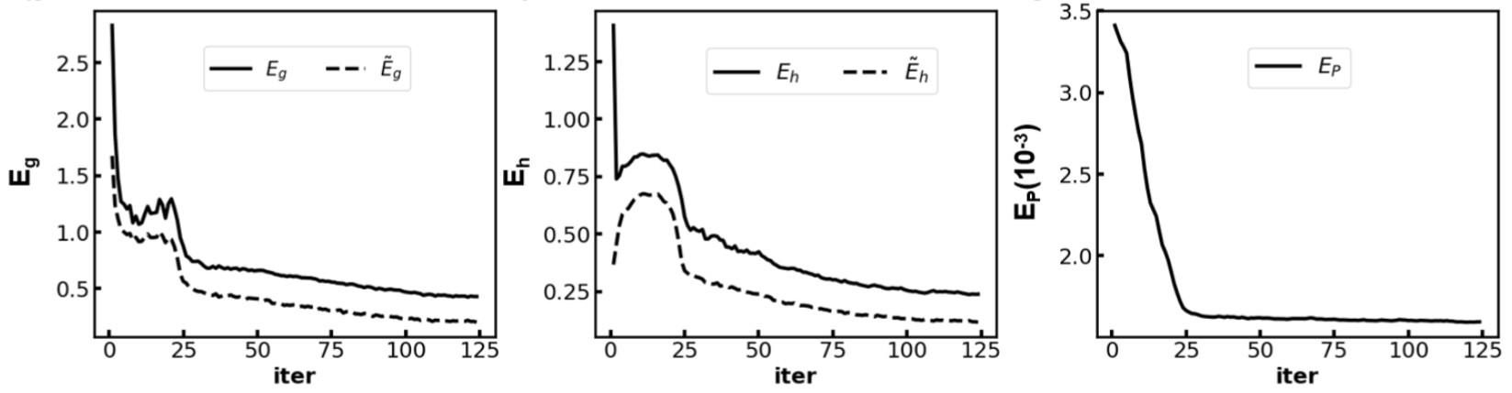
A Typical Training Curve
Error of trained g
Error of trained h
Error of trained P

Slide 14
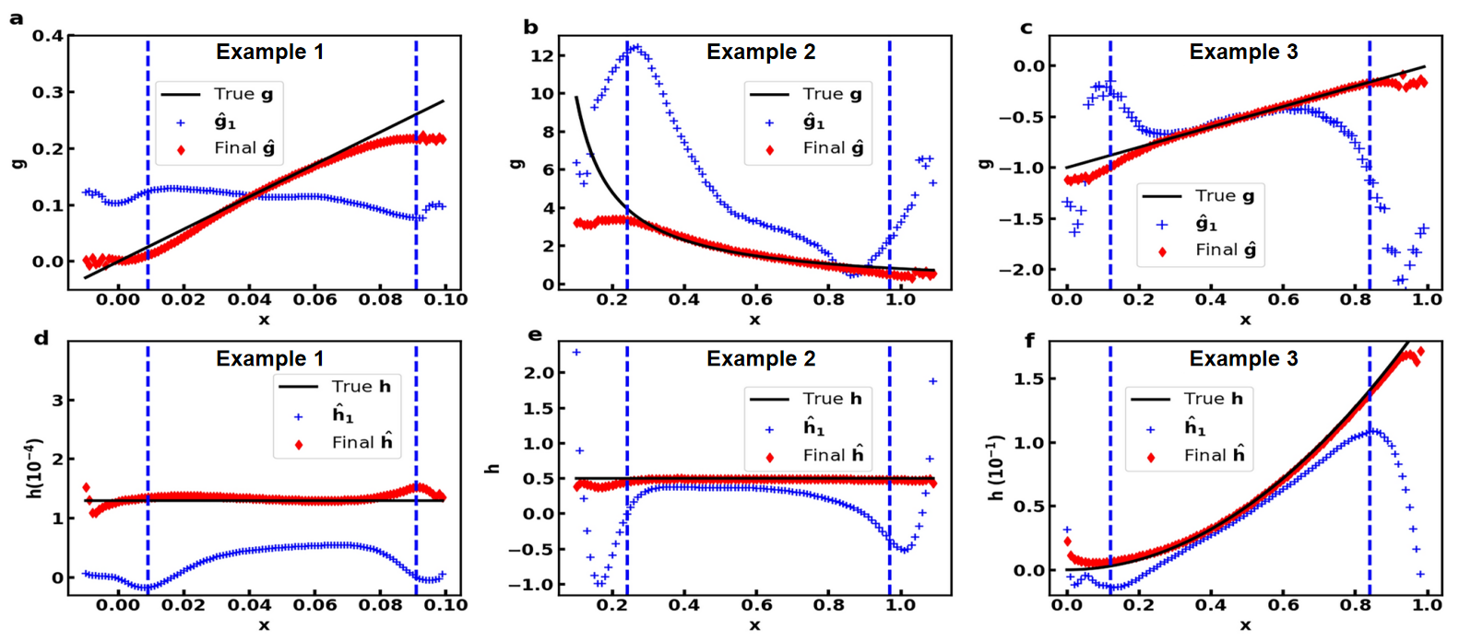
Results

Slide 15
Conclusion
FPE-NN can be used to uncover unknown g and h from the measure P(t) which is corrupted with noise.
The measured P(t) can be denoised by the alternating training process.
The denoised P(t) is essential to achieve high accuracy of trained g and h.

Slide 16
Thanks for watching!
Reference: Liu, W., Kou, C.K.L., Park, K.H. et al. Solving the inverse problem of time independent Fokker–Planck equation with a self supervised neural network method. Sci Rep 11, 15540 (2021). https://doi.org/10.1038/s41598-021-94712-5
Code: https://github.com/Gobliu/FPE-NN.git

