Slide 1
Building an Automated Firewall Rule Change Management and Approval Workflow
A Functional Prototype for Network Security, Auditing and Monitoring
CY376 - Network Monitoring, Security and Auditing | Blue Team Project | August 2025

Slide 2
The Problem: Manual Firewall Changes Are Risky
• Firewall rules are often changed via email, chat, or spreadsheets
• No standardized format = missing details and miscommunication
• Dangerous rules (e.g., SSH open to the Internet) get deployed without review
• When things break, nobody knows who approved what or why
• Rollback is manual, slow, and error-prone
Result: Misconfigured firewalls are a top cause of data breaches

Slide 3
Project Objectives
1. Build a web form that captures all technical details for a firewall change
2. Create a risk scoring engine that automatically flags dangerous requests
3. Enforce role-based approvals with the Four-Eyes Principle
4. Generate exact iptables commands automatically upon approval
5. Maintain an immutable audit trail for compliance
6. Provide one-click rollback for mistake recovery

Slide 4
System Architecture & Tech Stack
Tools Used
Architecture Layers
• Python 3.13 + Flask web framework
• SQLite database (zero config)
• HTML/CSS frontend with Jinja2 templates
• Werkzeug for secure sessions & password hashing
• Runs on any laptop — no cloud needed
• Presentation Layer: Web forms & dashboards
• Application Layer: Risk engine, RBAC, workflows
• Data Layer: Users, requests, immutable audit logs
• Firewall Layer: Command generation (iptables)
• Future: SSH/API push to live firewalls

Slide 5
The Risk Scoring Engine
• Automatically calculates danger from 0 to 10 for every request
• Factors: port danger + network exposure + protocol + action type
Examples:
→ Port 443 internal (HTTPS) = 2/10 LOW ✅
→ Port 8080 from Internet = 5/10 MEDIUM ⚠️
→ Port 22 from 0.0.0.0/0 = 9/10 HIGH 🔥
→ DROP rule (block traffic) = 1/10 LOW ✅
Enterprise tools like AlgoSec do the same thing — we built it for free

Slide 6
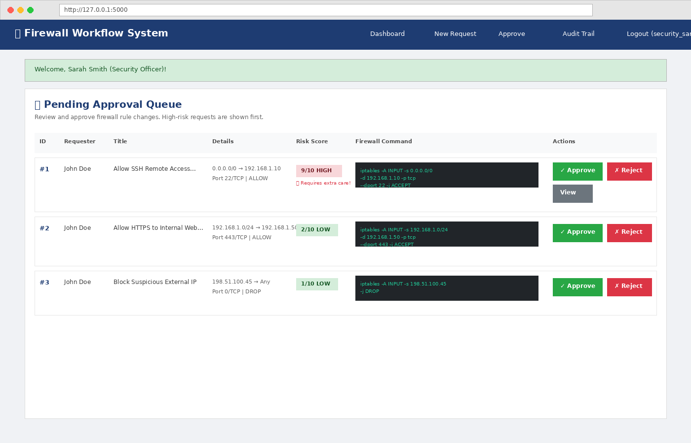
Approval Queue with Risk-Based Sorting
High-risk requests appear first. Approvers see the exact command before clicking approve.

Slide 7
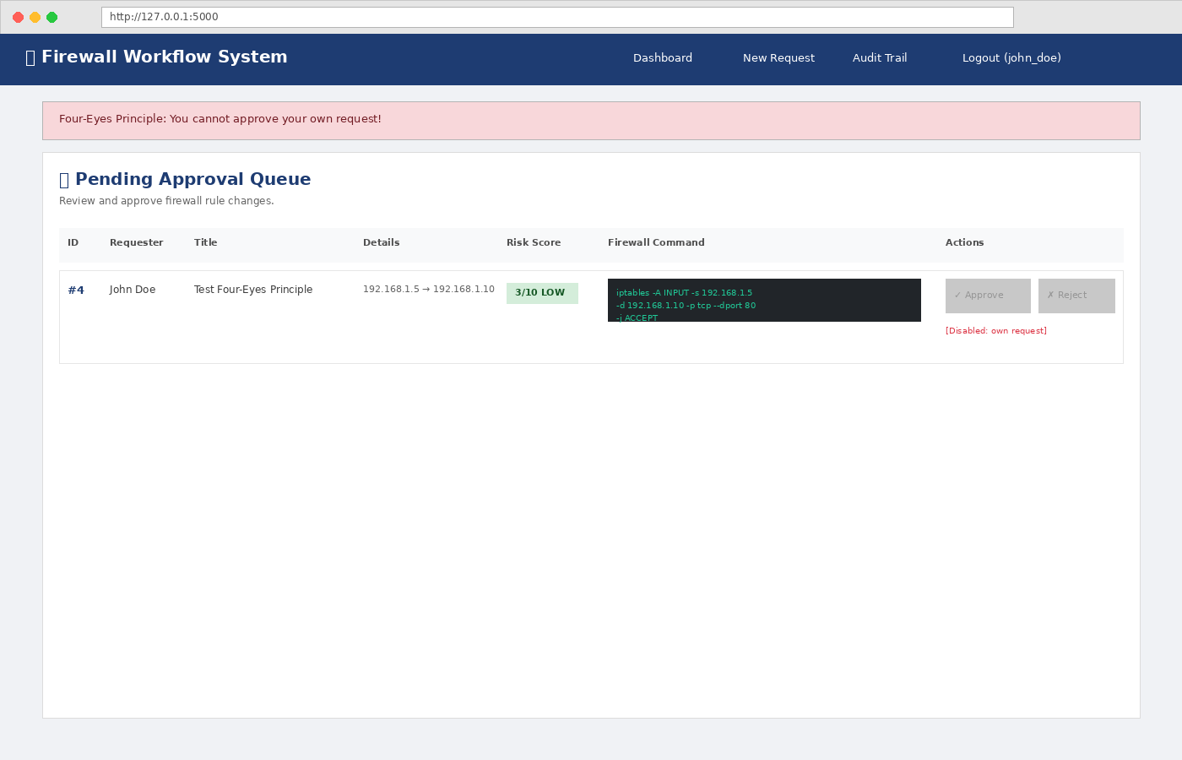
Four-Eyes Principle: Enforced in Code
The person who submits a request CANNOT approve it. This prevents insider threats.

Slide 8
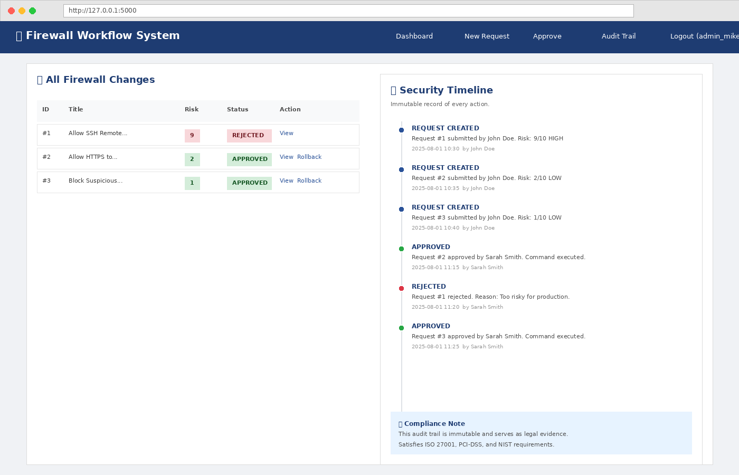
Immutable Security Timeline
Every action is logged permanently. Satisfies ISO 27001, PCI-DSS, and NIST requirements.

Slide 9
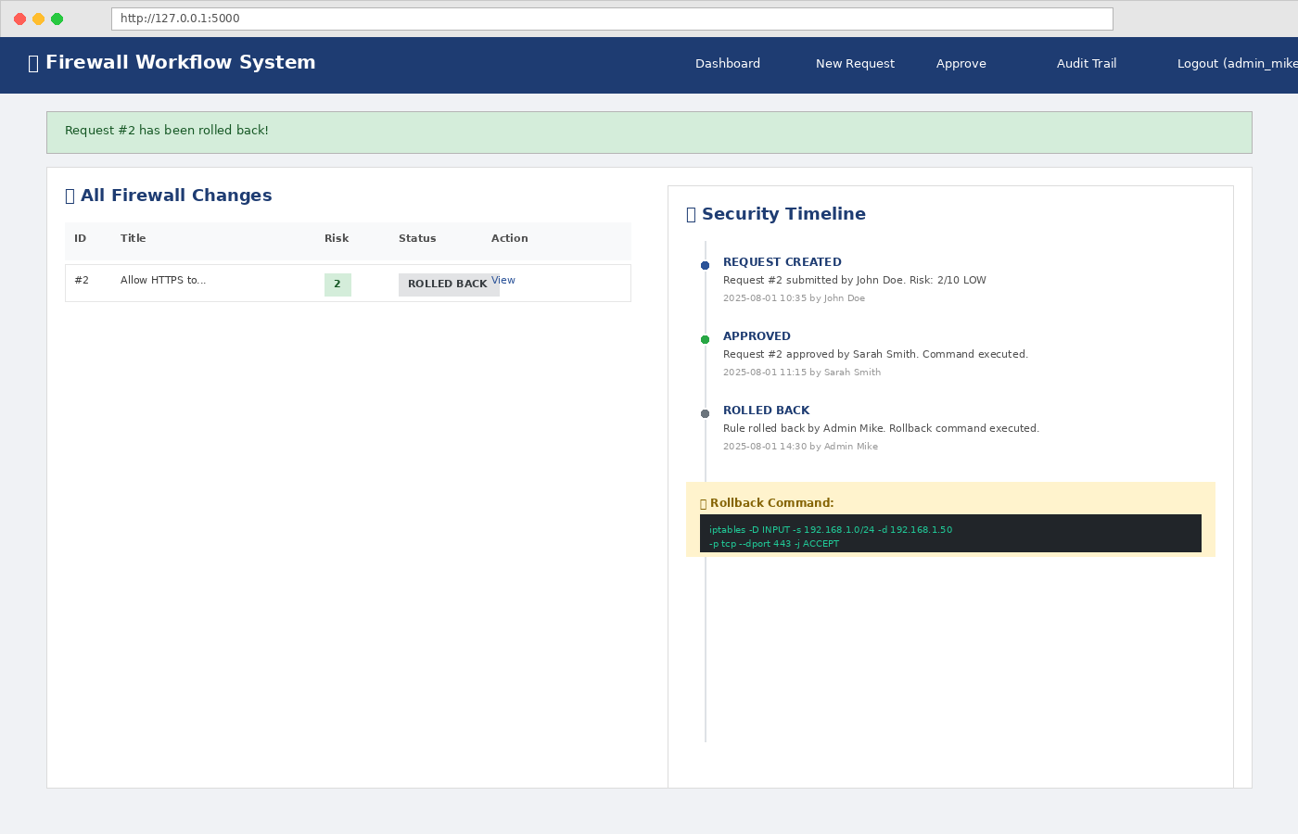
One-Click Rollback
Mistakes happen. Admins can instantly undo any change. The reverse command is generated automatically.

Slide 10
Results & Testing
Functional Tests
Risk Score Validation
✅ All 6 functional tests passed
✅ Risk scores match expected values
✅ Four-Eyes Principle blocks self-approval
✅ Audit trail records every action
✅ Rollback generates correct inverse command
• Internal HTTPS: 2/10 LOW ✅
• External API: 5/10 MEDIUM ⚠️
• SSH to Internet: 9/10 HIGH 🔥
• Block malicious IP: 1/10 LOW ✅
All scores validated against security best practices

Slide 11
Recommendations for Production
• Integrate with live firewalls via SSH or vendor APIs
• Migrate from SQLite to PostgreSQL for concurrency
• Add email/Slack notifications for pending approvals
• Implement rule conflict detection (overlap/duplication)
• Add automatic rule expiration after 30 days
• Deploy Multi-Factor Authentication (MFA)
• Containerize with Docker and orchestrate with Kubernetes

Slide 12
Conclusion
• Effective firewall change management does NOT require $30,000+ enterprise software
• The same core principles — risk scoring, approval workflows, audit trails, rollback —
can be built with free, open-source tools
• This prototype proves the concept and provides a foundation for production deployment
Built with Python, Flask, and SQLite. Ready to extend. Ready to demo.
Thank you. Questions?

