Slide 1
🛡️
Building an Automated Firewall Rule Change Management and Approval Workflow
A Functional Prototype for Network Security, Auditing and Monitoring
Course: CY376 — Network Monitoring, Security and Auditing
Team: Blue Team (Defensive Security)
Date: August 2025
CY376 | Blue Team | Network Security, Auditing and Monitoring
1

Slide 2
The Problem: Manual Firewall Changes Are Risky
Why organizations need automated change management
▸ Firewall changes handled through email, chat, or spreadsheets
▸ No standardized format — critical details get lost or misinterpreted
▸ Dangerous rules (e.g., SSH open to the entire Internet) deployed without review
▸ When breaches happen, nobody knows who approved what or why
▸ Rollback is manual, slow, and error-prone — extending downtime
The Impact
Cisco and Ponemon Institute research shows human error is a leading cause of network security incidents.
Misconfigured firewall rules rank among the top contributors to data breaches.
One typo in an IP address can expose an entire internal network to attackers.
CY376 | Blue Team | Network Security, Auditing and Monitoring
2

Slide 3
Project Objectives
What this prototype set out to achieve
▸ Build a web form that captures all technical details for a firewall change request
▸ Create a risk scoring engine that automatically flags dangerous requests before approval
▸ Enforce role-based approvals with the Four-Eyes Principle (no self-approval)
▸ Generate exact iptables commands automatically — eliminating human typos
▸ Maintain an immutable audit trail for compliance and forensic investigation
▸ Provide one-click rollback to reverse approved changes quickly and safely
CY376 | Blue Team | Network Security, Auditing and Monitoring
3

Slide 4
System Architecture & Tools
How the prototype is built and what powers it
Three-Tier Architecture
Open-Source Stack
Presentation Layer
→ HTML/CSS templates rendered by Flask's Jinja2 engine
Application Layer
→ Python modules: routing, validation, risk engine,
access control, command generation, rollback logic
Data Layer
→ SQLite database: users, requests, immutable audit_log
Python 3.13
Core application logic, risk engine, database
Flask 3.0
Web framework, routing, sessions, templates
SQLite 3
Zero-config persistent data storage
Werkzeug
PBKDF2 password hashing, secure cookies
Jinja2
HTML template rendering (built into Flask)
✓ Runs entirely on a laptop — no cloud, no licenses, no expensive hardware
CY376 | Blue Team | Network Security, Auditing and Monitoring
4

Slide 5
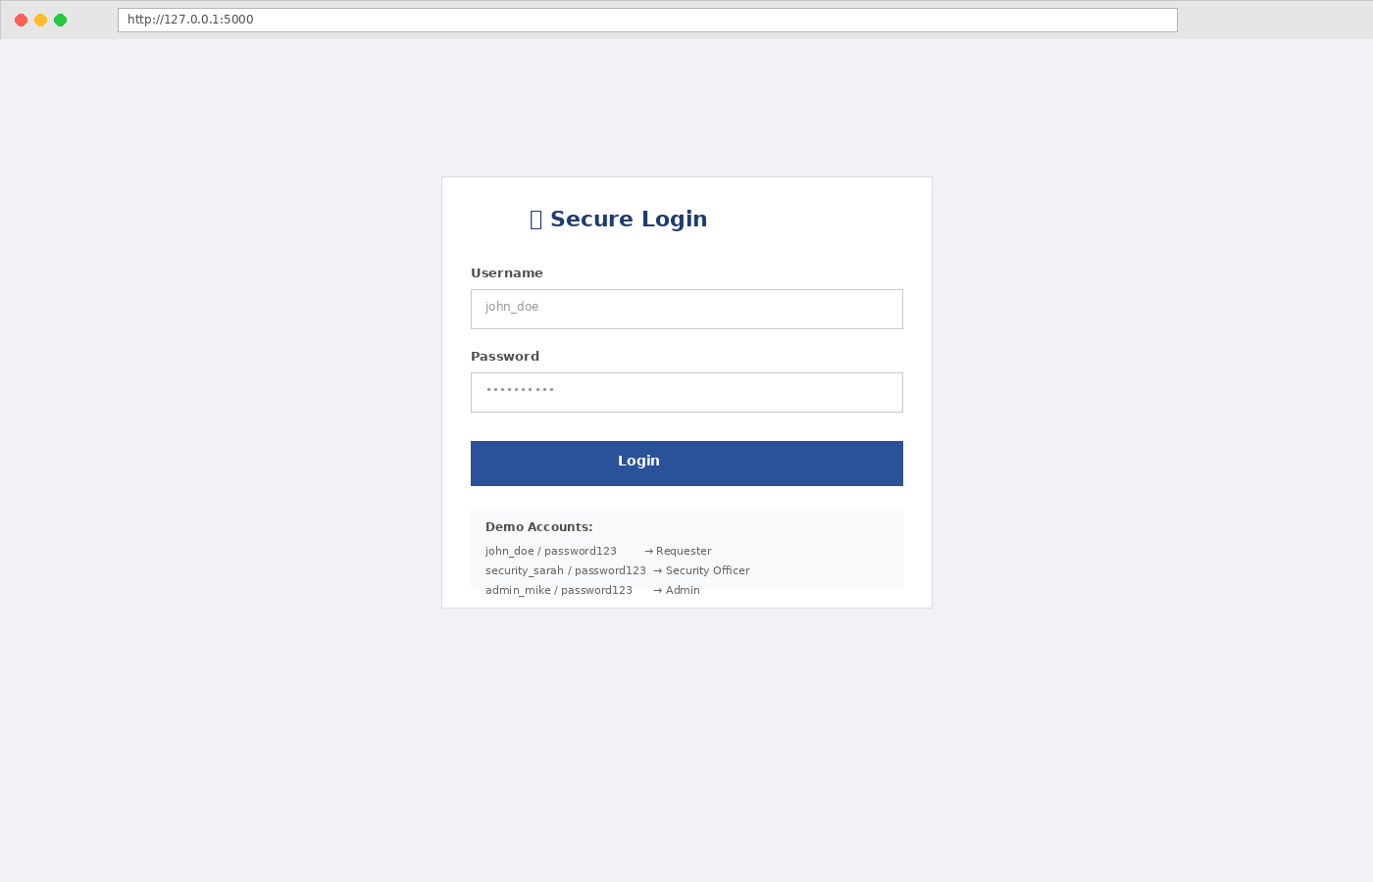
Results: Role-Based Access Control
Three user roles with progressively broader permissions
Requester
Submit requests, view own history, read audit trail
Security Officer
All above + approve/reject pending requests
Admin
All above + rollback approved changes
Principle of Least Privilege: each user gets only the access they need to do their job.
Figure 1: Login page showing the three role-based accounts
CY376 | Blue Team | Network Security, Auditing and Monitoring
5

Slide 6
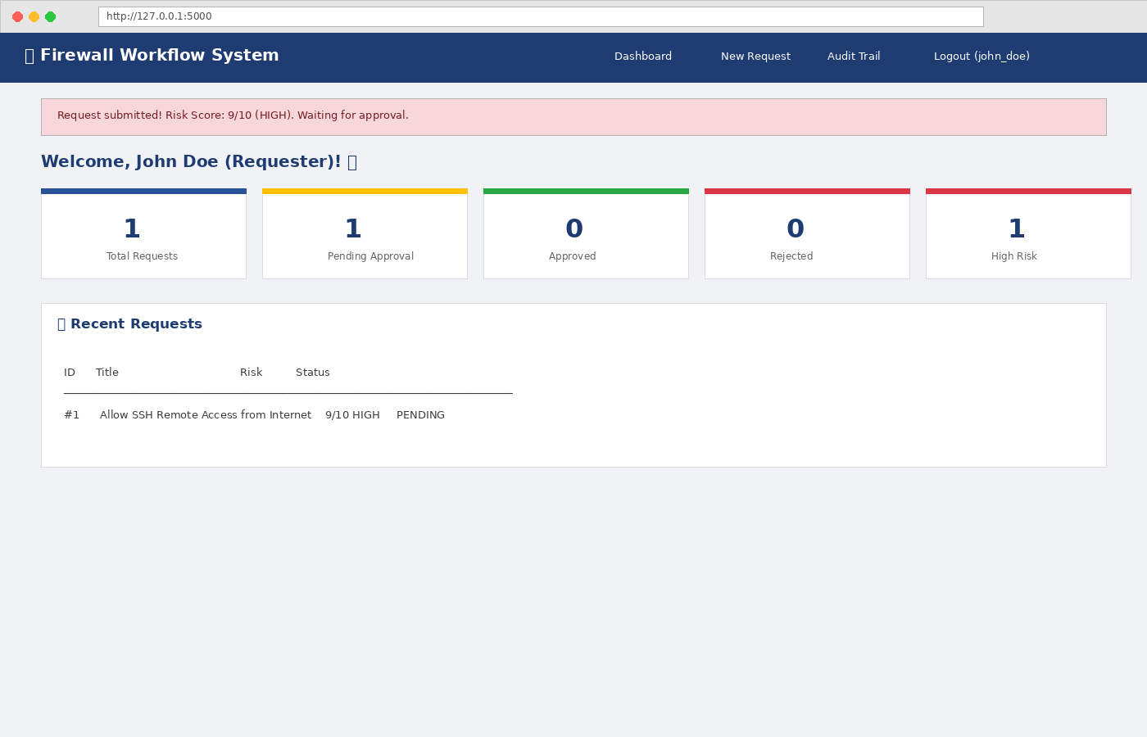
Results: The Risk Scoring Engine
Automatically calculates danger from 0 to 10 for every request
How the Score Is Calculated
▸ Port Danger
SSH/RDP = +4 | Other risky = +2 | System ports = +1
▸ Network Exposure
Internet (0.0.0.0/0) = +3 | External IP = +2 | Internal = +0
▸ Protocol
TCP = +0 | UDP = +1
▸ Action Type
ALLOW = +1 | DROP = -2 (safer)
Score Interpretation
🟢 0–3 LOW
Routine internal changes — minimal risk
🟡 4–6 MEDIUM
Requires review — moderate exposure
🔴 7–10 HIGH
Dangerous — strict approval required
Figure 2: High-risk request flagged at 9/10 — SSH exposed to the Internet
CY376 | Blue Team | Network Security, Auditing and Monitoring
6

Slide 7
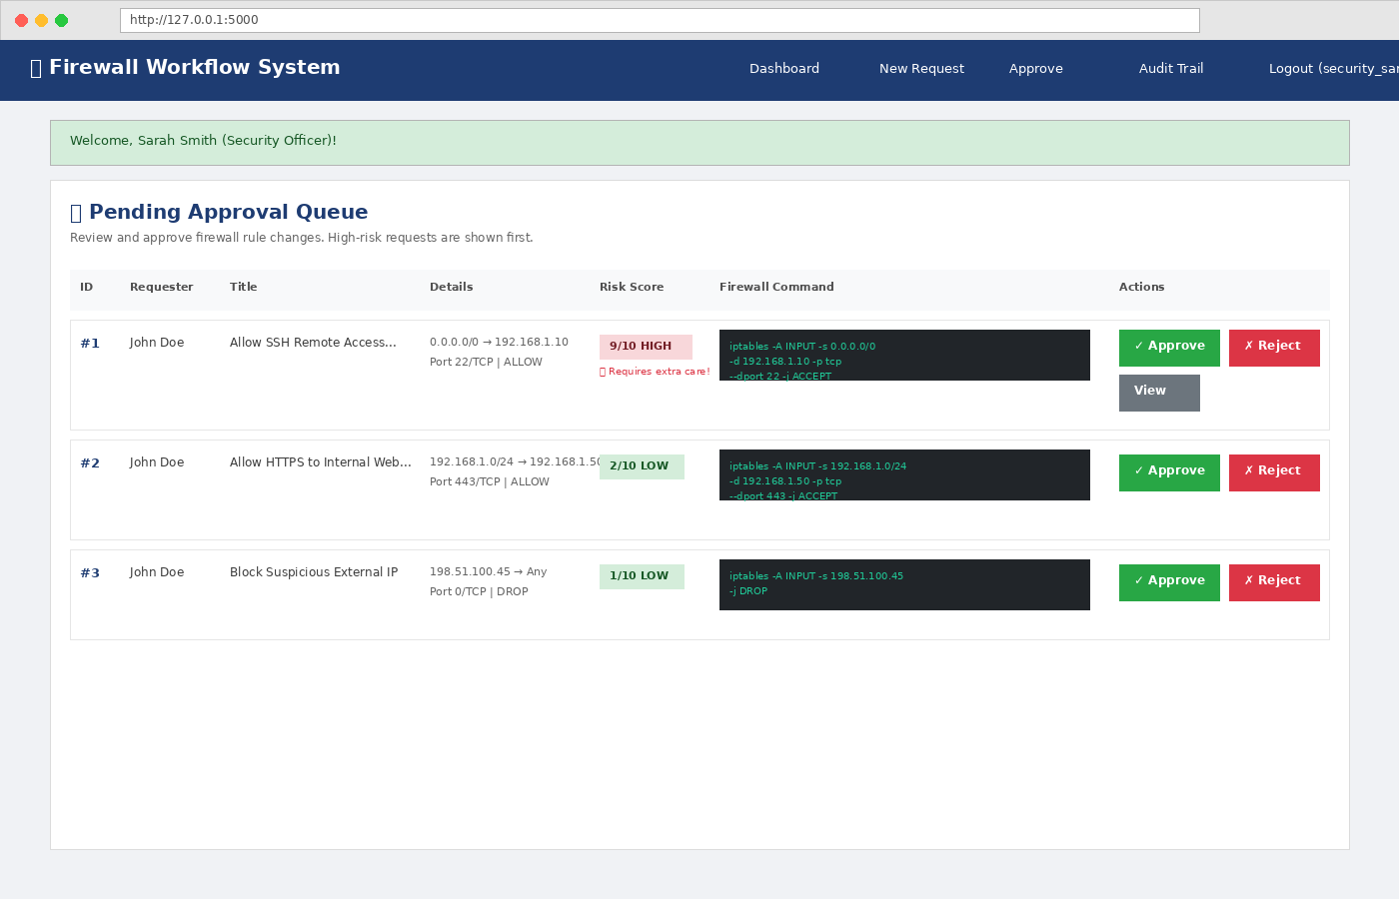
Results: The Approval Workflow
High-risk requests appear first — approvers see the exact command
How Approval Works
1. Requester fills the web form and submits
2. Risk engine scores the request instantly
3. Request appears in the Security Officer's queue
4. Queue is sorted by risk (highest danger first)
5. Officer reviews the generated iptables command
6. Officer clicks Approve or Reject with a reason
🛡️ Four-Eyes Principle
The person who submits a request CANNOT approve it. This separation of duties is enforced in code — not just written in a policy.
Figure 3: Approval queue sorted by risk score with generated commands visible
CY376 | Blue Team | Network Security, Auditing and Monitoring
7

Slide 8
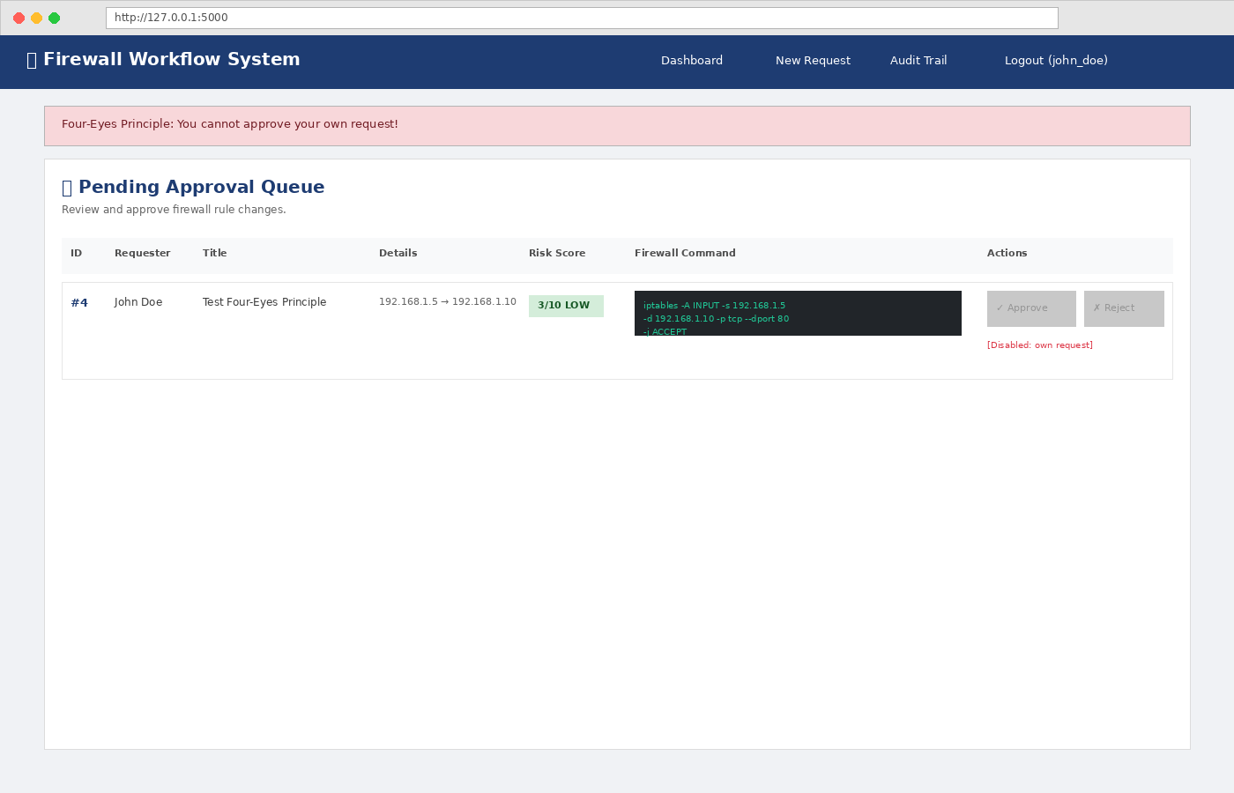
Results: Four-Eyes Principle in Action
Technical enforcement of separation of duties
Why This Matters
In many organizations, separation of duties is just a policy document.
This system enforces it at the application layer:
• When a user clicks 'Approve', the system checks their ID against the requester's ID
• If they match, the action is blocked immediately
• An error message is displayed — no bypass possible
Real-world analogy: In a bank, the person who deposits cash cannot also be the person who counts it. Two different people must be involved.
Compliance Alignment
Required by ISO 27001, PCI-DSS, and SOX frameworks
Figure 4: System blocking a user from approving their own request
CY376 | Blue Team | Network Security, Auditing and Monitoring
8

Slide 9
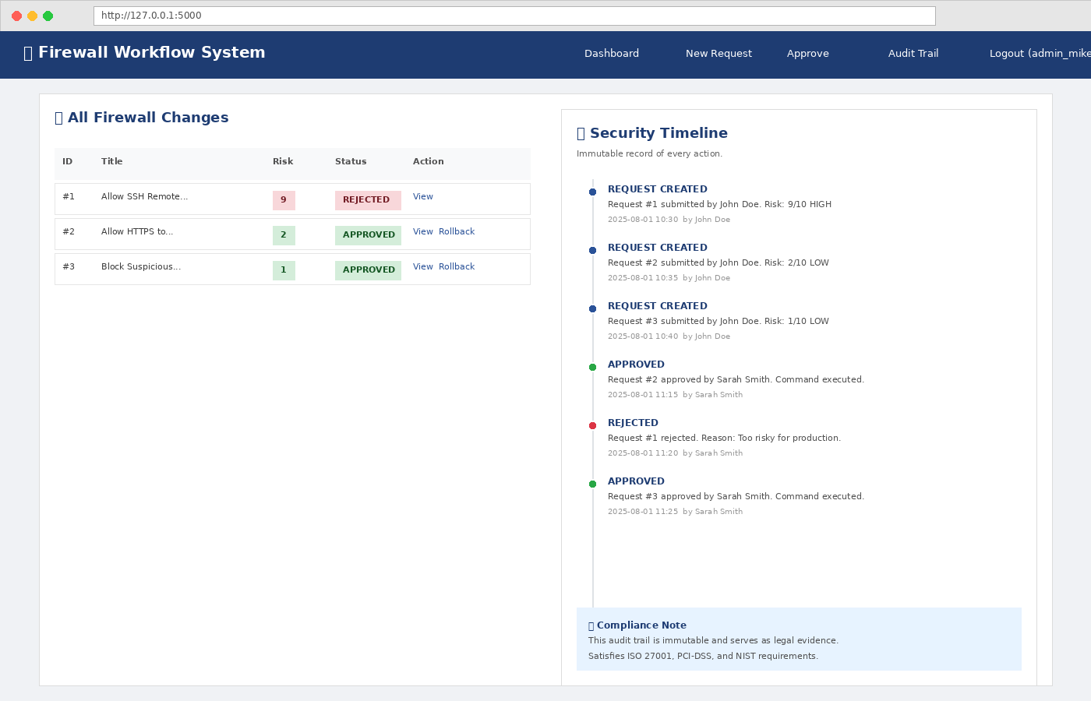
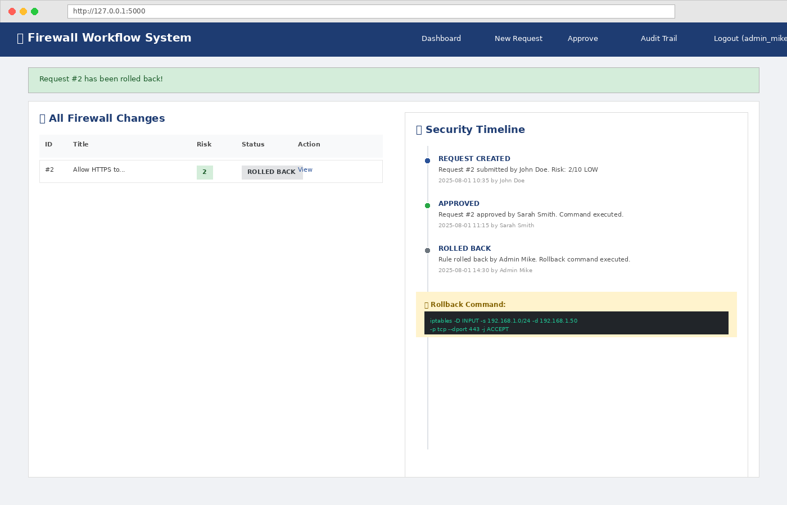
Results: Audit Trail & Rollback
Immutable logging and instant mistake recovery
Immutable Security Timeline
Every action is permanently recorded:
• WHO submitted, approved, rejected, or rolled back
• WHAT the request contained and the risk score
• WHEN each action occurred (timestamp)
• WHY the change was needed (business justification)
No application route can modify or delete audit entries.
Figure 5a: Security timeline with all logged actions
One-Click Rollback
When a rule breaks the network:
• Admin clicks 'Rollback'
• System generates the inverse command (replaces -A with -D)
• Rollback action is itself logged in the audit trail
• Mean Time To Recovery (MTTR) is reduced from hours to seconds
Figure 5b: Rollback showing the reverse iptables command
CY376 | Blue Team | Network Security, Auditing and Monitoring
9

Slide 10
Recommendations for Production
From prototype to enterprise-ready deployment
🔌 Live Firewall Integration
⏰ Rule Expiration
Connect via SSH (Paramiko) or vendor APIs to push commands to real devices
Auto-expire rules after 30 days unless recertified — reduces rule sprawl
🗄️ Database Upgrade
🔐 Multi-Factor Auth
Migrate from SQLite to PostgreSQL for concurrency, backups, and replication
Require TOTP for all accounts, mandatory for Admin and Security Officer roles
📧 Notifications
🐳 Containerization
Add email and Slack alerts when requests enter the approval queue
Deploy with Docker and orchestrate with Kubernetes for high availability
⚔️ Conflict Detection
📊 SIEM Integration
Warn if new rules overlap with, contradict, or duplicate existing ones
Feed audit logs into Splunk or ELK for centralized security monitoring
💡 The architecture is firewall-agnostic. Replacing the command generation module enables support for Cisco ASA, Palo Alto PAN-OS, AWS Security Groups, or Azure NSGs without changing the core workflow.
CY376 | Blue Team | Network Security, Auditing and Monitoring
10

Slide 11
Effective firewall change management does not require $30,000+ enterprise software.
✓ Risk-based approval ensures dangerous changes get the scrutiny they deserve
✓ The Four-Eyes Principle prevents a single compromised account from opening backdoors
✓ An immutable audit trail satisfies ISO 27001, PCI-DSS, and NIST requirements
✓ One-click rollback reduces recovery time from hours to seconds
Built with Python, Flask, and SQLite. Ready to extend. Ready to deploy.
Thank you.
CY376 | Blue Team | Network Security, Auditing and Monitoring
11

