Slide 1
ICLab01_SMC
Supper MOSFET Calculator

Slide 2
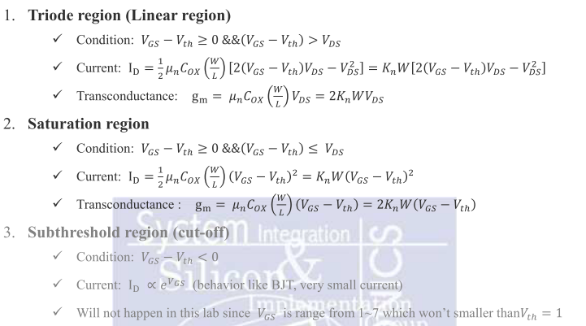
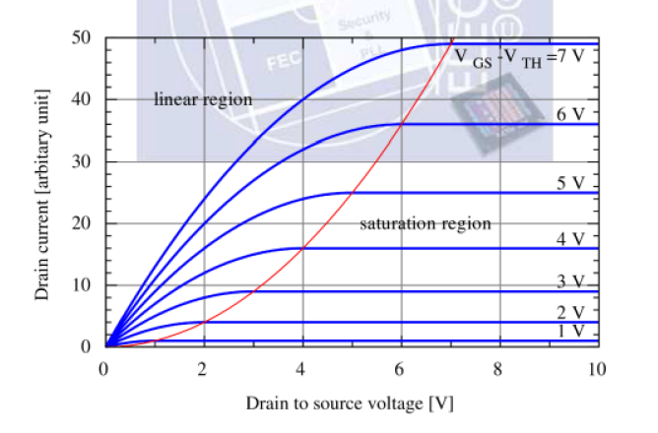
MOS’s modes of operation

Slide 3
OUTLINE
SPEC
System Architecture
RTL design

Slide 4
SPEC
Input Signal | Bit Width | Description
W_0, V_GS_0, V_DS_0 | 3/per sign | ranged from 1~7 unsigned integer
W_1, V_GS_1, V_DS_1 | 3/per sign | ranged from 1~7 unsigned integer
W_2, V_GS_2, V_DS_2 | 3/per sign | ranged from 1~7 unsigned integer
W_3, V_GS_3, V_DS_3 | 3/per sign | ranged from 1~7 unsigned integer
W_4, V_GS_4, V_DS_4 | 3/per sign | ranged from 1~7 unsigned integer
W_5, V_GS_5, V_DS_5 | 3/per sign | ranged from 1~7 unsigned integer
mode | 2 | mode [0]: 1: current, 0: transconductance mode [1]: 1: larger eq., 0: smaller eq.
Output Signal | Bit Width | Description
out_n | 10 | The answer. Ranged from 0~1023

Slide 5
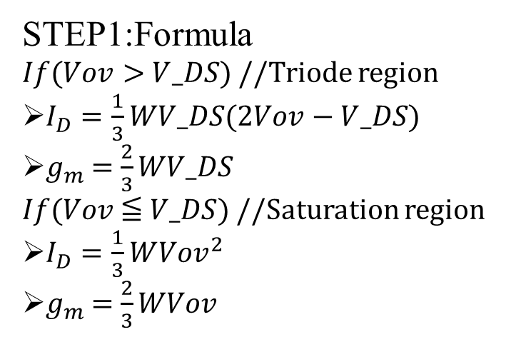
SPEC
STEP1:Formula
$If$($Vov>$ $V_DS$) //Triode region
$I_{D}=\frac{1}{3}WV_DS(2Vov−V_DS)$
$g_{m}$= $\frac{2}{3}WV_DS$
$If$($Vov$≦ $V_DS$) //Saturation region
$I_{D}=\frac{1}{3}W{Vov}^{2}$
$g_{m}$= $\frac{2}{3}WVov$
STEP3:mode signal
mode[0] = 0
Smaller: 𝒈𝒎_{𝒕𝒐𝒕𝒂𝒍} = 𝒏𝟑 + 𝒏𝟒 + 𝒏𝟓 (mode[1] = 0)
Larger: 𝒈𝒎_{𝒕𝒐𝒕𝒂𝒍} = 𝒏𝟎 + 𝒏𝟏 + 𝒏𝟐 (mode[1] = 1)
mode[0] = 1
Smaller: 𝑰_{𝒕𝒐𝒕𝒂𝒍} = 𝟑∗𝒏𝟑 + 𝟒∗𝒏𝟒 + 𝟓∗𝒏𝟓 (mode[1] = 0)
Larger: 𝑰_{𝒕𝒐𝒕𝒂𝒍} = 𝟑∗𝒏𝟎 + 𝟒∗𝒏𝟏 + 𝟓∗𝒏𝟐 (mode[1] = 1)
mode | calculation
2’b00 | smaller | transconductance
2’b01 | smaller | current
2’b10 | larger | transconductance
2’b11 | larger | current
STEP2:Sort
Sort the sequence from the largest to the smallest.
n0 > n1 > n2 > n3>n4>n5

Slide 6
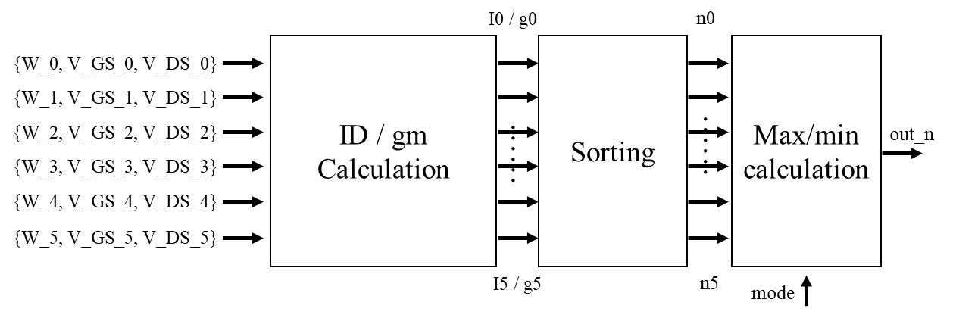
System Architecture

Slide 7
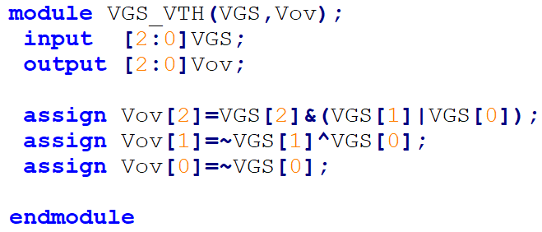
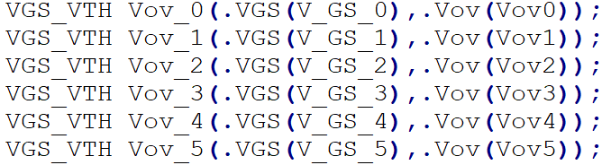
RTL design
V_GS_n-V_th ( V_GS ranged from 1~7 unsigned integer, V_th=1)
V_{GS}[2] | V_{GS}[1] | V_{GS}[0] | V_{ov}[2] | V_{ov}[1] | V_{ov}[0]
0 | 0 | 0 | X | X | X
0 | 0 | 1 | 0 | 0 | 0
0 | 1 | 0 | 0 | 0 | 1
0 | 1 | 1 | 0 | 1 | 0
1 | 0 | 0 | 0 | 1 | 1
1 | 0 | 1 | 1 | 0 | 0
1 | 1 | 0 | 1 | 0 | 1
1 | 1 | 1 | 1 | 1 | 0

Slide 8
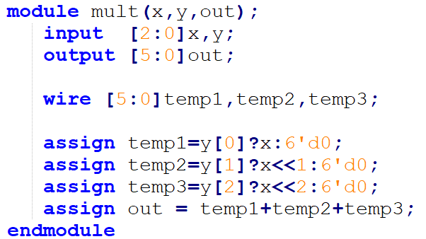
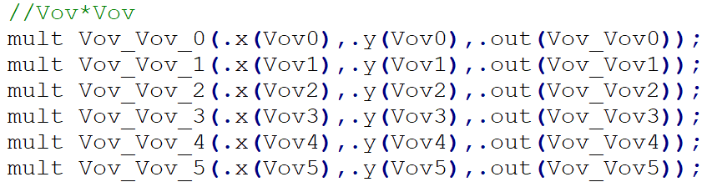

Multiplication
$If$($Vov>$ $V_DS$)
$I_{D}=\frac{1}{3}WV_DS(2Vov−V_DS)$
$g_{m}$= $\frac{2}{3}WV_DS$
$If$($Vov$≦ $V_DS$)
$I_{D}=\frac{1}{3}W{Vov}^{2}$
$g_{m}$= $\frac{2}{3}WVov$

Slide 9
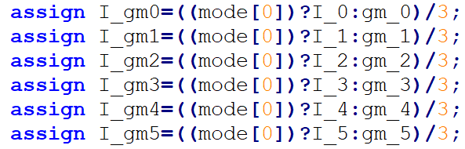

$I_{D}/g_{m}$ & Division
mode | calculation
2’b00 | smaller | transconductance
2’b01 | smaller | current
2’b10 | larger | transconductance
2’b11 | larger | current
Mode[0] signal
mode[0] = 0
transconductance
mode[0] = 1
current

Slide 10
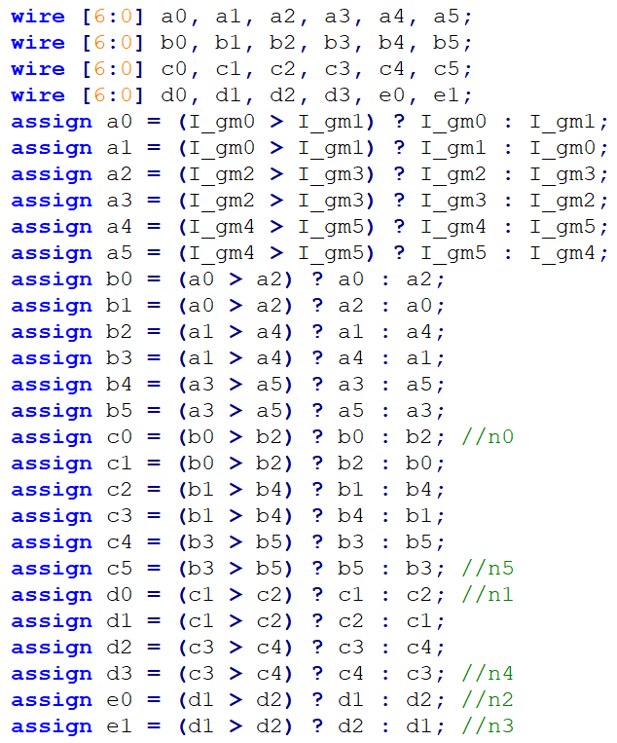
Sorting
I_gm_n
1 | 2 | 3 | 4 | 5 | 6
>?
>?
>?
a_n
2 | 1 | 4 | 3 | 6 | 5
>?
>?
>?
b_n
4 | 2 | 6 | 1 | 5 | 3
>?
>?
>?
c_n
6 | 4 | 5 | 2 | 3 | 1
>?
>?
d_n
6 | 5 | 4 | 3 | 2 | 1
>?
e_n
6 | 5 | 4 | 3 | 2 | 1

Slide 11
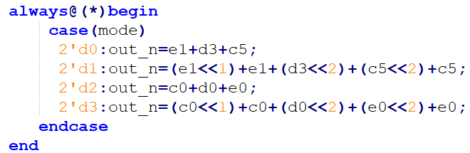
Out_n
mode signal :
mode[0] = 0
Smaller: 𝒈𝒎_{𝒕𝒐𝒕𝒂𝒍} = 𝒏𝟑 + 𝒏𝟒 + 𝒏𝟓 (mode[1] = 0)
Larger: 𝒈𝒎_{𝒕𝒐𝒕𝒂𝒍} = 𝒏𝟎 + 𝒏𝟏 + 𝒏𝟐 (mode[1] = 1)
mode[0] = 1
Smaller: 𝑰_{𝒕𝒐𝒕𝒂𝒍} = 𝟑∗𝒏𝟑 + 𝟒∗𝒏𝟒 + 𝟓∗𝒏𝟓 (mode[1] = 0)
Larger: 𝑰_{𝒕𝒐𝒕𝒂𝒍} = 𝟑∗𝒏𝟎 + 𝟒∗𝒏𝟏 + 𝟓∗𝒏𝟐 (mode[1] = 1)

Slide 12
THANK

