Slide 1
ICLab01_SD
Sort & Divider

Slide 2
OUTLINE
SPEC
System Architecture
RTL design

Slide 3
SPEC
Input Signal | Bit Width | Description
in_n0 | 4 | The first number of code. (Ranged from 1~15)
in_n1 | 4 | The second number of code. (Ranged from 1~15)
in_n2 | 4 | The third number of code. (Ranged from 1~15)
in_n3 | 4 | The forth number of code. (Ranged from 1~15)
mode | 1 | Operator for different modes.
Output Signal | Bit Width | Description
out_n | 4 | The answer. (Ranged from 0~15)
Sort:
Sort the sequence from the largest to the smallest.
n0 > n1 > n2 > n3
mode signal :
mode0 : n0 divide n3 (you need to design divider by yourself)
mode1 : (n0 - n1) + (n2 - n3)

Slide 4
System Architecture
mode
in_n0
sorting
n0
calculate
大
in_n1
n1
n0/n3
0
out_n
n2
(n0-n1)+(n2-n3)
in_n2
1
in_n3
小
n3

Slide 5
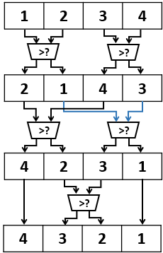
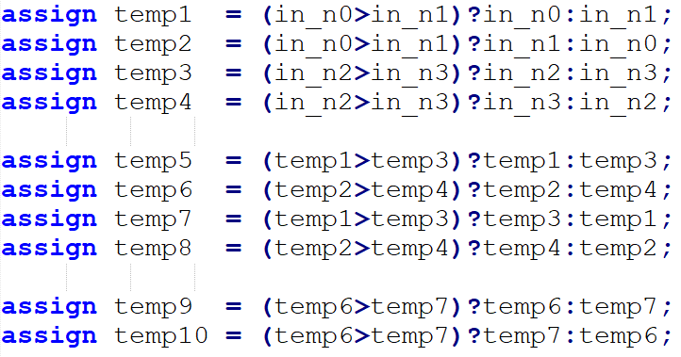
RTL design
Sorting

Slide 6
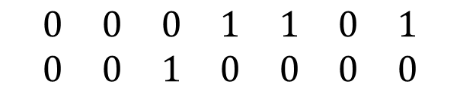
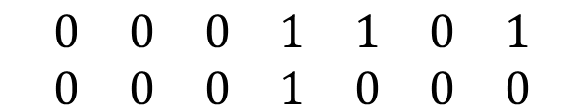
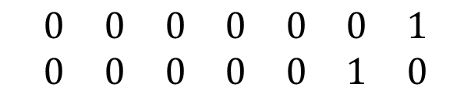
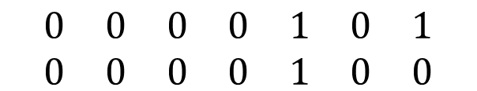
Divider
Let n0=1101, n3=0010, then Q=n0/n3.
0001101<0010000
Q[3]=0,餘數不變。
$$\begin{matrix}0 & 0 & 0 & 1 & 1 & 0 & 1 \\ 0 & 0 & 1 & 0 & 0 & 0 & 0\end{matrix}$$
{3’b000,n0}
{3’b000,n3}<<3
0001101>=0001000
Q[2]=1,餘數=0000101。
$$\begin{matrix}0 & 0 & 0 & 1 & 1 & 0 & 1 \\ 0 & 0 & 0 & 1 & 0 & 0 & 0\end{matrix}$$
{3’b000,n3}<<2
0000101>=0000100
Q[1]=1,餘數=0000001。
$$\begin{matrix}0 & 0 & 0 & 0 & 1 & 0 & 1 \\ 0 & 0 & 0 & 0 & 1 & 0 & 0\end{matrix}$$
{3’b000,n3}<<1
$$\begin{matrix}0 & 0 & 0 & 0 & 0 & 0 & 1 \\ 0 & 0 & 0 & 0 & 0 & 1 & 0\end{matrix}$$
0000001<0000010
Q[0]=0,餘數不變。
{3’b000,n3}

Slide 7
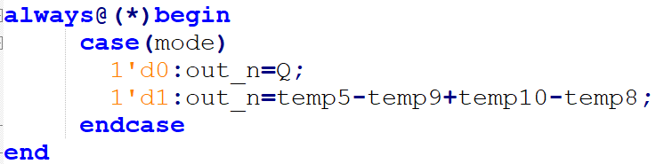
mode
OUTPUT
mode0 : n0 divide n3
mode1 : (n0 - n1) + (n2 - n3)
n0/n3
0
out_n
(n0-n1)+(n2-n3)
1

Slide 8
THANKS

