Slide 1
ICLab02_LU
LU decomposition

Slide 2
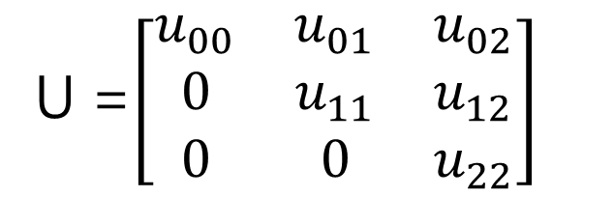
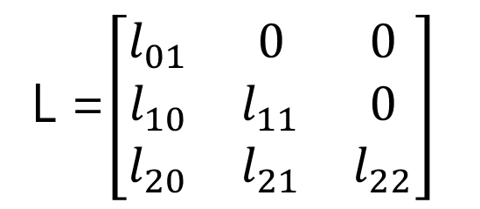
LU decomposition is a basic concept in linear algebra, it indicates the process and the result of Gaussian elimination, and factors a matrix as:
A = LU
L stands for unit lower triangular matrix, and U stands for upper triangular matrix. L and U have the from:
L =$\left[\begin{matrix}l_{01} & 0 & 0 \\ l_{10} & l_{11} & 0 \\ l_{20} & l_{21} & l_{22}\end{matrix}\right]$
U =$\left[\begin{matrix}u_{00} & u_{01} & u_{02} \\ 0 & u_{11} & u_{12} \\ 0 & 0 & u_{22}\end{matrix}\right]$

Slide 3
OUTLINE
SPEC
System Architecture
RTL design

Slide 4
SPEC
Input Signal | Bit Width | Description
clk | 1 | Clock.
rst_n | 1 | Asynchronous active-low reset.
in_valid | 1 | 0 for input invalid, 1 for input valid.
in_data | 1 | Element of a 3-by-3 matrix A.
Output Signal | Bit Width | Description
out_valid | 1 | 0 for output invalid, 1 for output valid.
invertible | 1 | 0 if A is not invertible.
decomposable | 1 | 0 if A cannot be decomposed to LU.
out_l | 3 | Element of a 3-by-3 matrix L, in raster scanning order.
out_u | 3 | Element of a 3-by-3 matrix U, in raster scanning order.

Slide 5
System Architecture
FSM diagram
in_valid
!in_valid
det≠0
out_valid=1
invertible=1
decomposable=1
out_l = L
out_u = U
IDLE
INPUT
CHECK_INV
DEC
DEC_1
OUTPUT
det=0
!in_valid
in_valid
out_cnt<9
OUTPUT_1
out_valid=1
out_cnt=9

Slide 6
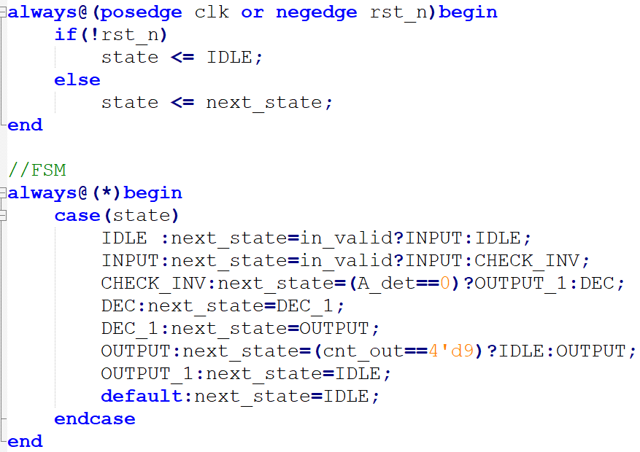
RTL design
FSM(moore machine)

Slide 7
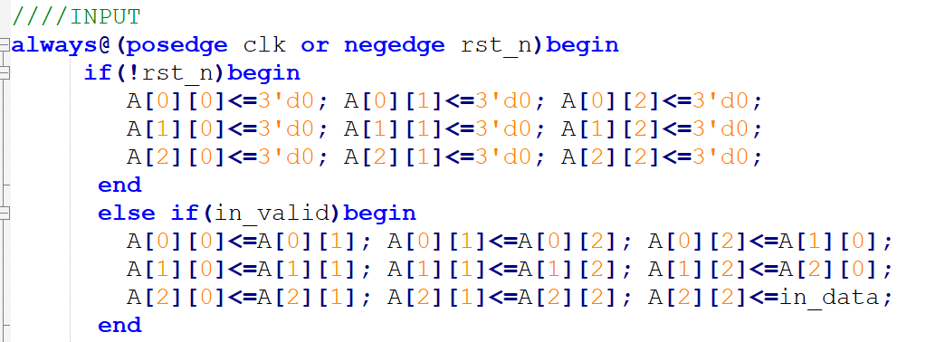
INPUT
Shift register

Slide 8
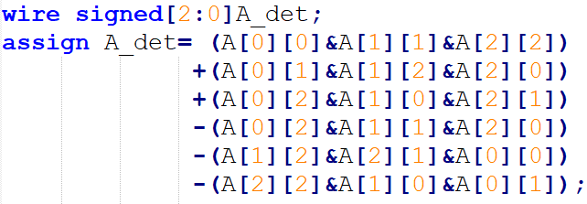
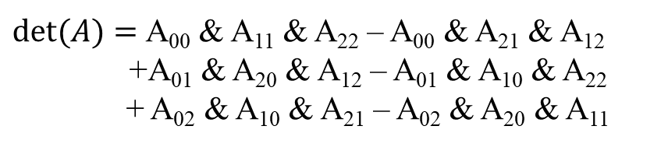

CHECK_INV
If matrix A is non-invertible, there is no need to perform LU decomposition.
A =$\left[\begin{matrix}A_{00} & A_{01} & A_{02} \\ A_{10} & A_{11} & A_{12} \\ A_{20} & A_{21} & A_{22}\end{matrix}\right]$
$det⁡(A)=$A₀₀ & A₁₁ & A₂₂ – A₀₀ & A₂₁ & A₁₂
+A₀₁ & A₂₀ & A₁₂ – A₀₁ & A₁₀ & A₂₂
+ A₀₂ & A₁₀ & A₂₁ – A₀₂ & A₂₀ & A₁₁

Slide 9
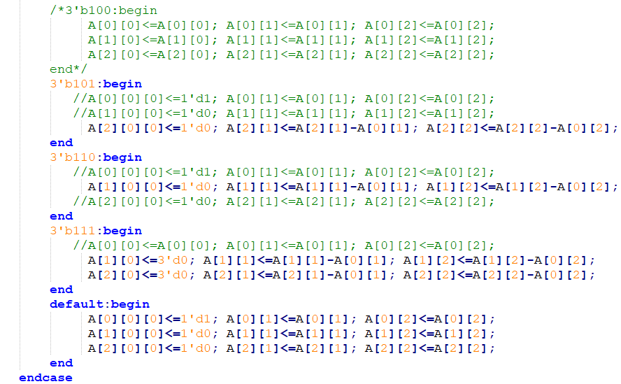
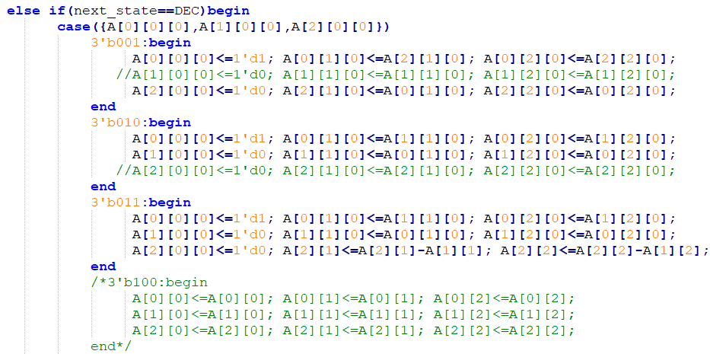

DEC
U stands for upper triangular matrix, and the result of Gaussian elimination.
In this state the result of Matrix A =$\left[\begin{matrix}1 & u_{01} & u_{02} \\ 0 & u_{11} & u_{12} \\ 0 & u_{21} & u_{22}\end{matrix}\right]$

Slide 10
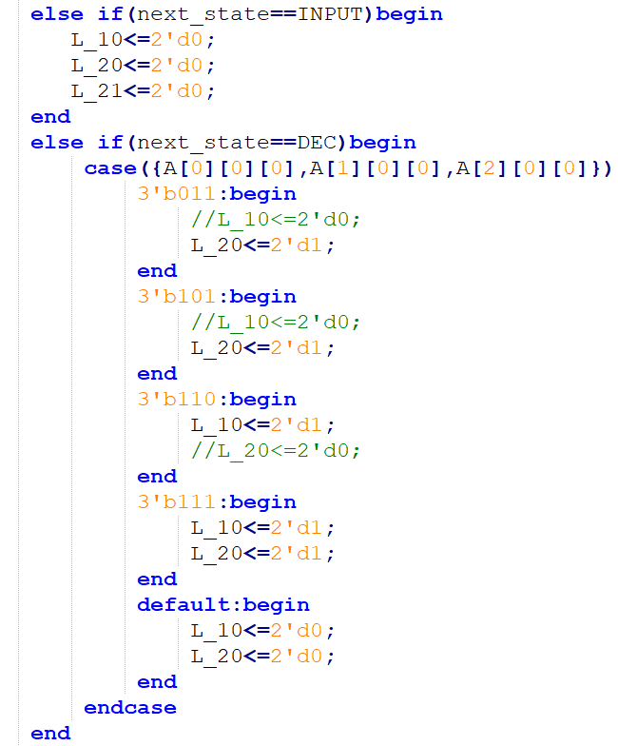

DEC
L stands for unit lower triangular matrix, and the process of Gaussian elimination.
In this state L =$\left[\begin{matrix}1 & 0 & 0 \\ l_{10} & 1 & 0 \\ l_{20} & l_{21} & 1\end{matrix}\right]$
0 | A₀₁ | A₀₂
1 | A₁₁ | A₁₂
1 | A₂₁ | A₂₂
1 | U₀₁ | U₀₂
0 | U₁₁ | U₁₂
0 | U₂₁ | U₂₂
1 | 0 | 0
0 | 1 | 0
1 | L₂₁ | 1
1 | A₀₁ | A₀₂
0 | A₁₁ | A₁₂
1 | A₂₁ | A₂₂
1 | U₀₁ | U₀₂
0 | U₁₁ | U₁₂
0 | U₂₁ | U₂₂
1 | 0 | 0
0 | 1 | 0
1 | L₂₁ | 1
1 | A₀₁ | A₀₂
1 | A₁₁ | A₁₂
0 | A₂₁ | A₂₂
1 | U₀₁ | U₀₂
0 | U₁₁ | U₁₂
0 | U₂₁ | U₂₂
1 | 0 | 0
1 | 1 | 0
0 | L₂₁ | 1
1 | A₀₁ | A₀₂
1 | A₁₁ | A₁₂
1 | A₂₁ | A₂₂
1 | U₀₁ | U₀₂
0 | U₁₁ | U₁₂
0 | U₂₁ | U₂₂
1 | 0 | 0
1 | 1 | 0
1 | L₂₁ | 1

Slide 11
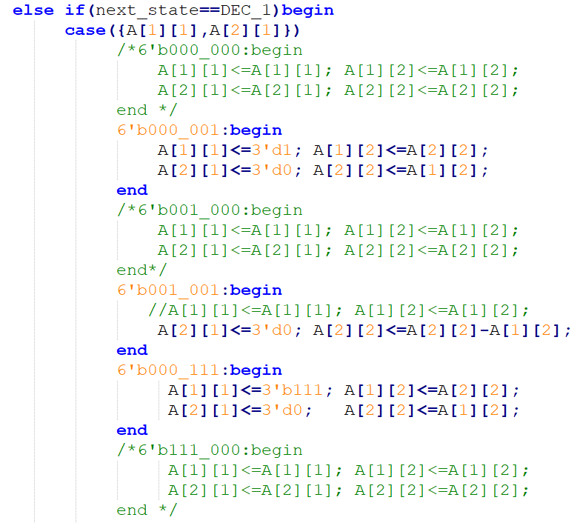
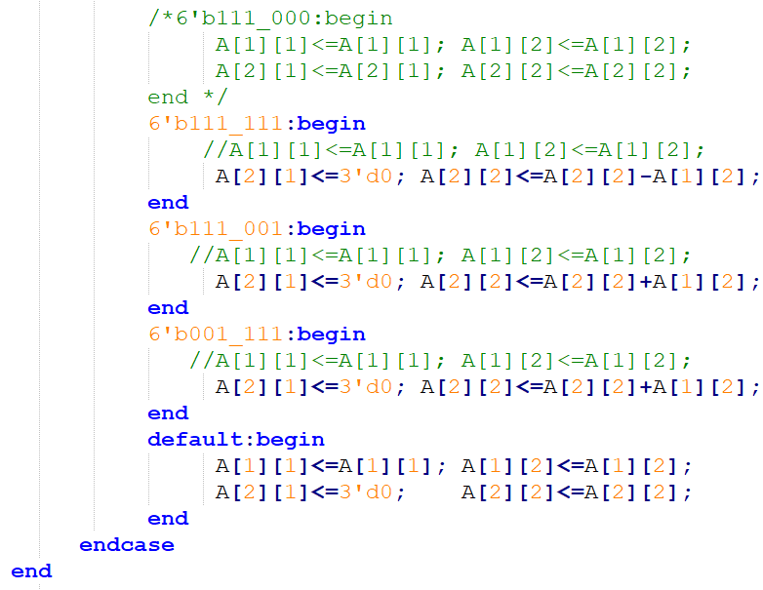

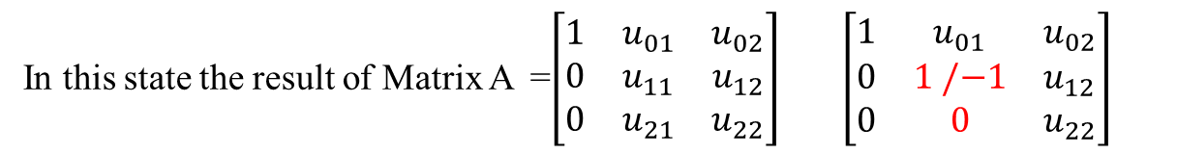
DEC_1
In this state the result of Matrix A =$\left[\begin{matrix}1 & u_{01} & u_{02} \\ 0 & u_{11} & u_{12} \\ 0 & u_{21} & u_{22}\end{matrix}\right] \left[\begin{matrix}1 & u_{01} & u_{02} \\ 0 & 1 /−1 & u_{12} \\ 0 & 0 & u_{22}\end{matrix}\right]$
$u_{11}$ and $u_{21}$ can be 1,0,-1

Slide 12
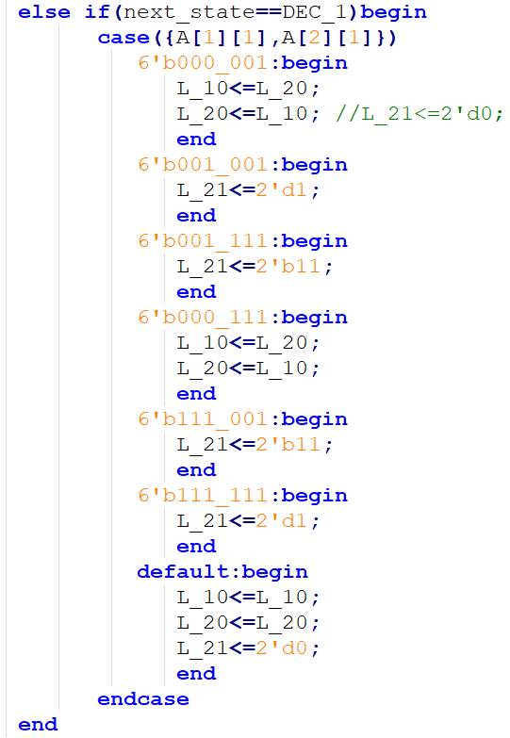

DEC_1
In this state L =$\left[\begin{matrix}1 & 0 & 0 \\ l_{10} & 1 & 0 \\ l_{20} & l_{21} & 1\end{matrix}\right]$
1 | A₀₁ | A₀₂
0 | 0 | A₁₂
0 | 1/-1 | A₂₂
1 | U₀₁ | U₀₂
0 | 1/-1 | U₁₂
0 | 0 | U₂₂
1 | 0 | 0
L₂₀ | 1 | 0
L₁₀ | 0 | 1
1 | A₀₁ | A₀₂
0 | 1/-1 | A₁₂
0 | 0 | A₂₂
1 | U₀₁ | U₀₂
0 | 1/-1 | U₁₂
0 | 0 | U₂₂
1 | 0 | 0
L₁₀ | 1 | 0
L₂₀ | 0 | 1
1 | A₀₁ | A₀₂
0 | 1/-1 | A₁₂
0 | 1/-1 | A₂₂
1 | U₀₁ | U₀₂
0 | 1/-1 | U₁₂
0 | 0 | U₂₂
1 | 0 | 0
L₂₀ | 1 | 0
L₁₀ | 1 | 1

Slide 13
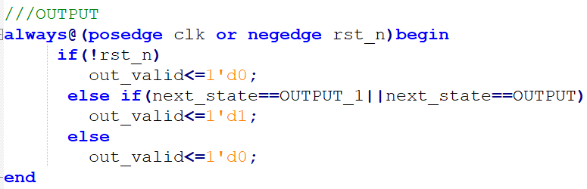
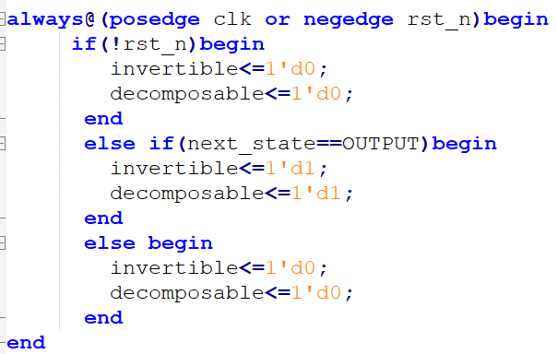
OUTPUT
out_valid
invertible & decomposable

Slide 14
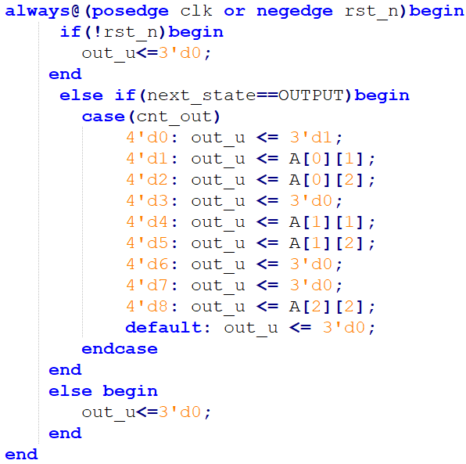
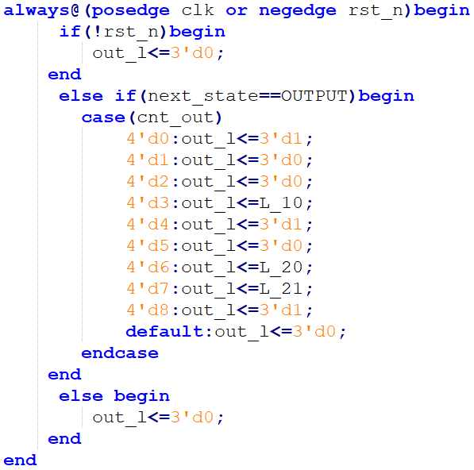
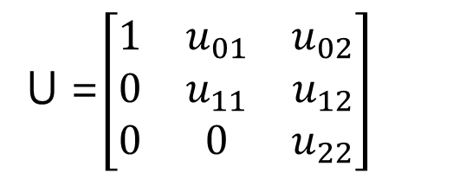
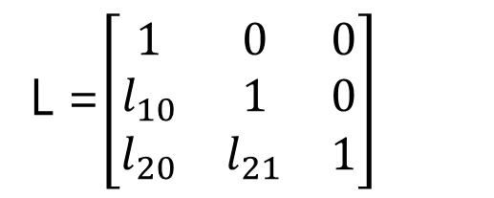
out_u
out_l
U =$\left[\begin{matrix}1 & u_{01} & u_{02} \\ 0 & u_{11} & u_{12} \\ 0 & 0 & u_{22}\end{matrix}\right]$
L =$\left[\begin{matrix}1 & 0 & 0 \\ l_{10} & 1 & 0 \\ l_{20} & l_{21} & 1\end{matrix}\right]$

Slide 15
THANK

