Slide 1
Lab03_MAZE
MAZE

Slide 2
OUTLINE
SPEC
Algorithm
System Architecture
RTL design

Slide 3
SPEC
Input Signal | Bit Width | Description
clk | 1 | Clock.
rst_n | 1 | Asynchronous active-low reset.
in_valid | 1 | High when input is valid.
in | 1 | High stands for path, and Low stands for wall
Output Signal | Bit Width | Description
out_valid | 1 | High when out is valid.
out | 2 | Right: 2’d0; Down: 2’d 1; Left: 2’d 2; Up: 2’d 3
The input signal in is delivered in raster scan order for 289 cycles continuously

Slide 4
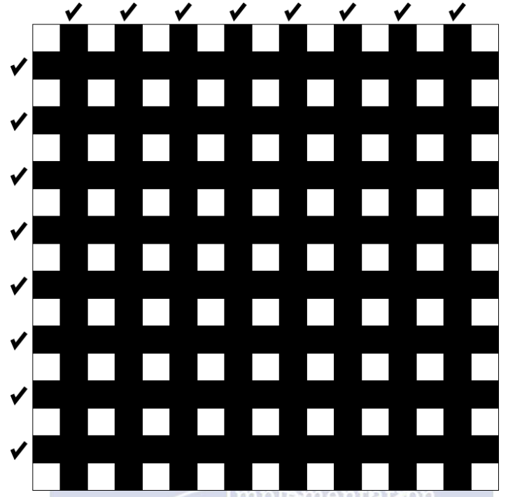
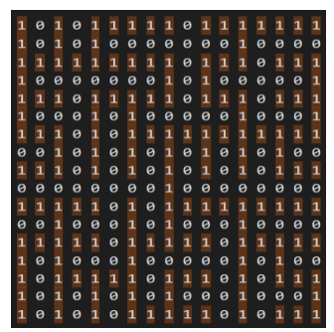
MAZE SPEC
In general, the walls can not exist in the white block
Maze examples

Slide 5
Algorithm
核心:填死路
1.先將迷宮外圍，填一圈牆，以便於判斷死路。
2.利用三面為牆來判斷是否為死路。
3.將死路填滿後，剩下的就是唯一正確道路。

Slide 6
System Architecture
hit wall
FSM(moore machine)
hit wall
RIGHT
LEFT
in_valid
!in_valid
in[0][col+1]
out = 0
out = 2
IDLE
INPUT
WALL
!in[0][col+1]
DOWN
UP
!in_valid
in_valid
cnt_wall<45
out = 1
out = 3
hit wall
hit wall

Slide 7
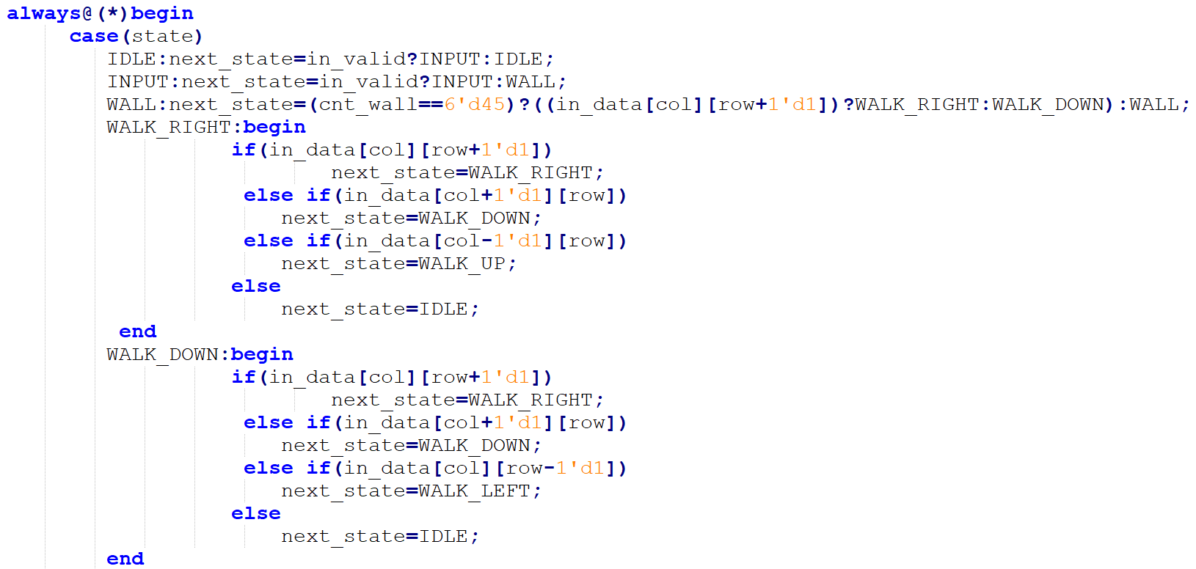
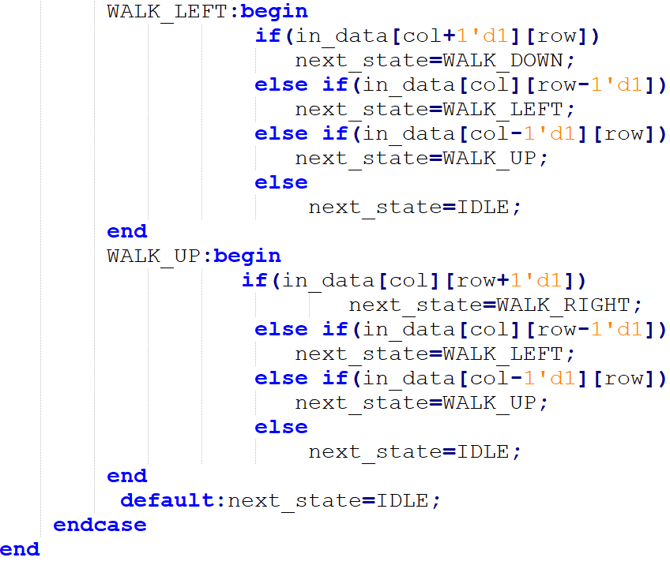
RTL design
FSM

Slide 8
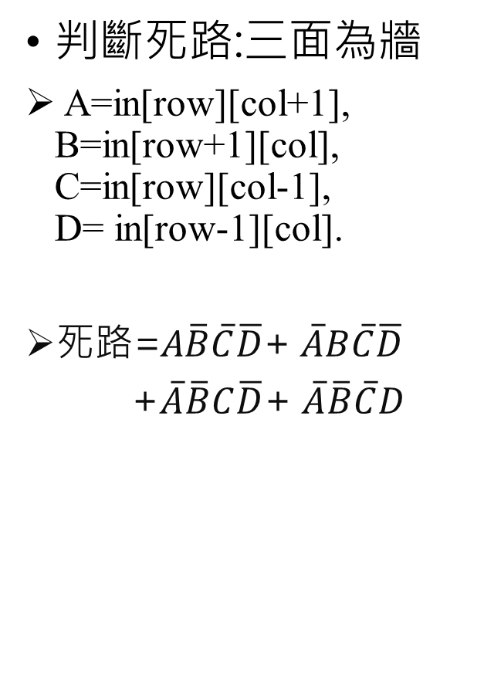
A | B | C | D | 死路
0 | 0 | 0 | 0 | 0
0 | 0 | 0 | 1 | 1
0 | 0 | 1 | 0 | 1
0 | 0 | 1 | 1 | 0
0 | 1 | 0 | 0 | 1
0 | 1 | 0 | 1 | 0
0 | 1 | 1 | 0 | 0
0 | 1 | 1 | 1 | 0
1 | 0 | 0 | 0 | 1
1 | 0 | 0 | 1 | 0
1 | 0 | 1 | 0 | 0
1 | 0 | 1 | 1 | 0
1 | 1 | 0 | 0 | 0
1 | 1 | 0 | 1 | 0
1 | 1 | 1 | 0 | 0
1 | 1 | 1 | 1 | 0
判斷死路:三面為牆
A=in[row][col+1], B=in[row+1][col], C=in[row][col-1], D= in[row-1][col].
死路=A$\overline{B}\overline{C}\overline{D}$+ $\overline{A}B\overline{C}\overline{D}$
+$\overline{A}\overline{B}C\overline{D}$+ $\overline{A}\overline{B}\overline{C}D$

Slide 9
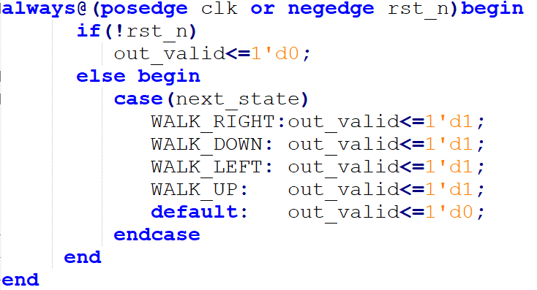
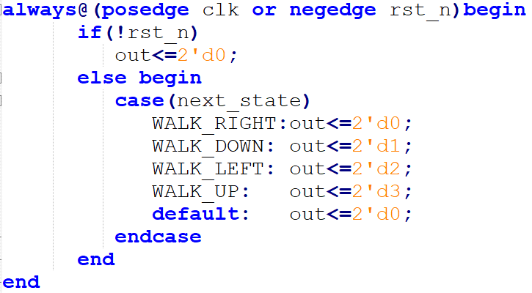
output
out_valid
out

Slide 10
THANK

