Slide 1
Lab04_NN
Artificial Neural Network

Slide 2
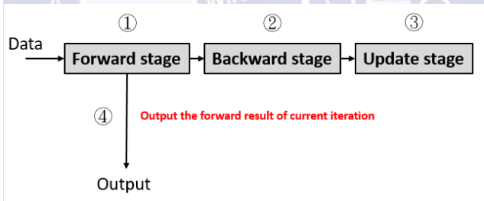
Introduction
Artificial Neural Networks are computing systems vaguely inspired by the biological neural networks that constitute animal brains.
In this lab, we are calculating a simple artificial neural network.

Slide 3
OUTLINE
SPEC
System Architecture
RTL design

Slide 4
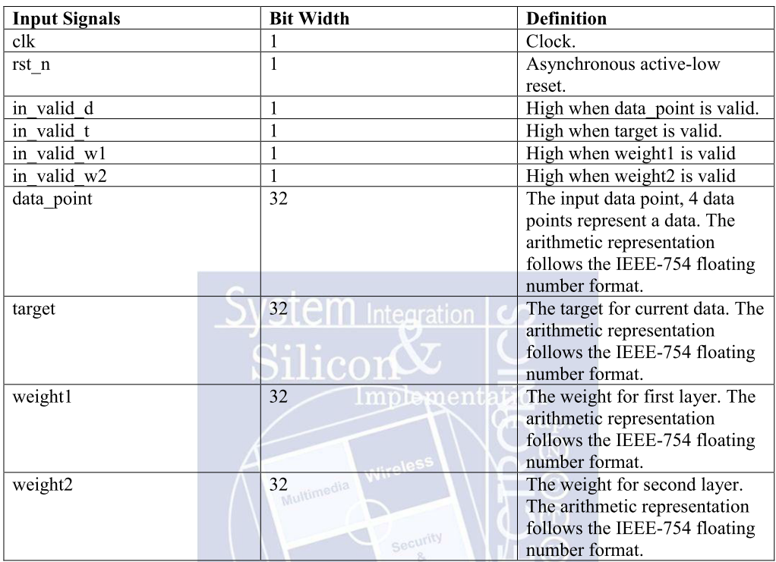
SPEC

Slide 5
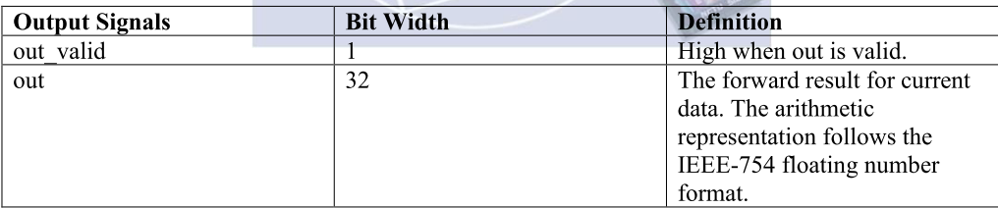
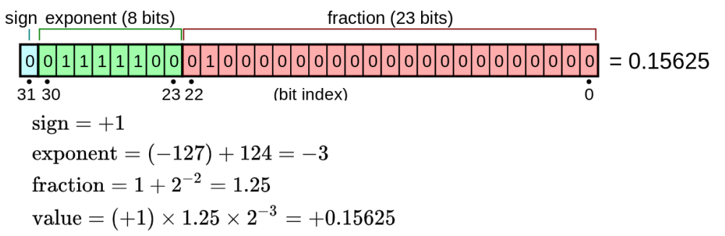

Slide 6
System Architecture
FSM(moore machine)
in_valid_d
in_valid_w1
!in_valid_d
cnt=22
IDLE
INPUT1
INPUT2
CAL
OUT
out_valid=1
out=out_sum
!in_valid_w1
in_valid_w1
in_valid_d
cnt<22

Slide 7
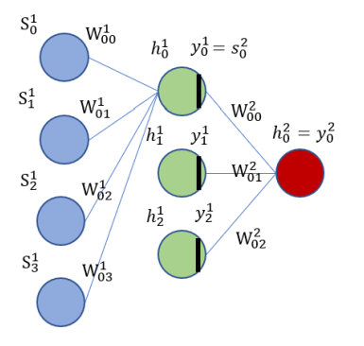




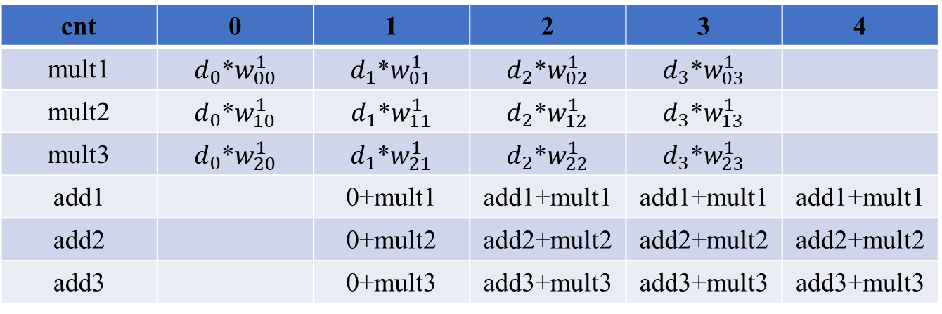
RTL design
Forward (first layer)
first layer
cnt | 0 | 1 | 2 | 3 | 4
mult1 | $d_{0}$*$w_{00}^{1}$ | $d_{1}$*$w_{01}^{1}$ | $d_{2}$*$w_{02}^{1}$ | $d_{3}$*$w_{03}^{1}$
mult2 | $d_{0}$*$w_{10}^{1}$ | $d_{1}$*$w_{11}^{1}$ | $d_{2}$*$w_{12}^{1}$ | $d_{3}$*$w_{13}^{1}$
mult3 | $d_{0}$*$w_{20}^{1}$ | $d_{1}$*$w_{21}^{1}$ | $d_{2}$*$w_{22}^{1}$ | $d_{3}$*$w_{23}^{1}$
add1 |  | 0+mult1 | add1+mult1 | add1+mult1 | add1+mult1
add2 |  | 0+mult2 | add2+mult2 | add2+mult2 | add2+mult2
add3 |  | 0+mult3 | add3+mult3 | add3+mult3 | add3+mult3
$$h_{0}^{1}$$
$$h_{1}^{1}$$
$$h_{2}^{1}$$

Slide 8

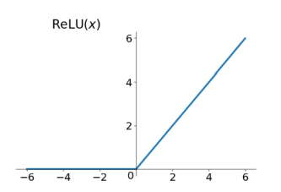
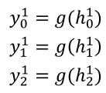


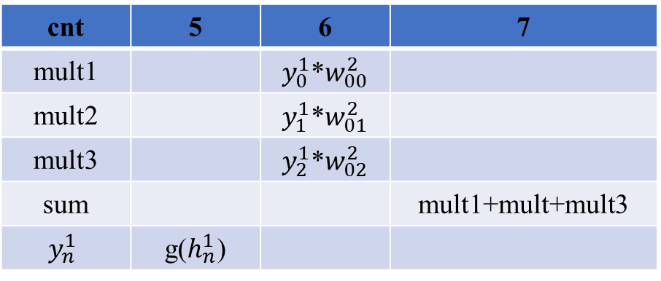

Forward (second layer)
$$y_{n}^{1}$$
second layer
$$h_{n}^{1}$$
cnt | 5 | 6 | 7
mult1 |  | $y_{0}^{1}$*$w_{00}^{2}$
mult2 |  | $y_{1}^{1}$*$w_{01}^{2}$
mult3 |  | $y_{2}^{1}$*$w_{02}^{2}$
sum |  |  | mult1+mult+mult3
$$y_{n}^{1}$$ | g($h_{n}^{1}$)
$y_{0}^{2}$=output

Slide 9
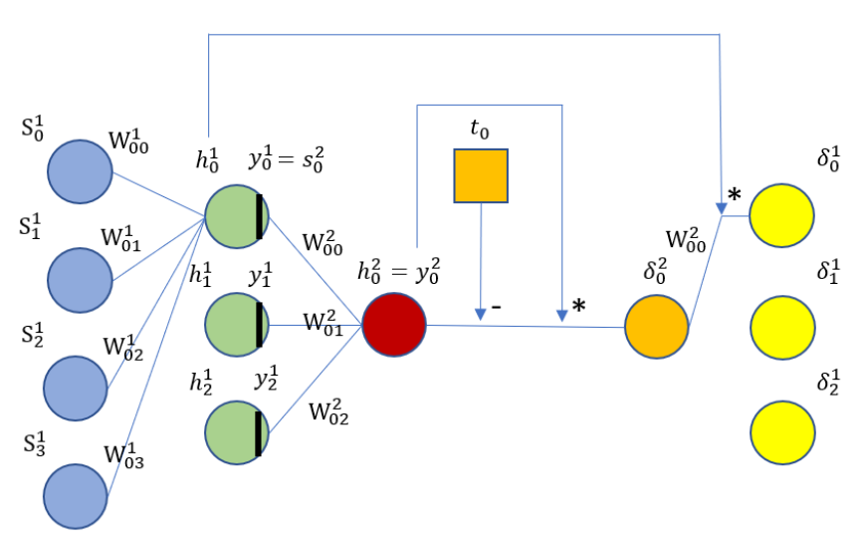

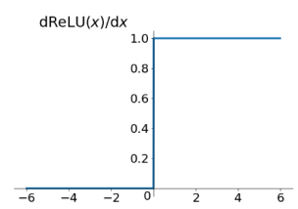




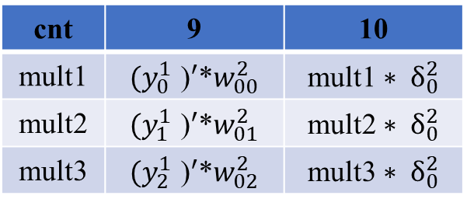
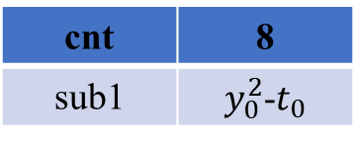



Backward(First layer)
Backward(second layer)
${ δ}_{n}^{1}={\text{g}\text{(}h_{n}^{1}\text{)} }^{′}∗w_{0n}^{2}$ ${ ∗ δ}_{0}^{2}$
cnt | 8
sub1 | $y_{0}^{2}$-$t_{0}$
first layer
$$δ_{0}^{2}$$
second layer
$${{(y}_{n}^{1}) }^{′}$$
cnt | 9 | 10
mult1 | ${(y_{0}^{1} \text{)}}^{′}$*$w_{00}^{2}$ | mult1${ ∗ δ}_{0}^{2}$
mult2 | ${(y_{1}^{1} \text{)}}^{′}$*$w_{01}^{2}$ | mult2${ ∗ δ}_{0}^{2}$
mult3 | ${(y_{2}^{1} \text{)}}^{′}$*$w_{02}^{2}$ | mult3${ ∗ δ}_{0}^{2}$
$$δ_{0}^{1}$$
$$δ_{2}^{1}$$
$$δ_{2}^{1}$$
$$h_{n}^{1}$$

Slide 10
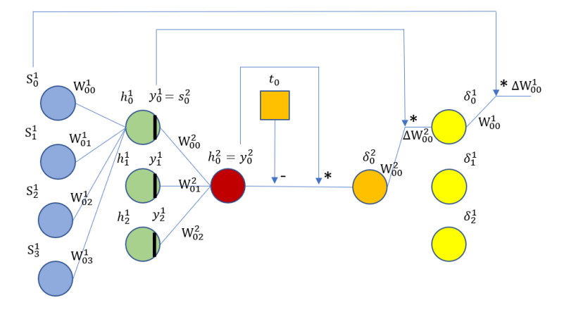
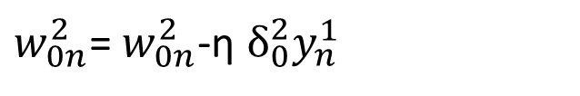



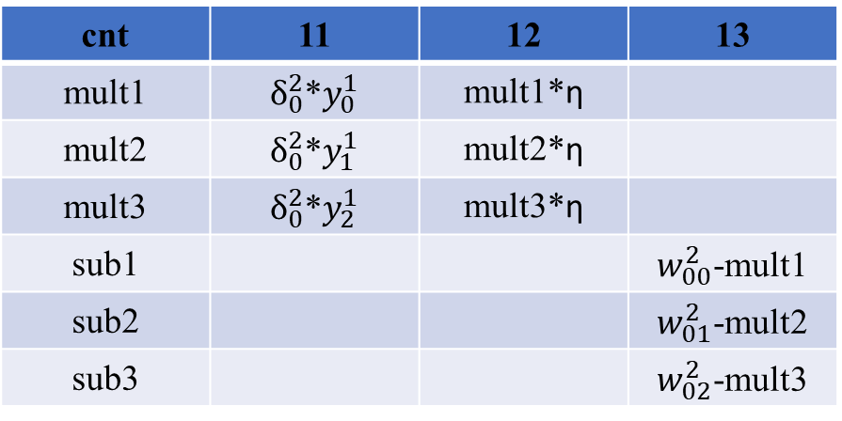
Update (first layer)
$w_{0n}^{2}$= $w_{0n}^{2}$-η $δ_{0}^{2}y_{n}^{1}$
first layer
cnt | 11 | 12 | 13
mult1 | $δ_{0}^{2}$*$y_{0}^{1}$ | mult1*η
mult2 | $δ_{0}^{2}$*$y_{1}^{1}$ | mult2*η
mult3 | $δ_{0}^{2}$*$y_{2}^{1}$ | mult3*η
sub1 |  |  | $w_{00}^{2}$-mult1
sub2 |  |  | $w_{01}^{2}$-mult2
sub3 |  |  | $w_{02}^{2}$-mult3
$$w_{00}^{2}$$
$$w_{01}^{2}$$
$$w_{02}^{2}$$

Slide 11


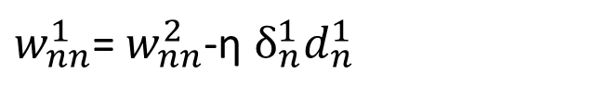








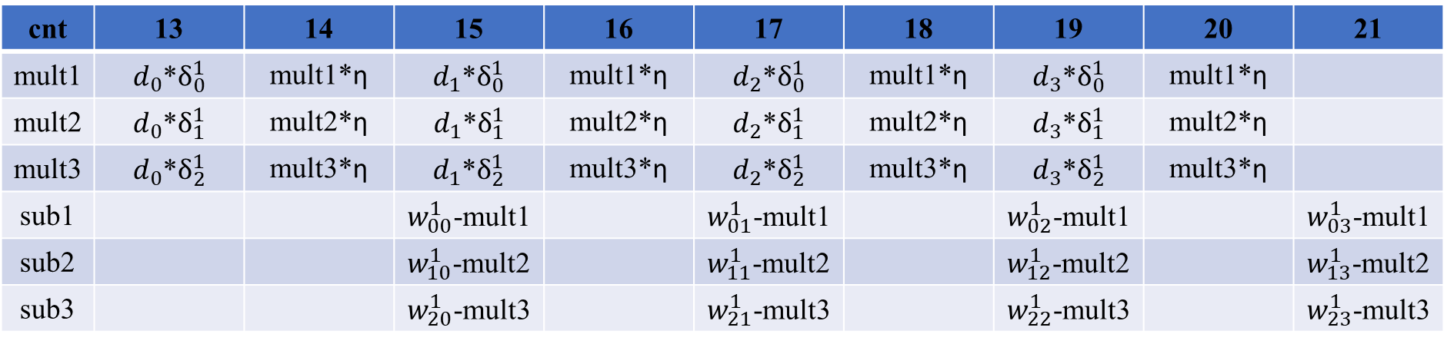


Update (second layer)
$w_{nn}^{1}$= $w_{nn}^{2}$-η $δ_{n}^{1}d_{n}^{1}$
second layer
cnt | 13 | 14 | 15 | 16 | 17 | 18 | 19 | 20 | 21
mult1 | $d_{0}$*$δ_{0}^{1}$ | mult1*η | $d_{1}$*$δ_{0}^{1}$ | mult1*η | $d_{2}$*$δ_{0}^{1}$ | mult1*η | $d_{3}$*$δ_{0}^{1}$ | mult1*η
mult2 | $d_{0}$*$δ_{1}^{1}$ | mult2*η | $d_{1}$*$δ_{1}^{1}$ | mult2*η | $d_{2}$*$δ_{1}^{1}$ | mult2*η | $d_{3}$*$δ_{1}^{1}$ | mult2*η
mult3 | $d_{0}$*$δ_{2}^{1}$ | mult3*η | $d_{1}$*$δ_{2}^{1}$ | mult3*η | $d_{2}$*$δ_{2}^{1}$ | mult3*η | $d_{3}$*$δ_{2}^{1}$ | mult3*η
sub1 |  |  | $w_{00}^{1}$-mult1 |  | $w_{01}^{1}$-mult1 |  | $w_{02}^{1}$-mult1 |  | $w_{03}^{1}$-mult1
sub2 |  |  | $w_{10}^{1}$-mult2 |  | $w_{11}^{1}$-mult2 |  | $w_{12}^{1}$-mult2 |  | $w_{13}^{1}$-mult2
sub3 |  |  | $w_{20}^{1}$-mult3 |  | $w_{21}^{1}$-mult3 |  | $w_{22}^{1}$-mult3 |  | $w_{23}^{1}$-mult3
$$w_{00}^{1}$$
$$w_{01}^{1}$$
$$w_{02}^{1}$$
$$w_{03}^{1}$$
$$w_{10}^{1}$$
$$w_{11}^{1}$$
$$w_{12}^{1}$$
$$w_{13}^{1}$$
$$w_{20}^{1}$$
$$w_{21}^{1}$$
$$w_{22}^{1}$$
$$w_{23}^{1}$$

Slide 12


Trade-off between Area and Timing
(a + b + c + d) x 1000 iterations
a [3:0] , b [3:0] , c [7:0] , d [7:0]
2
Basic Area: 24 units Time: 16 x 1000 = 16000 units
Parallel Area: 28 units Time: 14 x 1000 = 14000 units
Pipeline Area: 24 units + reg Time: 10 x 1002 = 10020 units
T = 0 | a1 + b1 + c1 + d1
T= 1 | a2 + b2 + c2 + d2
T = 2 | a3 + b3 + c3 + d3
T = 3 | a4 + b4 + c4 + d4
a
5-bit
Adder
4
b
10
9-bit
Adder
c
10-bit
Adder
d
4
a
9-bit
Adder
10
b
10-bit
Adder
T = 0 | a1 + b1
T= 1 | a2 + b2 | (a1 + b1) + c1
T = 2 | a3 + b3 | (a2 + b2) + c2 | (a1 + b1 + c1) + d1
T = 3 | a4 + b4 | (a3 + b3) + c3 | (a2 + b2 + c2) + d2
T = 4 |  | (a4 + b4) + c4 | (a3 + b3 + c3) + d3
T = 5 |  |  | (a4 + b4 + c4) + d4
c
9-bit
Adder
d
2
a
5-bit
Adder
4
b
10
9-bit
Adder
c
10-bit
Adder
d

Slide 13
THANK

