Slide 1

Fault Diagnostic Evaluations
Presented by: Renato Millan
Faculty Mentor: Dr. Alberto Cerpa

Slide 2
Outline
Motivation
Related work
Models
Experiments
Evaluations
Demo
Conclusion

Slide 3
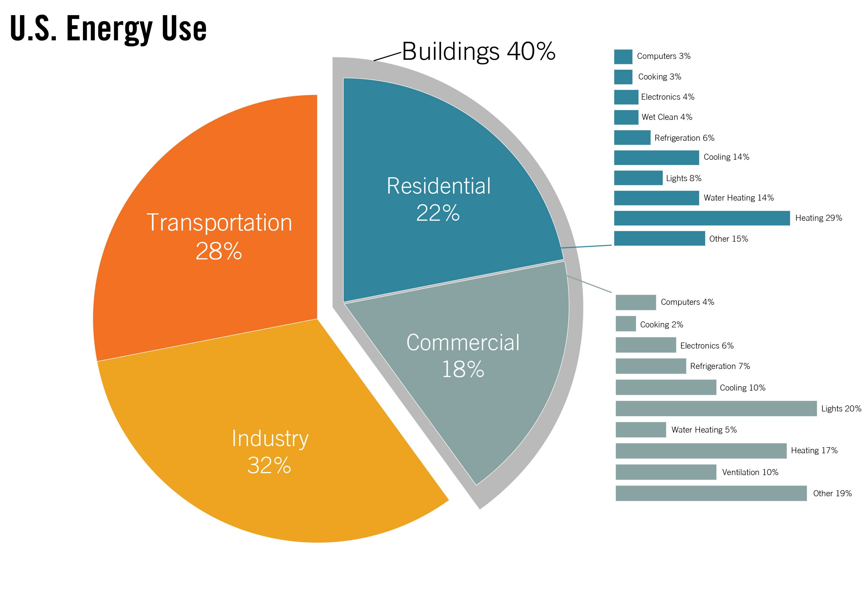
Motivation
In 2021, US total energy consumption
3.9 trillion kwh
Source: www.eia.gov

Slide 4
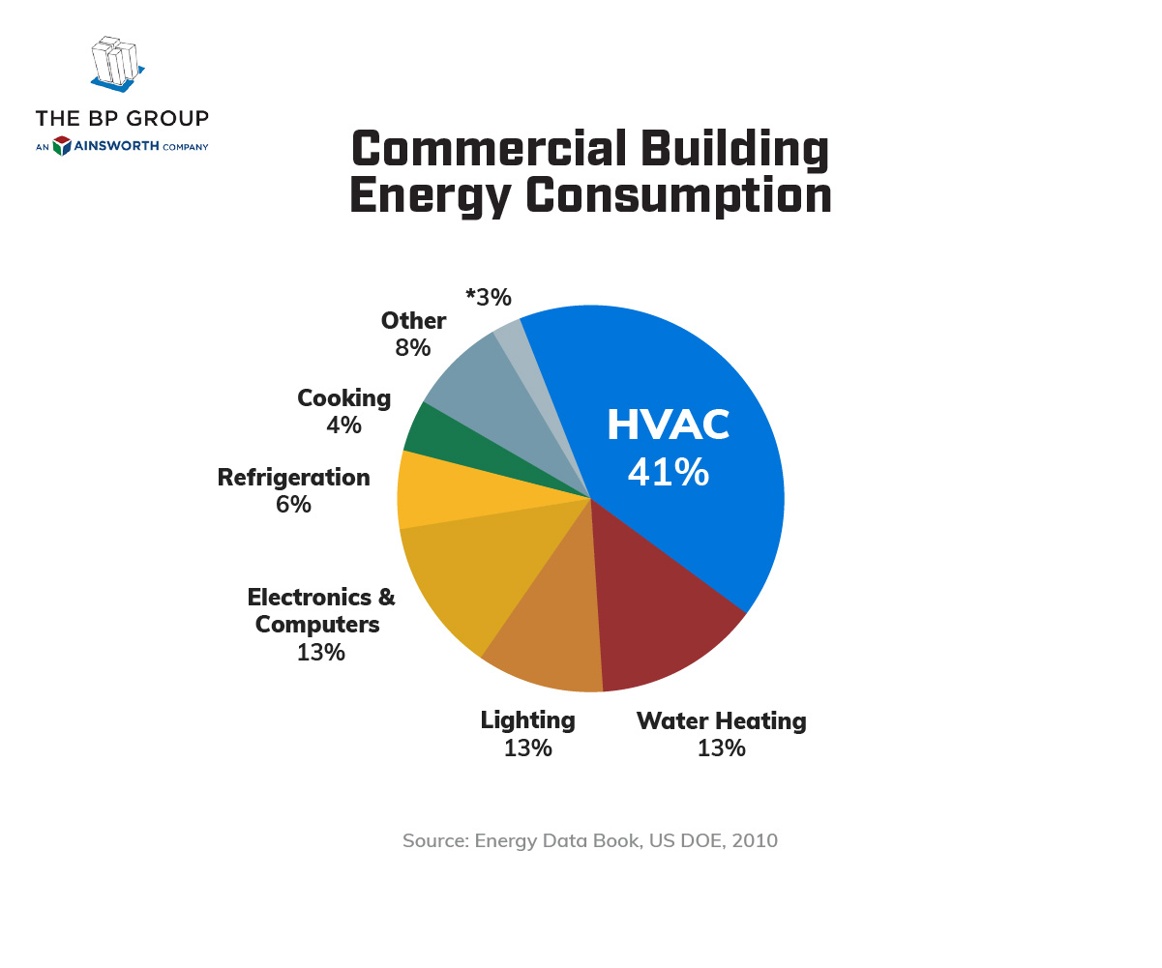
HVAC systems consumption
Residential sector’s energy consumption on cooling
235 billion kWh

Slide 5

Pivotal issue
How can building HVAC system know that a HVAC sensor or sensors is feeding false data?
Faulty data -> wrong inputs and outputs -> inefficient heating/cooling -> discomfort, rising cost, and energy waste
Garbage in and garbage out

Slide 6

Main features of HVAC
Supply temperature
Outdoor temperature
Zone temperatures
Air flow

Slide 7
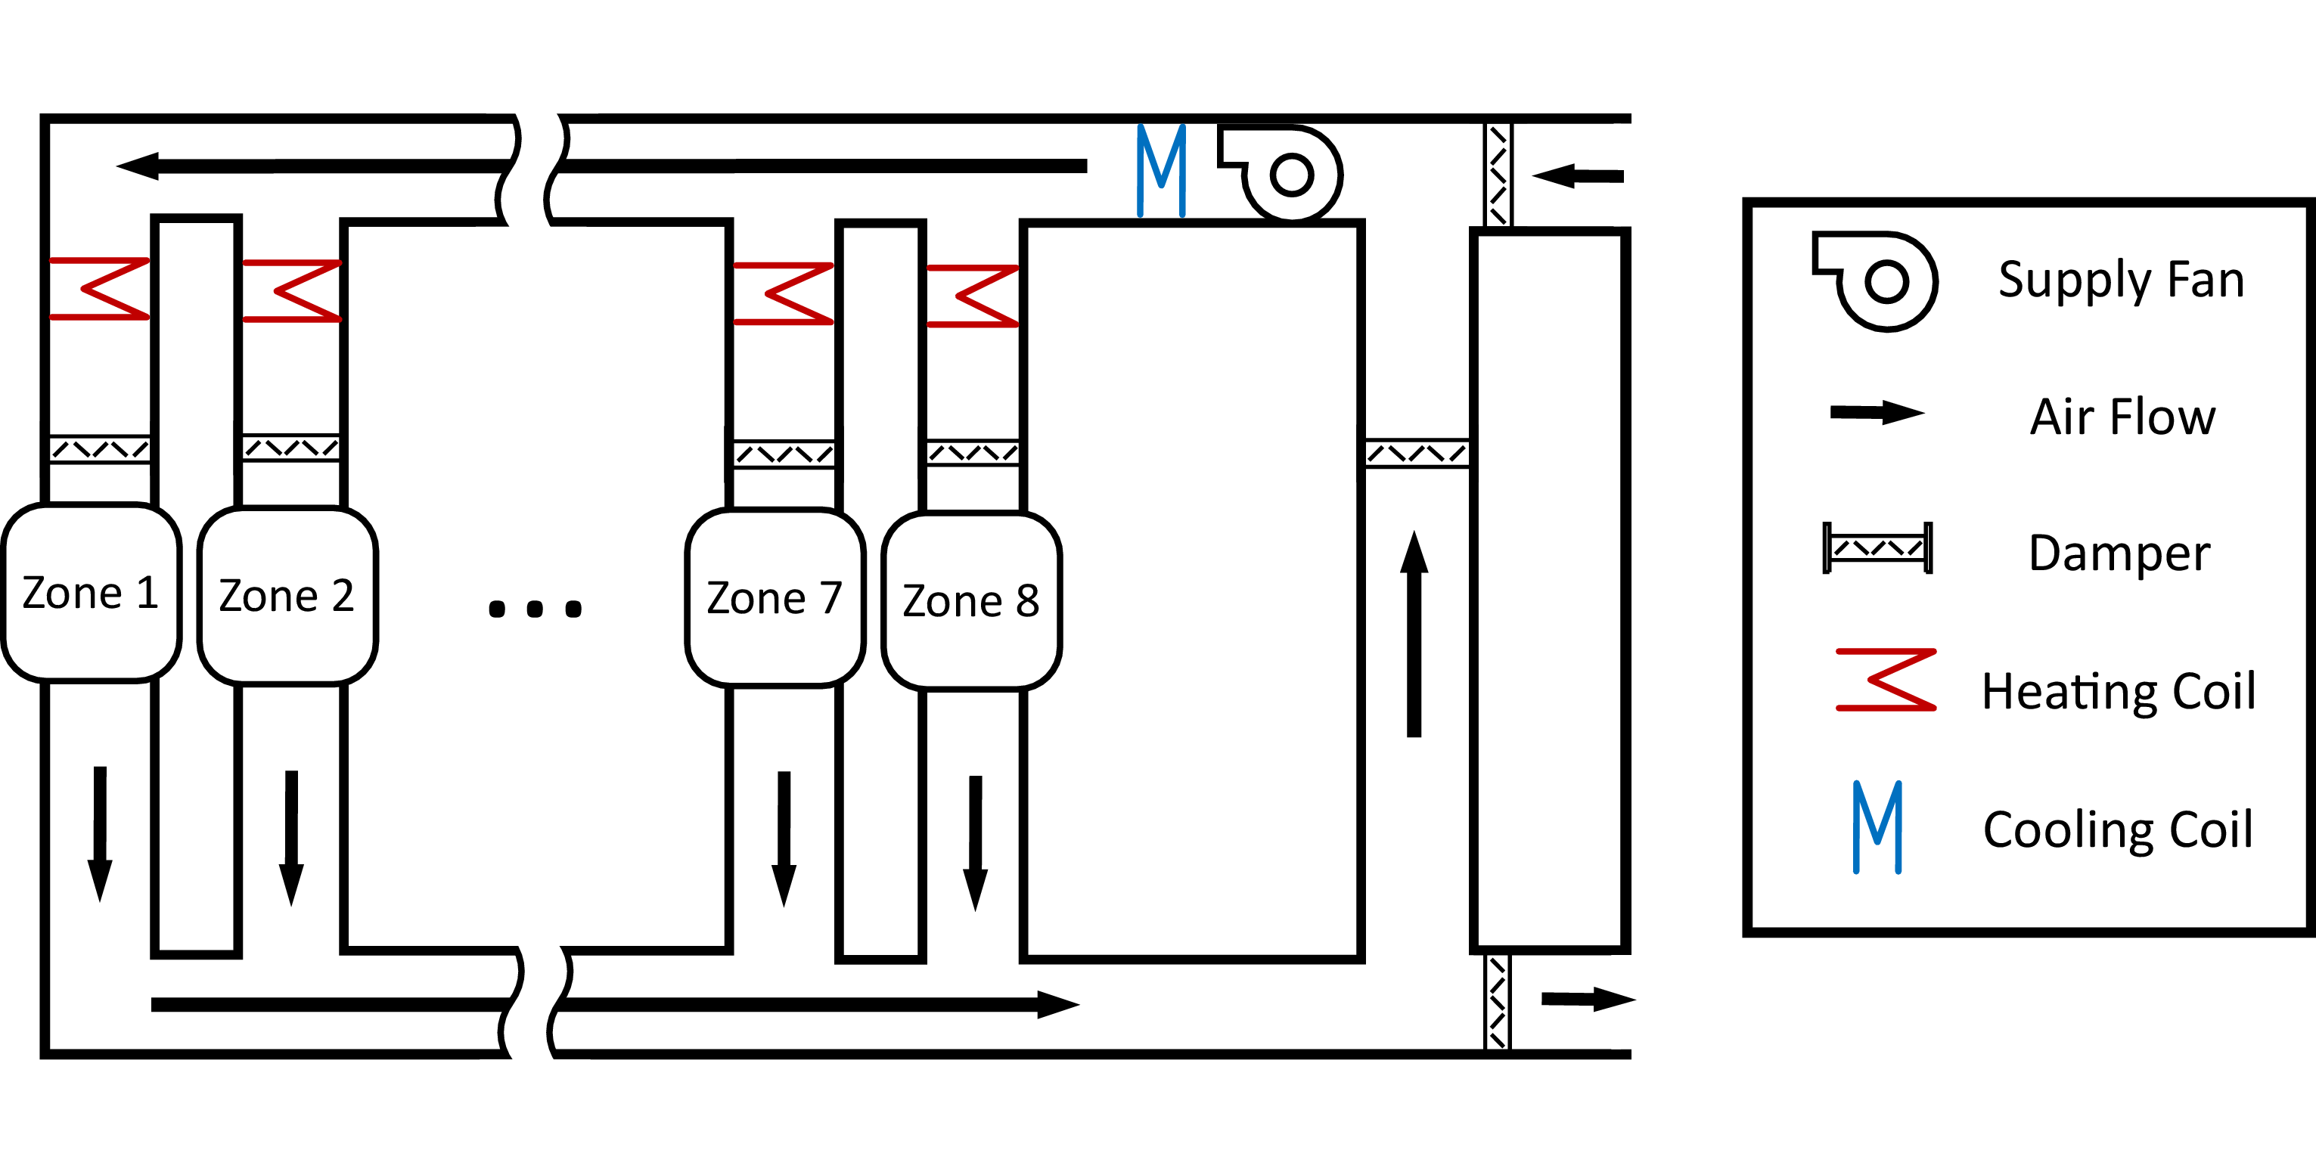
Simple HVAC system
Supply temperature (T_{s})
Mass
Flow (M_{z})

Slide 8

My approach
Evaluate how different machine learning algorithms performance with error simulation models
Creating a webapp that will choose the best model under these errors

Slide 9
Error models
Error model | Formulas
constant | X’ = a + x + err
gain | X’ = a*x + err
Stuck | X’ = a
Variation of gain over time | X’ = v * x + err, where v is changing over time
Constant + gain | X’ = a*x + b + err, where b is constant

Slide 10
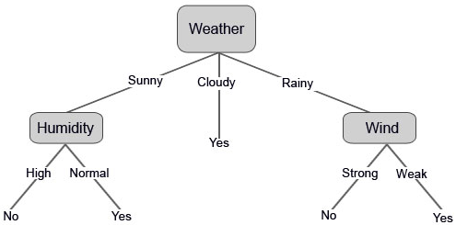
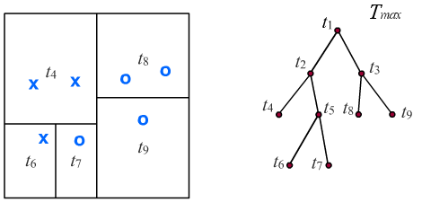
Models
Boosting Decision trees
Bagging Decision trees
Notes:
use the dataset features to create yes/no questions and continually split the dataset until you isolate all data points belonging to each class.
Boosting each classifier is trained on data, taking into account the previous classifiers’ success.
After each training step, the weights are redistributed. Misclassified data increases its weights to emphasise the most difficult cases.
Bagging random sampling with replacement
Every time you ask a question, you’re adding a node to the tree. And the first node is called the root node.

Slide 11
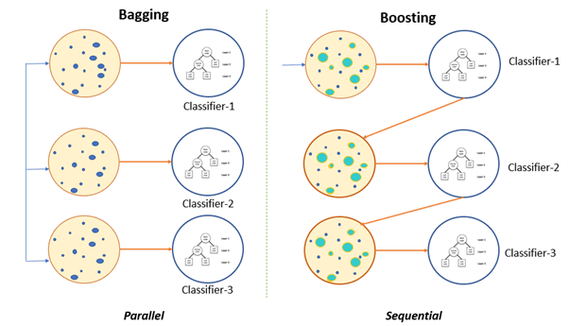
Boosting and Bagging
Notes:
a numerical optimisation problem where the objective is to minimise the loss function of the model by adding weak learners using gradient descent = gradient descent boosting

Slide 12


Why Boosted Decision tree ?
Boosted Decision tree is a supervised learning model that can be used for regression or classification analysis.
Capable of capturing complex patterns in the data.
Notes:
train multiple trees one stage at a time. In each, we construct a single tree to correct the errors of the previously fitted ones.

Slide 13


Why Bagging decision tree?
Helps in the reduction of variance
Tries to solve the over fitting problem

Slide 14
Limitation/tradeoff of both models
Boosting may increase overfitting
Bagging will rarely get a better bias
Tradeoffs is decreasing variance or bias
Notes:
Certain elements are overweighted or overrepresented like outlyers

Slide 15

Experiment
Location: Chicago, IL
HVAC system: single duct AHU
Data Generation Method: Simulation using EnergyPus and Modelica
Time scope: 1 year (365 days)
Data sample rate: 1 minute
Data points: 30

Slide 16
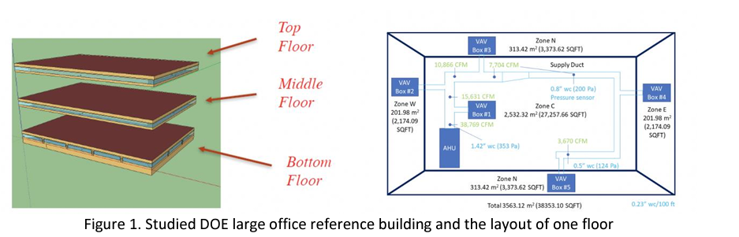
System Type and Diagram
Notes:
Cubic free per minute = air flow

Slide 17
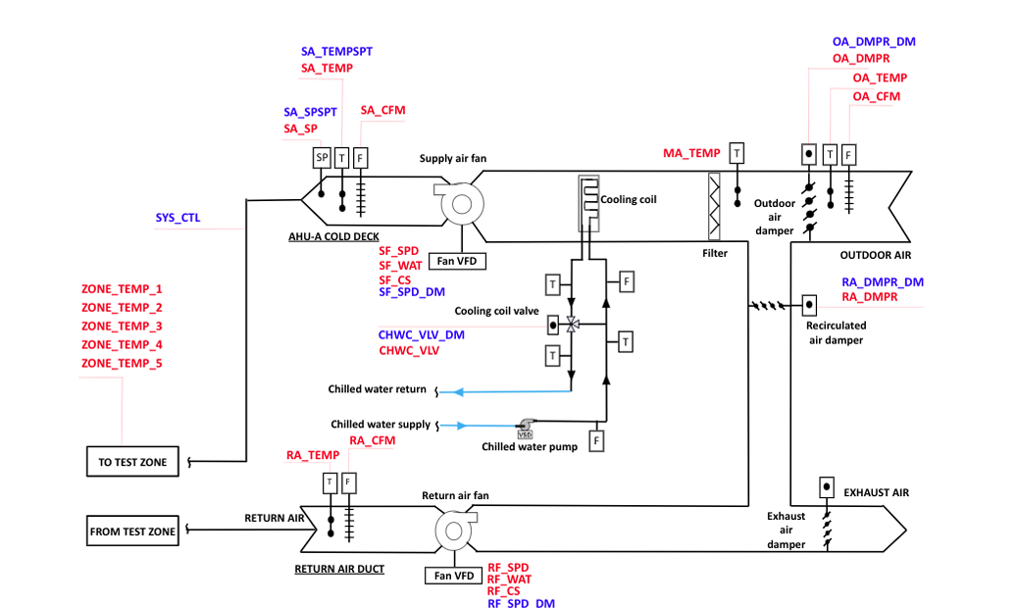
Diagram of HVAC

Slide 18
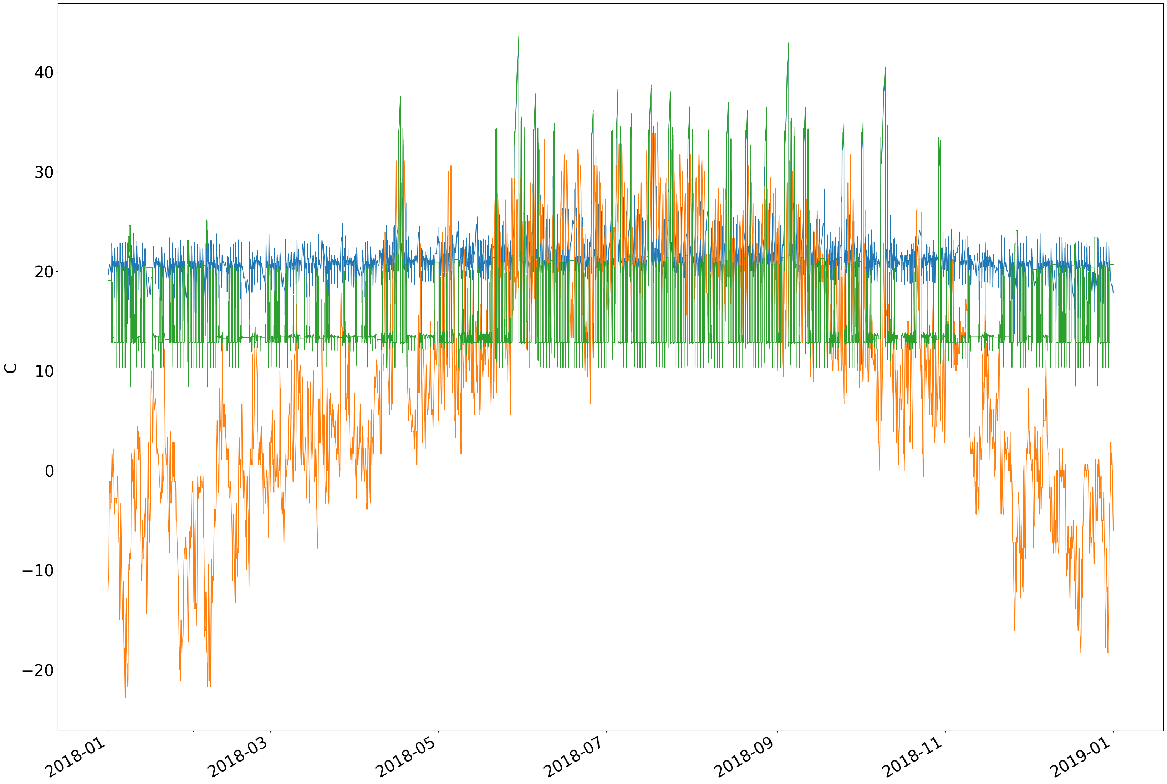
Graph of temperature

Slide 19
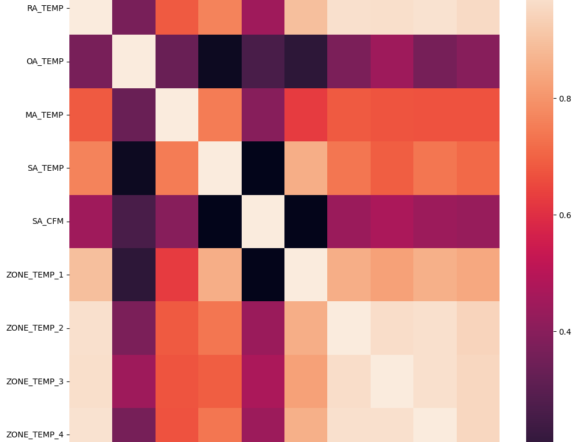
Heatmap

Slide 20
Evaluation For Boosted Decision trees
Boosted decision tree model for all errors
Confusion matrix
Cross validation score | percentage
Accuracy score | 98.8
Auc score | 99.3
Number of mislabeled points out of total: | 1255
 | Actual positives | Actual negative
Predicted positives | 933340 | 1255
Predicted negatives | 0 | 10510

Slide 21
Evaluation for Bagging Decision Trees
Bagging decision tree model for all errors (average)
Confusion matrix
Cross validation score | percentage
Accuracy score | 99.8
Auc score | 99.6
Number of mislabeled points out of total: | 656
 | Actual positives | Actual negative
Predicted positives | 93939 | 656
Predicted negatives | 0 | 10510

Slide 22



Tools
Used these tool to make the measuring app
Used these tool to make the data web app to deploy my models

Slide 23
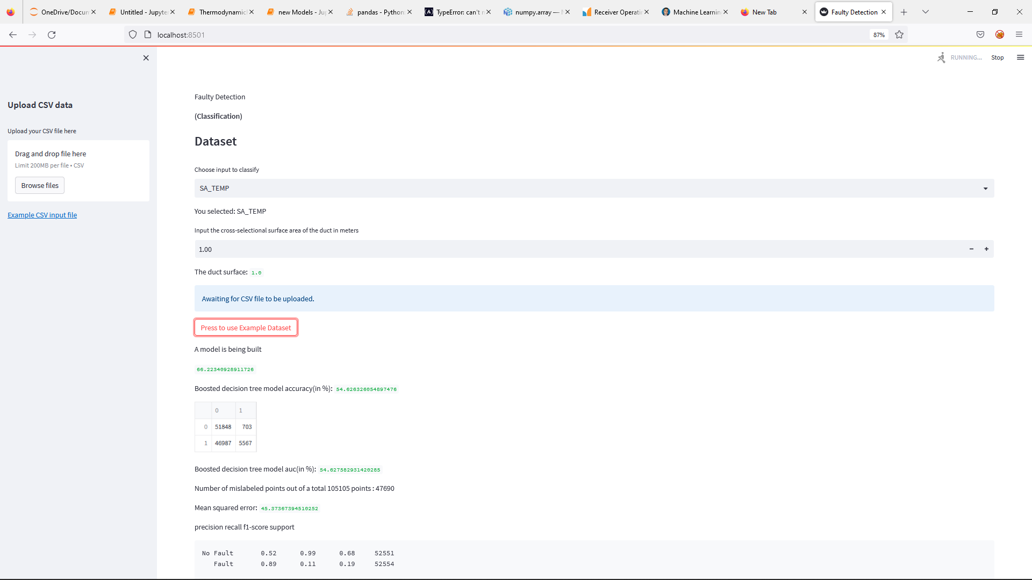
Demo

Slide 24
Future works/goals
Use more metrics to see if the models maintain current performance
Adapt these models to classify sensors in real time and make correction to the faulty sensor

Slide 25
Related work
Automatic Building Fault Diagnostic System using Smartphone
OFFICE: Optimization Framework For Improved Comfort and Efficiency

Slide 26
Thank You
Special thanks to
Dr. Cerpa
All you guys

Slide 27
Work Cited
Erickson, Varick L., and Alberto E. Cerpa. "Thermovote: participatory sensing for efficient building hvac conditioning." Proceedings of the Fourth ACM Workshop on Embedded Sensing Systems for Energy-Efficiency in Buildings. 2012.
https://www.whitehouse.gov/wp-content/uploads/2021/10/US-Long- Term-Strategy.pdf, The United Stated of America, The Long-Term Strategy of the United States: Pathways to Net-Zero Greenhouse Gas Emissions by 2050., The United States Department of State and the United States Executive Office of the President, Washington DC. November 2021
Rafati, A.; Shaker, H.R.; Ghahghahzadeh, S. Fault Detection and Efficiency Assessment for HVAC Systems Using Non-Intrusive Load Monitoring: A Review. Energies 2022, 15, 341. https://doi.org/10.3390/ en15010341

