Slide 1
AI-POWERED PRICING
Agentic AI-Based
Dynamic Tariff Optimization
for EV Charging Networks
Using UrbanEV and ACN Charging Session Data
Presented by:
Sajal Tuley

Slide 2
Executive Summary
OBJECTIVE
APPROACH
KEY RESULTS
Develop an Agentic AI framework that predicts charging demand, identifies congestion, and dynamically adjusts EV charging tariffs.
Improve network revenue and infrastructure utilization through real-time, data-driven pricing.
UrbanEV: behavioral insights; ACN: model training, validation & pricing evaluation.
Four sequential agents: Real-Time Demand Prediction → Congestion Monitoring → Dynamic Pricing → Monitoring & Feedback.
Demand Prediction (XGBoost): R² = 0.811
Congestion Agent: Accuracy = 91%, F1 = 0.59
Est. revenue uplift: +12.33% (fixed-demand assumptions).
Framework demonstrates real-time data can increase revenue & visibility.
UrbanEV was used for behavioral insights, while ACN was used for model training, validation, and pricing evaluation.
Limitations
Dynamic pricing evaluated through simulation.
Elasticity not directly estimated from historical data.
ACN primarily reflects workplace charging behaviour.

Slide 3
Data Landscape & Problem Understanding
UrbanEV Dataset
ACN Dataset
Behavioral Insight Dataset
Operational Modeling Dataset
247 stations 30 days 2.13M records
Purpose: Understand large-scale charging demand, congestion dynamics, and pricing behavior.
14,999 sessions
Session-level charging behavior
Energy delivered, duration, station info
Purpose: Develop the operational real-time demand prediction and dynamic pricing system.
UrbanEV was used for behavioral insights, while ACN was used for model training, validation, and pricing evaluation.
Key Challenge
Most charging networks use static tariffs despite significant demand variation — causing peak-hour congestion, underutilized off-peak infrastructure, and suboptimal revenue.
Agentic Workflow:
Demand Prediction
Congestion Monitoring
Dynamic Pricing
Monitoring & Feedback
Specialized agents collaborate through a continuous decision-support workflow.

Slide 4
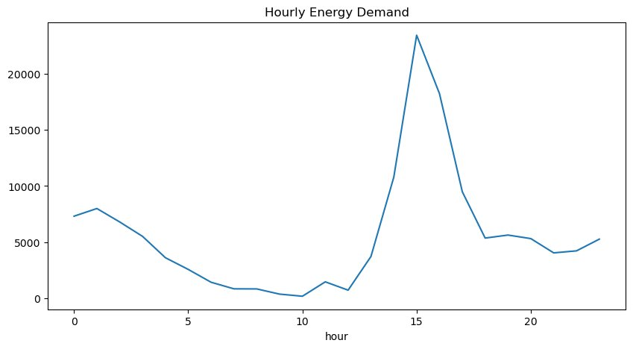
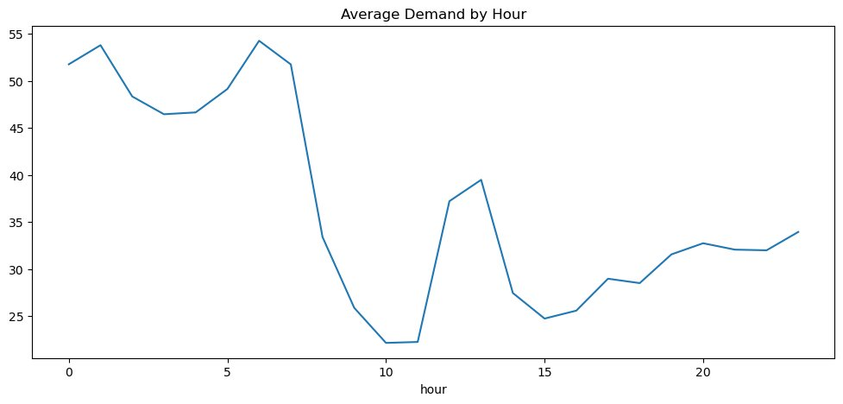
Charging Demand & User Behaviour Insights
ACN Hourly Demand Profile
UrbanEV Hourly Demand Profile
Key Findings
Both datasets exhibit strong temporal demand variation.
UrbanEV demonstrates city-scale charging demand cycles.
ACN demonstrates workplace charging behavior, with peak activity during afternoon hours.
Weekday demand consistently exceeds weekend demand.
These observations indicate that static pricing fails to reflect actual charging demand conditions.

Slide 5
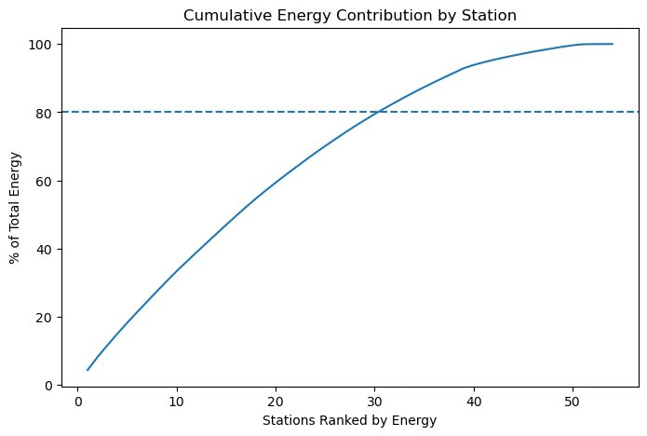
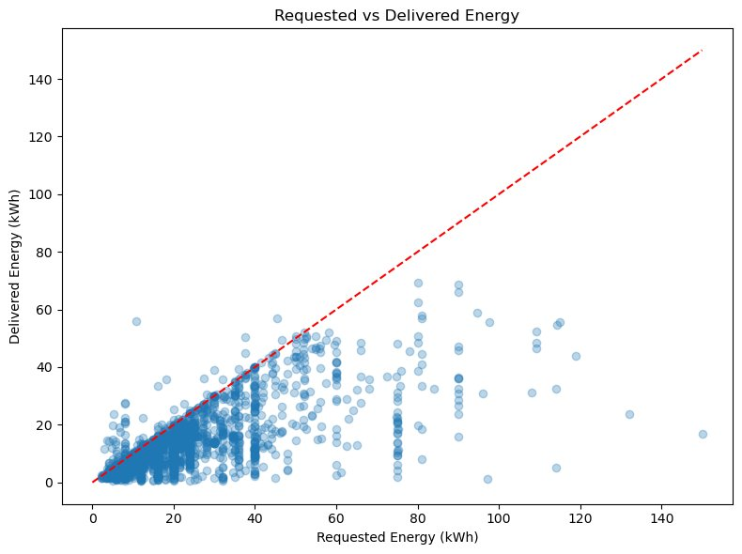
Infrastructure Utilization Analysis
Cumulative Energy Contribution by Station
Requested vs Delivered Energy
Key Findings
~30 stations account for 80% of total energy delivered — demand is highly concentrated.
Average request fulfillment is approximately 65%, indicating users frequently receive less energy than requested.
Vehicles often remain connected after charging completion, reducing charger availability.
Station utilization varies substantially across the network, creating opportunities for congestion-aware pricing strategies.

Slide 6
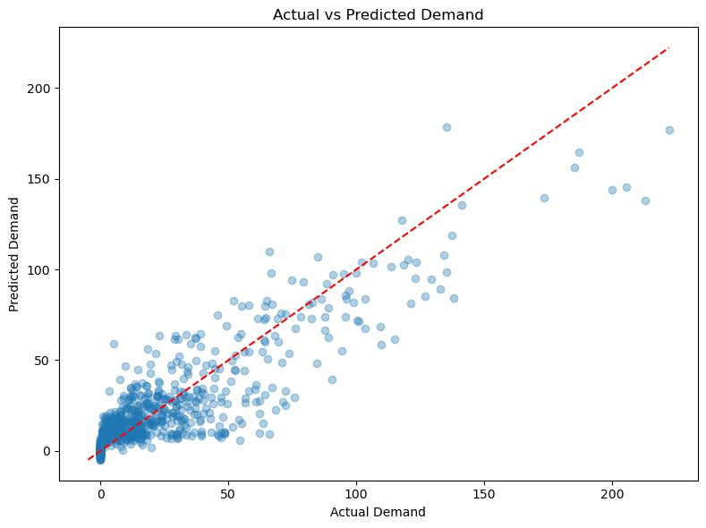
Real-Time Demand Prediction Agent
Model | R²
Naive Baseline | 0.105
Historical Features Only | 0.395
Real-Time Agent (XGBoost) | 0.811
Real-time charging activity significantly improves demand prediction accuracy compared with historical-only approaches.
Why XGBoost?
Handles nonlinear charging demand patterns.
Robust to noisy operational data.
Captures time, demand & session-count interactions.
Consistently outperformed all baseline approaches.
Real-Time Operational System: This agent operates as a real-time decision-support system using live session data — not a long-horizon forecasting model. Predictions are generated per charging cycle to feed the pricing engine immediately.

Slide 7
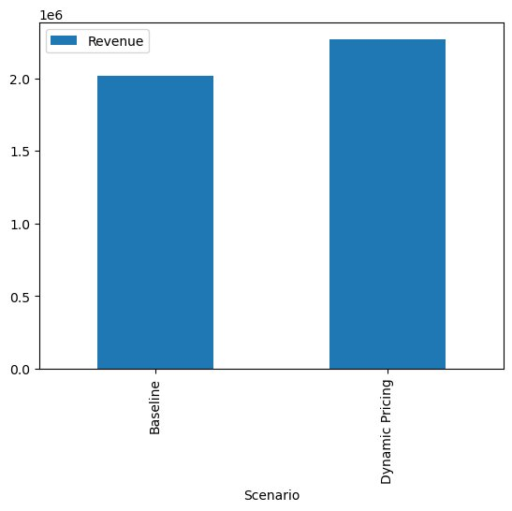
Dynamic Tariff Pricing Agent
Pricing Logic
Baseline Tariff: ₹15/kWh
Peak Demand
+15% → ₹17.25/kWh
High Demand
+8% → ₹16.20/kWh
Low Demand
−10% → ₹13.50/kWh
Tariff (₹/kWh) adjusts in real-time
based on predicted demand levels.
Pricing Pipeline:
Demand
Prediction
Demand
Classification
Tariff
Adjustment
Revenue
Simulation
Baseline Revenue
Dynamic Revenue
Est. Uplift (fixed-demand)
₹ 2.02 Million
₹ 2.27 Million
+12.33%
Elasticity: Sensitivity testing showed revenue gains remained positive under multiple customer-response assumptions. See Appendix D.

Slide 8
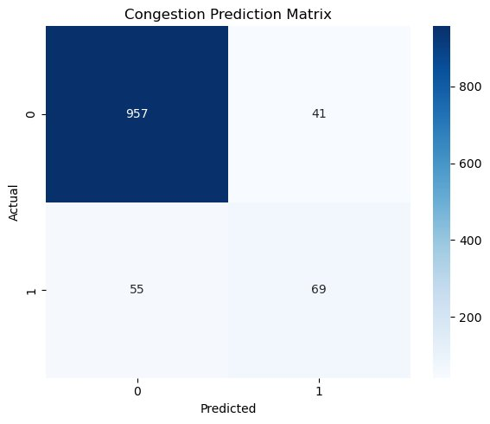
Congestion & Monitoring Agent
Congestion Definition: Session Count > Historical 80th Percentile · 80th percentile selected to balance operational sensitivity and training-data availability.
Monitoring Agent Responsibilities
Monitor real-time demand forecasts from the Prediction Agent.
Track congestion probability.
Evaluate revenue performance.
Monitor charging utilization.
Provide feedback for future tariff adjustments.
Performance Metrics
91%
63%
56%
59%
Accuracy
Precision
Recall
F1 Score
Congestion events are relatively infrequent; F1 score provides a more informative assessment than accuracy alone.

Slide 9
Business Impact & Recommendations
Business Impact
Deployment Recommendation
Estimated revenue uplift of 12.33% under fixed-demand assumptions.
Real-time demand prediction accuracy improved significantly vs. naive baseline methods.
Congestion periods can be identified proactively rather than reactively.
Charging infrastructure utilization can be managed more effectively through demand-responsive pricing.
Utilization < 30%
→
Discount Pricing
Normal Demand
→
Base Pricing
High Demand
→
Surge Pricing
Continuous
→
Auto Tariff Refinement
Conclusion
The proposed Agentic AI framework operates as a real-time operational decision-support system — not a long-horizon forecasting tool. It dynamically optimizes EV charging tariffs using live session data, producing an estimated 12.33% revenue uplift under fixed-demand assumptions.

Slide 10
Appendix A Why XGBoost?
Alternative Models Considered
Selected Model: XGBoost
Linear Regression
Reasons
Unable to capture nonlinear demand patterns.
Superior predictive performance.
Robust handling of missing and noisy operational data.
Effective modeling of nonlinear charging demand behavior.
Widely adopted in demand forecasting and energy analytics applications.
Decision Trees
High variance and overfitting risk.
Random Forest
Strong performance but weaker predictive performance and interpretability compared with the Real-Time Demand Prediction Agent (XGBoost).
Appendix A

Slide 11
Appendix B Model Validation & Leakage Checks
Validation Checks Performed
Results
Time-based train-test split used.
No random shuffling applied.
Naive baseline comparison performed.
Historical-only model comparison performed.
Naive Baseline
R² = 0.105
Historical Features Only
R² = 0.395
Real-Time Prediction Agent
R² = 0.811
These results indicate that the model learns meaningful demand patterns beyond simple historical averages while benefiting from real-time operational information.
Appendix B

Slide 12
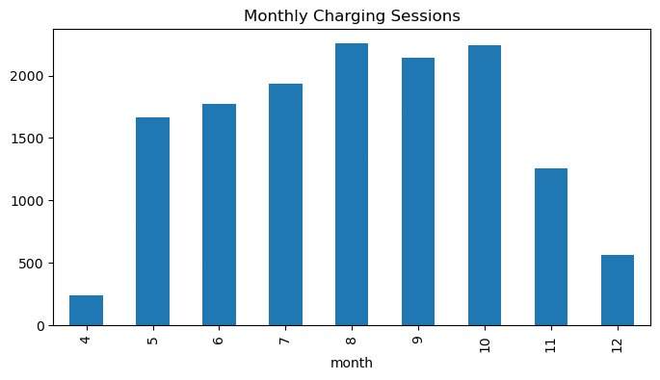
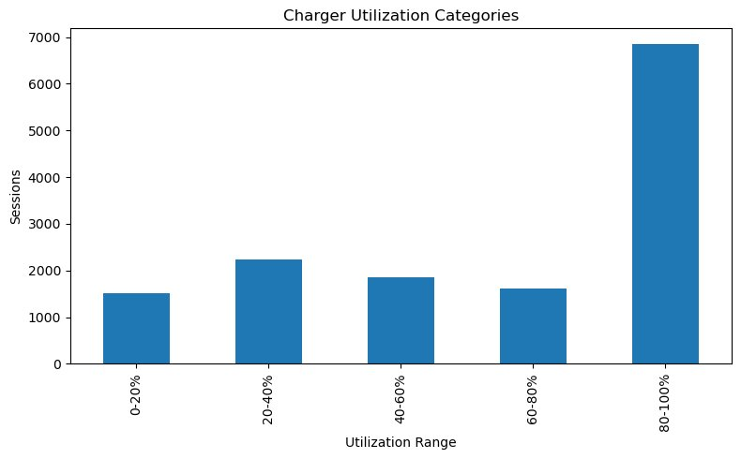
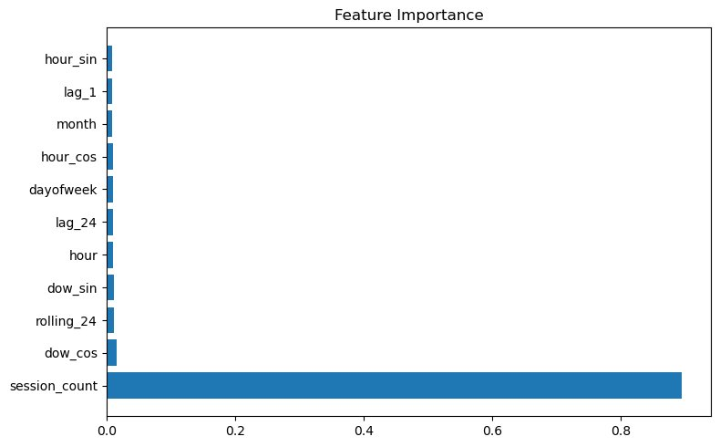
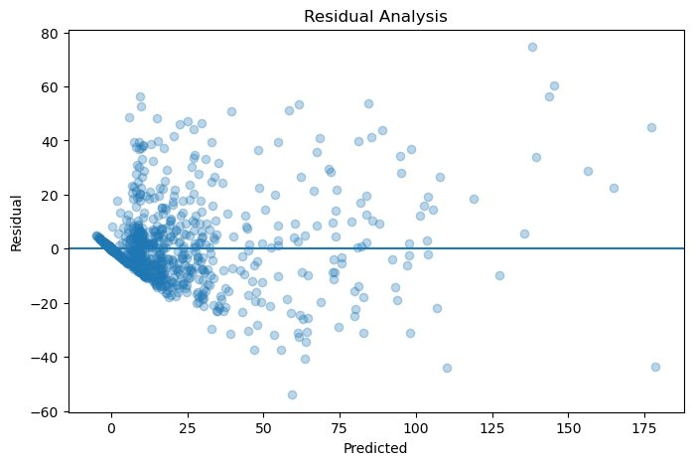
Appendix C Additional Insights
Monthly Charging Sessions
Charger Utilization Categories
Feature Importance
Residual Analysis
Additional EDA confirms strong temporal charging behavior, seasonal demand variation, and heterogeneous station utilization patterns across the network.

Slide 13
Appendix D Elasticity Robustness Check
Why Sensitivity Analysis?
Sensitivity Results
Limited historical tariff variation in the ACN dataset prevented direct elasticity estimation.
Customers were always charged the same rate historically, so their price-response behaviour is unobserved.
Sensitivity testing was performed instead, simulating revenue across a plausible elasticity range.
This approach follows standard practice in demand-response feasibility studies.
Elasticity Range Tested: −0.1 to −0.3
ε = −0.1 (low sensitivity)
Revenue uplift retained
ε = −0.2 (moderate)
Revenue uplift retained
ε = −0.3 (high sensitivity)
Revenue uplift retained
Revenue remained positive across all tested elasticity scenarios,
supporting the feasibility of dynamic pricing deployment.
Note: Elasticity was not directly learned due to limited historical tariff variation. Sensitivity testing across elasticity scenarios (−0.1 to −0.3) continued to show positive revenue uplift, supporting pricing robustness.
Appendix D

