Slide 1

Business Baazigar Round 2
January 2023
Team Name: Roorkee Consultancy Group
Team Members: Agam Pandey, Eva Rajput, Sajal Tuley, Yash Kumar
Team Mentors: Harshit Singh, Vansh Tickoo

Slide 2
Executive Summary
The SWOT analysis of the company-X reveals many insights which can be analyzed to strengthen its position in the Indian market (SWOT Analysis)
As per Media Partners Asia estimates, the online video content investment in India stood at $1.3 billion in 2022 and is projected to increase to $4.2 billion by 2027 (Potential market)
X has a single premium subscription plan priced at Rs 150 per month, in stark contrast to other OTT platforms that have a tiered pricing model (Subscription plan)
In order to increase its premium user base, X could have tie-ups with various data Service platforms, offer sales and discounts as a part of their Short-Term Strategy (Short-Term Strategy)
Loyalty programs, in house content, features and technologies, regional content and tiered pricing system could be used to achieve long term growth (Long-Term Strategy)
Adoption of a 4-layer subscription plan and doing the pricing after giving discount should be the Long-term pricing strategy company-X should follow for customer retention (Pricing Strategy)

Slide 3
The SWOT analysis of the company-X reveals many insights which can be analyzed to strengthen its position in the Indian market
STRENGTHS
Pan-India existence
30 Million user base
3 Million subscriber base
Major part of English content is produced in-house.
Exclusive Rights to some content
WEAKNESSES
Pricing is on the higher side
Hindi content is licensed
Metro cities have neared saturation
Dependent on the ad-based business model
OPPORTUNITIES
Tier-2 cities are yet to be tapped
Certain types of genres are only provided by a single OTT. For example, only Disney+Hotstar have a kids’ section
Regional movie industry is not yet tapped efficiently
No OTT uses UPI for subscription payments
Strategic Partnerships
THREATS
Userbase is very low as compared to other OTT platforms
Fierce competition from other OTT platforms
Piracy is always a matter of concern
Shared accounts through password sharing

Slide 4
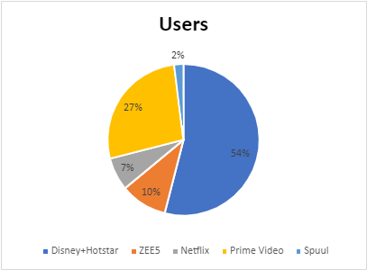
As per Media Partners Asia estimates, the online video content investment in India stood at $1.3 billion in 2022 and is projected to increase to $4.2 billion by 2027.
X, in the Freemium segment, has its primary competition with companies like MX Player and ZEE5 according to us.
AVOD
MX PLAYER
TVF
Spuul
Compared to big OTT giants, our user base is relatively small. Disney+Hotstar has 4.29 billion users, while Netflix has 0.55 billion paid subscribers.
Freemium
OTT Platform Types
ZEE5
SVOD
Netflix
Unlike its competitors, X produces a large amount of content in-house. In-house production is a cash-intensive venture. Companies like Netflix have struggled with this.
Amazon Prime Video
X should focus more on tie-ups with big media houses for content. Paying royalties, similar to Amazon Prime Video, could reduce costs and thus increase profits.
25% of the Indian OTT audience consumes news, knowledge, and sports content. companies like Disney+Hotstar and SonyLiv, which have collaborated with sports broadcasters and news channels, whereas X hasn’t tried expanding its content.
Source: Time Of India, ShARE analysis,

Slide 5
X has a single premium subscription plan priced at Rs 150 per month, in stark contrast to other OTT platforms that have a tiered pricing model.
OTTs following Freemium & Premium Pricing Strategies
Disney+Hotstar
ZEE5
SonyLiv
“ X”
Disney+ Hotstar Super (2 devices) - Rs 899/yr - Watch ad-supported content up to 1080p HD. Disney+ Hotstar Premium (up to 4 devices) - Rs 1499 /yr - Watch all content up to 4k resolution
Rs 599 - 1 year - Ad-free TV shows, 2800+ movies, Web series, compatible with 3 screens.- Rs 399 - 3 months - Movies, Ad-free TV shows, AltBalaji content, 2 screens
Rs 299/ Rs 699 / Rs 999 - 1 Month/ Six Months/ 1 Year
Contrary to other companies, X has a single subscription plan.
Price/month is higher than well-performing competitors
No basic entry-level plans with the distinction between perks of each plan
Subscription Plan
Disney+Hotstar follows a two-step market capture strategy by giving:
An entry-level plan
A premium level plan
Zee5 similarly follows the 2-step pricing strategy.
Ad-free access on any plan
Lower price than its counterparts
Pricing of SonyLiv is a three-level strategy, 3 different. Plans that are missing in other OTT platforms.
Premium Plan- 150/month
Pricing Strategy
IPL fans were turned into paying consumers by Hotstar+Disney. In order to watch a one-time sporting event or award ceremony, users must pay a monthly subscription cost. With the help of their web series and TV shows, Hotstar skillfully employed this method to first captivate the audience and then keep them watching.
Source: Company websites, Institute Websites, Economic Times, Research Citations

Slide 6
In order to increase its premium user base, X could have tie-ups with various data
Service platforms, offer sales and discounts as a part of their Short-Term Strategy
Tie-ups with data service companies
Like airtel,jio offers different data plans purchased by users
Sales and initiatives
Offering occasional deals like 24 hr. access to all content to everyone or making use of festive seasons to provide deals for more conversions
Adds another premium userbase to the set of already existing who primarily purchased a data service and additionally got the benefit of an OTT platform.
Discounts on subscription plans
  Offering occasional deals like 24 hr. access to all content to everyone or making use of festive seasons to provide deals for more conversions
Social media Marketing
  Social networks build audiences and drive conversations for major media brands. 60% of respondents use social media to discover new platforms.
  Our company could invest in developing an interactive and positive social media presence across Instagram, Facebook, and Twitter which would also help in the testing of what type of offers and content would resonate with the audience.
Categories like kids and sports
  One of the fastest growing audiences with almost 80m Netflix subscriptions watching kids-based content
  Live sports is a key driver. E.g., Disney+Hotstar added 50m subscribers because of IPL
  Adding kids and sports content would increase the premium conversions as people would be willing to pay for it

Slide 7
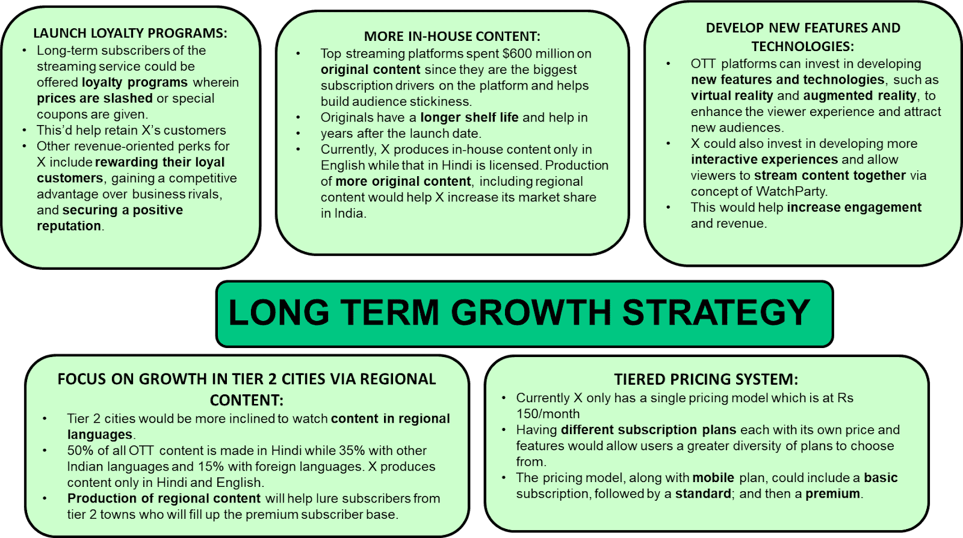
Loyalty programs, in house content, features and technologies, regional content and tiered pricing system could be used to achieve long term growth.

Slide 8
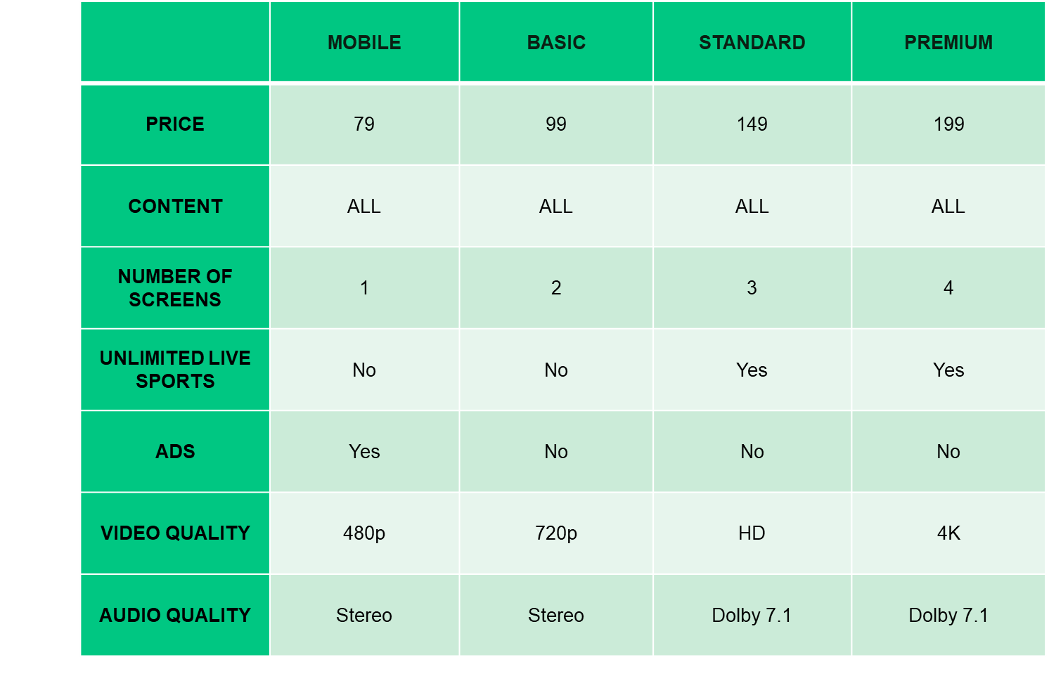
Adoption of a 4-layer subscription plan and doing the pricing after giving discount should be the Long-term pricing strategy company-X should follow for customer retention
Company X must adopt a 4 layer subscription plan.
Ad-supported Mobile plan @ 79/-
The pricing of X should be done after giving a certain amount of discount for audience to assume that the prices have actually gone down.
Ad-Free Basic Mobile +TV @99/-
Ad-free Standard @149/-
Ad-free Premium (all device access) @199/-

Slide 9
THANK YOU

