Slide 1

CMR COLLEGE OF ENGINEERING & TECHNOLOGY
Kandlakoya, Medchal, Hyderabad - 501401
Department of Computer Science and Engineering
MERN BASED PLACEMENT MANAGEMENT PORTAL
Batch No.: 84
Name of the student:
1. N. Srikanth Reddy (20H51A0570)
2. N. Krishna Koushik (20H51A05L3)
3. N. Sathwik (20H51A05E9)
Under esteemed guidance of
Ms. E. Krishnaveni
Asst. Professor, Dept of CSE
Batch: 2020-2024 Major Project Phase 2

Slide 2
OUTLINE
Abstract
Introduction
Literature Survey
Existing System
- Problems in existing system
Research Objective of Presentation
Problem Definition
- Scope of the Project
Research Work
- Proposed System Architecture
- Proposed Method
- Comparison of Proposed System with an existing system
Results
Conclusion
Future Work
References
Notes:
2

Slide 3
Abstract
Notes:
3

Slide 4
ABSTRACT
Managing the placements within an educational institution is completely a manual process which is time consuming and requires extra efforts to manage student and placements data.
To ace this concern, we are developed a MERN Based Placement Management Portal, which is a web-based application developed using the MERN stack, designed to streamline and simplify the placement process for educational institutions.
With the MERN Based Placement Management Portal students can easily access and maintain their interests, eliminating the need for manual paperwork and saving valuable time.
Through the application students can select companies based on their individual interests, skills and qualifications.
The students can practice the DSA problems, which improves their problem solving skills and check their progress with fellow students.
The Placement coordinator of the educational institution can manage the companies data, access students data, track the students progress in problem solving through the DSA tracker and select students for the drives based on the students profile.

Slide 5
Introduction
Notes:
5

Slide 6
INTRODUCTION
The MERN Based Placement Management Portal is a cutting-edge web application designed to revolutionize and optimize the placement process within educational institutions.
Built upon the formidable MERN Stack, which comprises MongoDB, Express.js, React, and Node.js, this portal offers a comprehensive and centralized solution for streamlining communication and data management between placement cells, students, and administrators.
In an era where efficiency and digitalization are most important, this portal is a game-changer. For students, it provides a user-friendly platform to manage their interests, certifications, and track their progress in solving problems via the integrated DSA Tracker.
Furthermore, students can seamlessly browse and select companies that align with their individual interests, skills, and qualifications, making the job search process both personalized and efficient.
Moreover, the placement coordinator can assess students profile and track students problem solving skills. The placement coordinator can manage placements data and select students with reference to companies profiles and student profile.
Notes:
6

Slide 7
Literature Survey
Notes:
7

Slide 8
Comparison Table for the Existing Systems
S.No | Authors and Journal Name& Year of publication | Problem Statement | Name of the Proposed solution/Method | Solution | Remarks
1 | Shiburaj Pappu, JETIR(Intern-tional Journal of Emerging Technologies and Innovative Research), 2021. | Placement Cell’s effectiveness is compromised by manual data handling. | Placement Management System | It comprises Student and Admin modules, streamlines tasks, enhances data security and accuracy, reduces paperwork, centralizes notices, validates academic details, simplifies information retrieval, and offers automated calculators for accuracy. | It empowers placement officers, centralizes notices, and integrates with the exam cell for streamlined academic validation.
2 | Praseetha V.M, IJISRT(International Journal of Innovative Science and Research Technology), 2020. | The current manual process of collecting student information for placements is time-consuming and labor-intensive. | Placement Management System for Campus Recruitment | It streamlines data collection and management using Laravel framework and MySQL, offers varied user accounts. | It streamlines data collection and management, reducing manual effort and time consumption for colleges.
3 | Prof. Aishwarya Sedamkar, International Research Journal of Engineering and Technology (IRJET), 2022. | The manual nature of placement processes in education institutions. | Placement Management System | The project entailed the creation of an efficient Placement Management System website, which manages comprehensive student and company data, following a rigorous process of research, planning, coding, design, and testing. | The system encompasses both student and company data management. It consists of conducting tests that benefits students and companies.
4 | Prof. Shiburaj Pappu, International Journal of Creative Research Thoughts (IJCRT), 2020. | The traditional college placement system lacks efficiency and security. | College Placement Management System | The system, comprising Admin, Test Taker, and CV/Resume Creation modules, streamlines test creation, administration, and results viewing, while enabling test takers to take tests, view scores, and generate customized CVs. | It provides a streamlined process for test creation, taking, and result viewing, enhancing both administrative and student user experiences.

Slide 9
PROBLEMS IN EXISTING SYSTEMS
The existing systems doesn’t manage the students data completely such as certifications, projects, and skills.
They do not provide a coding platform for students to improve their problem solving skills.
The students can directly apply for the companies that restricts the placement coordinator to select.
The existing ones doesn’t provide a way for placement cells for tracking the student progress in DSA.
Notes:
9

Slide 10
Research Objective of Presentation
Notes:
10

Slide 11
RESEARCH OBJECTIVE
The objective of a placement management system is to streamline the process of managing placements, job opportunities and students data within an organization or educational institution.
To maintain and manage students complete details including academic, skills, certifications, projects and resume.
To provide a coding platform for student to improve their problem solving skills in DSA.

Slide 12
Problem Definition
Notes:
12

Slide 13
PROBLEM DEFINITION
The problem we're addressing is the inefficiency of manual placement processes within educational institutions, where paperwork consumes time and causes missed opportunities. Our solution is a MERN-based centralized portal, a game-changer in education placement. It streamlines communication, eliminates manual tasks, and introduces a DSA (Data Structures and Algorithms) tracker. This portal saves time and offers an overall approach to optimize placement processes. It empowers students and administrators with an intuitive platform, transforming the education placement experience.

Slide 14
SCOPE OF THE PROJECT
Student Management: The MERN Based Placement Management Portal offers a comprehensive platform for students to efficiently manage their data, including company preferences, qualifications, skills, projects, resume, and certifications. This feature simplifies the placement process by eliminating the need for manual paperwork.
Job Listings: The system provides an extensive database of job listings, allowing students to browse and select companies that align with their interests and qualifications. This centralized job listing feature streamlines the job search process and enhances students' opportunities.
Application Management: The portal facilitates the application process, enabling students to apply to their preferred companies seamlessly. This application management system ensures a systematic approach to company applications and offers a centralized view of application status.
DSA Tracker: A notable feature of our portal is the DSA Tracker, which empowers students to enhance their data structures and algorithms skills. It offers a platform for problem-solving and progress tracking, contributing to their overall professional development.

Slide 15
Research Work
Notes:
15

Slide 16
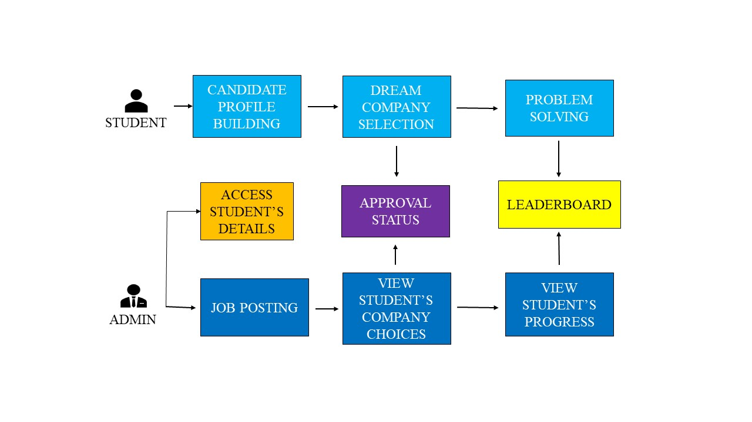
PROPOSED SYSTEM ARCHITECTURE
Notes:
16

Slide 17
PROPOSED METHOD
Our proposed method consists of two modules as Student module and Admin module.
STUDENT MODULE:
Every student has a unique ID given by the college and the students can login through their ID along with their password. Academic details of the students are entered by default. It contains the following:
Profile Building: The students can add their skills and improve their candidature.
Certifications: Provide a section for students to upload their skillset certifications.
Resume: Upload your resume for placement officer’s reference.
Projects: Students can upload the description and link of their projects.
Dream Company Selection: Provides a platform for students to explore job postings, view company details and apply for interested companies.
Check Approval Status: The students can check the approval status of the dream company application.
DSA Problem Solving: Implements a coding practice section where students can solve Data Structures and Algorithms (DSA) Problems.
Notes:
17

Slide 18
PROPOSED METHOD
ADMIN MODULE:
The Placement Officer is the admin of the portal. The admin can login through his login credentials. It contains the following:
Job Posting: Enable the admin to post job openings on behalf of companies. Include fields for job descriptions, eligibility criteria, and other relevant information.
Access Students Details: The admin can access student’s details.
Access Students Documents: Placement officer can access the documents that are uploaded by the students such as certificates, resume.
View Students Company Interests: Provides a feature for the admin to view the companies that the students are interested in. This can help in coordinating and facilitating the placement process.
View Leaderboard: Placement officer can check the leaderboard and observe the student’s performance.
Notes:
18

Slide 19
COMPARISON WITH EXISTING SYSTEMS
Our proposed system is better than existing systems in the following:
Student Data Management: The existing systems only maintains the students academic data whereas our proposed method maintains students complete data including skills, achievements, certifications, projects and resume.
DSA Problem Solving: Our project provides a coding platform for students to practice DSA problems and check their progress on the leaderboard whereas the existing ones doesn’t.
Candidate Selection: The proposed system provides the placement coordinators to select students for specific drives based on the student profile.
Notes:
19

Slide 20
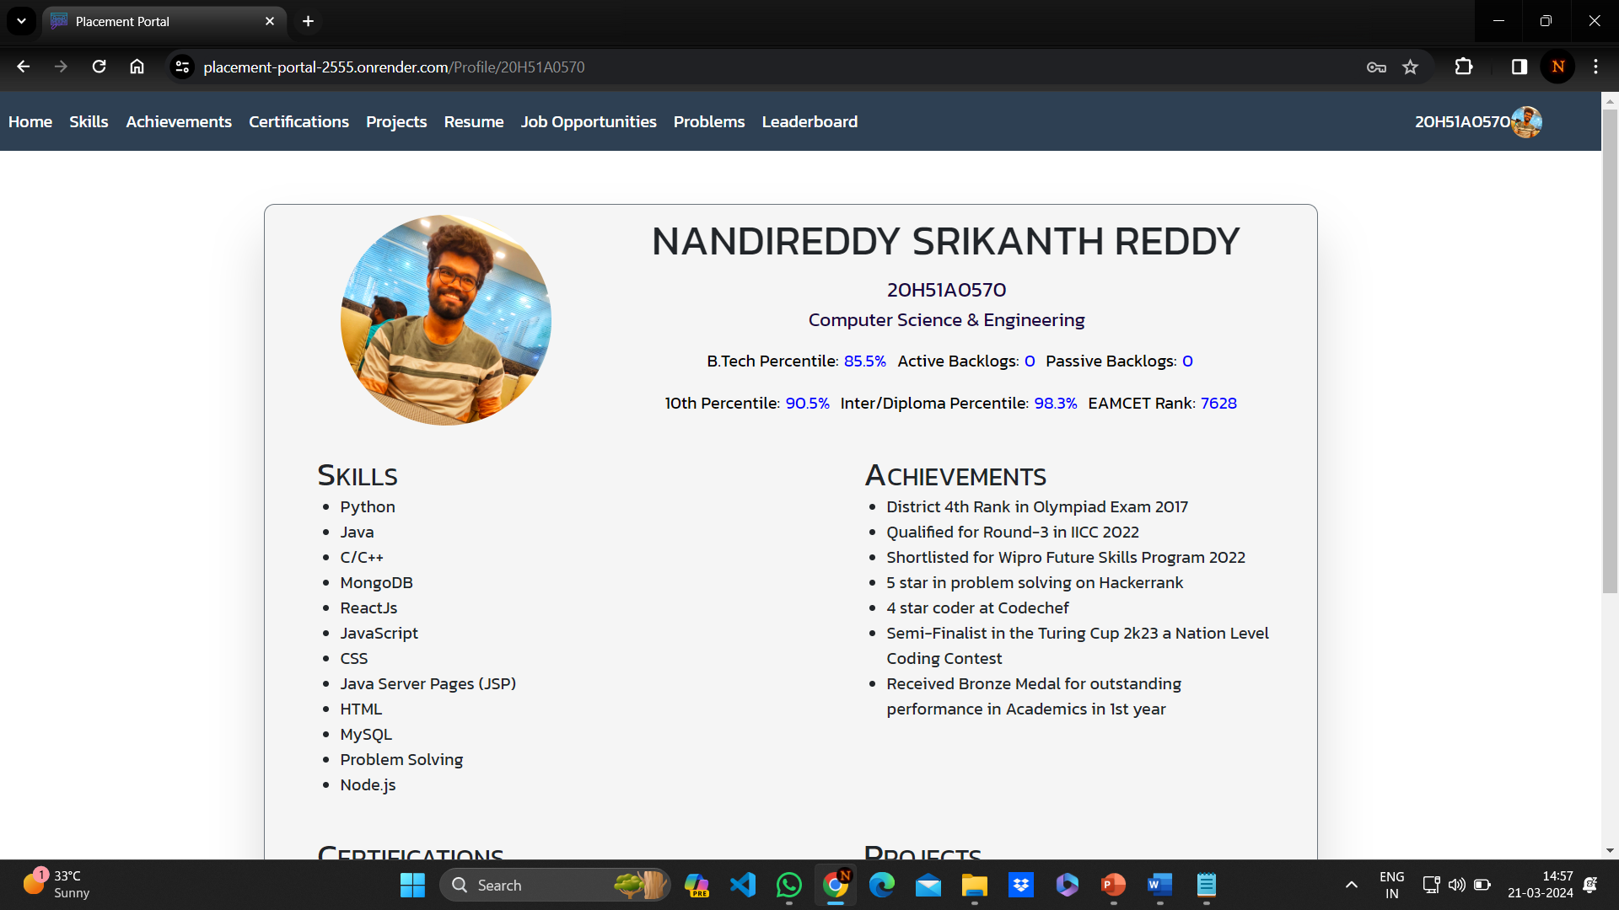
RESULT ANALYSIS
Our proposed system provides an user friendly interface to students and placement coordinators. It ensures effective data management, for students in managing their complete data including academic, skills, certifications, projects, company preferences and resume, and for placement coordinators in managing the job listings and students preferences.
It provides comprehensive coding platform for students to solve and improve their problems solving skills in DSA and check progress.
The placement coordinator can track the students progress in DSA through the leaderboard.

Slide 21
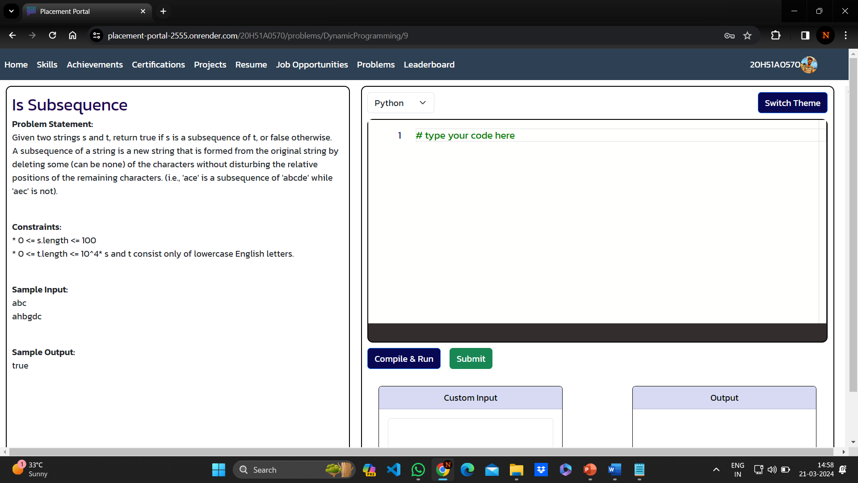
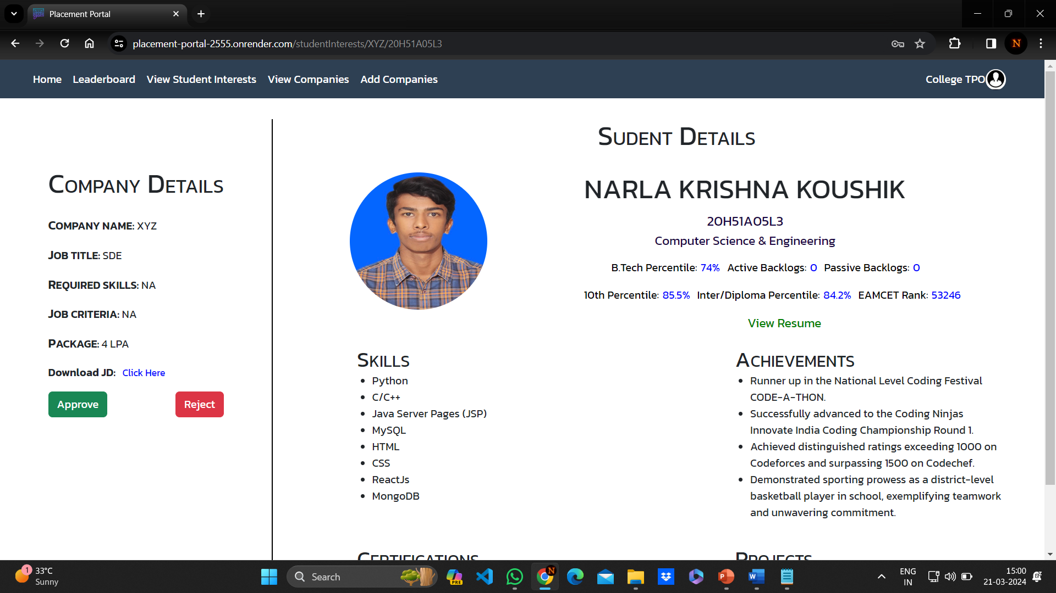
RESULT ANALYSIS

Slide 22
CONCLUSION
Overall our proposed method is a comprehensive solution that provides students with an easy-to-use platform to efficiently manage their data, search for jobs, and seamlessly apply to their desired companies. Incorporating a DSA tracker accelerates student’s professional development by providing a dedicated space to improve their Data Structures and Algorithms (DSA) skills.
Provides an easy way for college placement cells to access students data and manage placements data. Our project helps the placement coordinator to track the progress of the students in problem solving in DSA and also helps in analyzing the students profile.

Slide 23
FUTURE WORK
Company Logins: In future company logins will be added, which helps the placement coordinators and companies to easily communicate and schedule the drives.
Student Experiences: Student experiences with the drives can be gathered and make visible to the current students such that they can have an overview of how to prepare for the drives.
AI Enhancement: With the AI enhancement the placement coordinators can get the students profiles that matches with the companies profile automatically, which makes the selecting process simple.

Slide 24
REFERENCES
[1]. Santhosh Kumar H,” Online Training and Placement Management system” International Journal of Engineering Research Technology (IJERT), ICACT-2016 Conference Proceedings.
[2]. Mythili M, Aishwarya R, Shenbagam P, Sandhiya C,” E Placement Management”, International Journal of Pure and Applied Mathematics (IJPAM), Volume 119 No. 10 2018,1823-1834.
[3]. Rajnesh Tripathi, Raghvendra Singh, Jaweria Usmani, “Campus Recruitment and Placement System”, International Conference on Recent Innovations in Science and Engineering (Icrise -18), April, 2018.
[4]. Ajeena Sunny1 Aneena Felix1 Angelin Saji1 Christina Sebastian1 Praseetha V.M2 1UG Student, Dept. of CSE, SJCET, Palai, Kerala, India
[5]. Anjali v, Jeyalakshmi PR, Anbubala R,Sri Mathura devi, Ranjini.V, ”Web Based Placement Management System”, International Journal of Computer Science and Information Technologies(IJCSIT), Vol. 7 (2) , 2016, 760-763.

Slide 25
Thank You!

