Slide 1
CS5720 · Neural Networks & Deep Learning
Empirical Evaluation of
Embedding Models in RAG
for Domain-Specific QA
arXiv-rag — Complete Implementation Results
150
4
100
7
Research Papers
Models Evaluated
Manual QA Pairs
Evaluation Metrics
Srikant Reddy Nandireddy (700773949) · Harshit Naidu (700776786)
University of Central Missouri · Dr. Muhammad Zubair Khan · April 2026

Slide 2
PROBLEM STATEMENT
Why Dense Retrieval Matters in RAG
⚠
🔍
❓
LLM Hallucination
Retrieval Bottleneck
BM25 vs Dense?
Models generate plausible but factually incorrect responses when queries require domain knowledge not in training data.
RAG quality is only as good as retrieval. A weak retriever returns irrelevant passages — the generator cannot compensate.
Does semantic embedding offer a real advantage over classical term-frequency retrieval for ML research papers?
Core Question:
How do different transformer embedding models affect RAG performance for ML research question answering?

Slide 3
DESIGN & ARCHITECTURE
End-to-End RAG Pipeline
arXiv API
PyMuPDF
Chunker
Embeddings
FAISS Index
Retriever
Gemini
150 papers
cs.LG
PDF → text
cleaning
256/512/1024
tokens
MiniLM/MPNet
BGE + BM25
IndexFlatIP
exact cosine
Top-K
passages
2.5 Flash Lite
grounded answer
OFFLINE INDEXING
ONLINE QUERY
Package Structure (rag/)
Tech Stack
▸ rag/data/collector.py — arXiv downloader
PDF Extraction:
PyMuPDF 1.25.5
▸ rag/processing/chunker.py — PDF extraction + recursive chunking
Embeddings:
sentence-transformers 3.0
▸ rag/retrieval/dense.py — FAISS dense retriever
Vector Index:
FAISS IndexFlatIP
▸ rag/retrieval/bm25.py — BM25 sparse baseline
Sparse Baseline:
rank-bm25 (Okapi BM25)
▸ rag/generation/generator.py — Gemini + rate limiter
Generation:
Gemini 2.5 Flash Lite
▸ rag/evaluation/metrics.py — Recall@K, Precision@K, MRR@K, AR, Faithfulness
UI:
Streamlit
Acceleration:
Apple MPS / CUDA / CPU

Slide 4
DATASET & MODELS
Data and Embedding Models Under Evaluation
150
10,260
5,106
100
Papers
arXiv cs.LG
Max Chunks
(256 tokens)
Default Chunks
(512 tokens)
Benchmark QA
Pairs
FAST
BALANCED
ACCURATE
BASELINE
MiniLM
MPNet
BGE
BM25
all-MiniLM-L6-v2
all-mpnet-base-v2
BAAI/bge-large-en
Okapi BM25 (rank-bm25)
Layers: 6 Dim: 384d Params: 22M
Layers: 12 Dim: 768d Params: 110M
Layers: 24 Dim: 1024d Params: 335M
Layers: — Dim: sparse Params: —
Chunk sizes tested: 256 · 512 · 1024 tokens (64-token overlap) | Top-K tested: 3 · 5 · 10

Slide 5
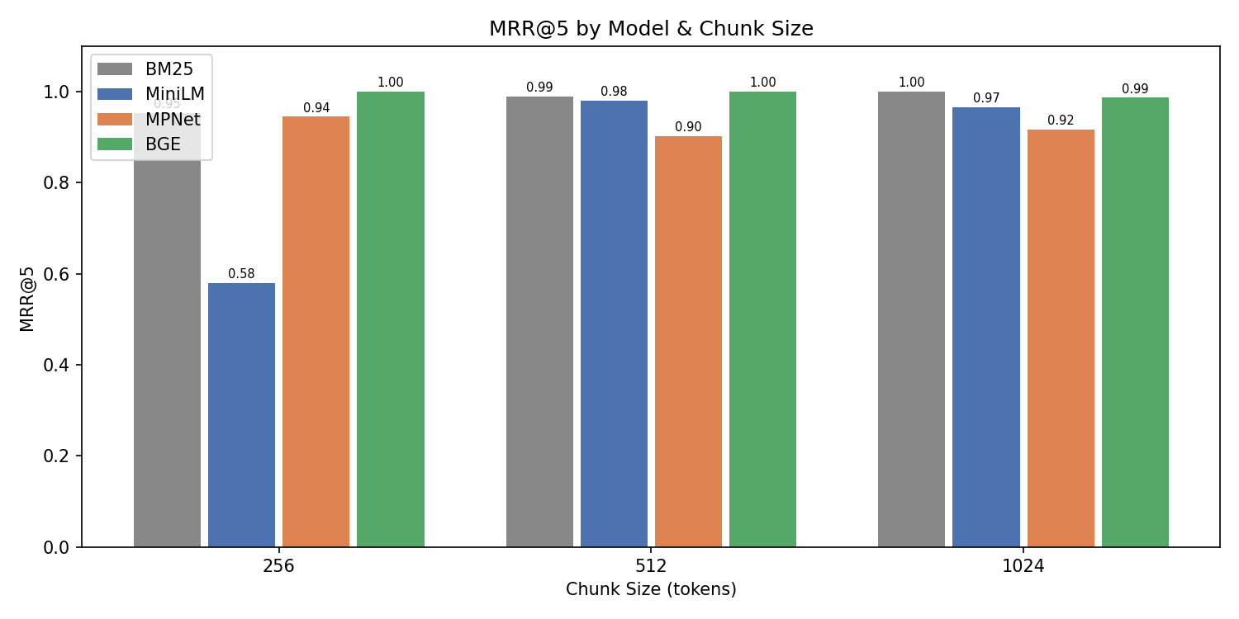
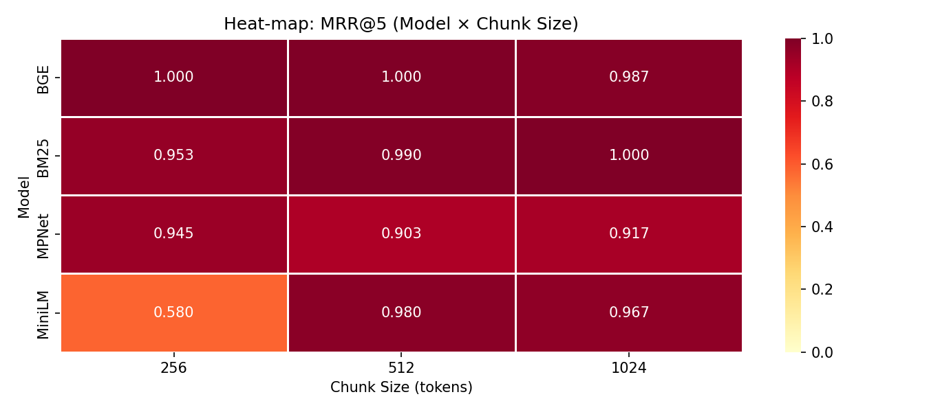
RESULTS — RETRIEVAL
MRR@5 Performance Across All Configurations
Dense Retrieval Leads at 256 / 512
BGE: 0.990 at chunk 256 and 512
BM25 Remains Competitive
MRR@5 range: 0.959 – 0.990
Chunk 1024 Favors BM25
BM25 (0.990) edges BGE (0.983) at chunk 1024 — sparse retrieval improves with larger chunks
BGE is strongest at 256/512, while BM25 slightly leads at 1024

Slide 6
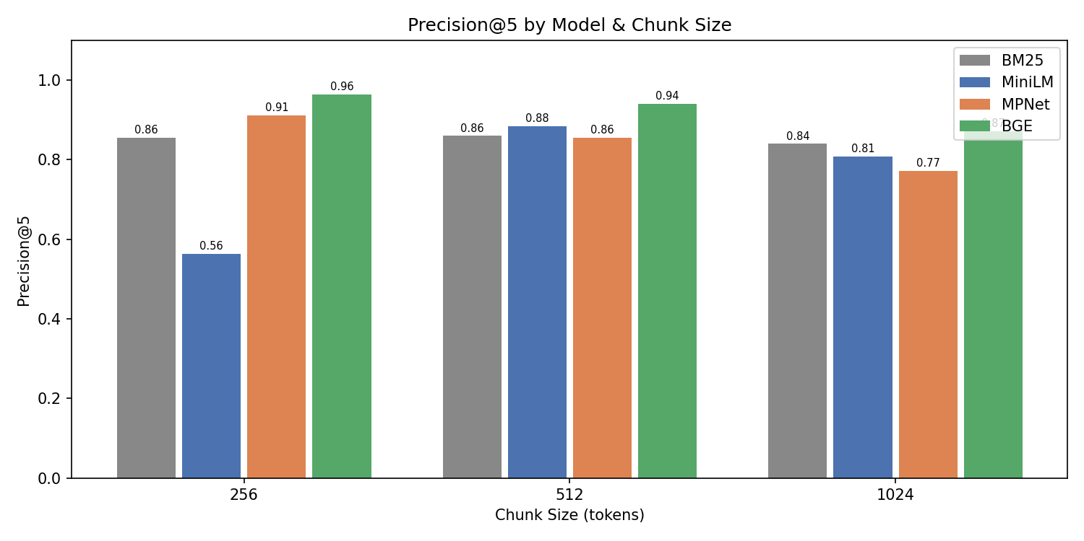
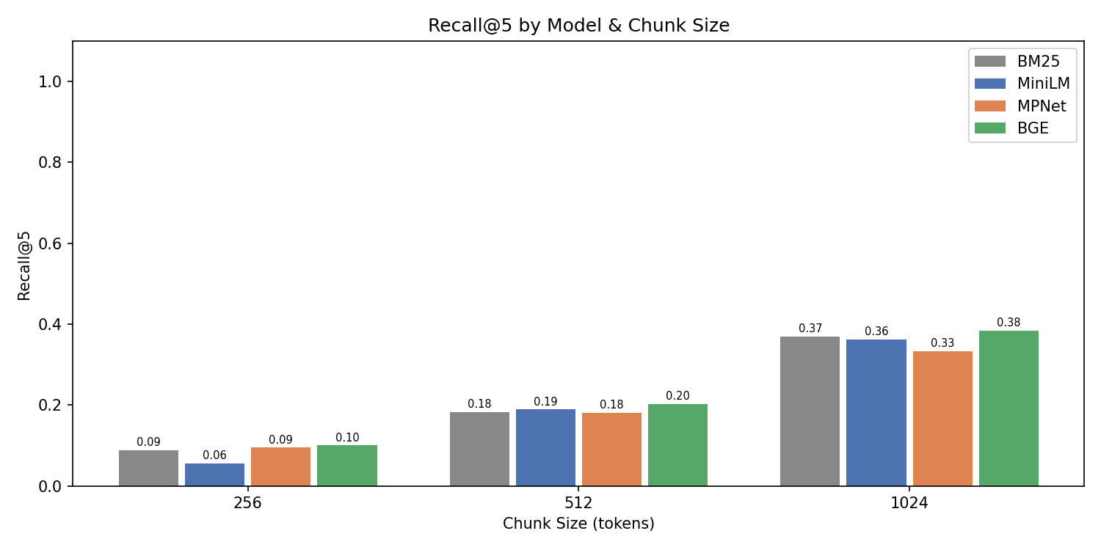
RESULTS — PRECISION & RECALL
Precision@5 and Recall@5 Across Chunk Sizes
Precision@5
Recall@5
Precision falls with chunk size
Recall grows with chunk size
Larger chunks introduce more mixed content per unit. BGE still maintains the highest Precision@5 at every size.
Recall@5 rises sharply with chunk size across all models. More content per chunk improves paper-level coverage.
BGE leads precision
BM25 recall competitive at 1024
BGE Precision@5: 0.970 (256), 0.950 (512), 0.888 (1024). BM25 stays close but consistently lower.
BM25 Recall@5 = 0.375 at chunk 1024, showing sparse retrieval catches up strongly at large chunk sizes.

Slide 7
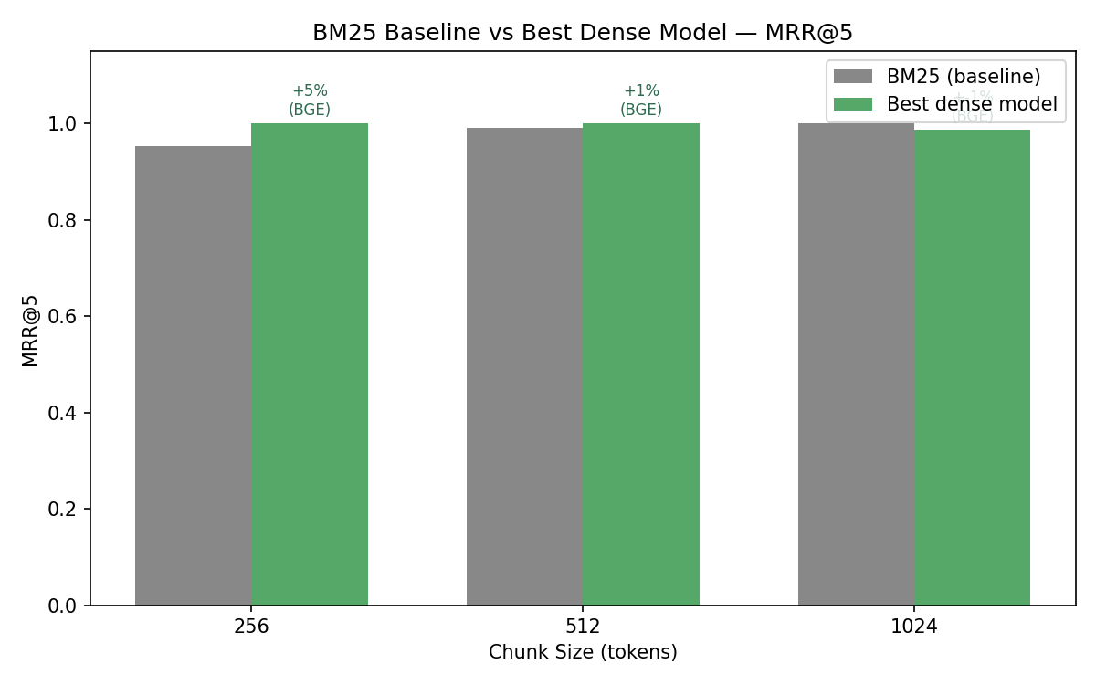
RESULTS — BM25 vs DENSE
Sparse Baseline vs Best Dense Model — MRR@5
Key Comparison
Chunk 256
BM25: 0.959 BGE: 0.990
Dense gain: +3%
Chunk 512
BM25: 0.978 BGE: 0.990
Dense gain: +1%
Chunk 1024
BM25: 0.990 BGE: 0.983
Dense retrieval leads at 256/512, but BM25 slightly leads at 1024.
The gap narrows sharply at chunk 1024 as term overlap increases.
Dense gain: -1%

Slide 8
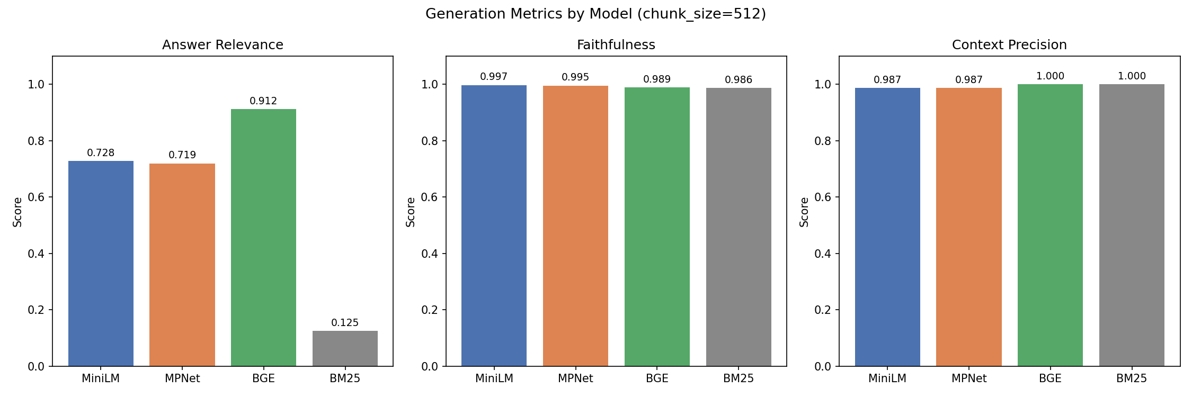
RESULTS — GENERATION
Generation Quality · Chunk Size 512 · Top-K 5
01
02
03
04
7.3× Answer Relevance Gap
Faithfulness Near-Perfect
Context Precision High
Retrieval is the Bottleneck
BGE: 0.912 vs BM25: 0.125
High retrieval precision ≠ semantic answer quality
All models: 0.986 – 0.997
Deterministic Gemini generation stays strongly grounded in context
BGE and BM25: 1.000
Retrieved chunks are consistently used in answers
Retrieval quality still drives semantic answer quality most strongly

Slide 9
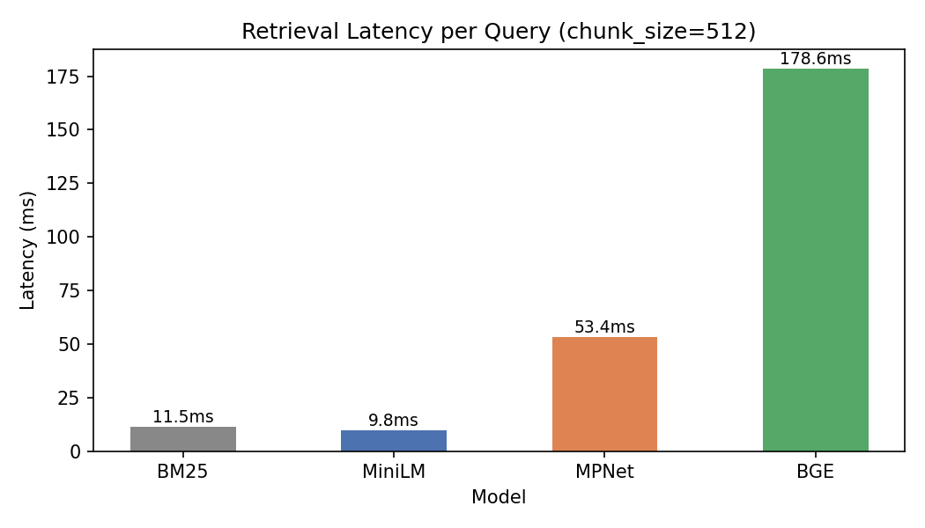
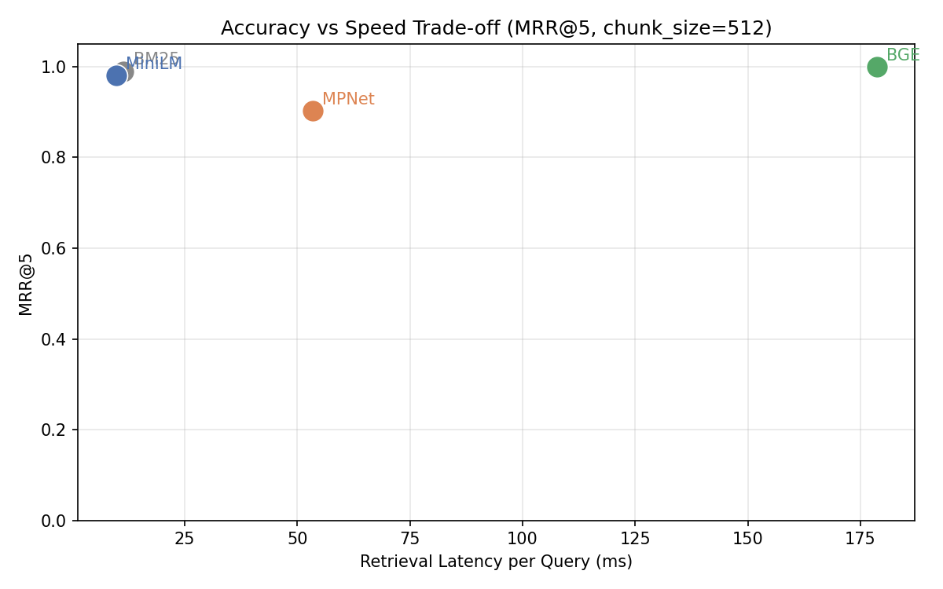
RESULTS — LATENCY
Accuracy vs Speed Trade-off · Chunk Size 512
Latency per Query
Accuracy vs Speed Scatter
BGE
MPNet
MiniLM
BM25
MRR@5: 0.990 · Latency: 31ms
MRR@5: 0.917 · Latency: 20ms
MRR@5: 0.975 · Latency: 7ms
MRR@5: 0.978 · Latency: 12ms
AR: 0.912
AR: 0.719
AR: 0.728
AR: 0.125
Best accuracy — use when quality is critical
Higher latency without a clear gain over MiniLM at chunk 512
⭐ Best speed-accuracy — production default
Fast and strong lexically, but still weak on semantic answer quality

Slide 10
ANALYSIS & KEY FINDINGS
What the Results Tell Us
Precision ≠ Generation Quality
BM25 is a strong lexical baseline
01
BM25 P@5 = 0.862 but Answer Relevance = 0.125. High lexical precision does not guarantee semantic alignment with query intent.
02
It becomes strongest at chunk 1024 on MRR@5, but dense retrievers still surface passages that align better with answer intent.
BGE is the best overall dense retriever
MiniLM is production-optimal
03
It leads the dense models at chunks 256 and 512 (MRR@5 = 0.990). Model scale and task-specific tuning still pay off.
04
6.8ms latency — about 98.5% of BGE's MRR@5 at chunk 512. Best speed-accuracy trade-off for latency-sensitive applications.
Chunk 512 is the sweet spot
Generator stays grounded
05
Balances MRR, Precision, and Recall. 256 = max precision; 1024 = max recall; 512 = best overall.
06
Faithfulness stays very high (0.986–0.997) across all models. Retrieval quality — not generation grounding — remains the bottleneck.

Slide 11
DEPLOYMENT & RECOMMENDATIONS
System Deployment and Practical Guidelines
Deployed System
Recommendations
▸ Streamlit UI — live model switching (BM25 / MiniLM / MPNet / BGE)
⭐ Use BGE
Best overall dense retrieval quality (MRR@5 0.990 at chunk 512). Justified for quality-critical applications.
▸ Source attribution chips per answer — title + similarity score
⚡ Use MiniLM for Speed
▸ Searchable paper browser — all 150 papers in sidebar
6.8ms latency at about 98.5% of BGE's MRR@5 — production default.
▸ Performance metric cards update with model selection
📦 Chunk at 512 Tokens
▸ CLI: python main.py --model BGE --top_k 5
Best balance of MRR, precision and recall across all models.
▸ Full benchmark: python scripts/run_experiments.py
🚫 Avoid BM25 for Generation
0.125 Answer Relevance keeps it unsuitable as a standalone RAG generator despite fast retrieval.
▸ Apple MPS auto-detected — GPU-accelerated on Mac
🔮 Future Work
▸ Embedding cache — reruns skip re-encoding (saves ~15 min)
Hybrid BM25+dense, cross-encoder reranking, multi-domain evaluation.

Slide 12
PROJECT MANAGEMENT
Team, Responsibilities, and Contributions
Project Timeline
Mar 13
Mar 14
Mar 15
Mar 16
Mar 20
Apr
Apr 22
Proposal
Pipeline
Eval
BM25
UI
Report
Submit
Task Allocation
Contributions
arXiv data collection pipeline
Srikant (Primary)
Harshit (Review)
Srikant Reddy Nandireddy
PDF extraction & chunking
Harshit (Primary)
Srikant (Review)
700773949
Embedding model integration
Srikant (Primary)
Harshit (Support)
50%
FAISS vector store
Srikant (Primary)
Harshit (Support)
BM25 baseline
Harshit (Primary)
Srikant (Review)
Harshit Naidu
Gemini generator + rate limiter
Srikant (Primary)
Harshit (Review)
700776786
Evaluation metrics
Harshit (Primary)
Srikant (Review)
50%
Streamlit UI
Harshit (Primary)
Srikant (Review)
Manual QA pairs & experiment runner
Both (Equal)
—

Slide 13
REFERENCES
Bibliography
[1] Brown et al. (2020). Language models are few-shot learners. NeurIPS 33.
[6] Reimers & Gurevych (2019). Sentence-BERT. EMNLP 2019.
[2] Gao et al. (2023). RAG for Large Language Models: A Survey. arXiv:2312.10997.
[7] Robertson & Zaragoza (2009). The Probabilistic Relevance Framework: BM25. Foundations & Trends IR.
[3] Izacard & Grave (2021). Leveraging Passage Retrieval with Generative Models. EACL.
[8] Santhanam et al. (2022). ColBERTv2. NAACL 2022.
[4] Karpukhin et al. (2020). Dense Passage Retrieval for Open-Domain QA. EMNLP.
[9] Shi et al. (2023). REPLUG. EMNLP 2023.
[5] Lewis et al. (2020). Retrieval-Augmented Generation for Knowledge-Intensive NLP. NeurIPS.
[10] Xiao et al. (2023). C-Pack: BGE embedding resources. arXiv:2309.07597.

Slide 14
Thank You
github.com/GodVilan/arXiv-rag
0.990
7.3×
7ms
0.99
BGE MRR@5
vs BM25 AR Gap
MiniLM Latency
Avg Faithfulness
Srikant Reddy Nandireddy · Harshit Naidu
CS5720 Neural Networks and Deep Learning · University of Central Missouri · April 2026

