Slide 1
CS5720 · Neural Networks & Deep Learning
Empirical Evaluation of
Embedding Models in RAG
for Domain-Specific QA
arXiv-rag — Complete Implementation Results
120
4
20
7
Research Papers
Models Evaluated
Manual QA Pairs
Evaluation Metrics
Srikant Reddy Nandireddy (700773949) · Harshit Naidu (700776786)
University of Central Missouri · Dr. Muhammad Zubair Khan · April 2026

Slide 2
PROBLEM STATEMENT
Why Dense Retrieval Matters in RAG
⚠
🔍
❓
LLM Hallucination
Retrieval Bottleneck
BM25 vs Dense?
Models generate plausible but factually incorrect responses when queries require domain knowledge not in training data.
RAG quality is only as good as retrieval. A weak retriever returns irrelevant passages — the generator cannot compensate.
Does semantic embedding offer a real advantage over classical term-frequency retrieval for ML research papers?
Core Question:
How do different transformer embedding models affect RAG performance for ML research question answering?

Slide 3
DESIGN & ARCHITECTURE
End-to-End RAG Pipeline
arXiv API
PyMuPDF
Chunker
Embeddings
FAISS Index
Retriever
Gemini
120 papers
cs.LG
PDF → text
cleaning
256/512/1024
tokens
MiniLM/MPNet
BGE + BM25
IndexFlatIP
exact cosine
Top-K
passages
2.5 Flash Lite
grounded answer
OFFLINE INDEXING
ONLINE QUERY
Package Structure (rag/)
Tech Stack
▸ rag/data/collector.py — arXiv downloader
PDF Extraction:
PyMuPDF 1.25.5
▸ rag/processing/chunker.py — PDF extraction + recursive chunking
Embeddings:
sentence-transformers 3.0
▸ rag/retrieval/dense.py — FAISS dense retriever
Vector Index:
FAISS IndexFlatIP
▸ rag/retrieval/bm25.py — BM25 sparse baseline
Sparse Baseline:
rank-bm25 (Okapi BM25)
▸ rag/generation/generator.py — Gemini + rate limiter
Generation:
Gemini 2.5 Flash Lite
▸ rag/evaluation/metrics.py — Recall@K, Precision@K, MRR, AR, Faithfulness
UI:
Streamlit
Acceleration:
Apple MPS / CUDA / CPU

Slide 4
DATASET & MODELS
Data and Embedding Models Under Evaluation
120
8,131
3,915
20
Papers
arXiv cs.LG
Max Chunks
(256 tokens)
Default Chunks
(512 tokens)
Manual QA
Pairs
FAST
BALANCED
ACCURATE
BASELINE
MiniLM
MPNet
BGE
BM25
all-MiniLM-L6-v2
all-mpnet-base-v2
BAAI/bge-large-en
Okapi BM25 (rank-bm25)
Layers: 6 Dim: 384d Params: 22M
Layers: 12 Dim: 768d Params: 110M
Layers: 24 Dim: 1024d Params: 335M
Layers: — Dim: sparse Params: —
Chunk sizes tested: 256 · 512 · 1024 tokens (64-token overlap) | Top-K tested: 3 · 5 · 10

Slide 5
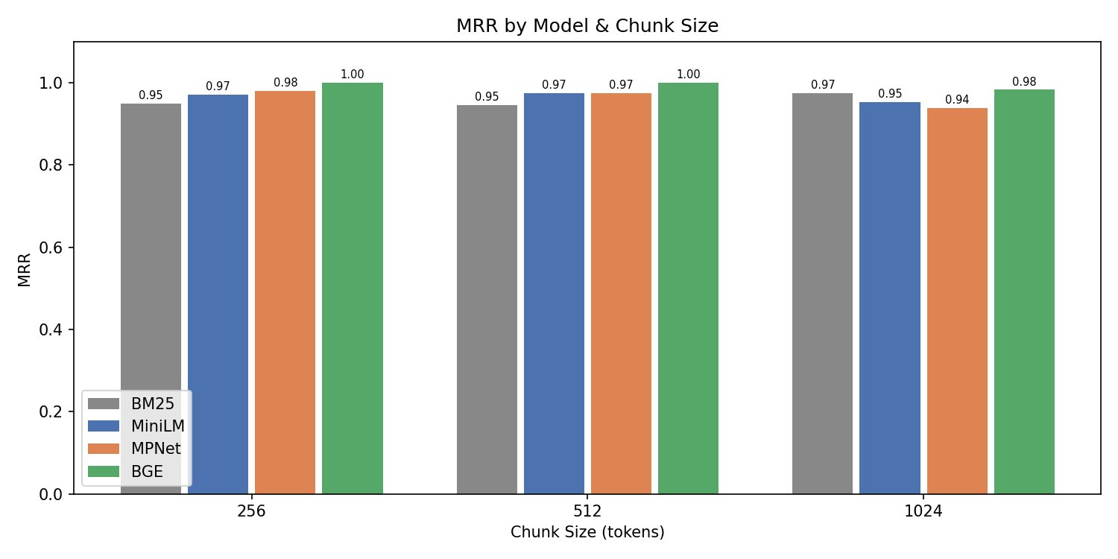
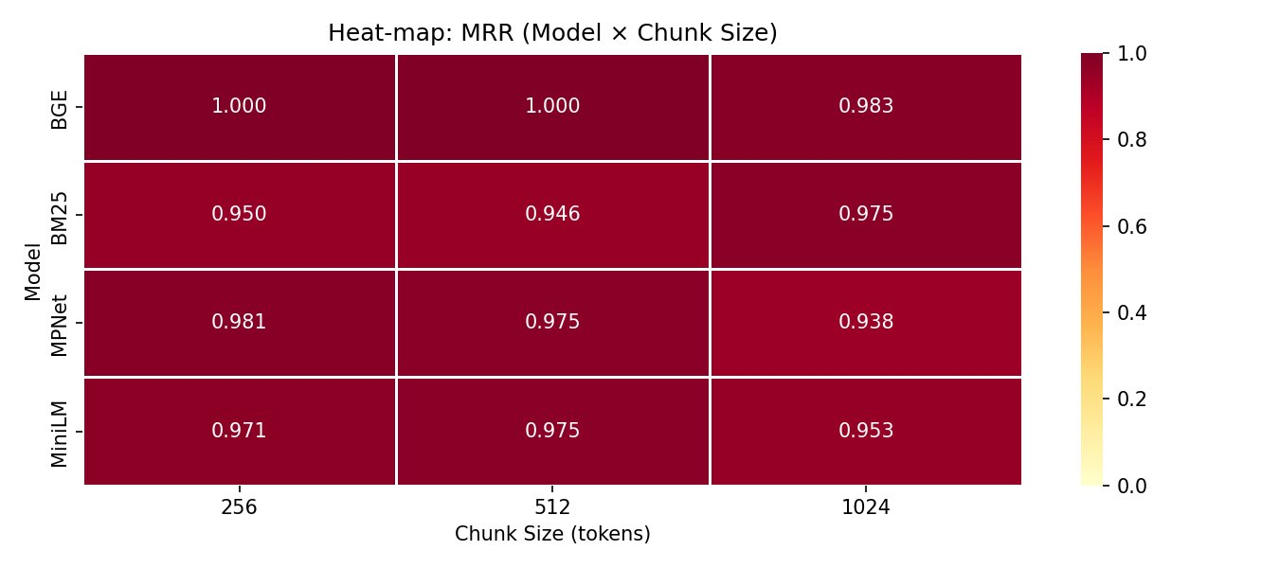
RESULTS — RETRIEVAL
MRR Performance Across All Configurations
Perfect MRR
BGE: 1.000 at chunk 256 and 512
BM25 Baseline
MRR range: 0.946 – 0.975
Chunk 1024 Gap Narrows
BM25 (0.975) surpasses MPNet (0.938) at chunk 1024 — sparse retrieval improves with larger chunks
BGE row is uniformly darkest — highest MRR across every chunk size configuration

Slide 6
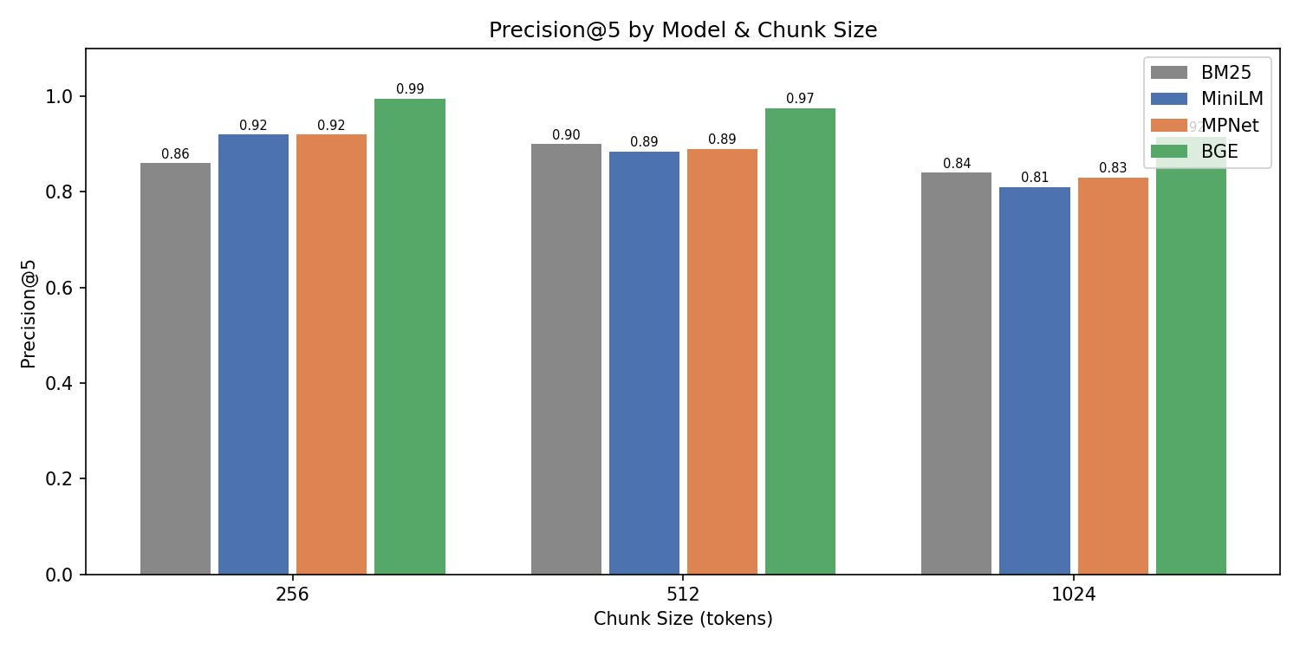
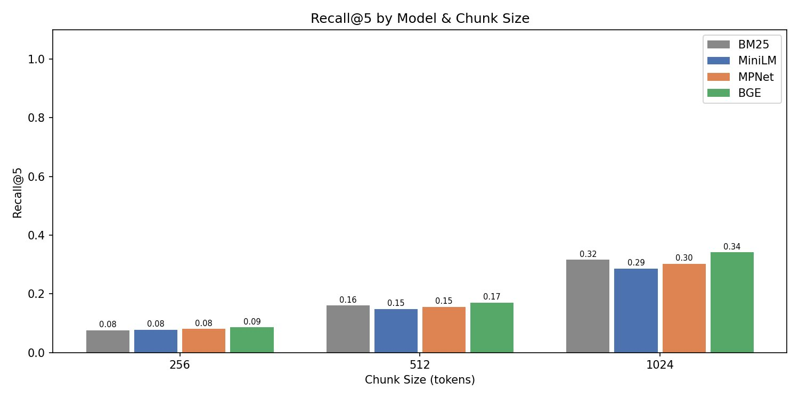
RESULTS — PRECISION & RECALL
Precision@5 and Recall@5 Across Chunk Sizes
Precision@5
Recall@5
Precision falls with chunk size
Recall grows with chunk size
All models — larger chunks introduce more off-topic content per unit. BGE maintains highest precision at every size.
Recall@5 doubles from chunk 256→512 across all models. More content per chunk = better paper coverage.
BGE leads precision
BM25 recall competitive at 1024
BGE Precision@5: 0.995 (256), 0.975 (512), 0.915 (1024). BM25 consistently 3–7% lower.
BM25 Recall@5 = 0.316 at chunk 1024, matching or exceeding dense models — sparse retrieval catches up at large chunk sizes.

Slide 7
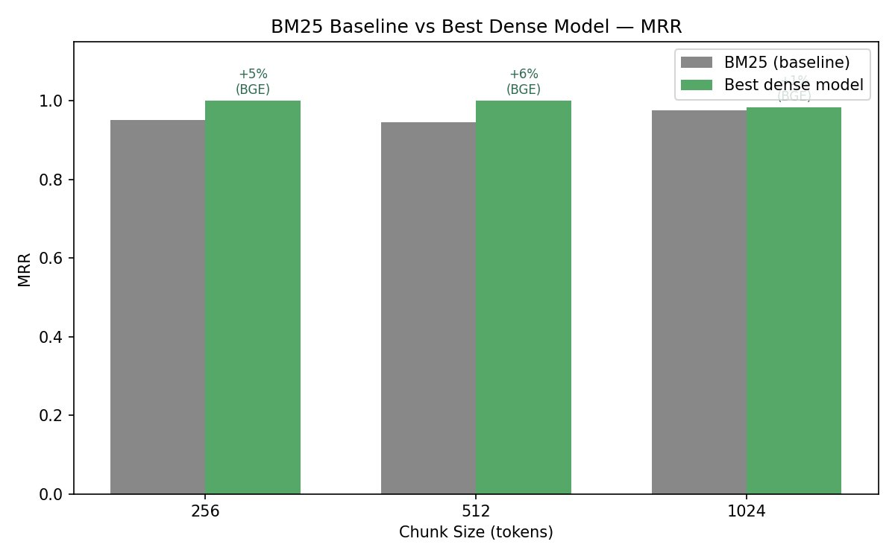
RESULTS — BM25 vs DENSE
Sparse Baseline vs Best Dense Model — MRR
Key Comparison
Chunk 256
BM25: 0.950 BGE: 1.000
Dense gain: +5%
Chunk 512
BM25: 0.946 BGE: 1.000
Dense gain: +6%
Chunk 1024
BM25: 0.975 BGE: 0.983
Dense retrieval consistently outperforms BM25 on MRR.
The gap narrows at chunk 1024 as term overlap increases.
Dense gain: +1%

Slide 8
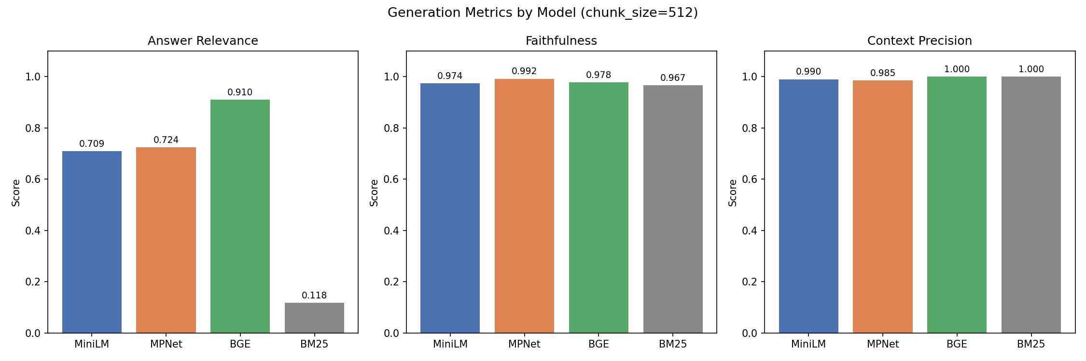
RESULTS — GENERATION
Generation Quality · Chunk Size 512 · Top-K 5
01
02
03
04
7.7× Answer Relevance Gap
Faithfulness Near-Perfect
Context Precision High
Retrieval is the Bottleneck
BGE: 0.910 vs BM25: 0.118
High retrieval precision ≠ semantic answer quality
All dense models: 0.974 – 0.992
Gemini reliably grounds answers in context
BGE and BM25: 1.000
Retrieved chunks are consistently used in answers
Generator performance is stable — embedding choice determines final answer quality

Slide 9
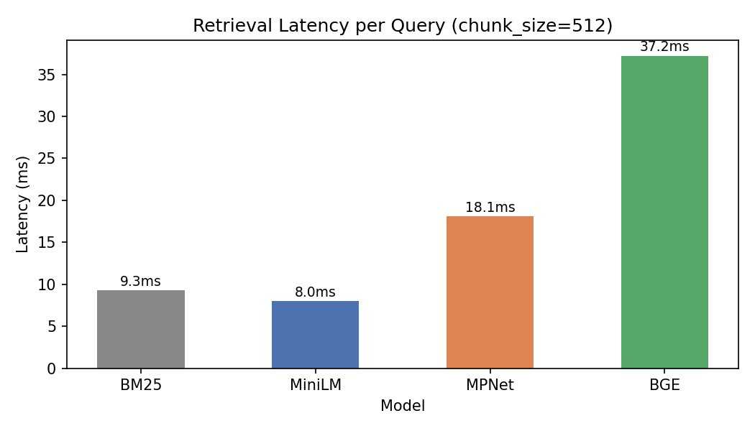
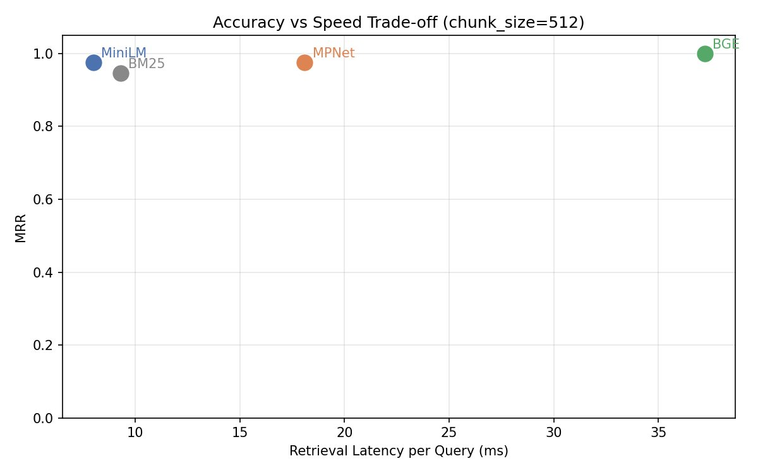
RESULTS — LATENCY
Accuracy vs Speed Trade-off · Chunk Size 512
Latency per Query
Accuracy vs Speed Scatter
BGE
MPNet
MiniLM
BM25
MRR: 1.000 · Latency: 37ms
MRR: 0.975 · Latency: 18ms
MRR: 0.975 · Latency: 8ms
MRR: 0.946 · Latency: 9ms
AR: 0.910
AR: 0.724
AR: 0.709
AR: 0.118
Best accuracy — use when quality is critical
Moderate gains at moderate latency cost
⭐ Best speed-accuracy — production default
Fast but poor generation quality — avoid for RAG

Slide 10
ANALYSIS & KEY FINDINGS
What the Results Tell Us
Precision ≠ Generation Quality
BM25 finds the paper, not the passage
01
BM25 P@5 = 0.900 but Answer Relevance = 0.118. High retrieval precision does not guarantee semantic alignment with query intent.
02
Dense retrieval finds the passage most aligned with the question. For RAG, that distinction determines answer quality.
BGE is the best retriever
MiniLM is production-optimal
03
Perfect MRR (1.000) at chunks 256 and 512. Model scale (24 layers, 1024d) and task-specific fine-tuning drive the advantage.
04
8ms latency — matches BM25 speed. 97.5% of BGE accuracy. Best speed-accuracy trade-off for latency-sensitive applications.
Chunk 512 is the sweet spot
Generator stays grounded
05
Balances MRR, Precision, and Recall. 256 = max precision; 1024 = max recall; 512 = best overall.
06
Faithfulness 0.974–0.992 across all dense models. Retrieval quality — not generation — is the bottleneck.

Slide 11
DEPLOYMENT & RECOMMENDATIONS
System Deployment and Practical Guidelines
Deployed System
Recommendations
▸ Streamlit UI — live model switching (BM25 / MiniLM / MPNet / BGE)
⭐ Use BGE
Best accuracy (MRR 1.000). Justified for quality-critical applications.
▸ Source attribution chips per answer — title + similarity score
⚡ Use MiniLM for Speed
▸ Searchable paper browser — all 120 papers in sidebar
8ms latency at 97.5% BGE accuracy — production default.
▸ Performance metric cards update with model selection
📦 Chunk at 512 Tokens
▸ CLI: python main.py --model BGE --top_k 5
Best balance of MRR, precision and recall across all models.
▸ Full benchmark: python scripts/run_experiments.py
🚫 Avoid BM25 for Generation
0.118 Answer Relevance makes it unsuitable despite fast retrieval.
▸ Apple MPS auto-detected — GPU-accelerated on Mac
🔮 Future Work
▸ Embedding cache — reruns skip re-encoding (saves ~15 min)
Hybrid BM25+dense, cross-encoder reranking, multi-domain evaluation.

Slide 12
PROJECT MANAGEMENT
Team, Responsibilities, and Contributions
Project Timeline
Mar 13
Mar 14
Mar 15
Mar 16
Mar 20
Apr
Apr 22
Proposal
Pipeline
Eval
BM25
UI
Report
Submit
Task Allocation
Contributions
arXiv data collection pipeline
Srikant (Primary)
Harshit (Review)
Srikant Reddy Nandireddy
PDF extraction & chunking
Harshit (Primary)
Srikant (Review)
700773949
Embedding model integration
Srikant (Primary)
Harshit (Support)
50%
FAISS vector store
Srikant (Primary)
Harshit (Support)
BM25 baseline
Harshit (Primary)
Srikant (Review)
Harshit Naidu
Gemini generator + rate limiter
Srikant (Primary)
Harshit (Review)
700776786
Evaluation metrics
Harshit (Primary)
Srikant (Review)
50%
Streamlit UI
Harshit (Primary)
Srikant (Review)
Manual QA pairs & experiment runner
Both (Equal)
—

Slide 13
REFERENCES
Bibliography
[1] Brown et al. (2020). Language models are few-shot learners. NeurIPS 33.
[6] Reimers & Gurevych (2019). Sentence-BERT. EMNLP 2019.
[2] Gao et al. (2023). RAG for Large Language Models: A Survey. arXiv:2312.10997.
[7] Robertson & Zaragoza (2009). The Probabilistic Relevance Framework: BM25. Foundations & Trends IR.
[3] Izacard & Grave (2021). Leveraging Passage Retrieval with Generative Models. EACL.
[8] Santhanam et al. (2022). ColBERTv2. NAACL 2022.
[4] Karpukhin et al. (2020). Dense Passage Retrieval for Open-Domain QA. EMNLP.
[9] Shi et al. (2023). REPLUG. EMNLP 2023.
[5] Lewis et al. (2020). Retrieval-Augmented Generation for Knowledge-Intensive NLP. NeurIPS.
[10] Xiao et al. (2023). C-Pack: BGE embedding resources. arXiv:2309.07597.

Slide 14
Thank You
github.com/GodVilan/arXiv-rag
1.000
7.7×
8ms
0.99
BGE MRR
vs BM25 AR Gap
MiniLM Latency
Avg Faithfulness
Srikant Reddy Nandireddy · Harshit Naidu
CS5720 Neural Networks and Deep Learning · University of Central Missouri · April 2026

