Slide 1
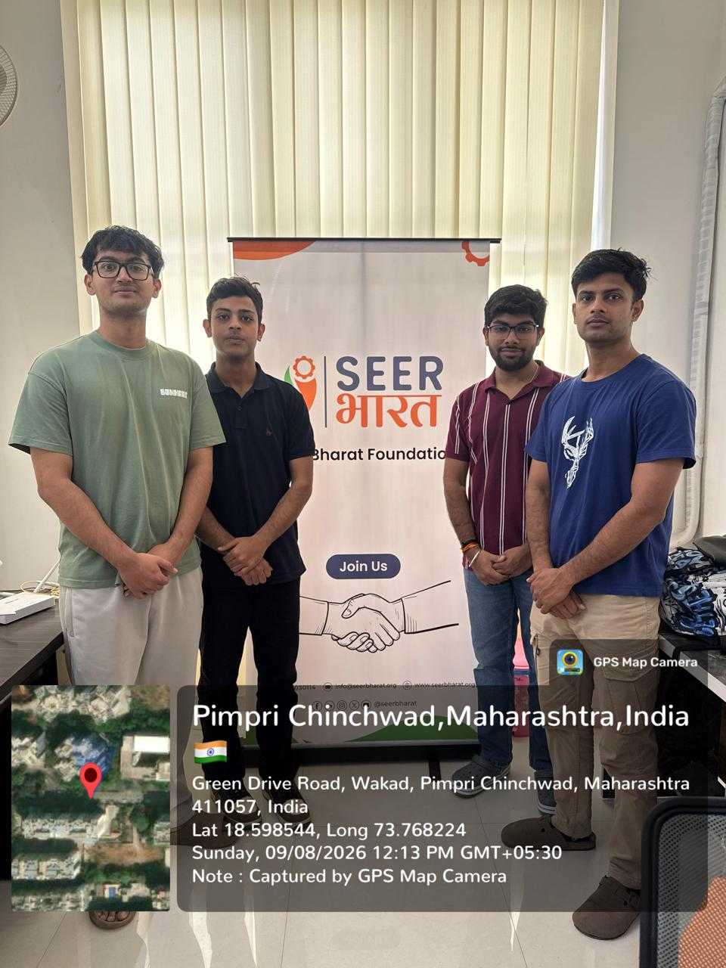
CA-2 PROJECT REVIEW • SERVICE-LEARNING EVALUATION II
UEHIS
AI-Based Urban Ecosystem Health Intelligence System
Geospatial analytics for urban heat-island intensity, ecological vulnerability, and carbon-sink planning — built with SEER Bharat Foundation
Aditya Sengar
Aditya Godar
Abhay Mosaita
Abhay Chaturvedi
24070126018
24070126014
24070126007
24070126006
01

Slide 2
WHY UEHIS EXISTS
Problem Statement & Solution
THE PROBLEM
Urban heat islands are pushing up temperatures in dense, low-canopy city blocks, yet NGOs like SEER Bharat still plant trees reactively, with no data on which blocks need intervention most or which have the most vulnerable population exposure. Existing environmental indices score ecosystem health using fixed, arbitrary weights that ignore local conditions, and there is no quantified way to prove carbon-offset impact to corporate CSR donors.
THE SOLUTION
1
2
3
4
Fuse Real Data
Score Every Block
Adapt to Local Data
Act on Results
Combine satellite imagery (Earth Engine) with 3D urban morphology from OpenStreetMap.
Rate each city block 0–100 on ecological and thermal health, not just the whole ward.
Use a data-driven, entropy-weighted formula instead of fixed, judgment-based weights.
Output actionable risk tiers, and eventually carbon-sink planting recommendations.
02

Slide 3
OUR SERVICE-LEARNING JOURNEY
From Community Roots to a Working Technical System
1
2
3
4
Community Engagement
Teamwork & Responsibility
Technical Exploration
Continued Development
Coordinated with SEER Bharat and stayed close to the NGO's real, on-ground needs.
Divided technical roles across four members, coordinated every week.
Built a full satellite-to-score pipeline end to end for one pilot ward.
Verified real results on real data, targeting completion by October 2026.
Pilot ward: Kothrud, Pune • Pipeline: Satellite ingestion → Classification → OSM merge → UEHI scoring • 256 blocks scored
03

Slide 4
FIVE PHASES, END TO END
Architecture & Project Timeline
1
2
3
4
5
Satellite Data
Ingestion
Segmentation &
Feature Engineering
3D UEHI
Scoring
Carbon Sink
Planning
API & Dashboard
Deployment
DONE
DONE
DONE
NEXT
NEXT
CURRENT STATUS
Phases 1–3 fully implemented and executed on our test region: Kothrud, Pune.
Real satellite composites generated; NDVI and land-cover segmentation run on live data.
Scoring engine executed, producing real block-level UEHI scores and risk tiers.
Carbon-sink planning and dashboard deployment are next, targeting October 2026.
04

Slide 5
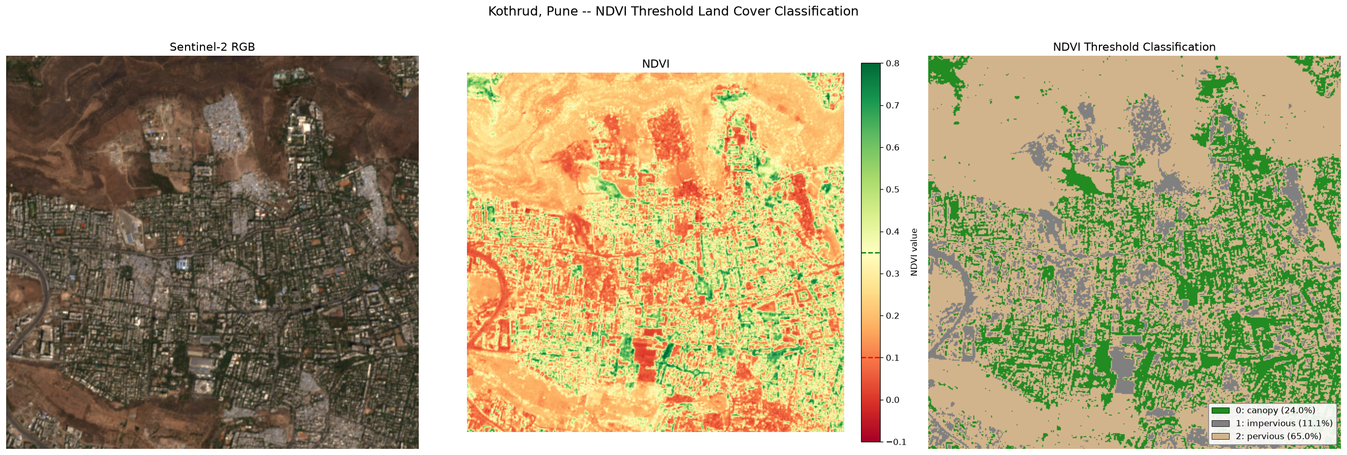
CASE STUDY — KOTHRUD, PUNE
Progress Update: Pipeline Execution
24.0%
Canopy
11.1%
Impervious
65.0%
Pervious
Sentinel-2 composite → NDVI → threshold-classified land cover, visually validated against known landmarks (Vetal Tekdi canopy, Karve Road built-up area).
PIPELINE RUN
Earth Engine ingestion → cloud filtering → NDVI classification → OSM overlay — all executed on real data, not mock inputs.
05

Slide 6
TURNING PIXELS INTO SCORABLE BLOCKS
Spatial Grid Generation & Data Fusion
DATA FUSION STEPS
Tessellated Kothrud into ~250m × 250m spatial city blocks.
Overlaid OpenStreetMap data: 12,758 building footprints and 4,705 road segments.
Vectorized the segmentation raster into 22,825 land-cover polygons.
Spatially fused raster segmentation with vector OSM data — 40,288 merged features total.
Aggregated to block level: canopy fraction, impervious fraction, tree density, and more.
40,288 total merged features from raster + vector spatial join
Kothrud tessellated into ~250m × 250m spatial blocks
06

Slide 7
BEYOND THE STANDARD FIXED-WEIGHT INDEX
The Core Novelty: Why a New UEHI Formula?
STANDARD APPROACH
UEHIS APPROACH
Index = w₁x₁ + w₂x₂ + … + wₙxₙ
Weights learned from real block-level data
Weights assigned once, by expert judgment.
Same fixed formula applied to every city, everywhere.
Factors treated as fully independent of each other.
Hard to defend rigorously when challenged.
Weights computed from real data variance (Shannon entropy).
Adapts automatically to each city's local conditions.
Captures a real interaction: canopy cools temperature.
Population exposure scales urgency, not just adds to it.
07

Slide 8
NOVELTY 1 OF 3
Formula Breakdown: Data-Driven Entropy Weights
p(i,j) = x(i,j) / Σx(i,j) → e(j) = −k·Σ p(i,j)·ln(p(i,j)) → w(j) = (1 − e(j)) / Σ(1 − e(j))
1
2
3
4
8 Base Factors
High Entropy → Low Weight
Low Entropy → High Weight
Genuinely Adaptive
Shannon entropy is computed for all 8 base factors: NDVI, tree density, AQI, temperature, impervious surfaces, water availability, biodiversity, and population exposure.
Factors that stay nearly uniform across blocks carry little discriminating information, so they automatically receive a lower weight.
Factors that vary a lot from block to block are more informative for telling blocks apart, so they automatically receive a higher weight.
Weights are recalculated from real block data, not assumed — they adapt per city instead of being fixed everywhere.
08

Slide 9
NOVELTY 2 AND 3 OF 3
Formula Breakdown: Synergy & Population Modifiers
NOVELTY 2 — CANOPY-TEMPERATURE SYNERGY
NOVELTY 3 — POPULATION IMPACT MULTIPLIER
s(i) = α · N(NDVI_i) · N(Temp_i), α = 0.1
m(i) = 1 + β · N(Pop_i), β = 0.3
Non-linear bonus for blocks with high canopy AND low temperature together.
Models the real, localized cooling effect of urban greening.
A plain additive sum misses this interaction entirely.
Environmental score is multiplied, not just added to, by population exposure.
A heat island is far more dangerous in a dense residential block than an empty plot.
Amplifies urgency exactly where it matters most.
FINAL EQUATION
UEHI(i) = 100 × [ Weighted_Base_Score(i) + Synergy_Bonus(i) ] × Population_Multiplier(i)
09

Slide 10
OUTPUT FROM RUN_SCORING.PY
Results: Kothrud Risk Classification
KEY NUMBERS
256
valid blocks scored, of 272 initially (after filtering incomplete edge blocks)
7.4 – 86.4
UEHI score range, out of 100
0.59
canopy-to-score correlation — confirms the formula responds correctly to real vegetation data
Edge-block filtering fix improved formula reliability: correlation rose from 0.53 to 0.59 after removing incomplete boundary cells with defaulted placeholder values.
10

Slide 11
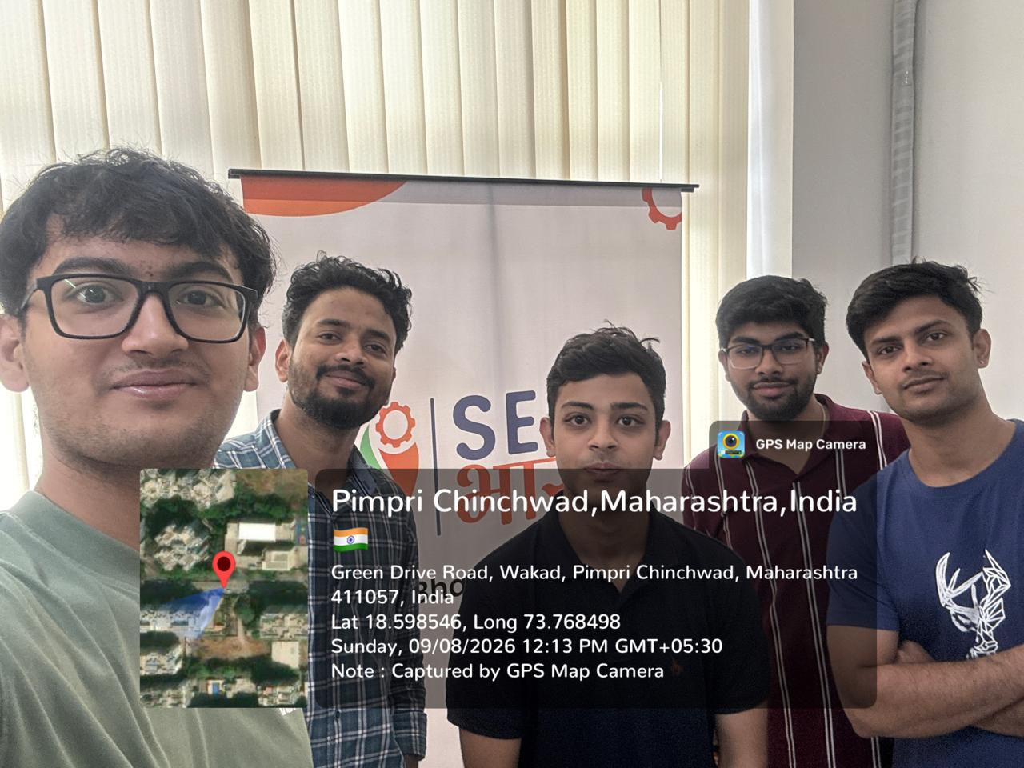
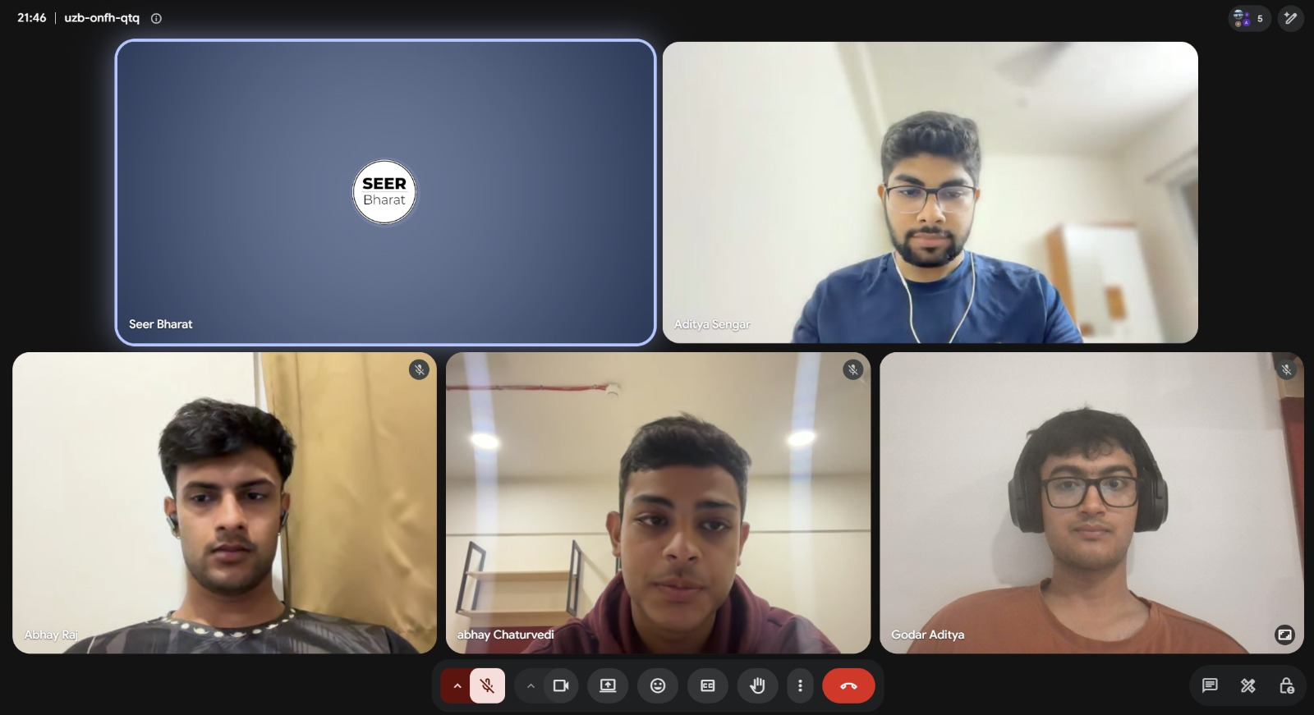
PRESENTING REAL RESULTS TO OUR NGO MENTOR
SEER Bharat Foundation — In-Person Engagement
Visited SEER Bharat's office to present the full working pipeline.
Walked through Kothrud composite, NDVI segmentation, and final scores.
Explained the entropy-weighted UEHI formula and its novelty in person.
All four members met weekly blockers like the U-Net random-weight issue were caught early.
On-site visit — Pimpri Chinchwad
Weekly team sync with SEER Bharat
Collaborated closely with the SEER Bharat mentor, incorporated feedback, and refined the project pipeline for future ward expansion.
11

Slide 12
CONTINUING / SUSTAINED WORK
Team Responsibilities & Next Phase
Aditya Sengar
Aditya Godar
Abhay Chaturvedi
Abhay Raj Mosaita
Data Engineering & Infrastructure
Computer Vision & Modeling
Data Science & Formula Design
Documentation & NGO Coordination
Earth Engine setup, ingestion pipeline, GeoTIFF export.
Land-cover classification, segmentation validation.
Entropy weighting, synergy term, scoring validation.
Proposal, formula documentation, NGO liaison.
NEXT PHASE — TARGETING OCTOBER 2026
Train a proper deep-learning segmentation model (U-Net) on labeled patches.
Wire in live AQI, temperature, water-availability, and population data feeds.
Build the carbon-sink calculator and the web dashboard for SEER Bharat.
12

Slide 13
WHAT THIS PHASE TAUGHT US
Learning Outcomes & Conclusion
TECHNICAL LEARNING
COMMUNITY LEARNING
Geospatial data engineering with Google Earth Engine.
Satellite image processing and NDVI analysis.
OpenStreetMap spatial data integration.
Entropy-based multi-criteria scoring design.
Direct collaboration with a real NGO partner.
Translating a conservation problem into a technical system.
Presenting technical work to a non-technical audience.
Coordinating a four-person team across weekly cycles.
This phase moved UEHIS from architecture-on-paper to a verified, working pilot on real data, a genuine step toward a system that can meaningfully support SEER Bharat Foundation's conservation work in Pune.
13

