Slide 1

FOUNDATIONS OF AGENTIC AI / CA-3
UPI
SENTINEL
Explainable multi-agent investigation of suspicious UPI transaction networks
A deterministic proof of concept for evidence-backed human review
Investigation leads for human review — not proof of fraud or mule activity.
ACADEMIC PROOF OF CONCEPT
01
Notes:
0:00–0:18
UPI Sentinel is a classroom proof of concept for reviewing suspicious UPI-style transaction networks. It helps surface patterns with their evidence. A lead always requires human review.

Slide 2
PROBLEM STATEMENT AND DOMAIN
The investigation problem
A transaction table records events. Investigators need to understand relationships between events.
DEFINED PROBLEM STATEMENT
WHY THE REVIEW IS DIFFICULT
Given transaction records with sender, receiver, amount and time, help an investigator identify connected transfer patterns that may warrant review, then show the source evidence needed to inspect each match.
01
Rows hide paths
A transfer is visible, but links across sender and receiver accounts require connecting rows.
02
Time changes meaning
A shared account matters differently when transfers happen close together.
The system must preserve invalid records for audit and keep a human responsible for interpretation.
03
Bad rows need handling
Missing fields and duplicate IDs must not silently enter the network.
CONCRETE EXAMPLE FROM THE SYNTHETIC FIXTURE
S2-T1 S2-A → S2-B · 500 · t=100
t=100 · 500
t=101 · 480
S2-T2 S2-B → S2-C · 480 · t=101
A
B
C
The shared account and sequence become visible as A → B → C.
Investigation leads for human review — not proof of fraud or mule activity.
02
Notes:
0:18–0:50
A transaction table records separate events. Investigators need to connect senders, receivers and timing across rows, while retaining malformed records for audit. Our demo uses synthetic data only.

Slide 3
FROM TRANSACTION ROWS TO A REVIEWABLE LEAD
Proposed solution
UPI Sentinel prepares a traceable evidence packet for patterns that meet explicit rules.
INPUT
DETERMINISTIC PROCESSING
REVIEWER OUTPUT
Transaction CSV
1
Validate
2
Connect
3
Check rules
Finding + evidence
ID · time · sender · receiver · amount · type
Keep accepted rows and rejected reasons.
Build a directed account network.
Match time and amount patterns.
Accounts · transaction IDs · times · thresholds · explanation
Default rule thresholds
RAPID TRANSFER CHAIN · ≤2 UNITS
SHARED INTERMEDIARY · ≤3 UNITS
A → B, then B → C. Both transfers must be strictly time-ordered and within 2 units.
At least 2 distinct senders must pay the hub before an onward transfer, within 3 units.
Onward rule: outgoing ÷ aggregate recent incoming ≥80% within 3 units. This does not trace specific funds. Numeric times are units; datetime inputs use hours.
Investigation leads for human review — not proof of fraud or mule activity.
03
Notes:
0:50–1:18
The workflow validates records, builds a directed graph from accepted rows, applies explicit rules, then packages the matching evidence. Defaults use a 2-unit rapid-chain window, at least 2 distinct senders to a hub with onward activity within 3 units, and an onward ratio of at least 80 percent of aggregate recent incoming within 3 units. Numeric timestamps are time units. The amount ratio does not trace specific funds.

Slide 4
SYSTEM ARCHITECTURE
Two paths with a strict boundary
Streamlit calls run_analysis(data, config). LangGraph coordinates the deterministic workflow.
DETERMINISTIC LANGGRAPH WORKFLOW
One coordinator plus five ordered Python agents
1 · Coordinator
2 · Data Validation
3 · Network Analysis
4 · Pattern Analysis
5 · Explanation
6 · Evaluation
Receives data + config
Runs the compiled graph
Returns WorkflowResult
Canonical schema
Accepted + rejected rows
Source IDs and reasons
Accepted rows only
Directed MultiDiGraph
Graph summary
Graph + RuleConfig
Deterministic rules
Evidence-backed findings
Counts + graph + findings
Human-readable summary
Adds no classification
Runs after findings
Eligible labels only
Metrics or unavailable
SHARED WORKFLOW STATE
Validation result → accepted-only graph → findings → summary → post-detection evaluation
Rejected rows keep source IDs and reasons outside the graph. Labels enter only at Evaluation.
OPTIONAL LOCAL EXPLANATION · OUTSIDE LANGGRAPH
User-triggered for one existing finding
Select finding
Whitelist evidence
Local Ollama
Check response
Show explanation
Reviewer chooses an
already-detected lead
Finding IDs, accounts,
transactions, times
qwen2.5:3b
localhost:11434
Validate output or use
deterministic fallback
Prose beside the same
selected finding
Only selected-finding whitelisted evidence is sent. No full CSV or unrelated history. Model text cannot change findings or rule outputs.
Investigation leads for human review — not proof of fraud or mule activity.
04
Notes:
1:18–2:00
Streamlit calls run_analysis with the selected data and rule configuration. The Coordinator runs the compiled LangGraph workflow through five agents: validation, network analysis, pattern analysis, explanation and evaluation. Shared state carries the results forward. Labels enter only after detection. The lower path is optional, user-triggered and outside LangGraph.

Slide 5
WHAT EACH STAGE RECEIVES AND RETURNS
Architecture: state and evidence flow
Each node adds a typed result to shared workflow state. Later stages use earlier outputs in order.
01
02
03
04
05
Data validation
Network analysis
Pattern analysis
Explanation
Evaluation
INPUT
INPUT
INPUT
INPUT
INPUT
raw_dataframe
valid_rows
graph + RuleConfig
counts + graph summary
+ findings
accepted labels
+ completed findings
OUTPUT
OUTPUT
OUTPUT
OUTPUT
OUTPUT
valid_rows
rejected_rows
schema_errors
MultiDiGraph
GraphSummary
Finding list
evidence + thresholds
Human-readable
summary
Metrics or
unavailable status
EVIDENCE CARRIED BY GRAPH EDGES
EVIDENCE CARRIED BY EACH FINDING
Account IDs are nodes. Each accepted transfer is a directed edge keyed by transaction ID.
Unique finding ID · rule · accounts · supporting transaction IDs · times
Edge fields: amount · transaction type · time · source row
Configured thresholds · measured values · explanation · human-review status
Labels stay in evaluation. Ollama sees only selected-finding evidence.
Investigation leads for human review — not proof of fraud or mule activity.
05
Notes:
2:00–2:25
The graph represents accounts as nodes and accepted transfers as directed edges keyed by transaction ID. Each finding retains the supporting transaction IDs, account IDs, times, thresholds and measured values. Evaluation labels do not enter graph edges or rule inputs.

Slide 6
A DETERMINISTIC PYTHON TEAM
Agent responsibilities
LangGraph coordinates six deterministic Python components. The local model only explains selected evidence.
01
02
03
Coordinator
Data Validation
Network Analysis
Orders stages, passes results, returns one workflow result and trace.
Calls the canonical validator; preserves accepted and rejected rows.
Builds the accepted-only MultiDiGraph and account activity summary.
04
05
06
Pattern Analysis
Explanation
Evaluation
Runs the configured rapid-chain, shared-intermediary and onward rules.
Summarizes actual counts and findings; adds no evidence or fraud label.
Runs last; compares eligible transaction labels with finding evidence.
Python
LangGraph
pandas
NetworkX
Plotly
Streamlit
Optional local Ollama · qwen2.5:3b
User-triggered explanation only; no detection authority.
Investigation leads for human review — not proof of fraud or mule activity.
06
Notes:
2:25–3:00
The six agents are deterministic Python components. The Coordinator orders the stages. Validation preserves rejection reasons, Network Analysis builds the accepted-only MultiDiGraph, Pattern Analysis applies the rules, Explanation summarizes outputs and Evaluation compares eligible transaction labels after findings exist.

Slide 7
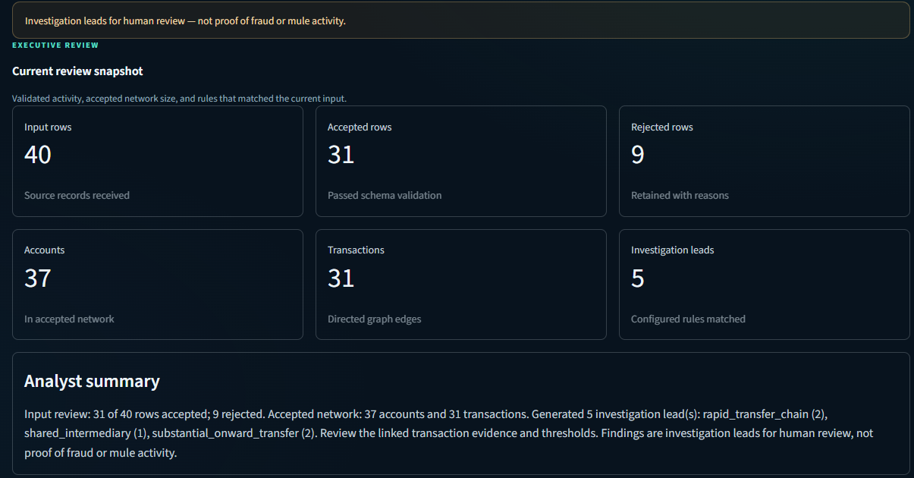
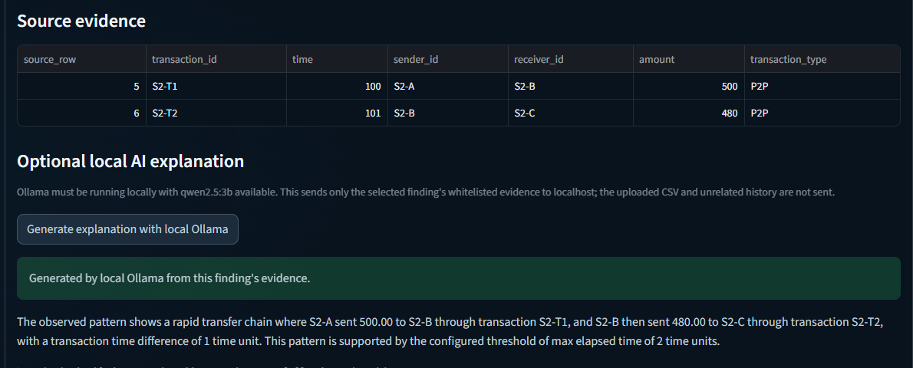
LIVE STREAMLIT CAPTURE · SYNTHETIC FIXTURE
Working dashboard and local explanation
Captured from the running application after fixture analysis.
Overview · verified fixture KPIs
Workflow counts are live. The six cards show validation, accepted graph size and findings.
Investigation evidence + optional local Ollama
qwen2.5:3b · user-triggered · local Ollama
Only selected-finding whitelisted evidence is sent. No full CSV or unrelated history is included. Detection stays deterministic; unsuitable output uses an evidence-based fallback.
Investigation leads for human review — not proof of fraud or mule activity.
07
Notes:
3:00–3:40
These are genuine captures from the running Streamlit application. The Overview displays the verified fixture counts. The second image shows source evidence and a successful optional local Ollama explanation from qwen2.5:3b. Only selected-finding whitelisted evidence is sent to localhost. The full CSV and unrelated transactions are excluded. Response checks and deterministic fallback reduce risk, but do not guarantee the model text is always correct.

Slide 8
40 ROWS · CHECKED WORKFLOW OUTPUT
Synthetic fixture results
40
31
9
37
31
5
Input rows
Accepted
Rejected
Accounts
Graph transactions
Findings
Validation
Findings by rule
Scenario outcomes
31 accepted
Rapid chain
2
S2 leads share the same 2 transactions. S3 is partial: S3-IN-1 is 4 units outside the 3-unit window.
Shared intermediary
1
9 rejected
Substantial onward
2
ID | Synthetic scenario | Observed result | Status
S1 | Ordinary P2P | 4 accepted · no findings | PASS
S2 | Rapid A → B → C | Rapid + overlapping onward leads | PASS
S3 | Senders → shared hub → onward | 2 qualify; S3-IN-1 is 4 units outside 3-unit window | PARTIAL
S4 | Malformed and duplicate rows | 9 rejected with reasons | PASS
S5 | 18 payments to merchant | Accepted · incoming volume alone not flagged | PASS
S6 | Split payment + refund | 3 accepted · no findings | PASS
Synthetic fixture results only. No real-world fraud performance is measured.
Investigation leads for human review — not proof of fraud or mule activity.
08
Notes:
3:40–4:20
The fixture has 40 rows, 31 accepted, 9 rejected, 37 accounts, 31 graph transfers and 5 findings. S1 has no finding. S2 yields a rapid-chain lead and an overlapping onward lead on the same two transfers. S3 is partial because S3-IN-1 is four numeric time units before S3-OUT, outside the three-unit window. S4 retains and rejects all nine malformed or duplicate rows with reasons. S5 has 18 accepted merchant payments and no volume-only finding. S6 has three accepted split/refund transactions and no finding.

Slide 9
RESPONSIBLE USE
Limits and next steps
What this PoC can show
What it cannot establish
01
Synthetic records only
01
Vet data and licensing
No UPI production data or PaySim integration.
Confirm governance, provenance and privacy.
02
Illustrative thresholds
Rules can match legitimate flows or miss relevant activity.
02
Review thresholds
03
Overlapping leads
Work with qualified investigators on rule assumptions.
Multiple findings can share the same evidence.
04
Aggregate onward ratio
Timing and amount do not trace specific funds.
03
Evaluate the right unit
05
Bounded graph display
Use suitable transaction or account labels, without leakage.
60 accounts and 100 transfers; analysis uses the full graph.
06
No real-world validation
04
Improve audit workflow
Toy transaction labels do not identify mule accounts.
Support reviewer notes, case tracking and traceability.
Human review remains required before any action.
Investigation leads for human review — not proof of fraud or mule activity.
09
Notes:
4:20–4:50
The thresholds are illustrative and can match legitimate behavior or miss relevant patterns. Findings may overlap. The aggregate onward ratio does not link specific funds. We have synthetic records, no production validation and no account-level mule ground truth. Future work needs governed data, threshold review and stronger investigation workflows.

Slide 10
CONCLUSION / QUESTIONS
Explainable leads.
Evidence attached.
Human judgment retained.
A
C
B
UPI Sentinel connects validated transactions, applies deterministic rules, and shows the records behind each match.
D
A person decides what the evidence means.
Network concept
Investigation leads for human review — not proof of fraud or mule activity.
10
Notes:
4:50–5:00
UPI Sentinel connects accepted transfers to transparent rules and traceable evidence. It presents leads for human review, not fraud verdicts. I’m ready for the demonstration or questions.

