Slide 1

Note: The data and information in this document is reflective of a hypothetical situation and client. This document is to be used for KPMG Virtual Internship purposes only.
Sprocket Central Pty Ltd
Data analytics approach
Deepak Godara

Slide 2
Note: The data and information in this document is reflective of a hypothetical situation and client. This document is to be used for KPMG Virtual Internship purposes only.
Agenda
Introduction
Data Exploration
Model Development
Interpretation

Slide 3
Note: The data and information in this document is reflective of a hypothetical situation and client. This document is to be used for KPMG Virtual Internship purposes only.
Introduction
Identify & Recommending High Value Customers
Outline of Problem
1.Sprocket Central is accompany that specializes in high quality bike and accessories.
2.The Market team is looking to boots sales
3. To target 1000 new customer that will bring the highest value to the business.
Approach For Data Analysis.
1.Bike related Purchases for the 3 years based on Gender
2.Top Industries contributing the maximum profit and bike related sales.
3.Wealth Segment by Age Category.
4.Number of Cars owned in each state.
5.CustomerClassification.

Slide 4
Note: The data and information in this document is reflective of a hypothetical situation and client. This document is to be used for KPMG Virtual Internship purposes only.
Data Exploration
Data Quality Assessment
Key issue dealt with for the data quality issue
Accuracy Completeness Consistency Currency Relevancy Validity
Customer Demographic | DOB: Inaccurate Age: Missing | Job Title: Blanks Customer id: Incomplete | Gender: Inconsistent | Deceased Customer: Filtered out | Default Column: Delete
Customer Address |  | Customer id: incomplete | State: Inconsistent
Transactions | Profit: Missing | Customer id: Incomplete Online Order: Blanks Brand: Blanks |  |  | Cancelled Status Order: Filtered out. | List Price: Format Product Sold Date: Format

Slide 5
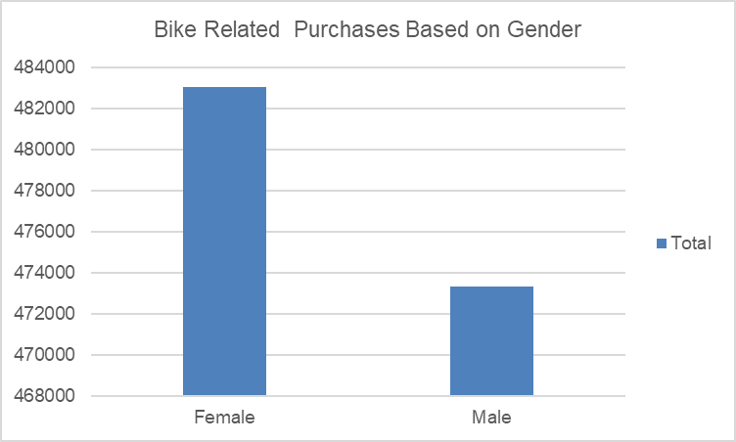
Note: The data and information in this document is reflective of a hypothetical situation and client. This document is to be used for KPMG Virtual Internship purposes only.
Data Exploration
Bike Related Purchase Over The last 3years Based On gender
1.Data shows, on average female shave made more bike related purchases in the last 3 years compared to males.
2.On Average Female have had 1% higher bike related purchases compared to men in the last 3 years.

Slide 6
Note: The data and information in this document is reflective of a hypothetical situation and client. This document is to be used for KPMG Virtual Internship purposes only.
Data Exploration
Top job Industry Contributing to the Maxing Profit & Bike Related Purchases
1.The top 3 Industry Sector Bringing in the Highest Profit are: Financial Services, Health & Manufacturing.
2.These can be obvious as most of these industry sectors are based within the city or on the outskirts of the city therefore consumers prefer bikes for commuting.
3.Most of the Industry Sector have returned less than$1,00,000 in profits

Slide 7
Note: The data and information in this document is reflective of a hypothetical situation and client. This document is to be used for KPMG Virtual Internship purposes only.
Data Exploration
Profit of Wealth Segment by Age Cluster
1.Overall, the mass customer segmentation makes the highest profit across the difference age clusters.
2.Mass Customer aged between 38-47 are like to bring more profit for the company compared to other age clusters.
3.This also indicates a trend of buying power, as the buying power increase over time till 47 and then see’s a decline in buying power, thus leading to lower profits.

Slide 8
Note: The data and information in this document is reflective of a hypothetical situation and client. This document is to be used for KPMG Virtual Internship purposes only.
Model Development
Customer Classification – Targeting High Value Customers.
These are the high value customers that should be target from the new list.
1.Most of high value customers will be female compared to male
2. Working in the financial services , health and manufacturing industry sector.
3. Aged between 38-47
4. Who are currently living NSW,VIC.

Slide 9
Note: The data and information in this document is reflective of a hypothetical situation and client. This document is to be used for KPMG Virtual Internship purposes only.
Thank You

