Slide 1

SMART INDIA HACKATHON 2026
IDEA SUBMISSION
Problem Statement ID – SIH26167
Problem Statement Title – SatQuery AI – An Interactive Vision-Language Assistant for Multimodal Remote Sensing Image Analysis through Text Queries
Theme – Space Technology
PS Category – Software
Team ID – <your team ID>
Team Name (Registered on portal) – SpectraX

Slide 2
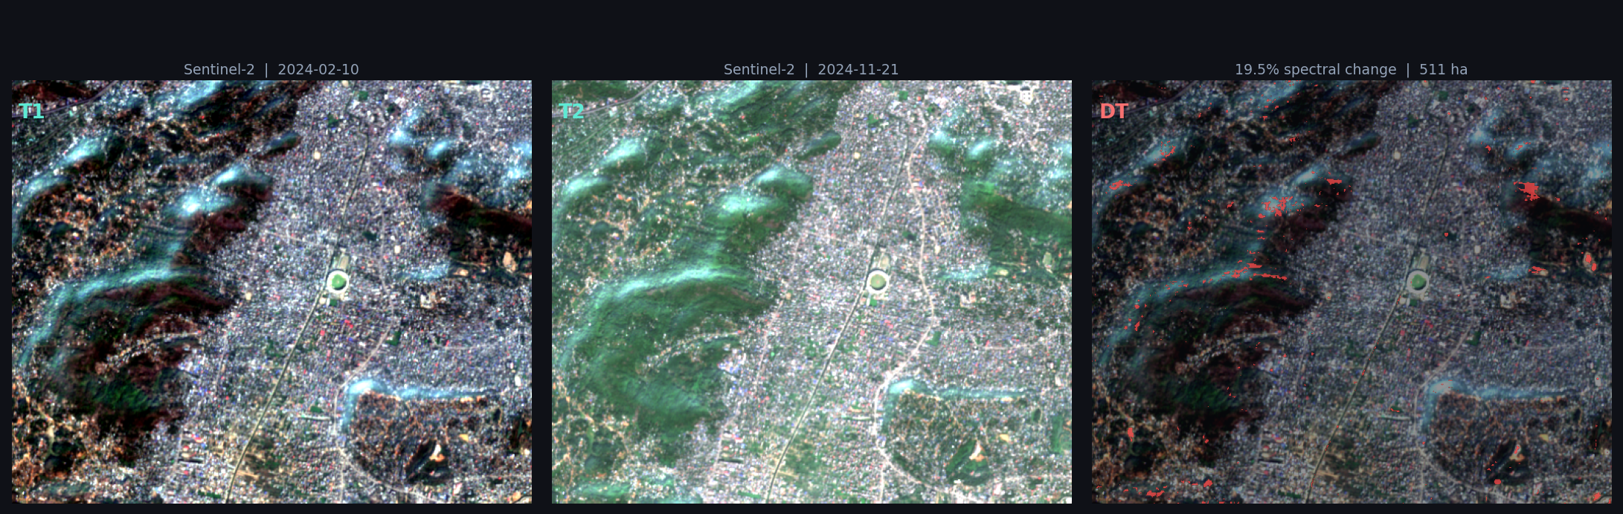
SatQuery AI — an agentic vision-language assistant for multimodal remote-sensing queries
SpectraX
Proposed Solution
Innovation and uniqueness of the solution
Type a plain-language question over satellite imagery — an agentic controller (not a generic LLM) validates it, selects specialist models, and returns an evidence-grounded answer.
• Remote-sensing adaptation: RemoteCLIP/SigLIP backbone QLoRA-tuned on BigEarthNet.txt (S1 SAR + S2 MSI + text); task adapters swapped at inference.
• Six intents, one registry: VQA · describe · ground · change · change-QA · optical–SAR fusion.
• Evidence, not prose: geo-anchored boxes and masks, change overlay, calibrated confidence, class areas, downloadable PDF report.
• Working prototype today: browser GUI with 3D globe, satellite basemap, 6 feature benches, live trace panel, rule-based router v1, offline fallback.
• Cross-model conflict detection — disagreement between specialists (e.g. grounding vs VQA) drops confidence and surfaces the conflict, something no single VLM can do.
• Resolution-gap engineering — trained at 10 m Sentinel, scored at ~0.65 m Cartosat-2S/RISAT, with GSD as a conditioning input across 0.3–10 m.
• Abstention as a capability — an unmet precondition triggers a reasoned decline naming the failed check, not a wrong answer.
Fully reproducible — every trace step is hash-logged and re-runnable by any reviewer.
How it addresses the problem
Barrier in the problem statement | SatQuery AI's answer
Single-task, siloed RS tools | One query bar; controller sequences the right specialists
Users must know GIS, sensors, parameters | Compatibility gate + parameter binding are automatic and logged
One optical image is often not enough | Bi-temporal and co-registered optical–SAR pairs are first-class inputs
Generic VLMs are unreliable on RS imagery | Domain-adapted backbone; a generic model is explicitly not used
Live output — Assam: real Sentinel-2 pair, 19.5% spectral change, 511 ha, 74% calibrated confidence.
Agentic query flow — each step emits its own trace line
QUERY
text + image(s)
INTERPRET
intent + slots
CHECK
5-field gate
SELECT
registry filter
EXECUTE
permitted params
COMBINE
confidence + conflict
EVIDENCE
overlay + trace + PDF
A failed gate short-circuits to a reasoned abstention — still a complete, scoreable trace.

Slide 3
TECHNICAL APPROACH
SpectraX
Technologies to be used
Methodology and process for implementation
Vision-language
RemoteCLIP / SigLIP · QLoRA (PEFT) · LLaVA-style projector + small LM head
Single image
optical / MSI / SAR · GeoTIFF
Cross-modal pair
co-registered optical + SAR
Bi-temporal pair
same footprint, two dates
Specialist models
ChangeFormer / BiT (change) · CLIPSeg + SAM (areal grounding) · open-vocab detector · dual-encoder Fusion-UNet
STAGE 0 · Ingest, sensor abstraction, normalisation
sensor-profile registry → band map · speckle filter · cloud mask · tiling ▸ emits Tile{bands, gsd, crs}}
Geospatial
rasterio / GDAL · pyproj · refined-Lee speckle filter · phase-correlation co-registration · Sentinel-2 SCL cloud mask
STAGE 1 · Agentic controller
6-way intent classifier (MiniLM, CPU) + slot extraction · five-field compatibility gate: number · modality · format · metadata · compatibility · declarative registry filter on task / modality / GSD range · parameter binding restricted to permitted_params
▸ emits ExecPlan — gate failure → reasoned abstention
Backend
Python 3.12 · FastAPI · PyTorch · ONNX / int8 quantisation · LRU model registry · tile cache
STAGE 2 · SPECIALIST REGISTRY — shared adapted backbone, swappable ~50 MB task adapters, one uniform run() signature
VQA
RSVQA-tuned mandatory
Describe
caption head BigEarthNet.txt
Ground
CLIPSeg + SAM geo-anchored
Change
ChangeFormer mask + text
Change-QA
derived from mask areas
Fusion
optical+SAR UNet decoder
Frontend
HTML/CSS/JS · three.js 3D globe · Leaflet + Esri World Imagery · canvas overlays · vendored assets for offline mode
STAGE 3 · Integration, confidence, abstention
per-task temperature scaling (0.8 means the same across heads) · cross-model consistency check · threshold → answer or decline · merge text + spatial evidence ▸ emits Answer
Data & eval
BigEarthNet.txt · VRSBench · RSVQA LR/HR · CDVQA · LEVIR-CD / OSCD / SECOND · DOTA / DIOR / LoveDA (high-res holdout)
STAGE 4–5 · Trace, evidence, serving
TraceStep{seq, intent, tool+version, weights_hash, params, input_hash, output, confidence, latency, gate_verdict} → one record renders the live view, the JSON and the PDF · FastAPI /upload /query /report · GUI · offline mode
STAGE 6 · Evaluation harness runs alongside from day one — RSVQA accuracy · VRSBench CIDEr / IoU@0.5 · CDVQA by question type · change F1 · fusion per-class IoU · ECE · abstention precision

Slide 4
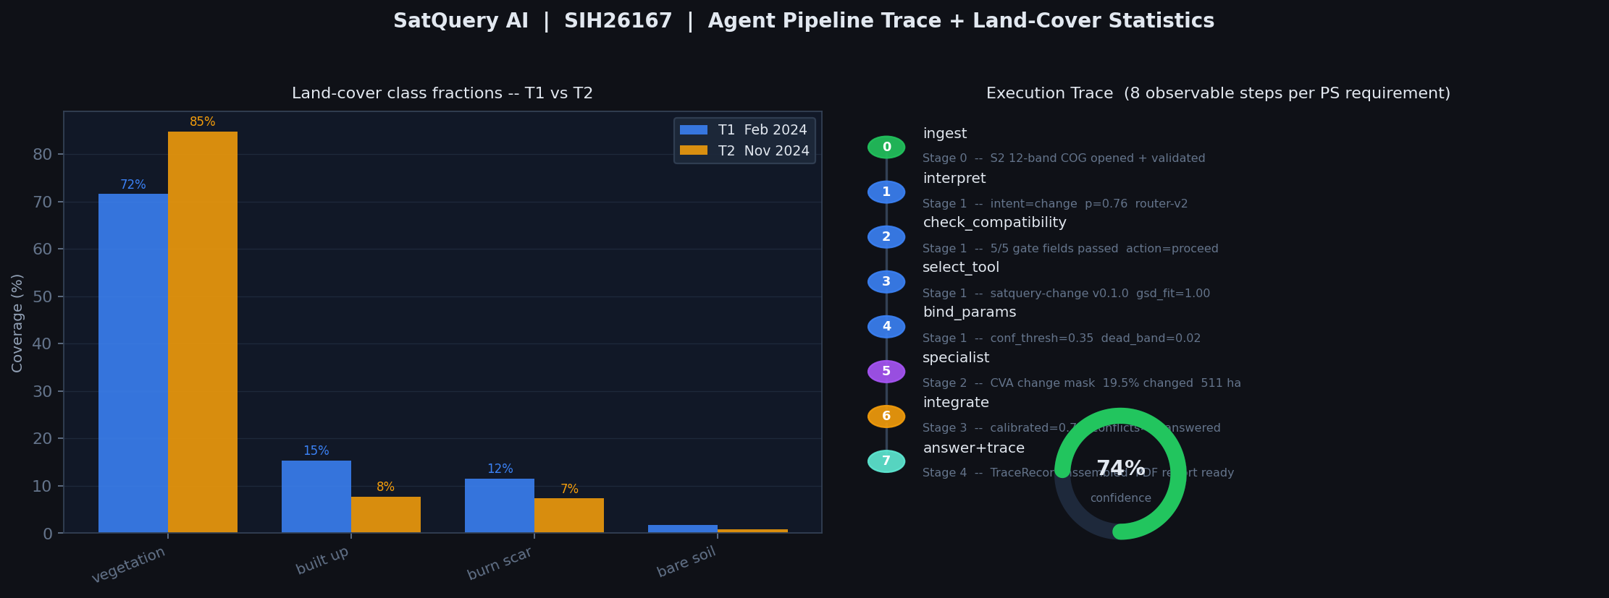
FEASIBILITY AND VIABILITY
SpectraX
Analysis of the feasibility of the idea
Potential challenges and risks · strategies for overcoming them
• Prototype runs end to end today. FastAPI backend + browser GUI; all six intents execute on real Sentinel-2 and Sentinel-1 pixels across 9 sites; the router scores 5/5 on the representative queries; the PDF report renders from the trace record.
• Nothing needs inventing. Every component has published open weights or a reference implementation — the work is adaptation and orchestration.
• Fits one GPU. QLoRA 4-bit on a single card; ~50 MB adapters over one shared backbone instead of four full checkpoints.
• All data is open. BigEarthNet, VRSBench, RSVQA, CDVQA, LEVIR-CD, SECOND, DOTA, DIOR — no procurement and no licence blocker.
Risk | Impact | Mitigation strategy
Resolution + sensor gap. Adaptation mandated at 10 m Sentinel; scoring on ~0.65 m Cartosat-2S + RISAT | Severe; invisible until final scoring | Multi-scale augmentation 0.3–10 m · GSD conditioning · high-res open data (DOTA, DIOR, Potsdam) · non-Sentinel holdout built before the models
Cartosat band structure. PAN is 1 band, MX is 4 — neither RGB nor Sentinel-2's 12 | Hard failure on evaluation day | Semantic band map in a sensor-profile registry; absent slots stay None, never zero-filled; no branching on dataset downstream
Bi-temporal misalignment manufacturing phantom change at sub-metre scale | Silently wrong change answers | Phase-correlation alignment with the residual shift logged in pixels and gated at 2 px
Compute budget for several specialists on demo hardware | Demo instability | Shared backbone + swappable adapters · LRU model registry · int8 / ONNX quantisation
BigEarthNet.txt link in the PS is unverified | Blocks the mandatory adaptation clause | Verify first; fallback to BigEarthNet-MM with generated captions — the PS permits any open-source training data
Router confusion between change and change-QA | Wrong output kind, scored wrong | Training data weighted at that boundary; confusion matrix published; output_kind asserted before execution
Build order — Stage 0 first, because every specialist needs the canonical tile contract
P0
sensor profiles · tile contract
P1
controller · gate · registry · trace
P2
QLoRA adaptation + GSD conditioning
P3
task heads → benchmarks
P4
calibration · conflict · abstain
P5
FastAPI · GUI · report · offline
P6
ablations · final scorecard

Slide 5
IMPACT AND BENEFITS
SpectraX
Agriculture & water
crop-area change and water-body extent answered in a sentence, without a GIS analyst
Disaster response
SAR sees through cloud and at night — flood and damage extent when optical is useless
Urban & infrastructure
“has built-up area increased?” with the change mask and the areas behind the claim
Forest & environment
encroachment and land-cover shift tracked from open multitemporal imagery
Potential impact on the target audience
Benefits of the solution (social, economic, environmental, etc.)
• Non-expert decision makers — district officers, panchayat and municipal staff, NGO field teams. Satellite evidence becomes a question in plain language instead of a GIS workflow, a model choice and a parameter set.
• ISRO / SAC and state remote-sensing centres — the auditable trace (task, model, version, weights hash, parameters, confidence) makes an AI answer defensible in an operational report, which is what blocks adoption today.
• Analysts — triage at query speed. Routine questions are answered and evidenced automatically; expert time goes to the cases the system declines, which it names explicitly.
• Researchers and students — one registry, one contract, six tasks: a new specialist can be added behind the same run() signature without touching the controller.
• Reach: browser-based, offline-capable, CPU-viable for the router and quantised heads — usable on district hardware and on an air-gapped laptop, not only on a GPU workstation.
Social
Democratises satellite intelligence — no GIS training needed. Faster disaster and flood assessment where cloud cover blocks optical imagery.
Economic
One shared adapted backbone replaces several siloed deployments. Analyst hours shift from routine extraction to judgement; no licence cost — open data, open weights.
Environmental
Continuous, low-cost monitoring of deforestation, water bodies, encroachment and land-cover change from freely available multitemporal imagery.
Strategic / trust
Confidence is calibrated, conflicts between specialists are surfaced, and the system declines rather than guessing — abstention precision is a reported metric, not a disclaimer.

Slide 6
RESEARCH AND REFERENCES
SpectraX
Details / Links of the reference and research work
Datasets · mandated & training
Benchmarks · prescribed evaluation
Models · methods · tooling
• BigEarthNet.txt — S1 SAR + S2 MSI + text, primary adaptation corpus (PS link: arxiv.org/abs/2603.29630)
• BigEarthNet-MM — bigearth.net (fallback if the .txt release is unavailable)
• LEVIR-CD · OSCD · SECOND — change-detection training; SECOND underlies CDVQA
• DOTA · DIOR / DIOR-RSVG · LoveDA · ISPRS Potsdam & Vaihingen — high-resolution open data for the resolution-gap holdout
• VRSBench — captioning, referring grounding and VQA on the same imagery (vrsbench.github.io)
• RSVQA LR / HR — rsvqa.sylvainlobry.com, prescribed test splits
• CDVQA — change-based VQA, scored by question type
• ISRO / SAC evaluation set — pre-georeferenced, co-registered Cartosat-2S optical + RISAT SAR pairs; annotations undisclosed
• Metrics: accuracy by question type · CIDEr / BLEU-4 / ROUGE-L · acc@IoU 0.5 · change F1 / IoU · per-class IoU · ECE · abstention precision
• RemoteCLIP — RS vision-language pretraining (arXiv:2306.11029) · SigLIP (arXiv:2303.15343)
• QLoRA — 4-bit adapter tuning (arXiv:2305.14314) · PEFT
• LLaVA — visual instruction tuning (arXiv:2304.08485) · GeoChat (arXiv:2311.15826)
• ChangeFormer (arXiv:2201.01293) · BiT (arXiv:2103.00208) · CLIPSeg (arXiv:2112.10003) · SAM (arXiv:2304.02643)
• Calibration: temperature scaling (arXiv:1706.04599) · refined-Lee speckle filter · rasterio / GDAL · FastAPI · PyTorch · ONNX Runtime
Prototype and design artefacts in this repository: index.html (working browser GUI — 3D globe, satellite basemap, 6 feature benches, live trace) · demo/server.py (stub API matching the planned /upload and /query contract) · docs/SatQuery_AI_Pipeline_SIH26167.pdf (full seven-stage engineering specification)
Problem statement text retrieved from sih.gov.in/sih2026PS on 8 September 2026. Idea submission deadline: 30 September 2026. The BigEarthNet.txt link printed in the problem statement is unverified and has a documented fallback.

