Slide 1

Team Name: Pollution Spotter
Team Leader Name: Sharanya Mondal
PROBLEM STATEMENT
Make visible pond and canal pollution easier to document and report.
Notes:
Pollution Spotter is our proposed hackathon project, led by Sharanya Mondal. The team name and leader were confirmed by the user. This is an idea-selection presentation, not evidence of an implemented product.
We want to make visible pollution observations around ponds and canals easier to document, review and turn into a structured report. The project does not determine water safety. Event: AKI HACKS, Kolkata, 31 October 2026. Official hacking time is 10:00 AM to 6:00 PM IST.

Slide 2
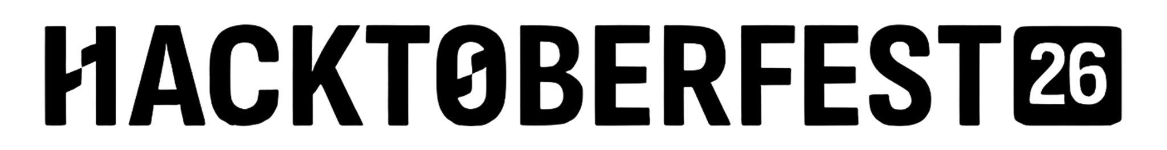

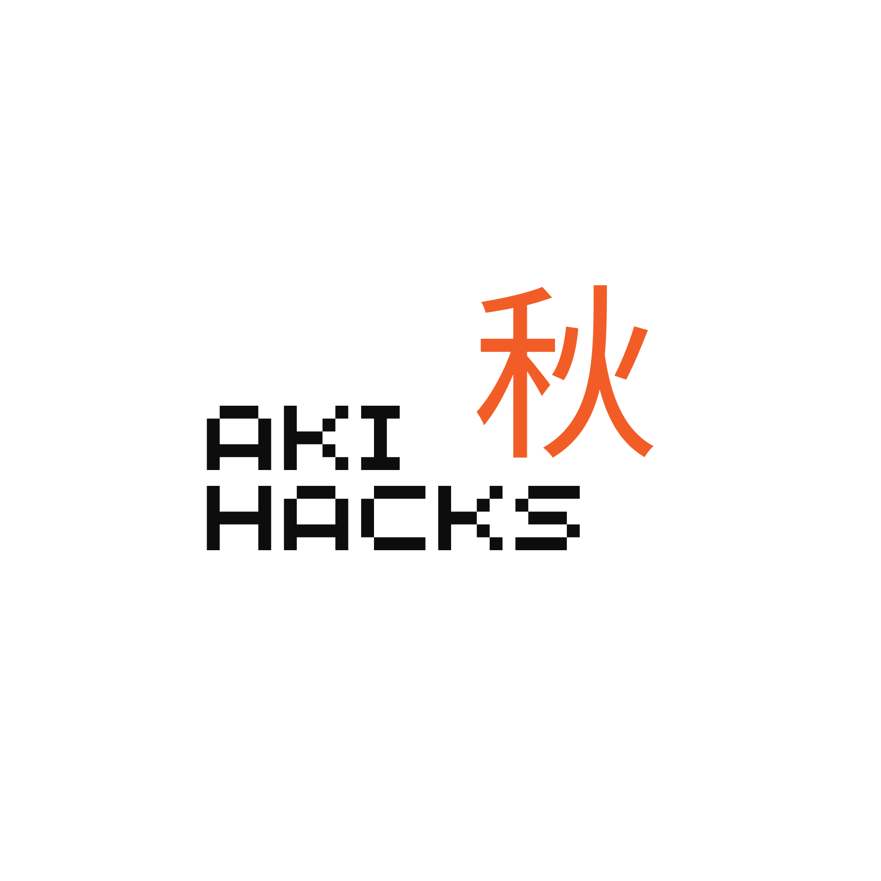
PROPOSED SOLUTION
The reporting gap
One guided reporting flow
Residents can see floating waste or discoloured water, but a photo alone lacks a clear reporting path.
01
Capture
Add a photo and confirm its location.
02
Review
Location, reviewed observations and a usable complaint need to stay together.
Correct the suggested labels and description.
03
Act
Publish a map report; copy a complaint draft.
For residents, student volunteers and local community groups.
POLLUTION SPOTTER | AKI HACKS 2026 | PROPOSED MVP 2/6
Notes:
Problem hypothesis: community observations often lack a consistent combination of photo, location, reviewed description and a usable reporting next step. This is a proposed problem/solution, not a measured market claim.
The MVP uses a private image upload, conservative model suggestions when available, mandatory human review, a public map of safe reviewed fields, and local complaint text that the user copies and sends. No automatic authority contact, toxicity detection or claim of official integration.

Slide 3
USER FLOW / WORKING
1
Add a photo
2
Confirm location
3
Get suggestions
JPEG, PNG or WebP
Up to 3 MB
Use a map pin or
optional GPS
Gemini, or a clearly
labeled manual path
6
Copy complaint
5
View the map
4
Review & publish
An editable draft;
the user sends it
Reviewed details only;
photos stay private
Edit labels and text;
explicitly confirm
Human confirmation is required before publication. Manual fallback remains visibly labeled.
POLLUTION SPOTTER | AKI HACKS 2026 | PROPOSED MVP 3/6
Notes:
The reporter selects a JPEG, PNG or WebP image up to 3 MB. They confirm location through a map pin or coordinates; GPS is optional. The server normalizes the image and strips EXIF.
A private owned draft is created. Gemini attempts visible-label suggestions; a 12-second deadline or invalid output activates an explicitly labeled manual fallback. The reporter can correct labels, description and location, then explicitly publish. Publication updates the same draft row to avoid duplication.
Only safe published details reach the map. Photos, owner identifiers and storage paths remain private. The map loads and refreshes after publication, with a manual refresh control. The complaint is generated locally from confirmed fields and copied. Samples stay in a distinct sample view.

Slide 4
TECHNICAL APPROACH
Proposed deployment: one TypeScript app on Vercel
Gemini vision
Server-side @google/genai
12-second deadline; fallback
Browser
Server routes
Next.js · TypeScript · Tailwind
React Leaflet + OpenStreetMap
Validate · review · publish
Authenticated owner writes
Supabase
Postgres + private Storage
Anonymous auth; owned drafts
Public map: reviewed fields only.
Photos, owner IDs and API keys remain private.
POLLUTION SPOTTER | AKI HACKS 2026 | PROPOSED MVP 4/6
Notes:
Proposed stack: Next.js App Router with TypeScript and Tailwind, React Leaflet with attributed OpenStreetMap tiles, Supabase Postgres/private Storage/anonymous auth, server-side Gemini via @google/genai, and Vercel.
Next.js server routes validate the session and draft owner on writes. Client code does not receive service-role or Gemini keys. Database/private-photo access is restricted. Only reviewed public fields are returned by the public reports route. The exact available Gemini model ID is chosen after the event-hour smoke test. Gemini Flash is not Gemma 4; this deck does not claim eligibility for the Gemma or open-source AI challenge.
Privacy checks and the live/manual distinction are minimum acceptance criteria, not optional polish. The diagrams describe the proposed architecture; they do not claim it has been deployed.

Slide 5
INNOVATION & DIFFERENTIATION
Human-reviewed by design
Privacy at the public map
AI proposes visible labels. The reporter corrects them before anything is published.
Photos and owner IDs stay private. Only approved report details appear on the map.
Works when AI does not
Observation to action
A clearly labeled manual path keeps reporting usable if model access fails.
Location, reviewed observations and complaint copy remain connected.
Visible observations do not establish chemical contamination or water safety.
POLLUTION SPOTTER | AKI HACKS 2026 | PROPOSED MVP 5/6
Notes:
These are design choices that distinguish the proposed workflow, not claims that no competing tool has them. Mandatory human review limits uncritical use of model labels. Private images and owner data reduce unnecessary public exposure. Manual fallback avoids pretending a provider failure succeeded. A coherent report-to-complaint flow gives the observation a next action.
Image labels describe visible appearance only. Discoloured water does not prove chemical contamination, and neutral labels do not prove safety. Hotspot analysis, public photos, moderation and production-scale reliability are outside the eight-hour core.

Slide 6
FEASIBILITY, IMPACT & FUTURE
Eight hours. One complete reporting journey.
H1
H3
H5
H7
H8
Contracts
Manual slice
Core flow
Freeze
Demo
Build
Impact to validate
After the event
Four parallel roles:
frontend, backend,
vision, map & QA.
Can a resident create a
clear reviewed report and
copy a useful complaint?
Density hotspots,
moderation and broader
field evaluation.
Current status: proposal and planning pack. Implementation follows the event rules.
POLLUTION SPOTTER | AKI HACKS 2026 | PROPOSED MVP 6/6
Notes:
The official hacking window is eight hours, 10:00 AM to 6:00 PM IST. H1 is 11 AM, H3 is 1 PM, H5 is 3 PM, H7 is 5 PM and H8 is 6 PM. H1 establishes contracts and setup. H3 demonstrates an integrated manual or clearly mocked slice. H5 targets the live core; if model access fails, record a labeled manual fallback and leave the live-AI gate unmet. H7 freezes features. H8 is a rehearsed, honestly labeled demonstration.
Four workstreams cover frontend, backend/deployment, vision, and map/integration QA. Six focused smoke cases replace a broad evaluation campaign; no accuracy percentage is claimed. The impact question is whether a person can create a clear reviewed report and copy a useful complaint. Hotspots, moderation and broader evaluation are future work.
The repository contains plans and presentation assets, not an implemented application. Pre-event coding permission and presentation submission deadlines are not specified on the public event page. Follow organizer instructions. Event source: https://events.mlh.com/events/15462-hacktoberfest-hack-day-kolkata-x-aki-hacks

