Slide 1
Shoreline change and erosion-rate classes along eight coastal barangays of Aparri, Cagayan, 1990–2025
GIS component of the thesis “Development of Construction Management Framework for Shoreline Protection Structures …”
Cagayan State University – Carig Campus · [DRAFT – FOR STUDENT REVIEW]
Notes:
Introduce the GIS part only. Say at the start that the GIS analysis was rebuilt in a documented, scripted workflow and that the figures differ from the proposal-stage figures (see the adviser memo).

Slide 2
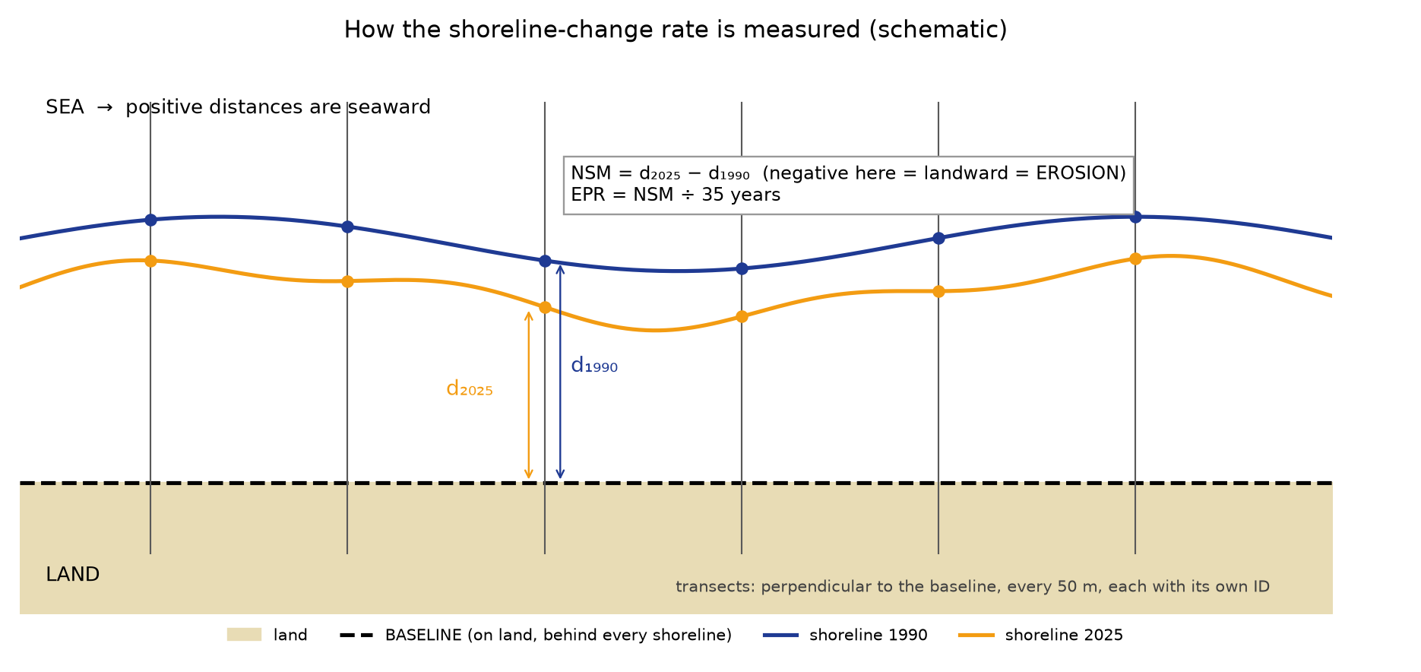
What we measured and why
Question (Objective 1): which parts of the coast erode slowly, moderately or fast?
Measure: End Point Rate (EPR) = shoreline movement 1990 → 2025 ÷ 35 years; negative = landward = erosion.
Classes (Table 3.1): Low < 2 · Medium 2–5 · High > 5 m/yr.
Study area: open sea-facing coast of 8 barangays, 20.2 km, from Bulala Sur to Paddaya.
The classes describe the erosion RATE only — not exposure or vulnerability.
Notes:
Define EPR in one sentence with the diagram: two distances measured along the same transect, subtract, divide by 35 years.

Slide 3
How the numbers were produced
Reproducible workflow – every step logged; all parameters in one config file
1 Shoreline lines for 1990, 2000, 2010, 2020, 2025 → cleaned (duplicate stretch, loops, fragments) with a logged script
2 Open coast separated from the Cagayan River banks by a fixed geometric rule
3 Baseline on land behind all years; 415 transects every 50 m (373 valid)
4 NSM, EPR (1990–2025) and LRR (all years); classes from Table 3.1
5 Barangay summary (Table 4.2): kilometres of shoreline per class (+ hectares of a 100 m strip)
[STUDENTS: add one line on the imagery source, sensors and dates]
Notes:
If asked about the source of the shorelines, answer from docs/04_defense_qa.md Q7 — fill in the origin truthfully.

Slide 4
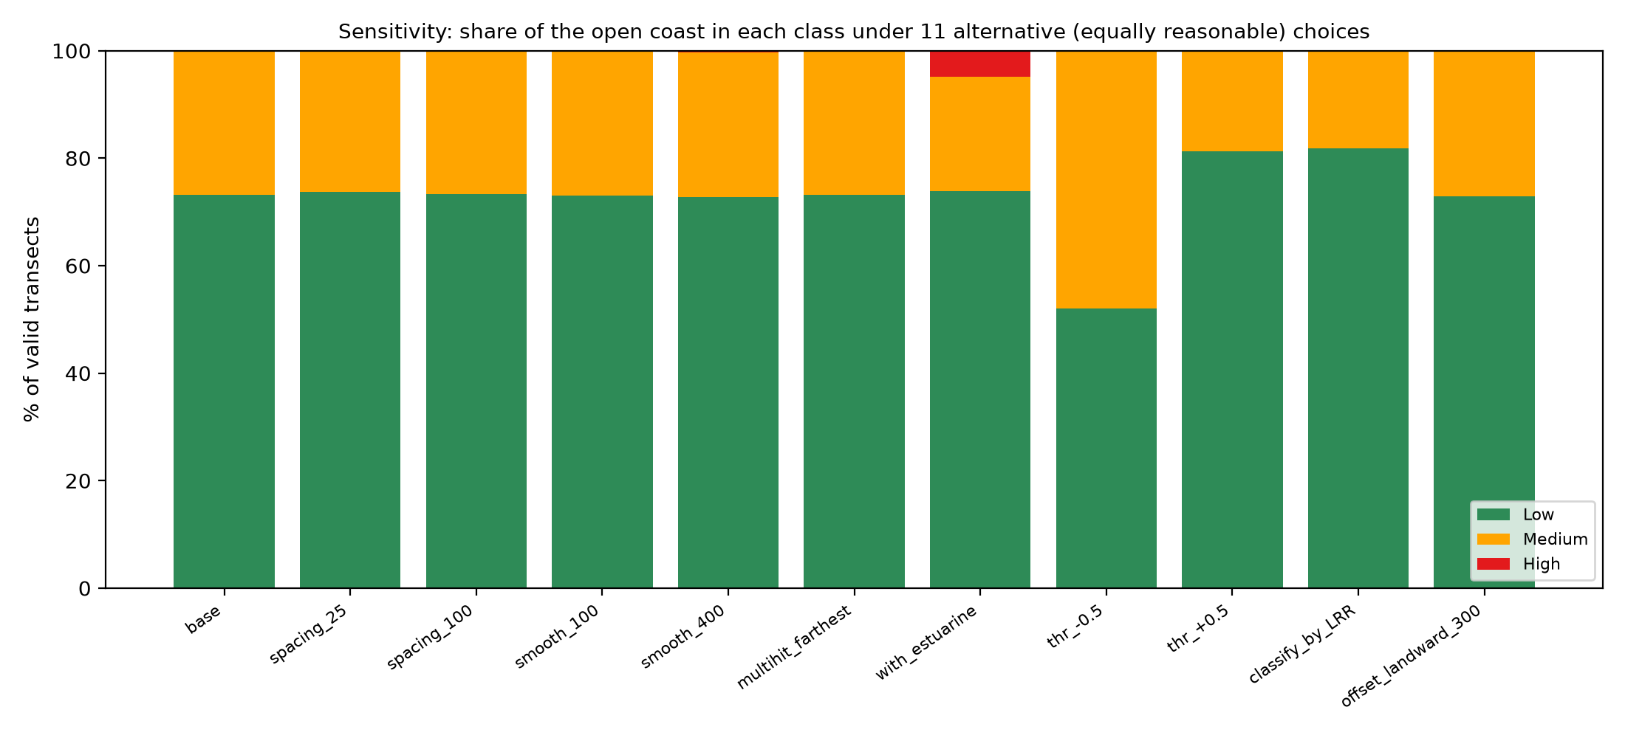
How we know the method is right
Checks with known answers, a second data set, and sensitivity
Synthetic coasts with known change: 2.000 m/yr retreat → EPR −2.000; 1.500 m/yr advance → +1.500; curved coast within 0.01 m/yr
Independent shoreline set (from the Earth Engine masks): EPR r = 0.89; same class for 92 % of 253 transects
Spacing, smoothing, baseline offset change any class share by ≤ 0.5 percentage points
Shifting the class limits by ±0.5 m/yr moves the Medium share from 27 % to 19–48 %
Notes:
The honest message: the technical choices do not matter; the class limits are conventions and the coast sits near the 2 m/yr limit.

Slide 5
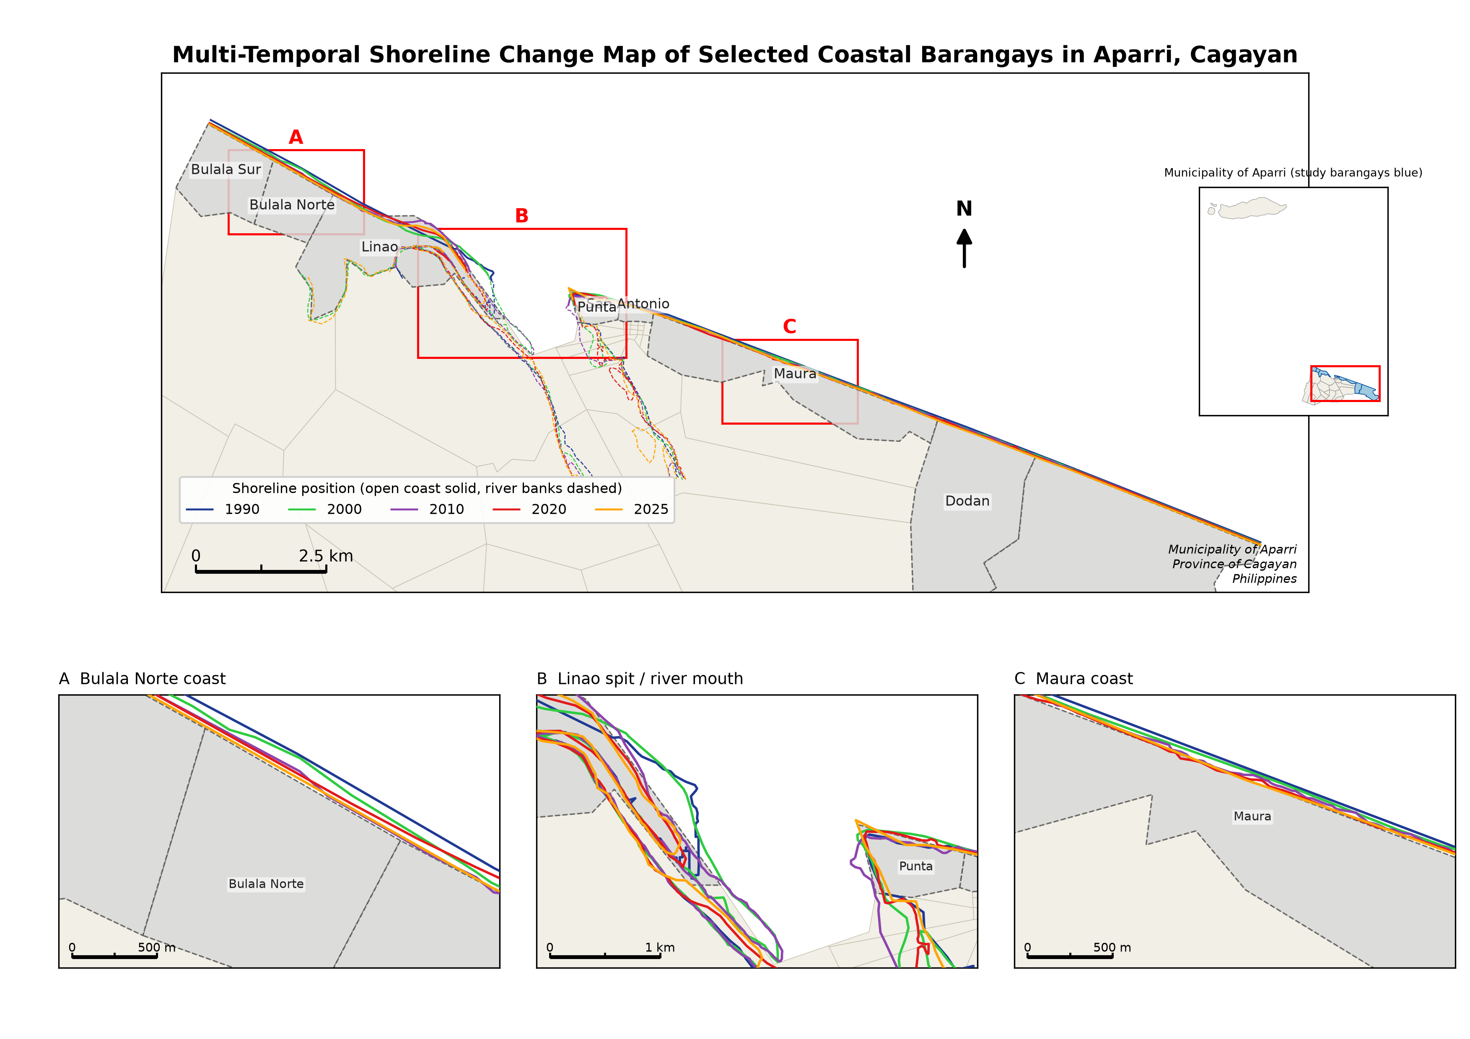
Figure 4.1 — shorelines 1990–2025
Notes:
Point to inset A: at Bulala Norte the 1990 line (purple) lies well seaward of the later lines. Inset B: the river mouth, where lines cross — not classified.

Slide 6
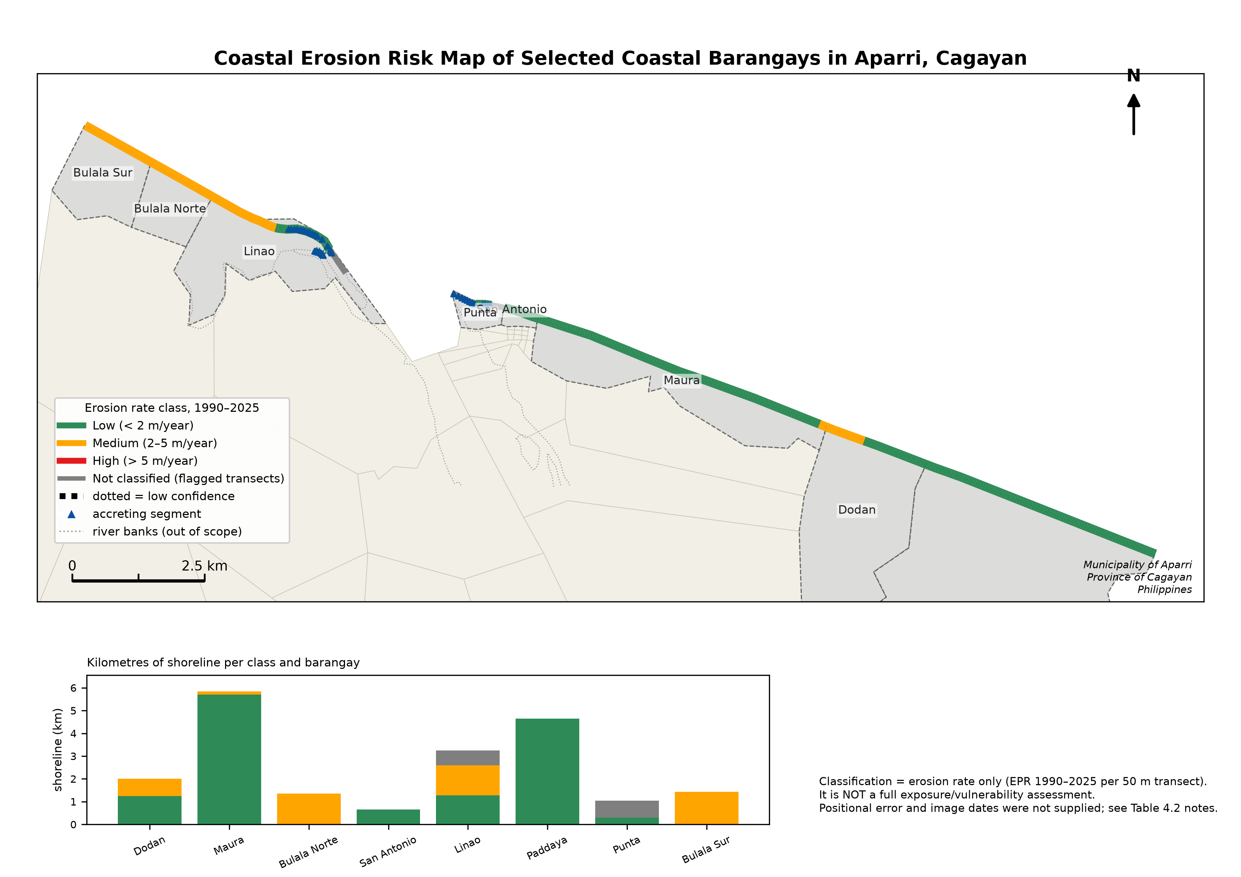
Figure 4.2 — erosion-rate classes
Notes:
No High class on the open coast. Medium at Bulala Sur/Norte and parts of Linao, Dodan, Maura. Dotted = low confidence, grey = not classified.

Slide 7
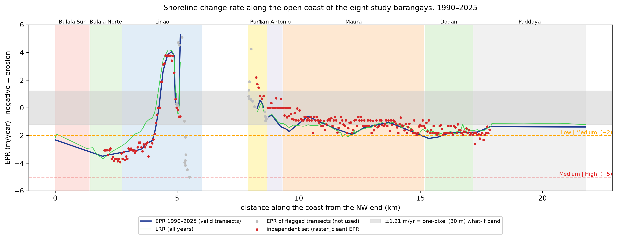
Rate along the coast, with the error band
Notes:
Grey band = ±1.21 m/yr (one 30 m pixel at both dates, a what-if because no measured error exists). Red dots are the independent set.

Slide 8
Table 4.2 — barangay-level results
Barangay | Mean EPR (m/year) | Minimum EPR (m/year) | Maximum EPR (m/year) | Low Risk (ha) | Medium Risk (ha) | High Risk (ha)
Dodan | -1.93 | -2.21 | -1.76 | 12.50 | 7.49 | 0.00
Maura | -1.39 | -2.07 | -0.62 | 56.97 | 1.50 | 0.00
Bulala Norte | -3.35 | -3.49 | -3.19 | 0.00 | 13.46 | 0.00
San Antonio | -0.91 | -1.41 | -0.53 | 6.51 | 0.00 | 0.00
Linao | -0.70 | -3.21 | 5.30 | 12.80 | 13.09 | 0.00
Paddaya | -1.41 | -1.76 | -1.36 | 46.50 | 0.00 | 0.00
Punta | 0.19 | -0.05 | 0.53 | 3.02 | 0.00 | 0.00
Bulala Sur | -2.74 | -3.16 | -2.32 | 0.00 | 14.35 | 0.00
Hectares = kilometres of classified shoreline × a 100 m strip (assumption). Kilometres per class are in the extended table.
Medium: Bulala Sur and Bulala Norte (most robust). Low vs Medium elsewhere is within the ±1.21 m/yr error band for much of the coast.

Slide 9
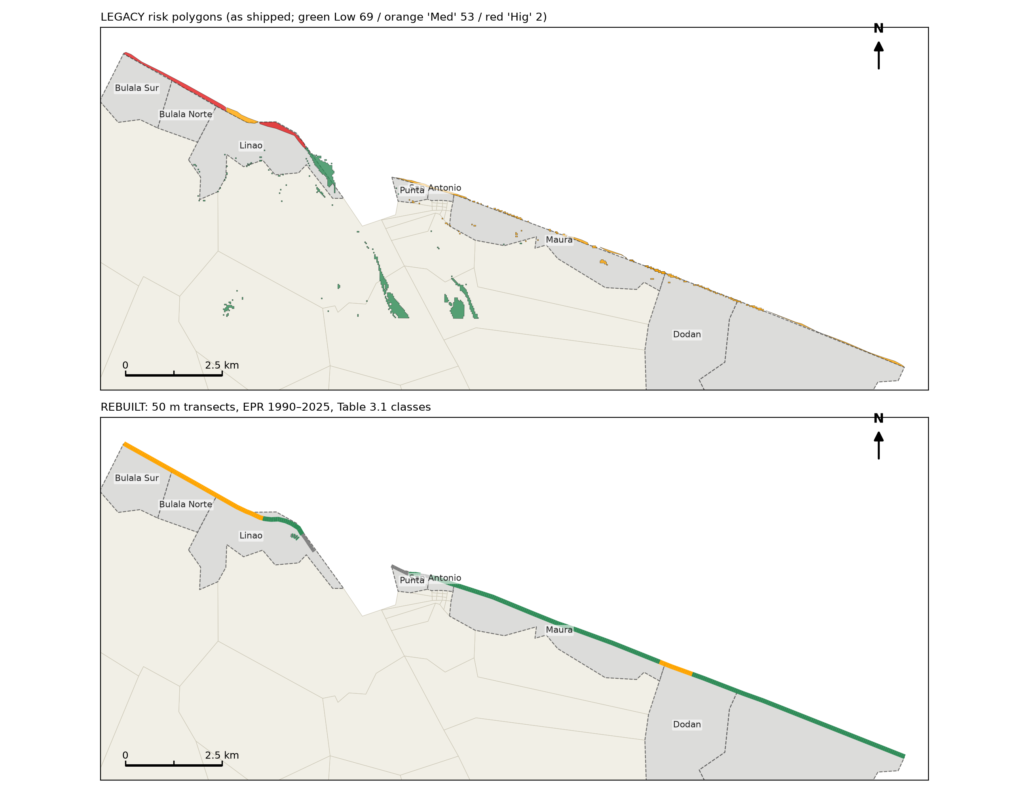
Why the figures differ from the proposal stage
The earlier layers could not be reproduced: 7 hand-drawn polygons carried all the Medium/High labels; 48 polygons labelled “Medium” had a rate of 0.857 m/yr (< 2).
The Earth Engine statistics were computed in 1 km circles around points; two study barangays were empty; 96 % of “accretion” pixels were open sea.
We rebuilt the analysis from the shoreline lines with a documented pipeline and told the adviser (memo).
Result: High along Bulala (old Fig. 4.2) is replaced by Medium; no High on the open coast.
Notes:
Be transparent. This slide pre-empts the question “why did your map change?”.

Slide 10
Survey: ranking of the five structures (Table 4.4)
54 experts rated 5 structures on 6 criteria (1–5): Seawall 4.35 (Very High) > Mangrove 4.14 > Revetment 3.99 > Breakwater 3.71 > Riprap 3.63.
Ranking is robust to criterion weights: Seawall first in 96 % of random weightings; the order of the others is not.
Limits: area-wide ranking (not per risk level); 54 respondents, mostly early-career; no SD or test reported yet.
[STUDENTS: add Cronbach’s alpha and the test among structures once the raw data are analysed]
Notes:
Do not claim a test that was not run. See docs/06_survey_statistics.md.

Slide 11
Limitations and next steps
Limitations
• 30 m imagery; dates, tide and measured error not recorded
• Waterline indicator; erosion rate only (no exposure)
• River mouth not classified
• No field verification yet
• Survey not per risk level
Next steps
• Field check at 20 points (form provided)
• Seasonal Landsat composites with recorded scenes (script provided)
• Exposure overlay: buildings, roads
• Per-risk-level questionnaire
• Field-inspection priority: Bulala Norte, Bulala Sur, Linao
Notes:
End with the field-inspection priority ranking (outputs/tables/priority_ranking_field_inspection.csv), which is stable across weights.

