Slide 1


Introduction to R and RStudio
Nikita Goddard

Slide 2
Coming up…
Basic Syntax of R and a tour of the RStudio GUI
Importing Data
Normality Checks
Measures of Central Tendency and Variation/Dispersion
Plotting
Overview of Statistical Methods
Notes:
R studio is open source so it allows the community to make updates and create new packages quickly, can use trial version of SPSS
OOC for machine learning, markdown such as making powerpoint presentations
Perosnally like r cause of control and I am a programmer myself

Slide 3
RStudio vs SPSS
RStudio | SPSS
Free and open source | Not free (unless you’re a student)
Has many object oriented capabilities, such as machine learning. | Only for interactive and statistical analysis
Graphs are fully customisable and interactive | Difficult to customise graphs and functionality is limited
Basic programming skills are required | Programming skills not required
Notes:
R studio is open source so it allows the community to make updates and create new packages quickly, can use trial version of SPSS
OOC for machine learning, markdown such as making powerpoint presentations
Perosnally like r cause of control and I am a programmer myself

Slide 4
GUI Layout
Similar to MATLAB
Notes:
Similar to MATLAB

Slide 5
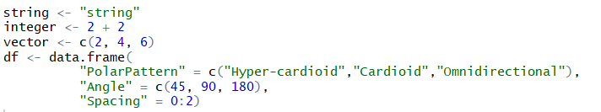


Basic Syntax
Use the assignment operator (<-) to create variables
Printing to console
Notes:
Variables will be added to the environment tab

Slide 6


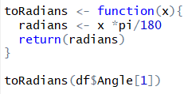
Basic Syntax
Creating a loop
Creating a function
Notes:
1 is first of array, like matlab

Slide 7
Help!
Help on Functions
? [function-name]
Help on Packages
help([package-name])

Slide 8

Importing Data
Data formatting
long format is easier for analysis
converting between long and wide format?
use ‘tidydr’ or ‘rshape2’ libraries
Files that can be imported
.xlsx, .csv, .txt, .Rdata
Browse built-in datasets with ‘data()’

Slide 9
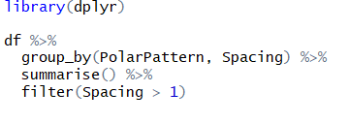

Data Manipulation
Dplyr library
For manipulating data frames
group_by()
allow operations to be performed by group
summarise()
shows all data measures for each specified variable
mutate()
Adds new variable based on function with existing ones

Slide 10

Data Manipulation
Subset()
Filters data based on logical operators (==, !=, &&, ||, >, <)

Slide 11

Normality Tests
Check normality of your data to see which type of analysis is right for your data
Normal Distribution = Parametric Tests
Non-normal Distribution = Non-Parametric Tests
Histograms
Q-Plots
Notes:
Assumed normal distribution from data size < 30

Slide 12

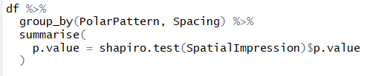
Normality Tests
Shapiro-Wilk Tests
p > 0.05 = distribution of data is NOT significantly different to normal distribution
p < 0.05 = distribution of data is significantly different to normal distribution
Using dplyr library
Notes:
Assumed normal distribution from data size < 30

Slide 13
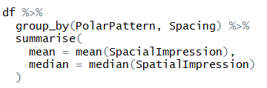
Measures of Central Tendency (Averages)
Mean
widely preferred for normally distributed data
Median
widely preferred for skewed or non-normal distributions
Mode
less common
For nominal data (not quantitive)
Notes:
Mean is susceptible to outliers, median isnt

Slide 14
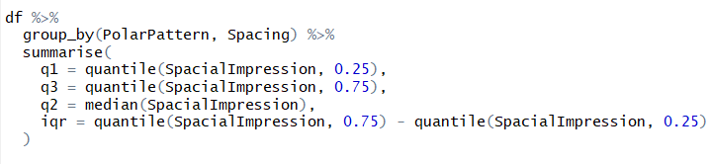
Measures of Variation or Dispersion
Standard Deviation (SD)
“spreadness” from the mean
Interquartile Range (IQR)
Q1 = first quarter
Q2 = median
Q3 = third quarter

Slide 15

Plotting
Default Plot function
limited customisation
No built-in data manipulation

Slide 16
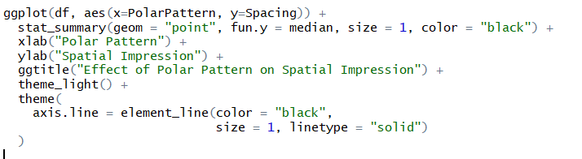
Plotting
‘ggplot2’ Library
For further customisability and control of data

Slide 17
Statistical methods
 | Within-subject | Between-subject
Parametric | Repeated Measures ANOVA, Paired T-Test | T-Test, One Way ANOVA
Non-Parametric | Wilcoxon signed rank test, Freidman Test | Mann-Whitney U- Test
p > 0.05 = don’t reject null hypothesis/ no significance difference
p < 0.05 = reject null hypothesis/ significance difference
Notes:
Between-subjects (or between-groups) study design: different people test each condition, so that each person is only exposed to a single user interface.
Within-subjects (or repeated-measures) study design: the same person tests all the conditions (i.e., all the user interfaces).

Slide 18
Thank You

