Slide 1
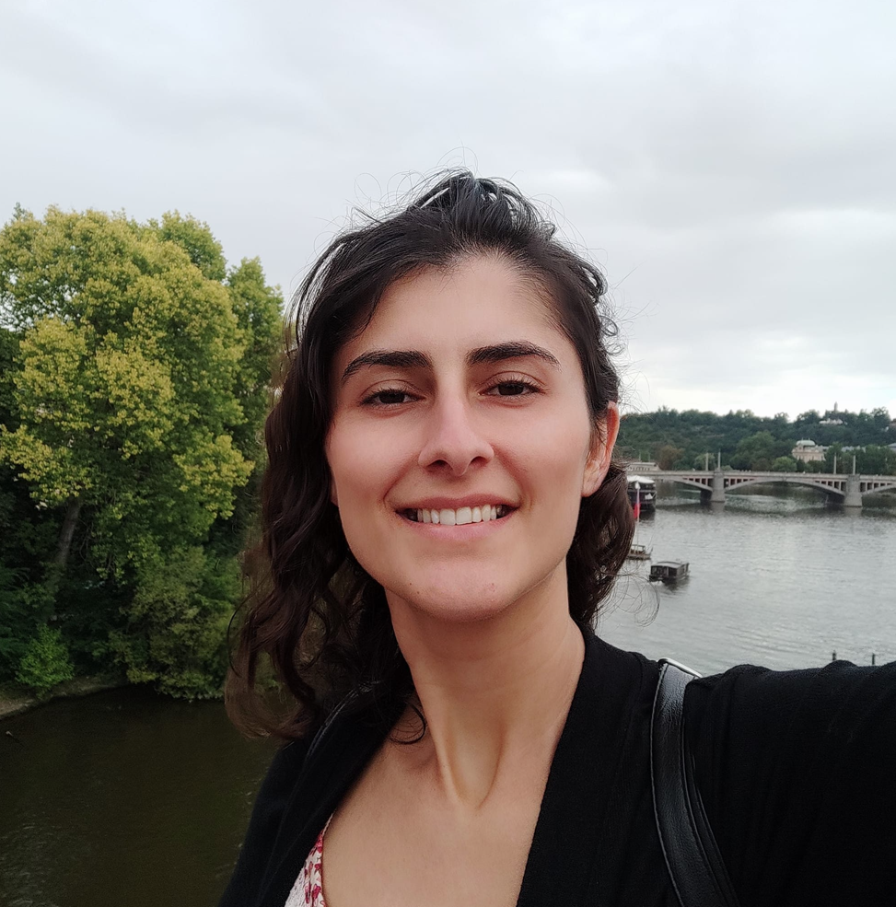


My interests are:
Listening to music
Dancing
Going to the beach
Watching movies
Cooking and baking
$ whoami
My name is Diana Cohen
I have ~10 years of IT experience (~2 years with cloud).
I work as cloud operations at Essence Group.
I live in Givat Shmuel.
cohen965@gmail.com
https://www.linkedin.com/in/adina-diana-cohen-1b664567/
I was working on these repos during my project:
https://github.com/GoddessDianaPub/aws-terraform
https://github.com/GoddessDianaPub/kandula-app

Slide 2
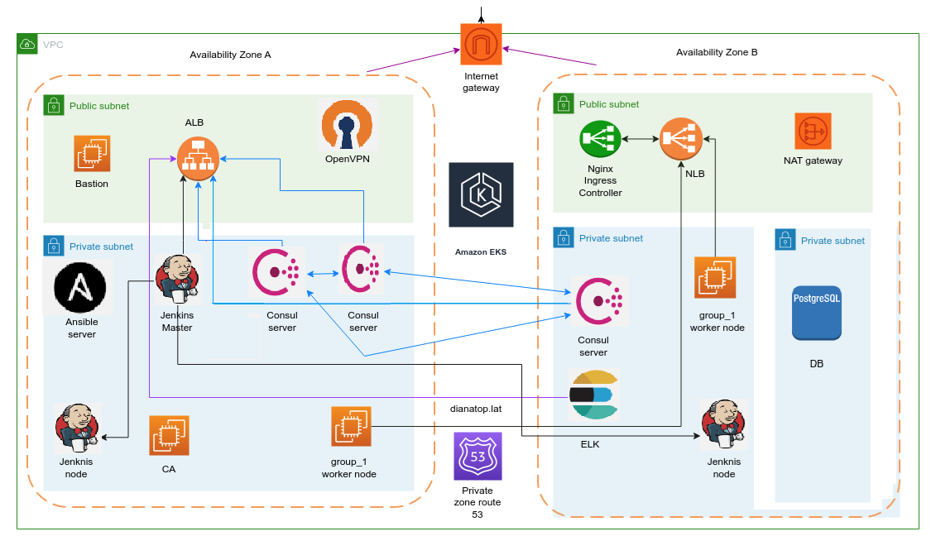

Slide 3

AWS Instances:
Ansible, bastion, CA, consul, Jenkins master, Jenkins agents, logging, OpenVPN, SG and IAM role for each instance
More resources:
RDS PostgreSQL, ALB, ALB SG, http listener, https listener + rules, target groups, route53 records
Terraform state is stored in S3 bucket
EKS:
Cluster, EKS SG, node_group_1, nodes SG, OIDC IAM for kandula app, OIDC IAM for filebeat
Networking:
VPC, NAT, EIP, IGW, public subnets,
private subnets, private data subnets,
route tables, DHCP options

Slide 4

Dynamic inventory for each playbook
Filebeat playbook deployment
on AWS instances
Consul playbook deployment
on AWS instances
Node_exporter playbook deployment
on AWS instances

Slide 5

Database resources creation for kandula app
Nginx ingress controller on EKS + NLB deployment with helm
Filebeat deployment
on EKS with helm
Consul deployment
on EKS with helm
Node_exporter deployment
on EKS with helm
Kandula app deployment
on EKS

Slide 6
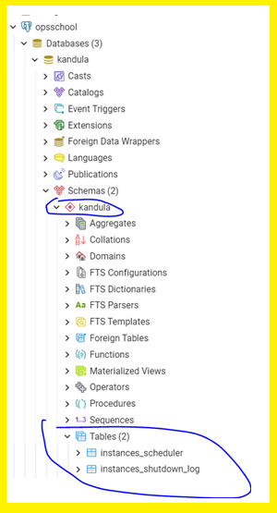
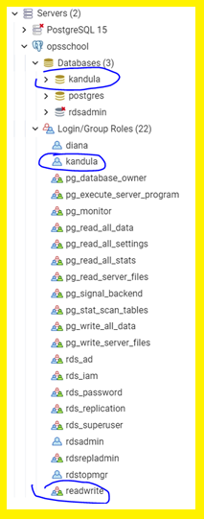
Postgres resources

Slide 7
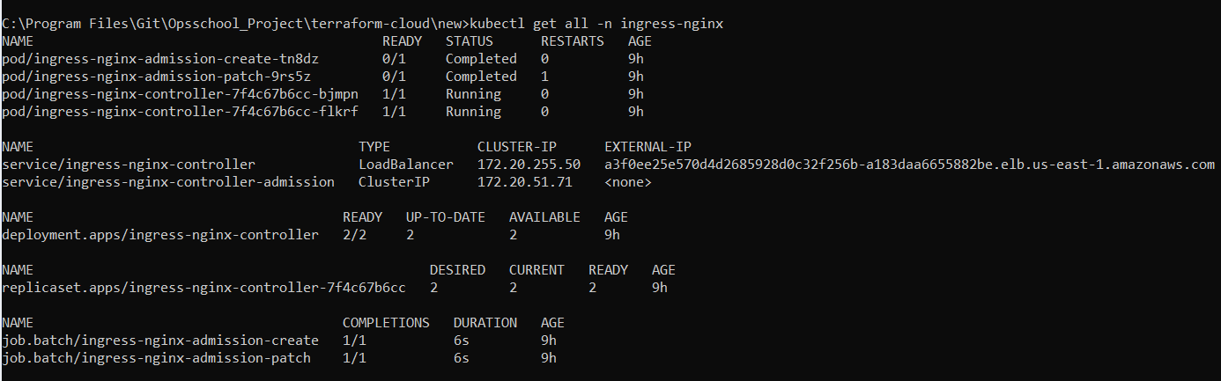

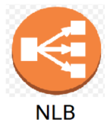


Nginx ingress controller + NLB
Resources output

Slide 8
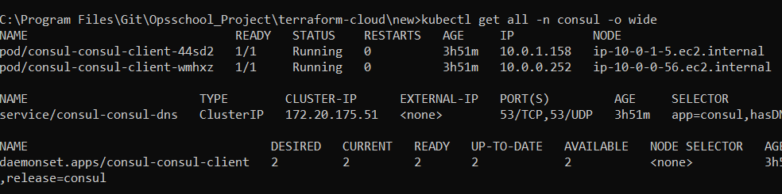

Consul resources output

Slide 9
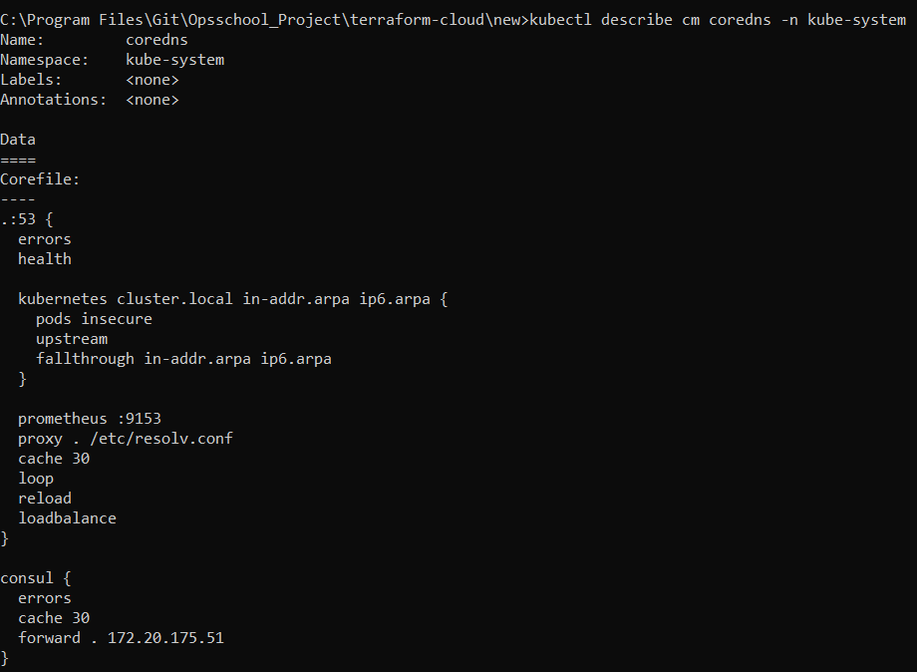
CoreDNS ConfigMap
Configuration output

Slide 10
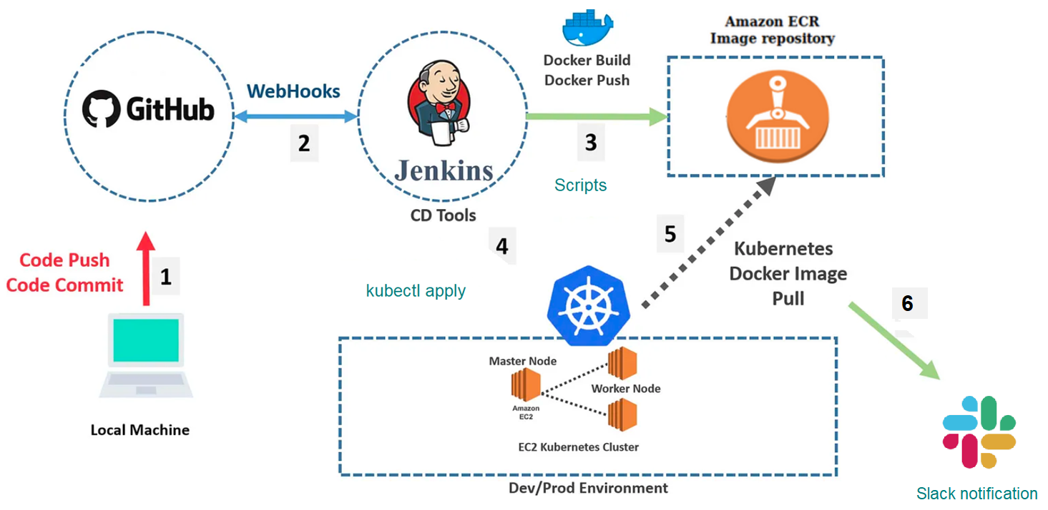

Slide 11
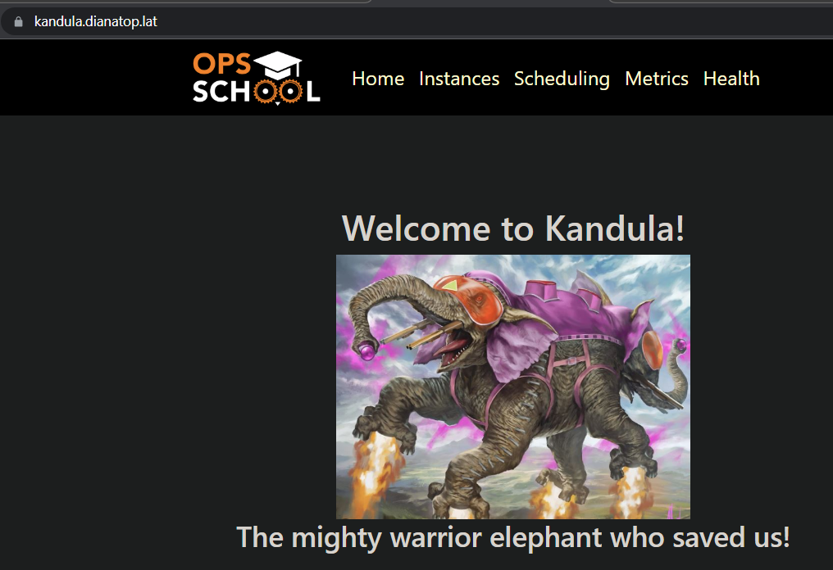
Accessing kandula app
With a subdomain configured
in Route53 + ingress

Slide 12
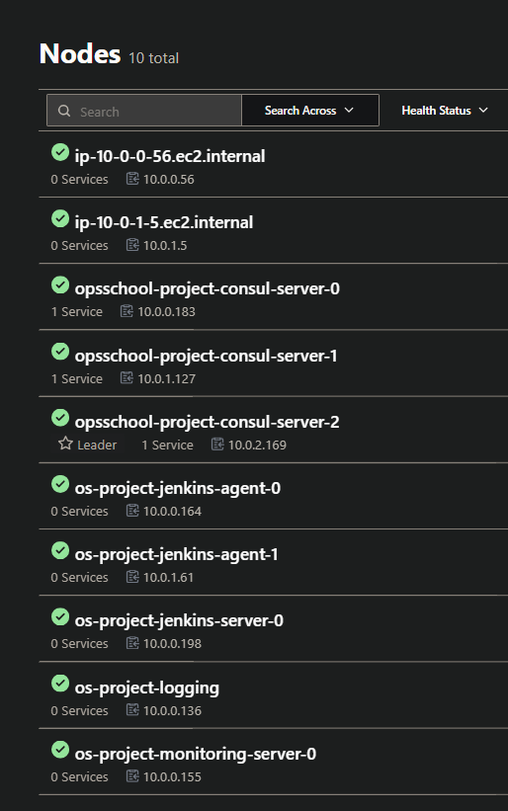
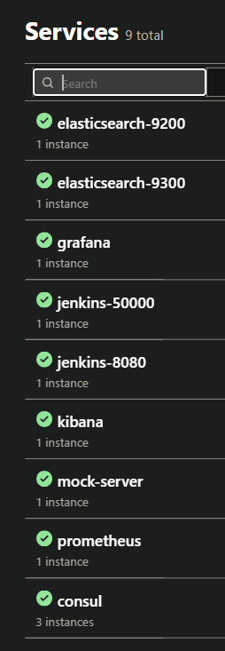
Deploying consul agent
and register them as a
Service, using ansible.
I have deployed a
registration container

Slide 13
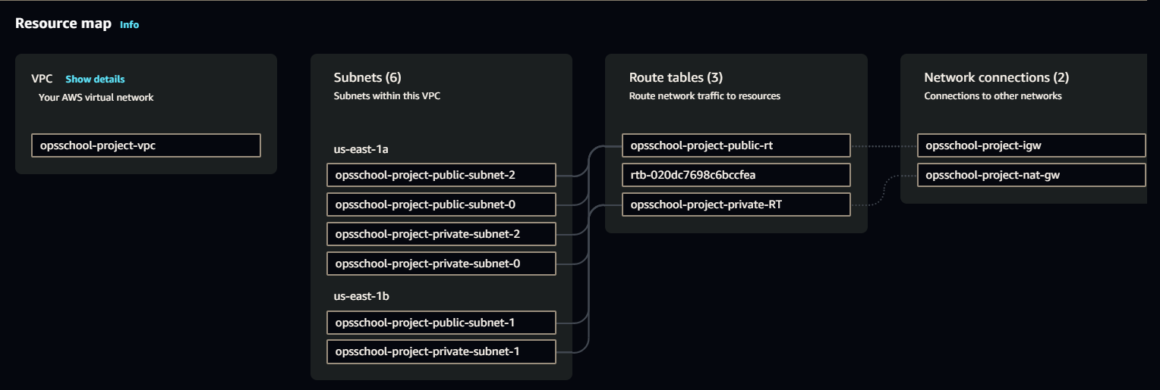
VPC resources

Slide 14
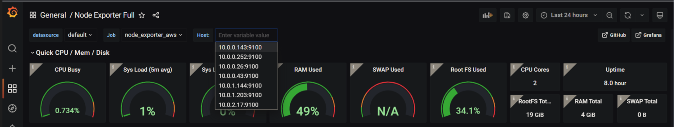

Grafana UI
Dashboard from
AWS instances
With tag:
Monitoring: node_exporter_aws

Slide 15
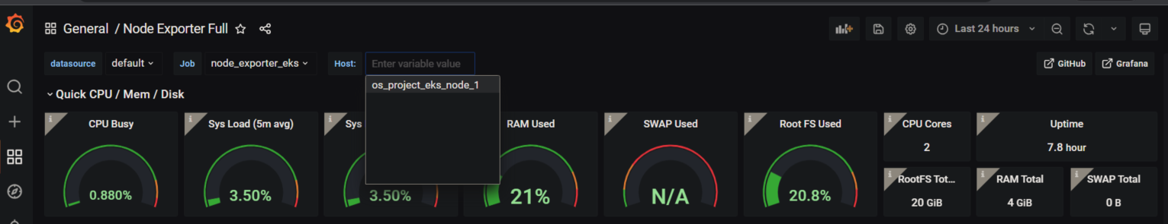
Grafana UI Dashboard from
EKS instances
With tag:
Monitoring: node_exporter_eks

Slide 16
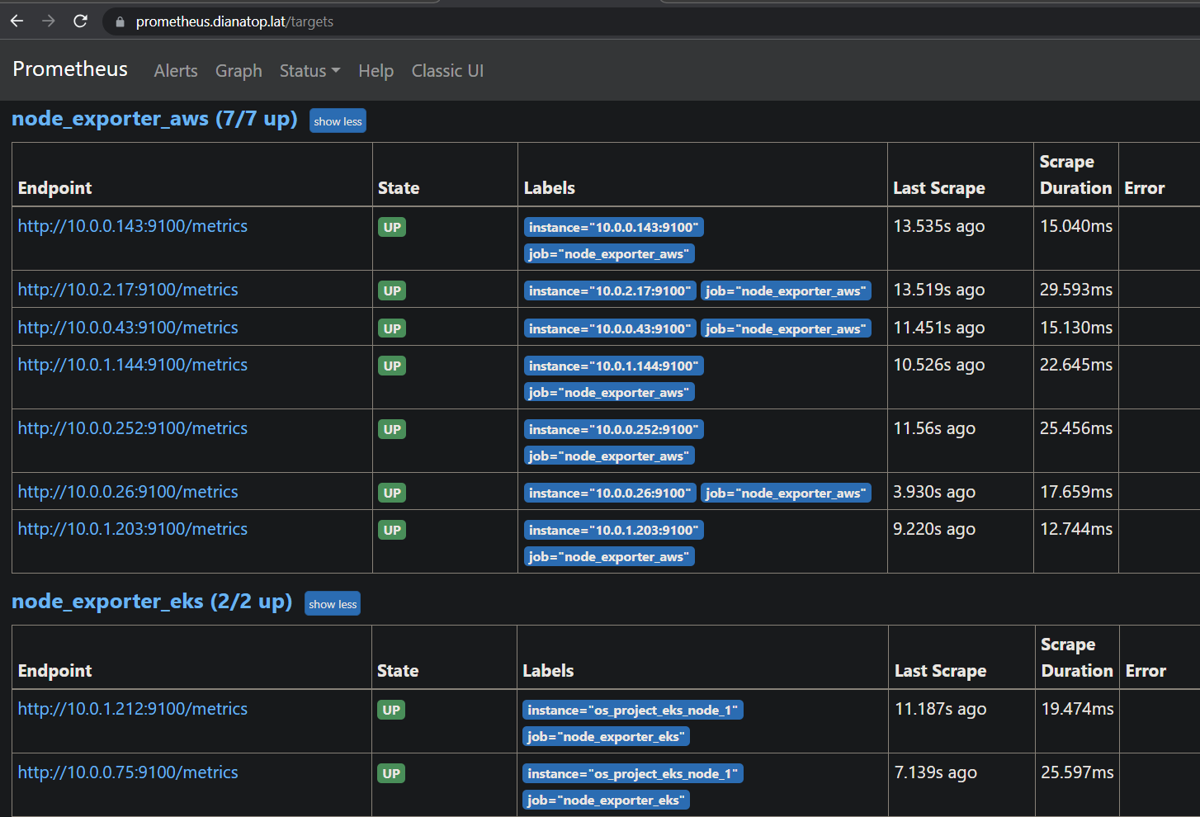

Prometheus UI

Slide 17
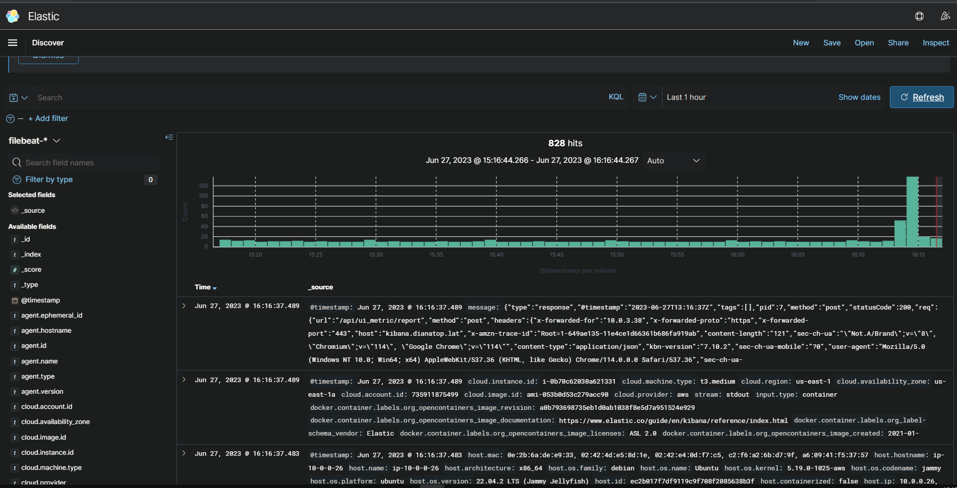

Kibana UI

Slide 18

Give before you receive!
Teaching others is a noble gift!
Kiyosaki says that his educated father was a man of values who contributed a lot of his time and knowledge to society, but hardly contributed any money.
The same principle of starting by giving, Kiyosaki explains, is especially true for studies.
He used to say, when we have extra money, we will donate, but this rarely happened.
In general, anything you want in life first give!
If you teach others or share with them the knowledge of how to make money, you are the ones who learn the most in the end. It’s true to every knowledge you want to gain.

Slide 19


