Slide 1
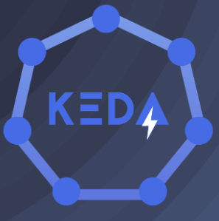
10-09-2023
Adina Diana Cohen

Slide 2
What is KEDA?
KEDA is a Kubernetes-based Event Driven Autoscaler. With KEDA, you can drive the scaling of any container in Kubernetes based on the number of events needing to be processed.
KEDA works alongside standard Kubernetes components like the Horizontal Pod Autoscaler and can extend functionality without overwriting or duplication. With KEDA you can explicitly map the apps you want to use event-driven scale, with other apps continuing to function.
We are going to use KEDA with Azure Service Bus scalers.

Slide 3
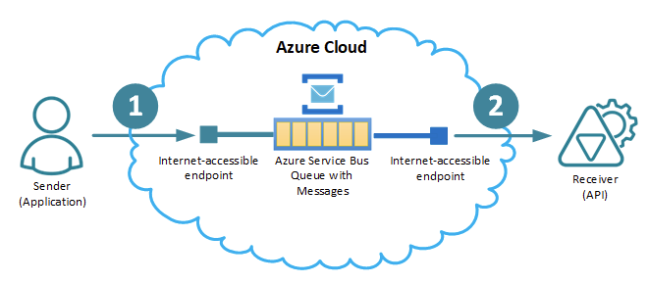
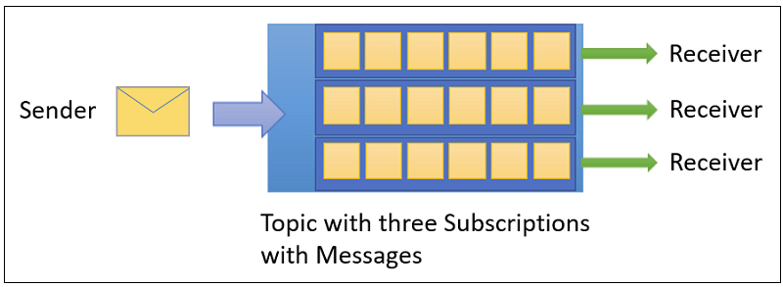
Azure Service Bus Topics
Queues typically receive and process messages in the order in which they were added to the queue.
Topics and subscriptions provide a one-to-many form of communication in a publish and subscribe pattern.

Slide 4
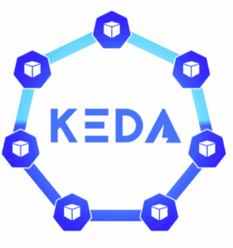

Installing KEDA with helm
KEDA needs to be installed on each cluster on keda namespace:
helm repo add kedacore https://kedacore.github.io/charts
helm repo update
helm install keda kedacore/keda --namespace keda --create-namespace
This is the link to version 2: https://keda.sh/docs/2.11/deploy/

Slide 5
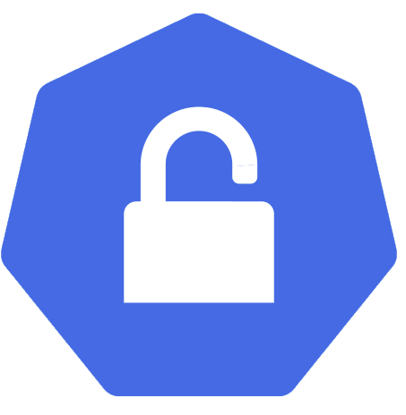
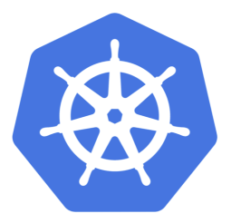
Authentication
Secret: configured with an azure service bus connection string
TriggerAuthentication: consumes the connection string from the secret

Slide 6

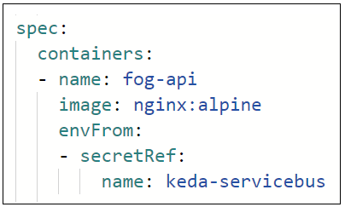
Deployment
Configuring the deployment with the secret envFrom, to consume the connection string
ScaledObject:
Scales the pods up and down according the triggers configured (topic and subscription), it authenticates with the TriggerAuthentication resource

Slide 7
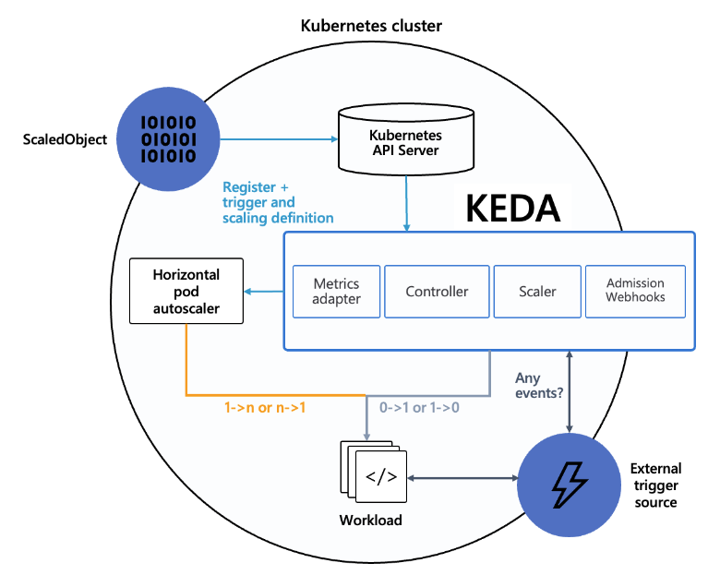

Slide 8
THANK YOU

