Slide 1
VinHack A hackathon by VinnovateIT
Team 26-
AAGS- Intelligent Warehouse
Management System

Slide 2
Problem Statement
Industries like e-commerce, retail, food and pharmaceuticals face a major issue of warehouse space optimization for stacking their products. These industries manufacture and store products of different shapes and sizes and have to spend extensive resources to allocate warehouse space and keep a track of the product whereabouts. There is a need for an intelligent warehouse management system that will:
Optimize & Allocate Warehouse Space For Different Products.
Simplify Product Tracking & Retrieving Process To Reduce/ Eliminate Errors.

Slide 3
Technology Used
HTML
CSS
Bootstrap
PHP
Arduino + RFID

Slide 4
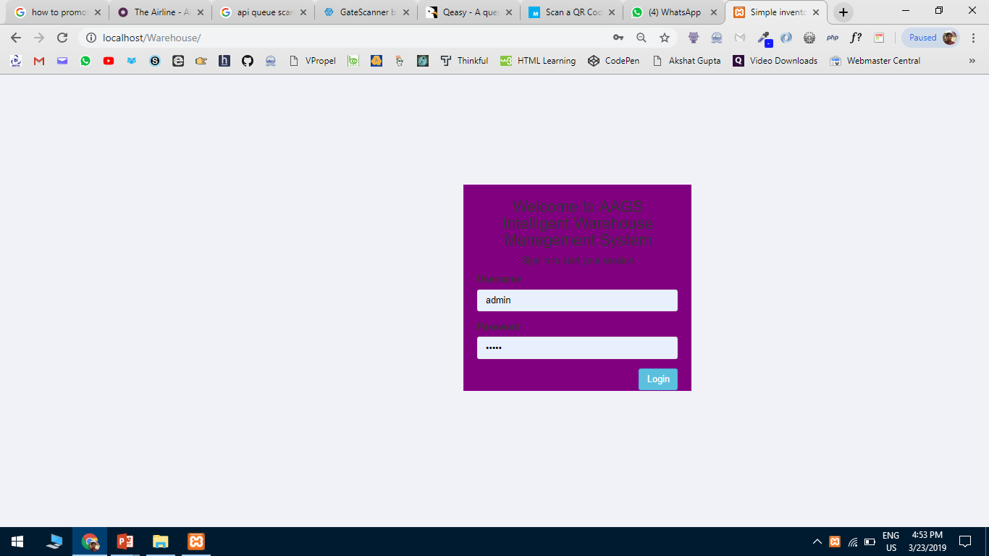
UI & UX

Slide 5
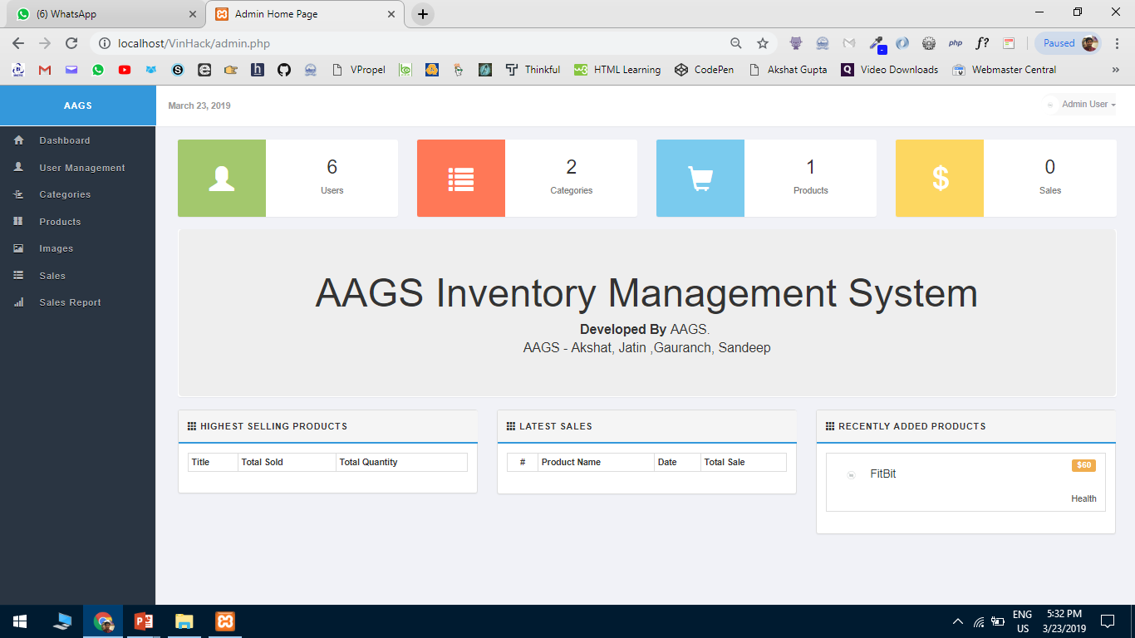

Slide 6
Team Members
Akshat Gupta- 18BIT0330
Gauransh Arora- 18BIT0393
Sai Sandeep- 18BIS0039
Jatin Rathee- 18BCA0052

Slide 7
Repository Link
https://github.com/akshatvg/AAGS-Warehouse-Management-System

Slide 8
Usefulness and Feasibility
Optimize indoor tracking and optimize the warehouse space.
Highest selling product.
Latest sales.
One hub for numerous features.
Cheap.
Effective.

Slide 9
Future Plans
Being freshers with limited knowledge of things we couldn’t implement a few features we wanted to. We intend to cover those features in the future!
We also would like to create a mobile application too in the future for the same.
We also hope to help predict which stock to buy next so as to increase profits for the company.

Slide 10
Thank You

